Slide 1
SQL
Unit-4

Slide 2
SCENARIO
Customer (customer_id, customer_name,email,phone_number)
Rooms (room_id, room_type,price)
Bookings (booking_id, room_id ,customer_id,check_in_date,check_out_date,is_availability)

Slide 3
Create Database
Create database database_name
  Database name should be understandable
  E.g. db_hotel
  CREATE DATABASE databasename;

Slide 4
Create table
Create table table_name(
customer_id int,
Tabel_id int,
Customer_name varchar(255),
Primary key(customer_id) ,
Constraint fk_table_name foreign key (Table_id) references Table_name(Table_ids)
)

Slide 5
CREATE TABLE employees (
employee_id INT PRIMARY KEY, -- Primary key constraint for employee_id
first_name VARCHAR(50) NOT NULL, -- Not null constraint for first_name
last_name VARCHAR(50) NOT NULL, -- Not null constraint for last_name
salary DECIMAL(10, 2) CHECK (salary >= 0), -- Check constraint for salary, must be >= 0
department_id INT, -- Foreign key that references the departments table
hire_date DATE DEFAULT CURRENT_DATE, -- Default value for hire_date
FOREIGN KEY (department_id) REFERENCES departments(department_id) -- Foreign key constraint
);

Slide 6
Alter /Drop
ALTER TABLE table_name ADD column_name datatype;
ALTER TABLE table_name DROP COLUMN column_name;
ALTER TABLE table_name ADD CONSTRAINT constraint_name PRIMARY KEY (col1);
ALTER TABLE orders ADD CONSTRAINT users_fk FOREIGN KEY (user_id) REFERENCES users (user_id);
ALTER TABLE table DROP CONSTRAINT constraint_name
ALTER TABLE table_name RENAME COLUMN old_column_name TO new_column_name;
ALTER TABLE old_table RENAME new_table;
DROP TABLE table_name;
DROP TABLE table_name;
Truncate → empty table without droping table

Slide 7
Insert
Insert into table_name (column1,column2….column) values (…….)
Varchar or text use single inverted comma ‘’ => ‘bcis’
INSERT INTO Person (Id, Name) VALUES (1, 'Amir' ),(2, 'Sofia'),……….

Slide 8
Select …. From …. where
Select * from table_name // if you want specific column to display
Select column1, column2 from table_name;
  Note columns should be present in table
SELECT * FROM offices WHERE country = 'USA’;
SELECT * FROM offices WHERE office_code > 5;
select name from instructor where dept name = ’Comp. Sci.’ and salary > 70000;
select name from instructor where salary between 90000 and 100000;

Slide 9
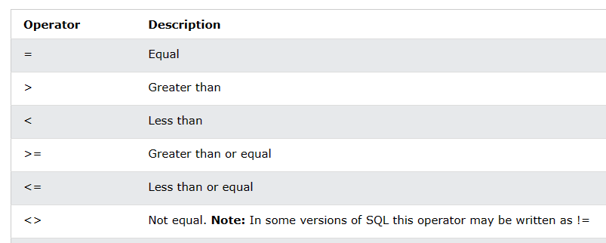

Slide 10
String Operations/Null operations
SELECT CONCAT(first_name, ' ', last_name) AS full_name FROM employees;
SELECT SUBSTRING(column_name, start_position, length) FROM table_name;
SELECT * FROM employees WHERE phone_number IS NULL;
SELECT * FROM employees WHERE phone_number IS NOT NULL;

Slide 11
Additional Basic Operations
As
select dept name from department where building like ’%Watson%’;

Slide 12
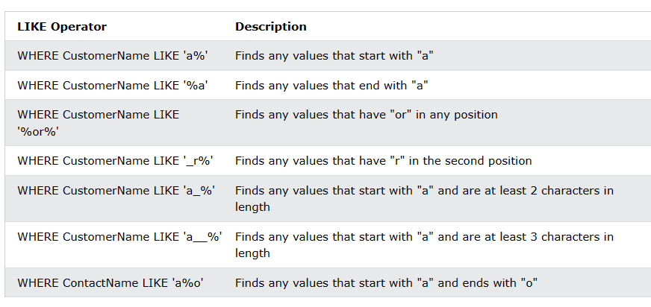

Slide 13
Ordering the Display of Tuples
select name from instructor where dept name = ’Physics’ order by name;
select * from instructor order by salary desc;
select * from instructor order by salary asc;

Slide 14
Set Operations
The SQL operations union, intersect, and except operate on relations.
select name from Speakers union select name from Authors order by name
select name from Speakers intersect select name from Authors order by name
select name from Authors except select name from Speakers order by name
  Union all for duplicate data

Slide 15
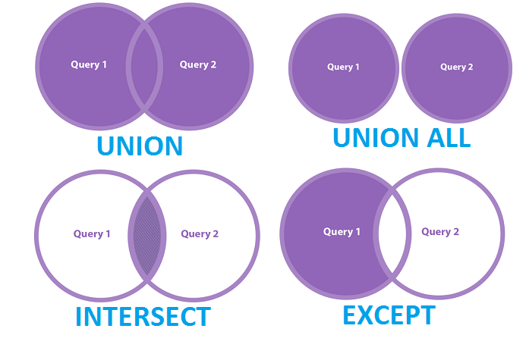

Slide 16
Modification of the Database
delete from instructor where dept name= ’Finance’;
update instructor set salary= salary * 1.05;
update instructor set salary = salary * 1.05 where salary < 70000;

Slide 17
SQL Query
select name from instructor where salary is null;
Aggregate Function
  Sum()
  Avg()
  Count()
  Min()
  Max()
SELECT AVG (salary) FROM employees;
select count (distinct ID) from teaches where semester = ’Spring’ and year = 2010;
select count (*) from course;
select sum (salary) from instructor;

Slide 18
Group By and Having
SELECT department, SUM(salary) as sum_salary from teacher GROUP BY department;
SELECT department, SUM(salary) as sum_salary from teacher GROUP BY department HAVING sum(salary)>3000;

Slide 19
Nested sub-queries
SQL provides a mechanism for nesting sub-queries.
A sub-query is a select-from-where expression that is nested within another query
https://medium.com/@basubinayak05/introduction-to-sql-nested-subqueries-37381a12939
Comparison
  The phrase “greater than at least one” is represented in SQL by > some.
  The construct > all corresponds to the phrase “greater than all.”
  SELECT name from instructor where salary > some(select salary from instructor where address = Hetauda’);
  SELECT name from instructor where salary > all(select salary from instructor where address = Hetauda');

Slide 20
Nested sub-queries
2.Empty relating from clause
The key concept applied here is that any select-from-where expression returns a relation as a result and, therefore, can be inserted into another select-from-where anywhere that a relation can appear.
  SELECT * FROM `instructor` WHERE address="Hetauda" and name="gita" and EXISTS ( SELECT * from instructor where salary=1500);
  select name, avg_salary from (select name, avg(salary) from instructor group by address) as inst_avg (name, avg_salary) where avg_salary > 2000;

Slide 21
Nested sub-queries
Scalar Subqueries
  SQL allows subqueries to occur wherever an expression returning a value permitted, provided the subquery returns only one tuple containing a single attribute; such subqueries are called scalar subqueries.
  select name, (select count(*) from teacher where teacher.id = instructor.id) as num_instructors from instructor;

Slide 22
