Slide 1
SQL
Unit-4 (Part-II)

Slide 2
Join Expression
A join expression is used in a database query to combine rows from two or more tables based on a related column between them.
It specifies the condition for matching rows from different tables and determines which rows should be included in the result set.

Slide 3
Join Condition
A join condition is a logical expression that specifies how two or more tables should be combined in a database query.
It defines the relationship between columns in the tables and determines which rows should be included in the result set.
The join condition is typically specified in the ON clause of the join statement.
It can involve one or more columns from each table and use comparison operators to establish the relationship.
SELECT * FROM customer JOIN orders ON customer.id = orders.customer_id;

Slide 4
Outer Join
An outer join is a type of join operation in a relational database that returns all the rows from one table and the matching rows from another table, including any unmatched rows.
It includes rows from one table even if there is no corresponding match in the other table.

Slide 5
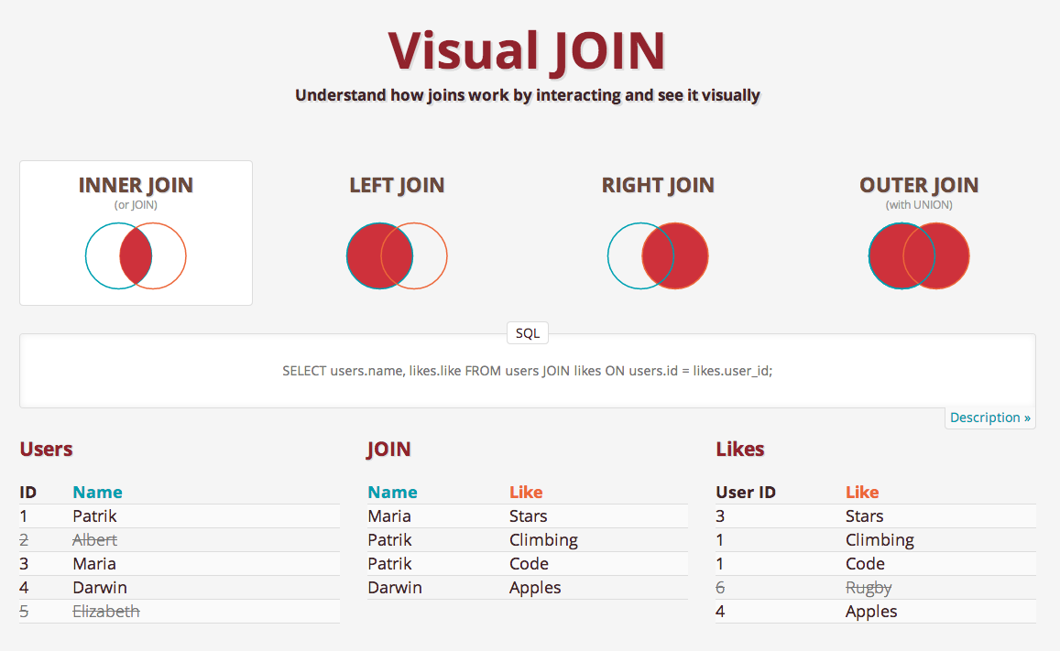


Slide 6
Outer Join
There are three types of outer joins:
  Left Outer Join (or Left Join): Returns all the rows from the left table (the first table mentioned in the query) and the matching rows from the right table (the second table mentioned in the query). If there is no match in the right table, NULL values are included for the columns of the right table.
  Right Outer Join (or Right Join): Returns all the rows from the right table and the matching rows from the left table. If there is no match in the left table, NULL values are included for the columns of the left table.
  Full Outer Join (or Full Join): Returns all the rows from both tables, including matching and non-matching rows. If there is no match for a row in either table, NULL values are included for the columns of the non-matching table.

Slide 7
Outer Join
SELECT * FROM customer LEFT OUTER JOIN orders ON customer.id = orders.customer_id;
SELECT * FROM customer RIGHT OUTER JOIN orders ON customer.id = orders.customer_id;
SELECT customer.name,orders.product_name FROM customer FULL OUTER JOIN orders ON customer.id = orders.customer_id;

Slide 8
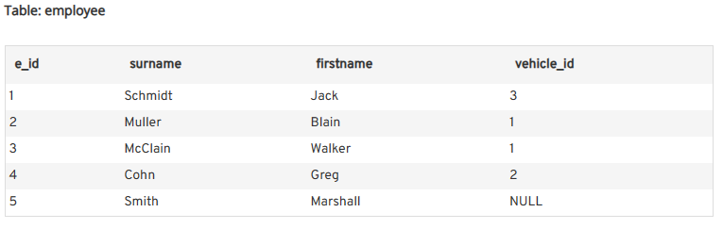
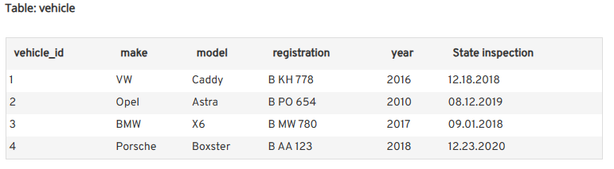

Slide 9
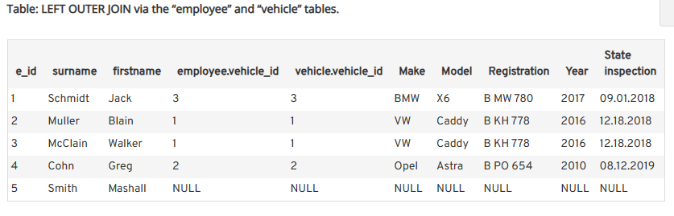
SQL LEFT OUTER JOIN
SELECT * FROM employee LEFT JOIN vehicle ON employee.vehicle_id = vehicle.vehicle_id;

Slide 10
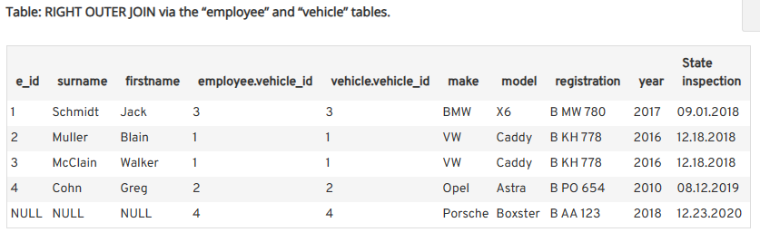
SQL RIGHT OUTER JOIN
SELECT * FROM employee RIGHT JOIN vehicle ON employee.vehicle_id = vehicle.vehicle_id;

Slide 11
SQL RIGHT OUTER JOIN
SELECT * FROM employee RIGHT JOIN vehicle ON employee.vehicle_id = vehicle.vehicle_id;

Slide 12
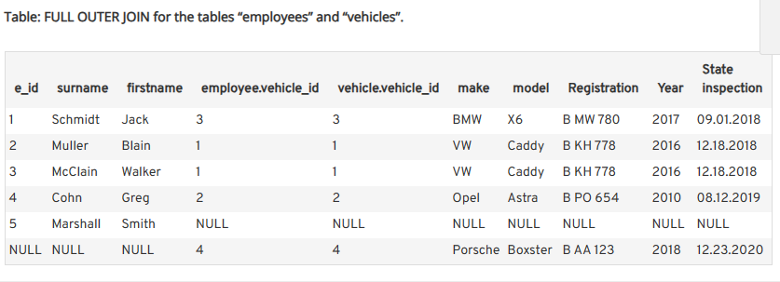
SQL FULL OUTER JOIN
SELECT * FROM employee FULL JOIN vehicle ON employee.vehicle_id = vehicle.vehicle_id;

Slide 13
View Definition
A view definition refers to the logical description or definition of a view.
A view is a virtual table that is derived from one or more tables or other views in the database.
It represents a specific subset of data or a transformation of data from the underlying tables.
Any change in base table View table data also change.
CREATE VIEW CustomerOrders AS
SELECT CustomerID, OrderDate, TotalAmount
FROM Orders
WHERE Status = 'Completed';

Slide 14
Materialized View
A materialized view is a database object that stores the results of a query in a physical form.
Unlike regular views, which are virtual and derive their data from the underlying tables dynamically at the time of query execution, materialized views precompute and persist the query results in a separate table-like structure.
This offers several benefits, including improved query performance and reduced database workload.

Slide 15
Transaction
a transaction refers to a logical unit of work that consists of one or more database operations.
Commit:
  When a transaction is committed, it means that all the changes made within the transaction are permanently saved to the database.
  The commit operation makes the changes visible to other concurrent transactions. Once a commit is performed, the transaction is considered complete, and its changes become a permanent part of the database.
Rollback:
  On the other hand, if a transaction encounters an error or needs to be cancelled for any reason, a rollback operation can be used. Rollback undoes all the changes made within the transaction, restoring the database to its state before the transaction started. It ensures that no changes are persisted to the database.

Slide 16
Integrity Constraints
Not Null Constraint,
Unique Constraint
Check Constraint
Referential integrity
CREATE TABLE students (
id INT PRIMARY KEY NOT NULL,
name VARCHAR(50),
age INT ,
email VARCHAR(100) UNIQUE,
grade CHAR(1) CHECK (grade IN ('A', 'B', 'C', 'D', 'F’)),
FOREIGN KEY (customer_id) REFERENCES customers(id)
);

Slide 17
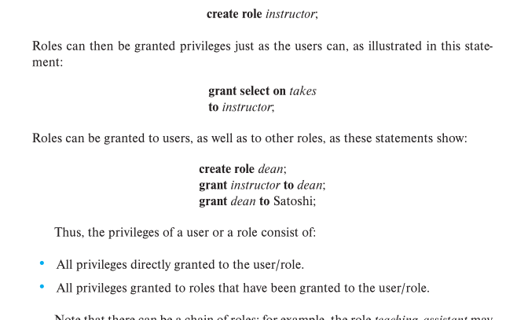
Authorization
GRANT

Slide 18
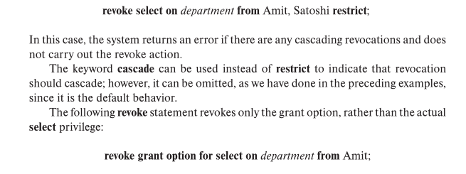
Authorization
REVOKE

Slide 19
Functions and Procedure
SEE NOTES // another side unit-3

Slide 20
Triggers
See notes // Next unit

