Slide 1
Relational Database Design
Unit-4

Slide 2
Database anomalies
Database anomalies refer to inconsistencies or problems that can occur in a database due to incorrect design or improper data management.
There are three main types of anomalies:
  Insertion anomalies
  Update anomalies
  Delete anomalies

Slide 3
Database anomalies
Insertion Anomalies: Insertion anomalies occur when it is not possible to insert data into the database without adding incomplete or inconsistent information.
  For example, if a table is not properly designed and requires certain fields to be populated even when they are not applicable to every record, it can lead to insertion anomalies.
Update Anomalies: Update anomalies occur when updating data in the database leads to inconsistencies or data loss.
  For example, if the same information is stored in multiple places within the database and one instance is updated while the others are not, it can result in inconsistent data.
Deletion Anomalies: Deletion anomalies occur when removing data from the database unintentionally removes other related data that should have been preserved.
  For example, if deleting a record from a table also removes related records in other tables, it can lead to data loss and inconsistencies.

Slide 4
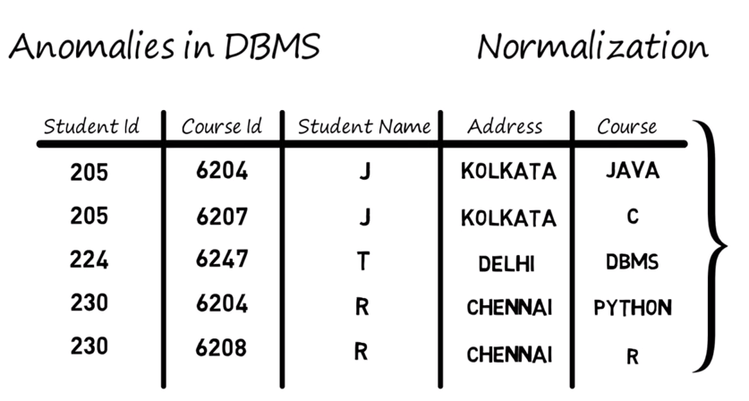

Slide 5
Functional Dependency
A functional dependency (FD) is a constraint between two sets of attributes in a relation in a relational database.
Informally, an FD states that the value of one set of attributes (the determinant) determines the value of another set of attributes (the dependent).
Functional dependencies are denoted using an arrow notation: X -> Y, where X represents the determinant attributes and Y represents the dependent attributes.
This notation signifies that for every unique combination of values in X, there is a unique value in Y. (X is determinant and Y is dependent)

Slide 6
Functional Dependency
X | Y
a | 1
b | 2
c | 3
d | 1
Notes:
T1.x=t2.x => t1.y=t2.y
T1.x!= t1.x => then no need to check it may or may not be the same value

Slide 7
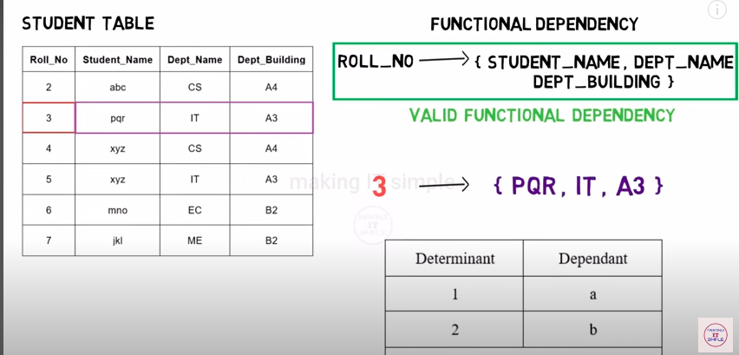
Functional Dependency
Notes:
T1.x=t2.x => t1.y=t2.y
T1.x!= t1.x => then no need to check it may or may not be the same value

Slide 8
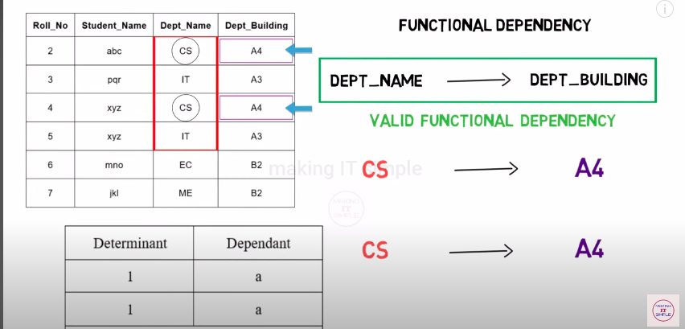
Functional Dependency
Notes:
T1.x=t2.x => t1.y=t2.y
T1.x!= t1.x => then no need to check it may or may not be the same value

Slide 9
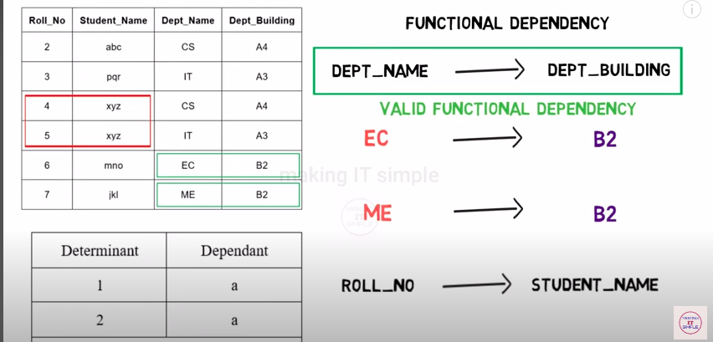
Functional Dependency
Notes:
T1.x=t2.x => t1.y=t2.y
T1.x!= t1.x => then no need to check it may or may not be the same value

Slide 10
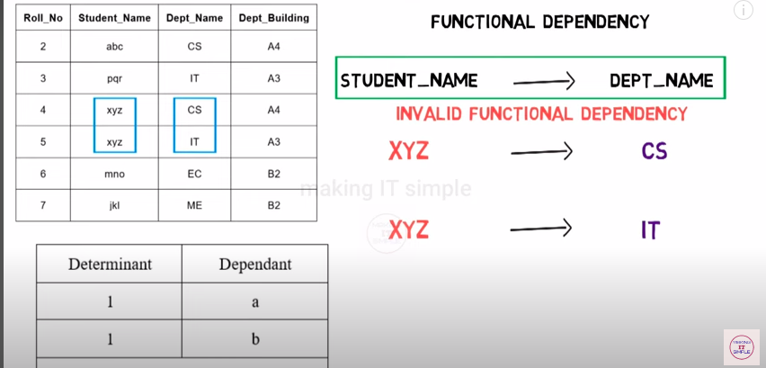
Functional Dependency
Notes:
T1.x=t2.x => t1.y=t2.y
T1.x!= t1.x => then no need to check it may or may not be the same value

Slide 11
Types of functional dependencies
Trivial functional dependencies are those that involve all attributes of a relation.
They are considered trivial because they do not provide any meaningful or useful information about the relationship between attributes.
Y⊆X (y is subsets of X)
A -> A: This dependency states that attribute A determines itself, which is always true.
A, B, C -> A, B, C: This dependency states that all attributes in the relation determine themselves, which is again always true.

Slide 12
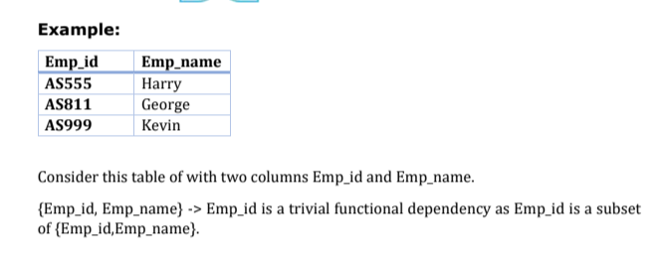

Slide 13
Types of functional dependencies
Non-trivial functional dependencies are dependencies where the determined attributes are not a subset of the determining attributes.
In other words, the functional dependency expresses a meaningful relationship between the attributes involved.
This is a non-trivial functional dependency because the determined attribute (B) is not a subset of the determining attribute (A).
It indicates that the value of attribute B is functionally dependent on the value of attribute A.
A∩B=Φ (A insertion B equals to Phi which A and B don’t have any common)

Slide 14
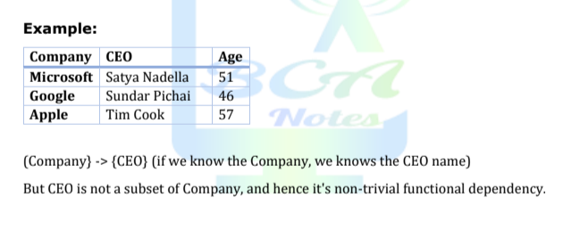

Slide 15
Axioms or rules of FD
Reflexivity Rule:
  Y->X , Y->Y , X->X
Transitivity Rule:
  If(X->Y and Y->Z then X->Z)
Augmentation Rule:
  If(X->Y the XA->YA)
Union Rule
  If(X->Y and X->Z then X->YZ)
Decomposition Rule
  If(X->YZ then X->Y and X->Z)
Pseudo transitivity Rule
  If(X->Y and YZ->A then XZ->A)
Composition Rule
  If(X->Y and A->B then XA->YB)

Slide 16
Closure of Set of Functional Dependencies
The Closure Of Functional Dependency means the complete set of all possible attributes that can be functionally derived from given functional dependency using the inference rules known as Armstrong’s Rules.
If “F” is a functional dependency then closure of functional dependency can be denoted using “{F}+”.
There are three steps to calculate closure of functional dependency. These are:
  Step-1 : Add the attributes which are present on Left Hand Side in the original functional dependency.
  Step-2 : Now, add the attributes present on the Right Hand Side of the functional dependency.
  Step-3 : With the help of attributes present on Right Hand Side, check the other attributes that can be derived from the other given functional dependencies. Repeat this process until all the possible attributes which can be derived are added in the closure.

Slide 17
Closure of SETS Attribute
Closure of an Attribute: Closure of an Attribute can be defined as a set of attributes that can be functionally determined from it.
OR
Closure of a set F of FDs is the set F+ of all FDs that can be inferred from F
Closure of a set of attributes X concerning F is the set X+ of all attributes that are functionally determined by X

Slide 18

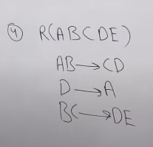
Closure of Set of Functional Dependencies
R = (A, B, C, G, H, I) {A→ B, A→ C, CG → H, CG → I , B → H}.
a)Determines closure of set of functional dependencies F+.
b)Determine attribute set closure (AG)+.
c) List of Super key and candidate key.
d)Determine canonical cover or minimal cover (fc) .
e.g f={a->b,c->b,d->abc,ac-d}
Notes:
A → H. Since A → B and B → H hold, we apply the transitivity rule. Canonical cover => a->b remove a+(set attributes) we need to get b
Observe that it was much easier to use Armstrong’s axioms to show that ac->d if a remove from c+ you need to get a and vice versa
A → H holds than it was to argue directly from the definitions, as we did
earlier in this section.
• CG → HI. Since CG → H and CG → I , the union rule implies that CG →
HI .
• AG → I. Since A→C and CG → I , the pseudotransitivity rule implies that
AG → I holds.
Another way of finding that AG → I holds is as follows: We use the
augmentation rule on A→ C to infer AG → CG. Applying the transitivity
rule to this dependency and CG → I, we infer AG → I .

Slide 19
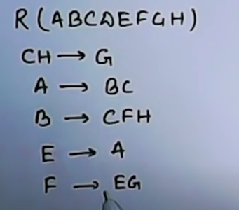
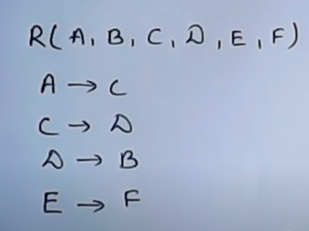
Notes:
Find super key and Candidate key
Prime attributes

Slide 20
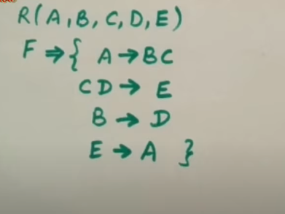

Slide 21
Canonical cover
A canonical cover is a simplified and reduced version of the given set of functional dependencies.
Since it is a reduced version, it is also called as Irreducible set.
Canonical cover is free from all the extraneous functional dependencies.
Steps To Find Canonical Cover-
  Splitting rule so that in every FD right hand side has single attributes (Discard trivial FD)
  Remove extraneous attributes //redundant attributes (LHS remove)
  Remove redundant FD
  R( A, B, C, D) and set of Function Dependency FD = { B → A, AD → BC, C → ABD }.
  R( A, B, C, D) and set of Function Dependency FD = { A → B, B → C, AB → D }.
Notes:
Remove trivial F.D //// Example :- https://www.youtube.com/watch?v=o0GQQFu-5C0
Answe : -> B->A , AD->C ,C->B and C->D

Slide 22
Decomposition
Decomposition is the process of breaking down bigger relation into smaller relations. So,
  It breaks a bigger table into smaller tables in database.
  Also, there should not be any loss of information while breaking into smaller parts. i.e. We should be able to construct bigger table using smaller ones, when needed.
  If we can not construct bigger table from smaller ones, then there is loss of information.
  It is needed when relation is not in appropriate normal format.
  It is used to eliminate problems like anomalies, inconsistencies and redundancy.

Slide 23
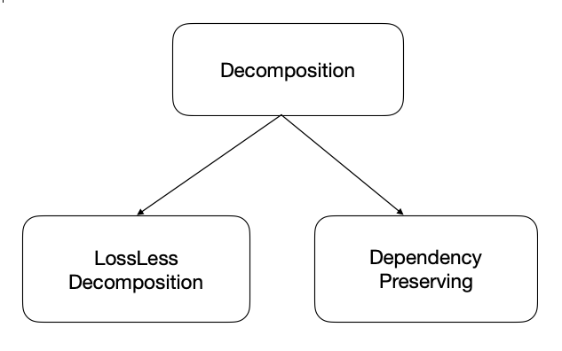
Types of decomposition techniques

Slide 24
Loss Less Decomposition
If the information is not lost after decomposition, then decomposition is loss less decomposition.
If you perform natural JOIN operation on decomposed relations, resultant relation will be original relation which was decomposed.
2. Lossy Decomposition
  when a relation is decomposed into two or more relational schemas, the loss of information is unavoidable when the original relation is retrieved.

Slide 25
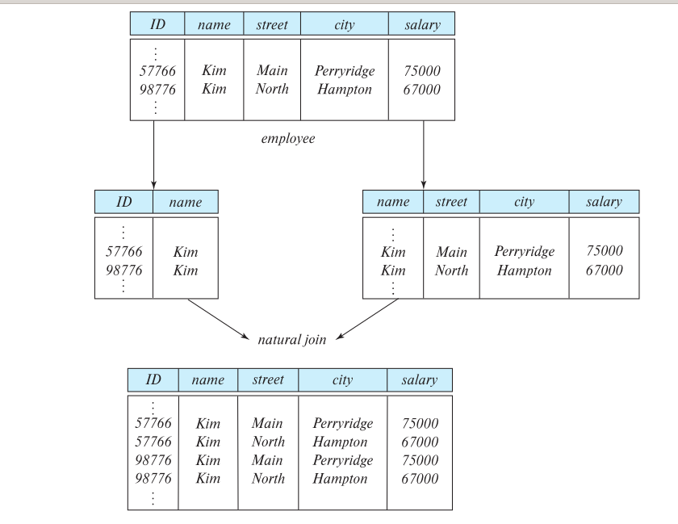

Slide 26
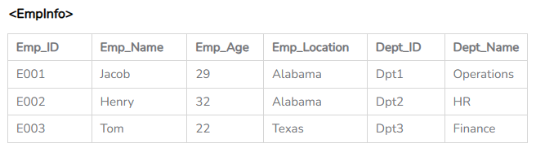
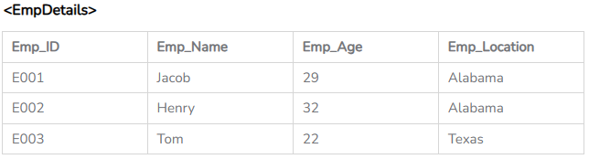
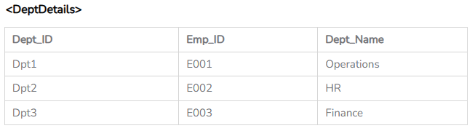
Loss Less Decomposition

Slide 27
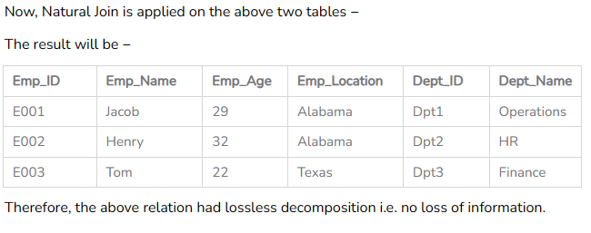
Loss Less Decomposition

Slide 28
Dependency Preserving Decomposition
Dependency Preserving Decomposition is a technique used in Database Management System (DBMS) to decompose a relation into smaller relations while preserving the functional dependencies between the attributes.
1NF, 2NF, and 3NF are valid for dependency-preserving decomposition.
In dependency preservation which says that after decomposing a relation R into R1 and R2, all dependencies of the original relation R must be present either in R1 or R2 or they must be derivable using the combination of functional dependencies present in R1 and R2.

Slide 29
Dependency Preserving Decomposition
Employee_Code | Employee_Name | Employee_Email | Project_Name | Project_ID
101 | John | john@demo.com | Project103 | P03
101 | John | john@demo.com | Project101 | P01
102 | Ryan | ryan@example.com | Project104 | P04
103 | Stephanie | stephanie@abc.com | Project102 | P02
In this relation we have the following FDs:
Employee_Code -> {Employee_Name, Employee_Email}
Project_ID - > Project_Name

Slide 30
Dependency Preserving Decomposition
Now, after decomposing the relation into EmployeeProject and ProjectDetail as:
ProjectDetail Table
  In this relation we have the following FDs:
  Project_ID - > Project_Name
EmployeeProject Table
  In this relation we have the following FDs:
  Employee_Code -> {Employee_Name, Employee_Email}

Slide 31
Integrity and Domain constraints
Domain Constraints
Define the valid values that an attribute (column) can hold.
  Specify the data type (e.g., integer, string, date) and any additional restrictions (e.g., range of values, allowed patterns).
  Check ,Null
Key Constraints
  Primary key, unique key, foreign key
Entity Integrity Constraints
  the Entity Integrity Constraint reinforces the importance of non-null values within the Primary Key to maintain the uniqueness of each record in a relational database
Referential Integrity Constraintsa
  Referential integrity in a database is a crucial concept ensuring data consistency among related tables through primary and foreign keys.

Slide 32
Normalization
Normalization is the process of organizing the data in the database.
Normalization is used to minimize the redundancy from a relation or set of relations. It is also used to eliminate undesirable characteristics like Insertion, Update, and Deletion Anomalies.
Normalization divides the larger table into smaller and links them using relationships.
The normal form is used to reduce redundancy from the database table.
It involves breaking down a large table into smaller, well-structured tables based on specific rules and functional dependencies.

Slide 33
Normalization
Why we need this?
  The main reason for normalizing the relations is removing these anomalies.
  Failure to eliminate anomalies leads to data redundancy and can cause data integrity and other problems as the database grows.
  Normalization consists of a series of guidelines that helps to guide you in creating a good database structure.
Advantages and Disadvantages ?

Slide 34
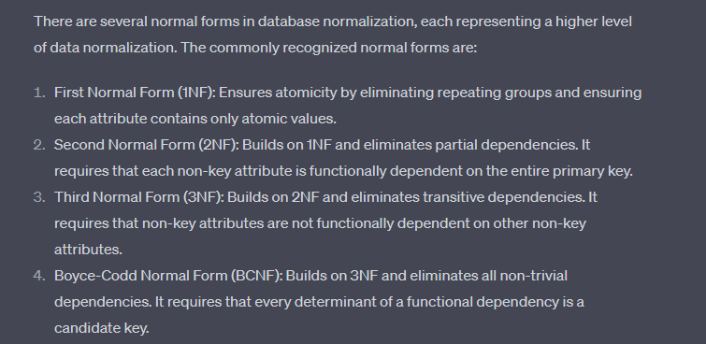
Types of Normalization

Slide 35
First Normal Form (1NF)
A relation will be 1NF if it contains an atomic value.
It states that an attribute of a table cannot hold multiple values. It must hold only single-valued attribute.
First normal form disallows the multi-valued attribute, composite attribute, and their combinations.
Notes:
Atomic value that cannot be further divided or decomposed into smaller parts.

Slide 36
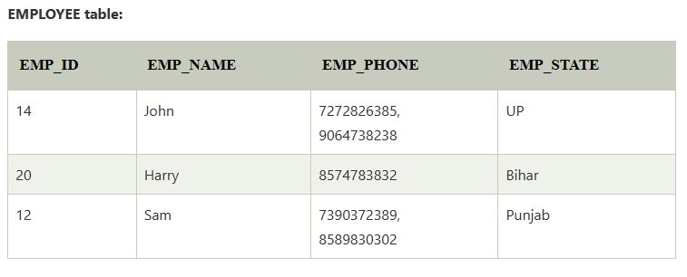
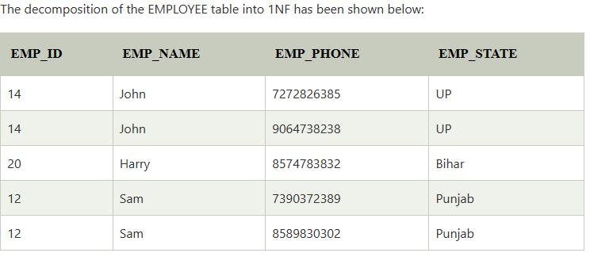
First Normal Form (1NF)
Notes:
Atomic value that cannot be further divided or decomposed into smaller parts.

Slide 37
Normalization
2NF
3NF
BCNF(Boyce - Codd Normal Form)
Comparison of BCNF and 3NF

Slide 38
Normalization in DBMS: 1NF, 2NF, 3NF and BCNF in Database (beginnersbook.com)
https://popsql.com/blog/normalization-in-sqls
Multivalued Functional Dependency

Slide 39
Triggers
A trigger is a set of instructions in a database that is automatically executed or fired when a certain event occurs, such as an INSERT, UPDATE, or DELETE operation on a table. Triggers help automate tasks, enforce business rules, and maintain data integrity. ==>Event , condition and Action
Types of Triggers:
BEFORE Trigger: Executes before the operation (e.g., before an INSERT).
AFTER Trigger: Executes after the operation (e.g., after a row is deleted).
INSTEAD OF Trigger: Used to override the default behavior of an operation, often for complex views.

Slide 40
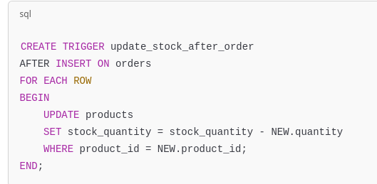

Slide 41
Assertions
Assertions are conditions or constraints that are checked periodically to ensure the database's consistency and integrity. Unlike triggers, assertions are typically more complex checks that are not tied to a specific table's operation but instead ensure that overall data integrity is maintained.
Assertions can enforce more complex integrity conditions than what triggers can do alone.
Not all databases support assertions natively (e.g., MySQL doesn't support assertions, but PostgreSQL does).

Slide 42


Slide 43
Feature of good relational model
Remove reduncany
  While removing redundancy:-
    Decomposition
    Lossless decomposition
    Normalization

Slide 44
Denormalization for Performance
Denormalization in database systems is the process of intentionally introducing redundancy into a normalized database to improve query performance.
It involves combining tables or creating additional derived data structures to reduce the number of joins required in queries, which can be expensive in terms of computational resources.

