Slide 1
Query Processing
Jan 23, 2024 – DBMS

Slide 2
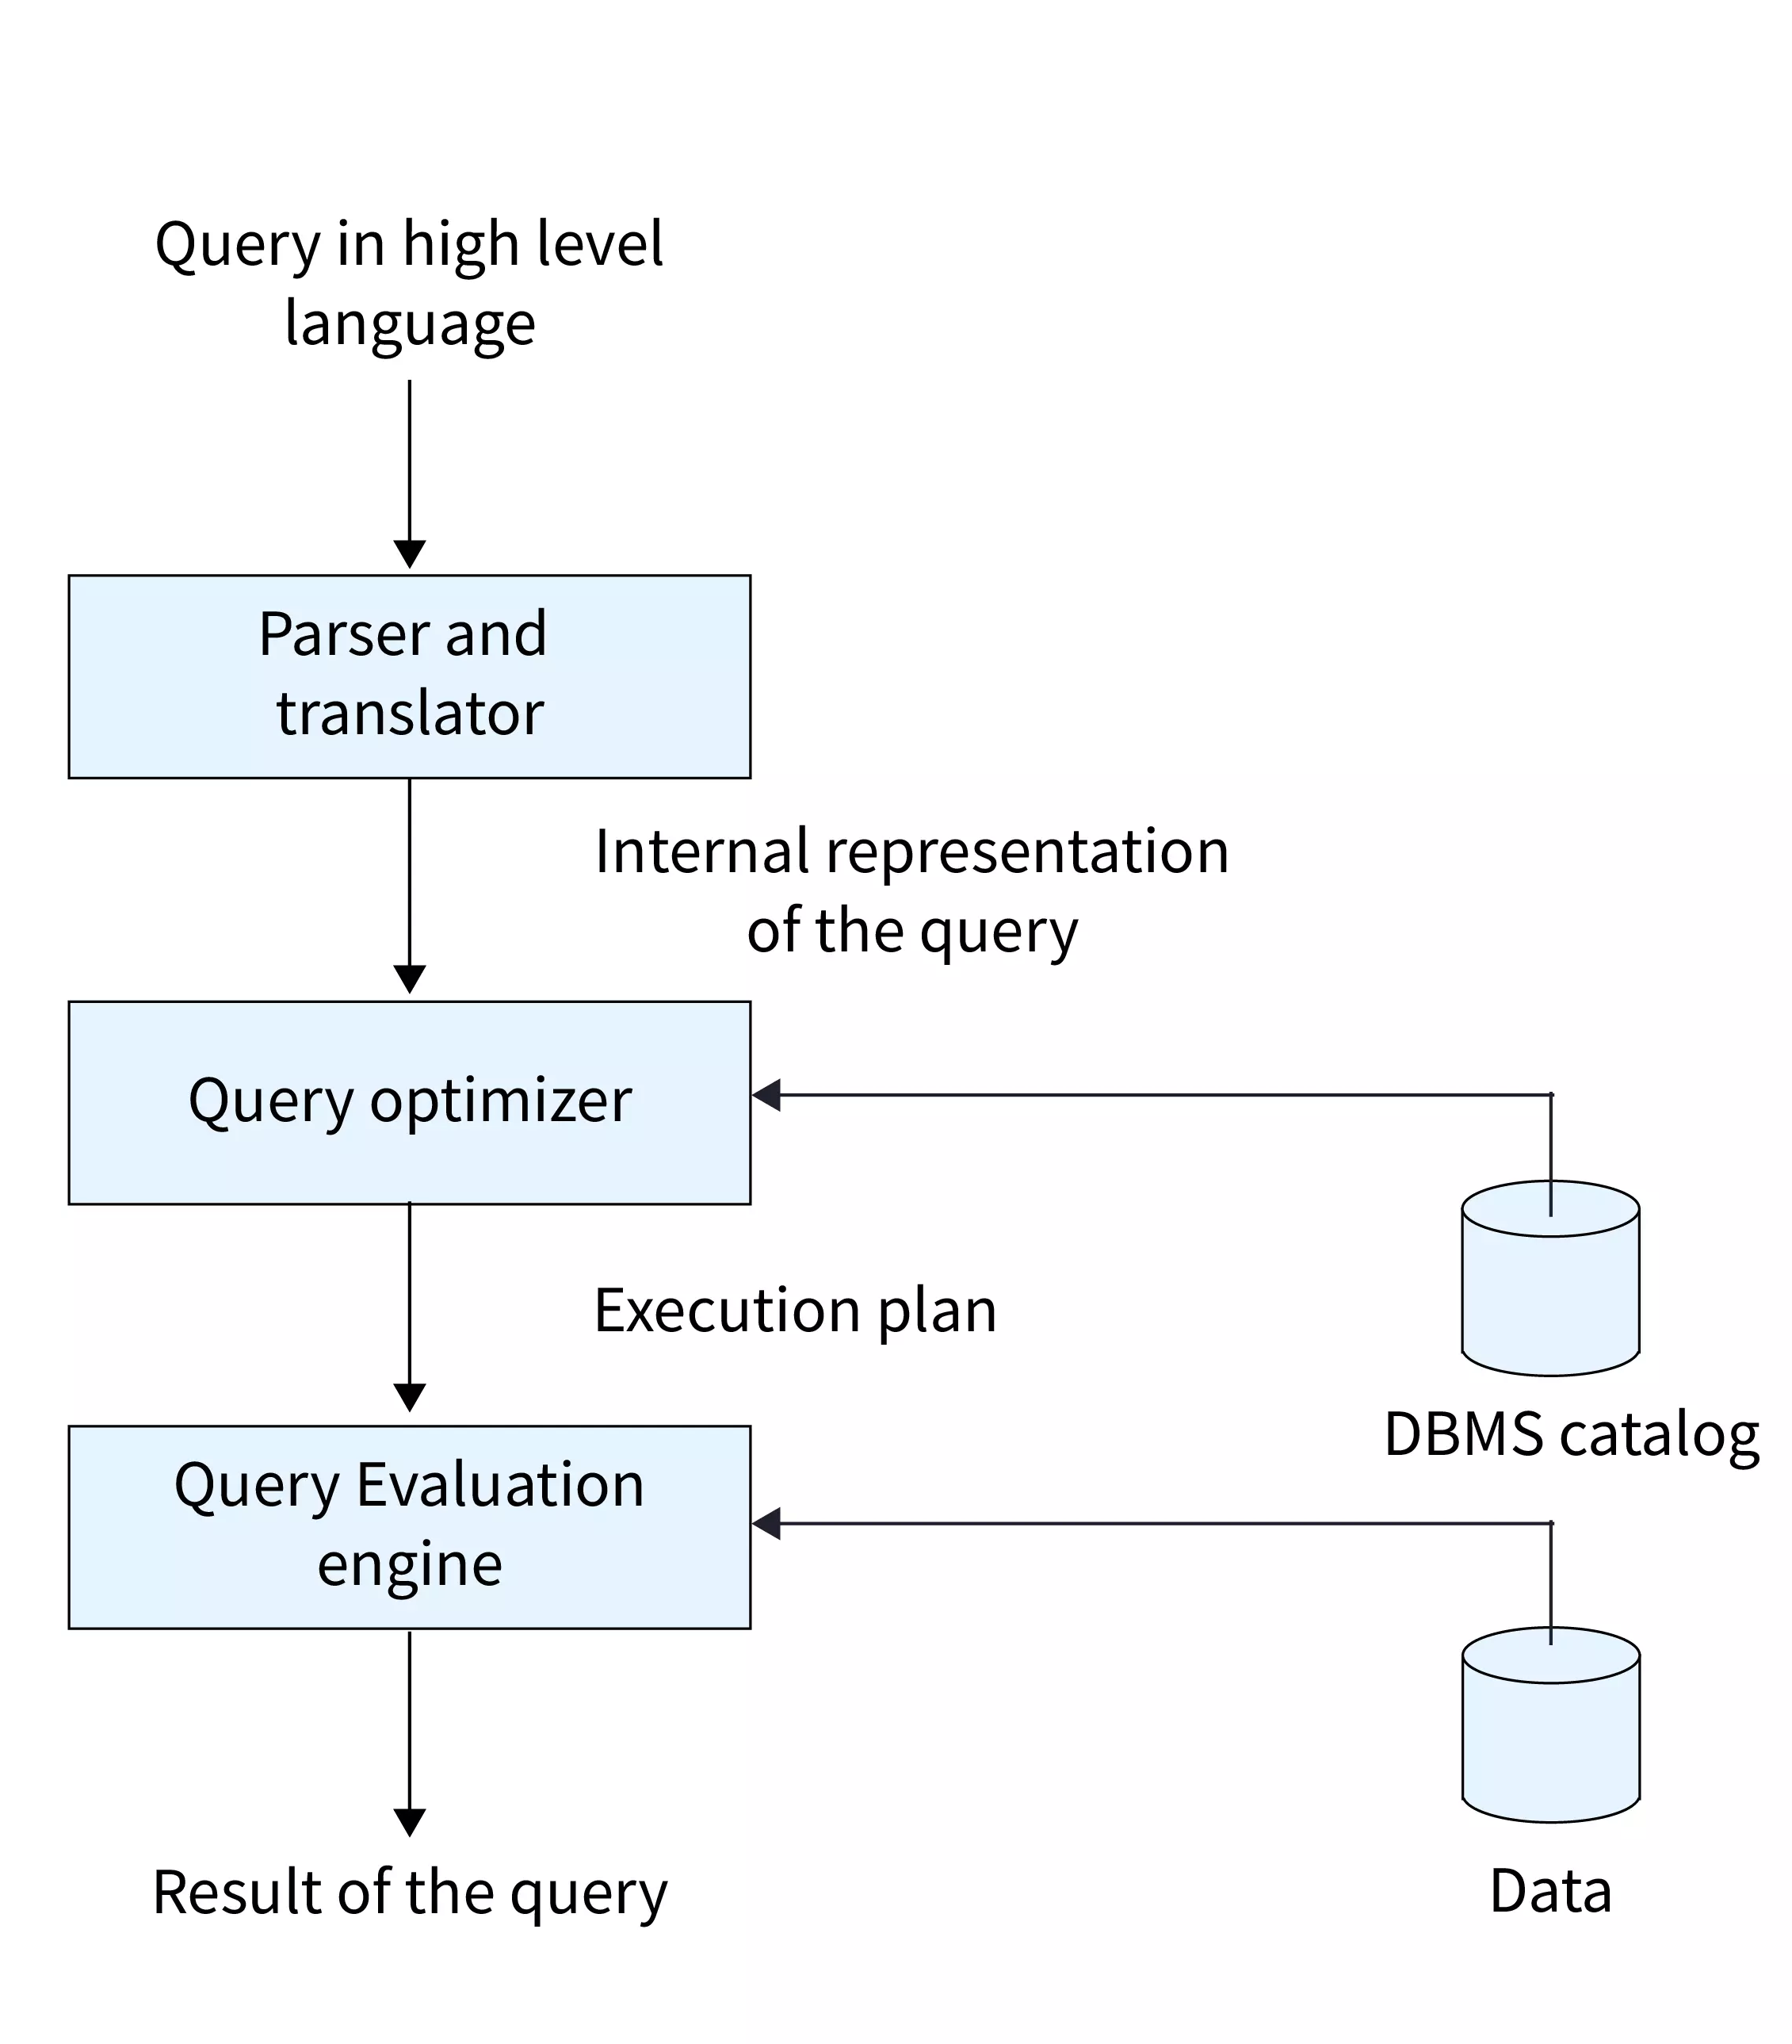
Query Processing
Query processing is a crucial component of database management systems (DBMS) responsible for translating high-level queries into efficient execution plans.
This process involves several stages, including parsing, semantic analysis, query optimization, and execution.

Slide 3
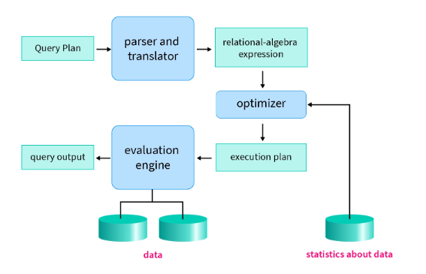

Slide 4
Query Processing
Parsing and Lexical Analysis:
Breaking down the query into its individual components (tokens) like keywords, table names, and operators.
Checking for syntactic correctness and resolving ambiguities.
SELECT FirstName, LastName FROM Employees WHERE Department = 'IT’;
  In this query, parsing involves identifying:
  keywords (SELECT, FROM, WHERE),
  table and column names (Employees, FirstName, LastName, Department)
  filtering condition (Department = 'IT').

Slide 5
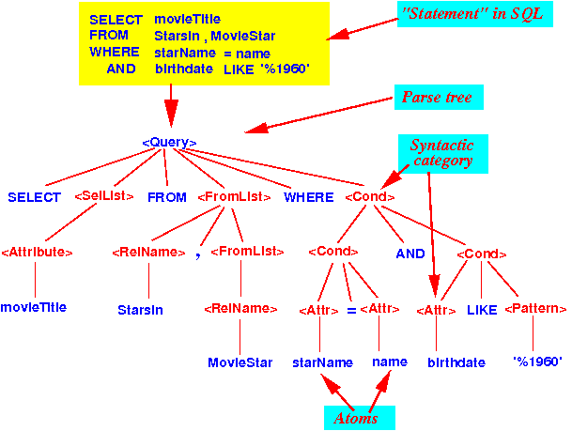
Query Processing

Slide 6
Query Processing
Semantic Analysis:
Validating the existence of tables, columns, and relations mentioned in the query.
Identifying joins, aggregations, and other operations to be performed.
SELECT FirstName, LastName FROM Employees WHERE Department = 'IT’;
  Semantic analysis checks that there is a table named "Employees" and that it contains columns named "FirstName," "LastName," and "Department."

Slide 7
Query Processing
Parsing:
  The query is broken down into smaller components (keywords, operators, operands).
  The DBMS checks for syntax errors and validates the query structure.
Translation:
  The query is converted into an internal representation, often an abstract syntax tree (AST).
  Semantic checks ensure the query references valid database objects (tables, columns) and consistent data types.
  SELECT emp_name FROM employee WHERE salary>10000;
  ∏ emp_name (σ salary > 10000(employee))
  σ salary > 10000( ∏ emp_name (employee))s

Slide 8
Query Processing
Query Optimization:
Analyzing different possible execution plans for the query.
Choosing the most efficient plan based on factors like estimated cost, available indexes, and data distribution.
SELECT Orders.OrderID, Customers.CustomerName FROM Orders
JOIN Customers ON Orders.CustomerID = Customers.CustomerID;
  The optimizer considers various join algorithms (e.g., nested loop, hash join) and access paths to the tables (e.g., indexes) to determine the most efficient plan for retrieving the requested data.

Slide 9
Query Optimization
The optimization phase determines the most efficient way to execute the parsed query. This is crucial for performance, especially with large databases or complex queries.
Query Optimizer:
  Generates multiple execution plans.
  Evaluate each plan based on cost factors like CPU time, memory, and I/O operations.
  Selects the execution plan with the lowest estimated cost.
Optimization Considerations:
  Indexes: Decide whether to use indexes or perform full table scans.
  Data Size: Considers the volume of data involved.
  Joins and Conditions: Analyses the complexity of joins and the selectivity of query conditions

Slide 10
Query Processing
Execution Plan:
Physically accessing the relevant data files and indexes.
Applying the chosen operations (filtering, sorting, joining, etc.) in the optimized order.
Returning the final result set to the user.
SELECT FirstName, LastName FROM Employees WHERE Department = 'IT’;
  The execution phase retrieves the first and last names of employees from the "Employees" table where the department is 'IT'.

Slide 11
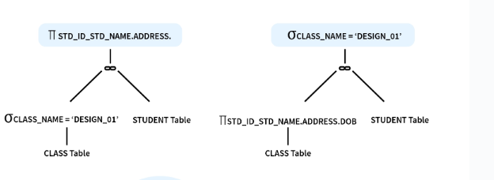
Execution plan
1.Internal nodes represent relational algebra operations (e.g., selection, projection, join). 2.Leaf nodes represent base relations (e.g., tables).

Slide 12
Execution Plan
The evaluation phase is where the DBMS executes the optimised query plan, interacting with the storage engine to retrieve or modify data.
Execution:
  Follow the steps outlined in the execution plan.
  Performs operations like reading data, applying filters, joining tables, sorting, and aggregating results.
Data Interaction:
  Uses indexes or performs full table scans as per the execution plan.
  Handles intermediate results in memory or on disk, depending on the query’s complexity and available resources.

Slide 13
Query Optimization
Query optimization involves selecting the best execution strategy or plan from several possible ways the database could execute the query, ensuring that it runs as fast and efficiently as possible.
1. Transformation of relational expressions
2. Cost Estimation

Slide 14
Query Optimization
Transformation of relational expressions
  Two relational algebra expressions are said to be equivalent if, one or every legal database instance both expressions generate the same set of tuples.
  This is the first step of optimization,
  It generates logically equivalent expressions to the given expressions using equivalence rules.
  Equivalence Rules
    Conjunctive selection
    Selection operations
    Theta-join operations (and natural joins) are commutative.
    Natural join operations are associative
    And so on.
Notes:
10-12 rules to convert :- R1==R2

Slide 15
Query Optimization
Estimating the statistics of expressions
  catalog information,
    Number of tuples (rows)
    Number of distinct values
    Index availability
  selection size
    Condition
  join size
    Simple/complex/equi join
  Size estimation of operation
Notes:
is crucial for determining the cost of different query execution plans.

Slide 16
Query Optimization
An evaluation plan is used to define exactly what algorithm should be used for each operation and how the execution of the operations should be coordinated.
  (a) heuristic optimization
    a. System uses heuristics to reduce number of choices to evaluate,
    b. A query is transformed by using a set of rules as:
    i. Perform selection early
    ii. Perform projection early
    iii. Perform most restrictive selection and join operations before other similar operations.
  (b) cost-based optimization.
    a. It explores the space of all query evaluation plans that are equivalent to given query and chooses one with least estimated cost.
    b. Exploring space of all possible plans may be expensive.
    c. It guarantees finding of optimal plans.

Slide 17
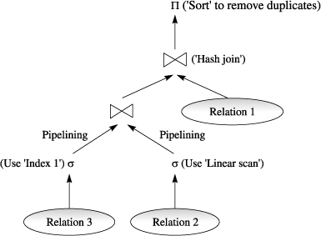

Slide 18
Query Cost Estimation (Measures of Query Cost)
If we consider the number of block transfers as the main component in calculating the cost of a query, it would include more sub-components. Those are;
Rotational latency - time taken to bring and spin the required data under the read-write head of the disk.
Seek time - time taken to position the read-write head over the required track or cylinder.
Sequential I/O - reading data that are stored in contiguous blocks of the disk
Random I/O - reading data that are stored in different blocks that are not contiguous.
That is, the blocks might be stored in different tracks, or different cylinders, etc. Whether read/write? - read takes less time, write takes more.

Slide 19
Query Cost Estimation (Measures of Query Cost)
From these sub-components, we would list the components of a more accurate measure as follows;
The number of seek operations performed The number of block read The number of blocks written To get the final result, these numbers to be multiplied by the average time required to complete the task.
Hence, it can be written as follows;
Most read Query cost = (number of seek operations X average seek time) + (number of blocks read X average transfer time for reading a block) + (number of blocks written X average transfer time for writing a block)

Slide 20
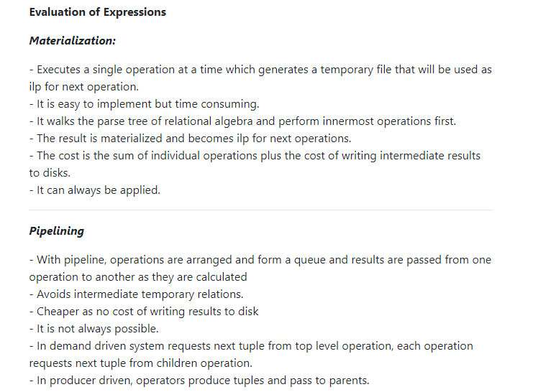

Slide 21
Equivalence of Expressions
In the context of query processing, the equivalence of expressions refers to the ability to transform one query expression into another while preserving the semantic meaning and final result.
This is essential for query optimization, as the database management system (DBMS) can explore different but equivalent expressions to choose the one with the lowest execution cost.
This relies on principles of relational algebra and known equivalences between operations under certain conditions.

Slide 22
Equivalence of Expressions
Algebraic Transformations:
Equivalence often involves algebraic transformations based on relational algebra rules.
For example, relational algebra has certain laws like commutativity, associativity, and distributivity.
These laws can be applied to transform one expression into an equivalent one.
Selection Pushdown:
  Original Expression: σ_{A}(σ_{B}(R))
  Transformation: σ_{A ∩ B}(R)
  Pushing down two selection operations on a relation R with conditions A and B to a single selection with the combined condition A ∩ B.

Slide 23
Equivalence of Expressions
Algebraic Transformations:
Projection Commutativity:
  Original Expression: π_{A, B}(R)
  Transformation: π_{B, A}(R)
  The order of projecting attributes A and B from relation R does not affect the result, so the two expressions are equivalent.
Join Commutativity:
  Original Expression: R ⨝_{A=B} S
  Transformation: S ⨝_{B=A} R
  The order of joining relations R and S on attributes A and B is interchangeable, resulting in an equivalent expression.

Slide 24
Equivalence of Expressions
Predicate Pushdown:
Equivalence can also be achieved through predicate pushdown. For instance, consider the following query:
  SELECT FirstName, LastName FROM Employees WHERE Department = 'IT' AND Salary > 50000;
  SELECT FirstName, LastName FROM (SELECT * FROM Employees WHERE Salary > 50000) AS EmpSubset WHERE Department = 'IT';
Here, the DBMS can push down the predicate Salary > 50000 to create an equivalent expression. The internal query retrieves the subset of employees with a salary greater than 50000, and the outer query then filters those by department.

Slide 25
Query Cost Estimation
Query cost estimation is a critical aspect of query optimization within a database management system (DBMS).
The goal is to predict the resource requirements and execution time for different query execution plans, allowing the optimizer to choose the most efficient plan.
Various factors contribute to the cost of executing a query, and these are considered during the estimation process.

Slide 26
Component of Query Cost Estimation
Access Methods:
  Cost associated with accessing data, considering factors such as table scans, index scans, and the presence of appropriate indexes.
  For example, if an index is available on a column used in a WHERE clause, using that index for selective data retrieval might have a lower cost than a full table scan.
Join Operations:
  Cost of joining tables, which depends on the join method chosen (e.g., nested loops, hash join, merge join) and the size of the intermediate result set.
  For instance, the cost of joining large tables may be higher, and the optimizer needs to estimate these costs accurately.

Slide 27
Component of Query Cost Estimation
Filtering Conditions:
  Cost of applying filtering conditions, considering the selectivity of predicates (percentage of rows that satisfy a condition) and the availability of indexes.
  Evaluating the cost of filtering conditions helps in determining the most efficient way to narrow down the result set.
Sorting and Grouping:
  Cost associated with sorting or grouping operations, which depends on the size of the dataset and the available indexes.
  Sorting and grouping can be resource-intensive, and the cost estimation considers the computational expense associated with these operations.

Slide 28
Component of Query Cost Estimation
Data Distribution Statistics:
  Utilization of statistical information about data distribution, index selectivity, and cardinality (number of distinct values) of columns.
  Understanding the distribution of data helps in making informed decisions about the most efficient access paths and join strategies.

Slide 29
Example Query Cost Estimation
Consider the following SQL query:
  SELECT Orders.OrderID, Customers.CustomerName FROM Orders JOIN Customers ON Orders.CustomerID = Customers.CustomerID WHERE Orders.OrderDate >= '2022-01-01’;
  The cost estimation involves considering the cost of accessing the "Orders" and "Customers" tables, the cost of the join operation, and the cost of applying the filtering condition on the "OrderDate."
  If there is an index on the "OrderDate" column in the "Orders" table, the cost of applying the filtering condition might be lower compared to a full table scan.
  The cost estimation also considers the join method (e.g., hash join) and the size of the intermediate result set when joining "Orders" and "Customers."

Slide 30
Query Optimization
Query optimization is a crucial phase in the database management system (DBMS) that involves selecting the most efficient execution plan for processing a given query.
The goal is to minimize the overall cost of executing the query, where cost is typically measured in terms of time, CPU usage, and other system resources.
The optimization process involves several steps, and modern DBMSs employ sophisticated algorithms and heuristics to make intelligent decisions.

Slide 31
Steps in Query Optimization
Parsing and Semantic Analysis:
  The query is parsed to ensure it adheres to the syntax rules of the query language (e.g., SQL).
  Semantic analysis verifies the logical correctness of the query by checking the existence of tables, columns, and relationships.
Equivalence Class Generation:
  Equivalent query expressions that produce the same result are identified. This involves recognizing algebraic transformations and logical equivalences.
  For example, transforming a WHERE clause condition or rearranging joins without changing the final result.

Slide 32
Steps in Query Optimization
Search Space Exploration:
  The optimizer explores the search space of possible execution plans by considering different access paths, join strategies, and other optimization techniques.
  Techniques such as dynamic programming, rule-based systems, or cost-based optimization are employed to traverse the search space efficiently.
Cost Estimation:
  The cost of each candidate execution plan is estimated based on factors such as access methods, join operations, filtering conditions, and sorting/grouping.
  Statistical information about data distribution, index selectivity, and hardware characteristics are used to provide accurate cost estimates.

Slide 33
Steps in Query Optimization
Plan Selection:
  The execution plan with the lowest estimated cost is selected as the optimal plan.
  The goal is to choose a plan that minimizes the overall resource consumption and execution time.
Plan Execution:
  The chosen execution plan is implemented to fetch the data from the database.
  This involves accessing tables, applying filters, performing joins, and any other operations specified in the query.

Slide 34
Example of Query Optimization
Consider the following SQL query:
  SELECT Customers.CustomerName, COUNT(Orders.OrderID) AS OrderCount FROM Customers LEFT JOIN Orders ON Customers.CustomerID = Orders.CustomerID WHERE Orders.OrderDate >= '2022-01-01’ GROUP BY Customers.CustomerID, Customers.CustomerName HAVING COUNT(Orders.OrderID) > 5;
  The optimizer explores different execution plans, considering options like index usage, join methods, and access paths.
  It estimates the cost of various plans, taking into account the cost of accessing the "Customers" and "Orders" tables, the join operation, and the filtering condition on "OrderDate."
  The plan with the lowest estimated cost might involve using an index on "OrderDate" and a suitable join method.

Slide 35
Query Optimization Steps
SQL to Relational Algebra
  The first step is to translate the high-level SQL query into a relational algebra representation. This representation provides a structured and formal way to express queries, making it easier to analyze and optimize them.
Logical Query Optimization (Generating Equivalent Expressions)
  The system generates logically equivalent expressions using equivalence rules (e.g., commutativity, associativity, distributivity). These rules allow transformations such as:
    Rearranging joins.
    Reordering selection and projection operations.
  The goal is to produce an optimized logical query plan that minimizes resource usage (e.g., reducing intermediate results).
Estimation of Statistics
  Statistics estimation involves collecting data such as:
    Cardinality (number of tuples in a table or result of an operation).
    Selectivity (fraction of tuples satisfying a condition).
    Data distribution (e.g., histograms, indexes).
  These statistics are essential for estimating the cost of various query execution strategies.

Slide 36
Query Optimization Steps
4. Cost Estimation
  Based on the collected statistics, the system estimates the cost of different query execution plans. Cost can include: Cost-Based Optimization and Heuristic Optimization
    Disk I/O cost: Reading/writing data from/to disk.
    CPU cost: Processing time for computations.
    Network cost: Transferring data between distributed systems (if applicable).
5. Physical Query Plan Generation (Evaluation Plans)
  The optimizer evaluates different physical query plans, which include specific algorithms and data access methods for executing the query (e.g., using nested-loop join vs. hash join, or full table scan vs. index scan).
  It chooses the plan with the lowest estimated cost.
  This is where evaluation strategies like Materialization and Pipelining are decided. These strategies define how intermediate results are handled: Materialization: Store intermediate results on disk or in memory. Pipelining: Pass intermediate results directly to the next operation without storing them.
6. Selection of the Optimal Plan
  Finally, the optimal plan (the most cost-effective one) is selected and passed to the evaluation engine for execution.

Slide 37
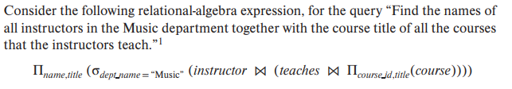
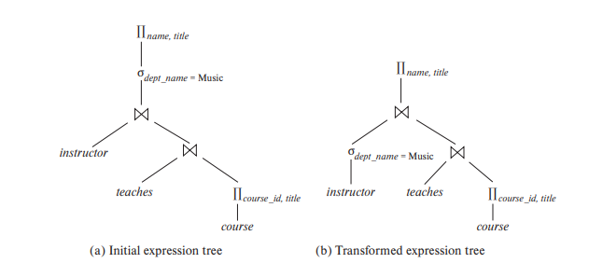

Slide 38

  instructor(ID, name, dept name, salary)
  teaches(ID, course id, sec id, semester, year)
  course(course id, title, dept name, credits)
“Find the names of all instructors in the Music department and instructors who have taught a course in 2017 together with the course title of all the courses that the instructors teach”
Construct initial operator tree and final efficient operator tree after applying transformation rules.

Slide 39

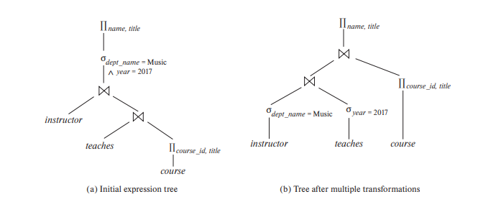
Notes:
1. Rule (associativity of natural join)
2. “perform selections early
Optimizations applied:
Split compound SELECT into separate operations
Pushed SELECTs closer to their respective relations
Moved PROJECT to top level
Reasons:
Early filtering reduces tuple count before joins
Separate selections allow independent optimization
Natural joins preserved for proper attribute matching

