Slide 1
Storage Management and indexing
Unit-7

Slide 2
Disks and storage
The storage system in a DBMS refers to the hierarchical arrangement of storage devices and media to store, manage, and retrieve data efficiently.
The system is designed to handle different storage capacities, access speeds, volatility, and costs.

Slide 3
Storage System Hierarchy in DBMS
The storage hierarchy typically has multiple levels, each with its specific characteristics. Here's a typical hierarchy from fastest (and usually most expensive per byte) to slowest (and usually least expensive per byte):
1. Registers
Located within the CPU.
Smallest and fastest type of storage.
Used to hold data currently being processed.
2. Cache Memory (L1, L2, L3 caches)
On or very close to the CPU.
Extremely fast but small in size.
Acts as a buffer for frequently used data.
3. Main Memory (RAM)
Data that's actively being used or processed is loaded here.
Faster than secondary storage.
Volatile in nature (i.e., data is lost when power is turned off).
4. Flash Storage (Solid State Drives - SSD)
No moving parts.
Faster than traditional hard drives.
More durable and reliable.

Slide 4
Storage System Hierarchy in DBMS
5. Magnetic Disks (Hard Disk Drives - HDD)
Primary secondary storage medium.
Non-volatile, persistent storage.
Data is stored in tracks, sectors, and cylinders.
Slower than main memory but offers a large storage capacity at a lower cost.
6. Optical Disks (CD, DVD, Blu-Ray)
Data is read using lasers.
Slower than magnetic disks and usually have less storage capacity.
Portable and commonly used for media and software distribution.
7. Magnetic Tapes
Sequential access storage, unlike disks which are random access.
Often used for backups and archiving due to their high capacity and low cost.
Much slower access times compared to magnetic disks.
8. Remote Storage/Cloud Storage
Data stored in remote servers and accessed over the internet.
Provides scalability, availability, and fault-tolerance.
Latency depends on network speed and distance to servers.

Slide 5
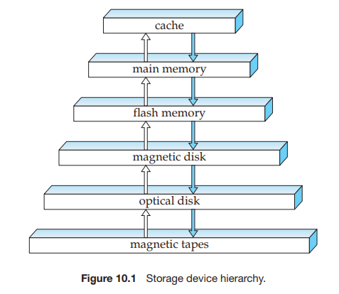

Slide 6
Types of Storage
Primary Storage: Includes registers, cache memory, and main memory (RAM). It's the main memory where the operating system, application programs, and data in current use are kept for quick access by the computer's processor.
Secondary Storage: Encompasses data storage devices like HDDs, SSDs, CDs, and USB drives. It is non-volatile and retains data even when the computer is turned off.
Tertiary Storage or Off-line Storage: Often involves magnetic tape systems or optical disk archives. This is slower than secondary storage and is used for data archiving and backup.
Quaternary Storage: Refers to methods like cloud storage or other remote storage techniques where data is stored in remote servers and is fetched over the internet or other networks.

Slide 7
File Organizations
A database is mapped into a number of different files that are maintained by the underlying operating system.
These files reside permanently on disks.
A file is organized logically as a sequence of records.
These records are mapped onto disk blocks.
Files are provided as a basic construct in operating systems.
Each file is also logically partitioned into fixed-length storage units called blocks, which are the units of both storage allocation and data transfer.
A block may contain several records; the exact set of records that a block contains is determined by the form of physical data organization being used.

Slide 8
File Organizations
1.Fixed Length Records
2. Variable Length Records
https://cse.poriyaan.in/topic/file-organization-50897/

Slide 9
Organization of Records in Files
Heap file organization
Sequential file organization
Index sequential file organization
Hashing file organization
B+ Tree File Organization
Clustered File Organization

Slide 10
Heap file organization
It is the most fundamental and basic form of file organization.
Any record can be placed anywhere in the file where there is space for the record.
There is no ordering of records. Typically, there is a single file for each relation
Pile File Method/Sorted Method

Slide 11
Sequential file organization
A sequential file is designed for efficient processing of records in sorted order based on some search key.
A search key is any attribute or set of attributes; it need not be the primary key, or even a superkey.
To permit fast retrieval of records in search-key order, we chain together records by pointers.
The pointer in each record points to the next record in search-key order.

Slide 12
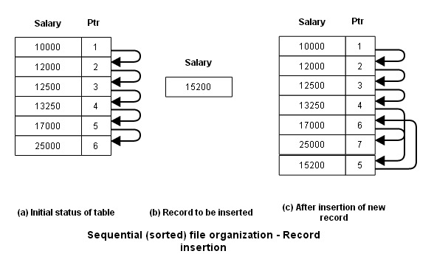

Slide 13
Index sequential file organization
ISAM (Indexed sequential access method) is an advanced sequential file organization method.
Hybrid Access: Combines sequential and direct access to records.
Primary File: Records stored in sorted order based on a search key.
Index File: Stores pointers to records for quick direct access.

Slide 14
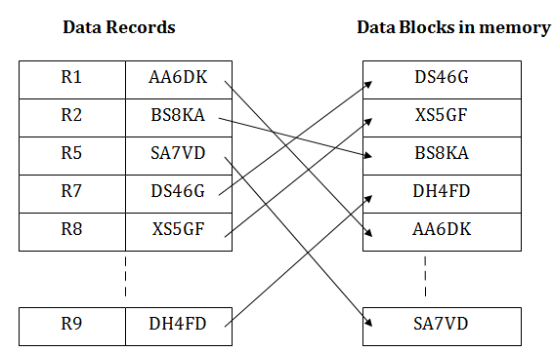
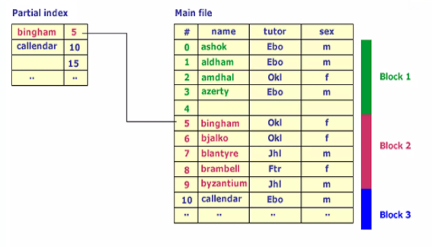

Slide 15
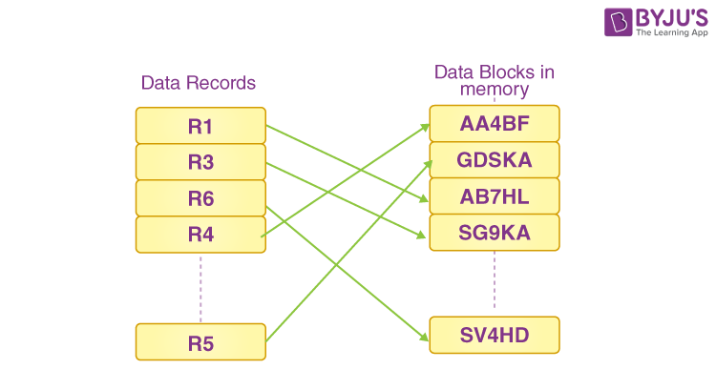
Hashing file organization
Hash File Organization in a Database Management System (DBMS) is a method of storing and retrieving records based on a hash function that maps a search key to a specific location (or bucket) in a file.

Slide 16
Clustered File Organization
A clustered file organization keeps two or more related tables/records in a single file known as a cluster.
These files consist of two or more tables within a single data block, and the mapping attributes, defining the relationships between the tables, are stored only once.
These contain two or more tables in one data block and the key attributes that are related between the tables are stored only once.

Slide 17
B+ tree Index
Only leaf nodes contain data pointers along with keys, internal nodes contain keys only.
Duplicate keys are present in this, all internal nodes are also present at leaves.
Leaf nodes are linked to each other.
All nodes are present at leaves, so sequential access is possible just like a linked list.

Slide 18
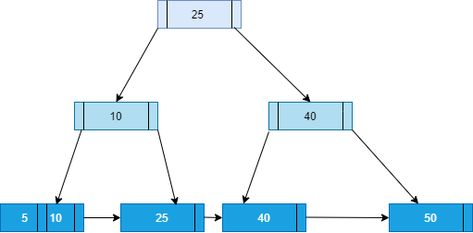

Slide 19
B+ tree
B-tree vs B+ tree
5,15, 25, 35, 45. order 3
1, 3, 5, 7, 9, 2, 4, 6, 8, 10 order 4
delete

Slide 20
