Slide 1
Transaction and Concurrency Control
Unit-8

Slide 2
Introduction to Transaction
A transaction is a single, logical unit of work that consists of one or more related tasks.
A transaction is treated as a single, indivisible operation, which means that either all the tasks within the transaction are executed successfully, or none are.

Slide 3
Transaction
Transactions refer to a set of operations that are used for performing a set of logical work.
Usually, a transaction means the data present in the DB has changed.
Protecting the user data from system failures is one of the primary uses of DBMS.
This “all-or-none” property is referred to as atomicity.
Notes:
1.Money transfer example : A-> B R(A) W(B) atomic in nature A=A-10

Slide 4
ACID Properties
ACID is an acronym that stands for Atomicity, Consistency, Isolation, and Durability.
These properties are fundamental in database systems and ensure reliable and consistent transactions.
Atomicity: Atomicity guarantees that a transaction is treated as a single, indivisible unit of work. It means that either all the operations within a transaction are successfully completed, or none of them take effect at all. If any part of the transaction fails, the entire transaction is rolled back, and the database is restored to its previous state.
Notes:
Money transfer to start so rollback , no resume ->no like download

Slide 5
ACID Properties
Consistency: Consistency ensures that a transaction brings the database from one consistent state to another consistent state. It means that a transaction must adhere to all the defined integrity constraints, business rules, and validation rules of the database. If a transaction violates any of these constraints, it is rolled back to maintain data consistency.
Isolation: Isolation guarantees that each transaction is executed in isolation from other concurrent transactions. It ensures that the intermediate states of a transaction are not visible to other transactions until the transaction is committed. Isolation prevents interference and conflicts between concurrent transactions and maintains data integrity.
Durability: Durability ensures that once a transaction is committed, its changes are permanently stored in the database and survive any subsequent failures or system crashes. The changes made by a committed transaction should persist even in the event of power loss or system failures.
Notes:
2. A=2000 B=3000 B=4000 A=1000 commit; ATM money => cash
4.permanent

Slide 6
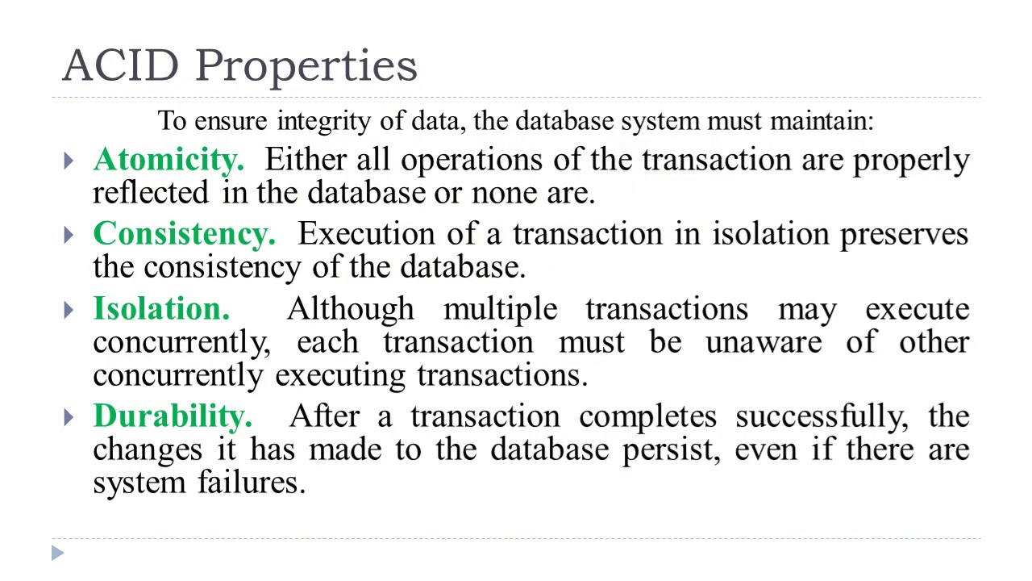

Slide 7
Simple Transaction Model
Transactions with a simple database language that focuses on when data are moved from disk to main memory and from main memory to disk.
Transactions access data using two operations:
  read(X), which transfers the data item X from the database to a variable, also called X, in a buffer in main memory belonging to the transaction that executed the read operation.
  write(X), which transfers the value in the variable X in the main-memory buffer of the transaction that executed the write to the data item X in the database.

Slide 8
Simple Transaction Model
Ti : read(A);
A := A − 50;
write(A);
read(B);
B := B + 50;
write(B).

Slide 9
Transaction Atomicity and Durability
A transaction must be in one of the following states:
Active, the initial state; the transaction stays in this state while it is executing.
Partially committed, after the final statement has been executed.
Failed, after the discovery that normal execution can no longer proceed.
Aborted, after the transaction has been rolled back and the database has been restored to its state prior to the start of the transaction.
Committed, after successful completion.
Notes:
→ Active Ram initialized.
→ All operation perform
→permanent save
Free resources , use by other
Any problem (only fail in active, partially committed)

Slide 10
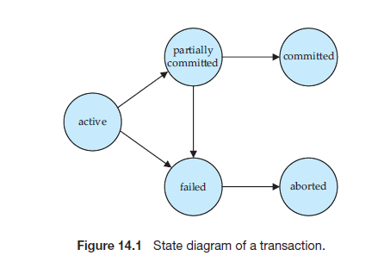
Transaction Atomicity and Durability

Slide 11
Transaction Isolation
Transaction-processing systems usually allow multiple transactions to run concurrently.
Allowing multiple transactions to update data concurrently causes several complications with consistency of the data.
consistency in spite of concurrent execution of transactions requires extra work;
it is far easier to insist that transactions run serially—that is, one at a time, each starting only after the previous one has completed.
Notes:
--Dirty Read
-- Phanton
—for this chapter see notes

Slide 12
Transaction Isolation
There are two good reasons for allowing concurrency:
  Improved throughput and resource utilization.
  Reduced waiting time.
Notes:
--Dirty Read
-- Phanton
-----Prefer teaching from notes-------
If we have developed schedule from transaction we verify those schedule if it is conflict or not using Serializability either it is ok to use or not and concurrency control used to make schedule that’s not going to conflict

Slide 13
Concurrent Executions
https://studyglance.in/dbms/display.php?tno=40&topic=Concurrent-Executions-in-DBMS

Slide 14
Serializability
When multiple transactions are running concurrently then there is a possibility that the database may be left in an inconsistent state.
Serializability is a concept that helps us to check which schedules are serializable.
  sequence of operations is known as Schedule.
A serializable schedule is the one that always leaves the database in consistent state.

Slide 15
Serializable schedule
A serializable schedule always leaves the database in consistent state.
A serial schedule is always a serializable schedule, because in serial schedule, a transaction only starts when the other transaction finished execution.
However a non-serial schedule needs to be checked for Serializability.
A serial schedule doesn’t allow concurrency, only one transaction executes at a time and the other starts when the already running transaction finished.

Slide 16
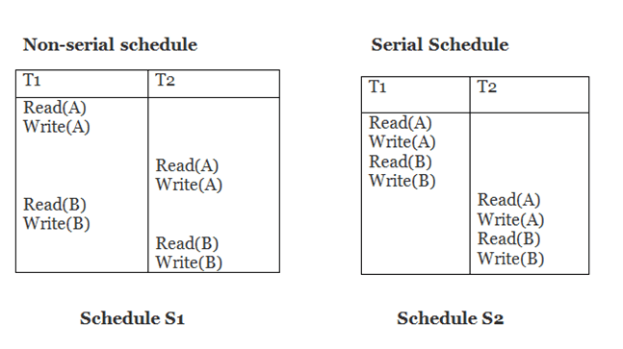
Types of Serializability
Conflict Serializability
  It can be used to check whether a non-serial schedule is conflict serializable or not.
  A schedule is called conflict serializable if we can convert it into a serial schedule after swapping its non-conflicting operations.
  The two operations become conflicting if all conditions satisfy:
    Both belong to separate transactions.
    They have the same data item.
    They contain at least one write operation.
Notes:
Precedence graph== R-W,W-R,W-W //see notes
No loop graph =>CS=> serial=> consistence

Slide 17
Types of Serializability
View Serializability
  View Serializability is a process to find out that a given schedule is view serializable or not.
  To check whether a given schedule is view serializable, we need to check whether the given schedule is View Equivalent to its serial schedule.
  View serializability is not used in practice due to its high degree of computational complexity
Notes:
Different condition should apply

