Slide 1
Crash Recovery
Unit-9

Slide 2
Recovery System
A computer system, like any other device, is subject to failure from a variety of causes: disk crash, power outage, software error, a fire in the machine room, even sabotage.
In any failure, information may be lost.
Therefore, the database system must take actions in advance to ensure that the atomicity and durability properties of transactions, are preserved.

Slide 3
Failure Classification
There are various types of failure that may occur in a system, each of which needs to be dealt with in a different manner.
Transaction failure. There are two types of errors that may cause a transaction to fail:
  Logical error. The transaction can no longer continue with its normal execution because of some internal condition, such as bad input, data not found, overflow, or resource limit exceeded.
  System error. The system has entered an undesirable state (for example, deadlock), as a result of which a transaction cannot continue with its normal execution. The transaction, however, can be re executed at a later time.

Slide 4
Failure Classification
System crash. There is a hardware malfunction, or a bug in the database software or the operating system, that causes the loss of the content of volatile storage, and brings transaction processing to a halt.
The assumption that hardware errors and bugs in the software bring the system to a halt, but do not corrupt the nonvolatile storage contents, is known as the fail-stop assumption.
Disk failure. A disk block loses its content as a result of either a head crash or failure during a data-transfer operation

Slide 5
Failure Classification
To determine how the system should recover from failures, we need to identify the failure modes of those devices used for storing data.
These algorithms, known as recovery algorithms, have two parts:
  1. Actions taken during normal transaction processing to ensure that enough information exists to allow recovery from failures.
  2. Actions taken after a failure to recover the database contents to a state that ensures database consistency, transaction atomicity, and durability.

Slide 6
Storage
Identified three categories of storage:
  • Volatile storage
  • Nonvolatile storage
  • Stable storage
Stable storage or, more accurately, an approximation thereof, plays a critical role in recovery algorithms.
Stable-Storage Implementation
  To implement stable storage, we need to replicate the needed information in several nonvolatile storage media (usually disk)with independent failure modes, and to update the information in a controlled manner to ensure that failure during data transfer does not damage the needed information.
  RAID
  Remote backup
Notes:
redundant array of independent disks

Slide 7
Storage
how storage media can be protected from failure during data transfer. Block transfer between memory and disk storage can result in:
  • Successful completion. The transferred information arrived safely at its destination.
  • Partial failure. A failure occurred in the midst of transfer, and the destination block has incorrect information.
  • Total failure. The failure occurred sufficiently early during the transfer that the destination block remains intact.
  (checksum)

Slide 8
Storage
Data Access
  The database system resides permanently on nonvolatile storage (usually disks) and only parts of the database are in memory at any time.
  The database is partitioned into fixed-length storage units called blocks.
  Transactions input information from the disk to main memory, and then output the information back onto the disk.
  The input and output operations are done in block units.
  The blocks residing on the disk are referred to as physical blocks;
  the blocks residing temporarily in main memory are referred to as buffer blocks.
  The area of memory where blocks reside temporarily is called the disk buffer.

Slide 9
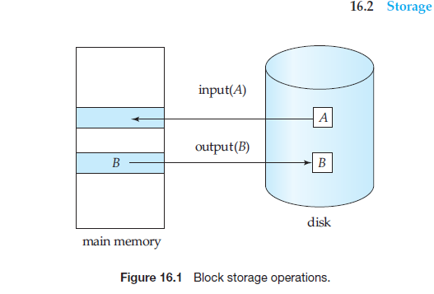

Slide 10
Recovery and Atomicity
To achieve our goal of atomicity, we must first output to stable storage information describing the modifications, without modifying the database itself.
This information can help us ensure that all modifications performed by committed transactions are reflected in the database (perhaps during the course of recovery actions after a crash).
This information can also help us ensure that no modifications made by an aborted transaction persist in the database.

Slide 11
Recovery and Atomicity
Log Records
  The most widely used structure for recording database modifications is the log.
  The log is a sequence of log records, recording all the update activities in the database.
  There are several types of log records. An update log record describes a single database write. It has these fields:
  Transaction identifier, which is the unique identifier of the transaction that
  performed the write operation.
  Data-item identifier, which is the unique identifier of the data item written. Typically, it is the location on disk of the data item, consisting of the block identifier of the block on which the data item resides, and an offset within the block.
  Old value, which is the value of the data item prior to the write.
  New value, which is the value that the data item will have after the write.
Notes:
Shadow copying

Slide 12
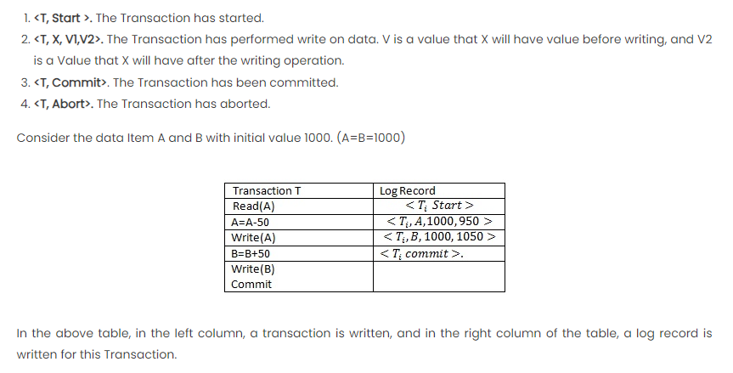

Slide 13
Recovery and Atomicity
Database Modification
  The log records allow the system to undo changes made by a transaction in the event that the transaction must be aborted;
  they allow the system also to redo changes made by a transaction if the transaction has committed but the system crashed before those changes could be stored in the database on disk.
  If a transaction does not modify the database until it has committed (partially committed), it is said to use the deferred-modification technique.
  If database modifications occur while the transaction is still active, the transaction is said to use the immediate-modification technique.
  Undo using a log record sets the data item specified in the log record to the
  old value.
  Redo using a log record sets the data item specified in the log record to the
  new value.

Slide 14
Recovery and Atomicity
Concurrency Control and Recovery
Transaction Commit
Using the Log to Redo and Undo Transactions
Checkpoints

Slide 15
Shadow Paging
Shadow paging is a recovery scheme in which database is considered to be made up of number of fixed size disk pages.
It involves creating a shadow copy or snapshot of the entire database, which serves as a consistent version for transaction execution.
The shadow copy remains unaltered during the transaction, while the original data is modified.
Once the transaction is committed, the shadow copy becomes the new main copy, ensuring consistency.

Slide 16
Key Components of Shadow Paging:
Page Table
  The directory which is in the memory.
Shadow Page
Transaction Log

Slide 17
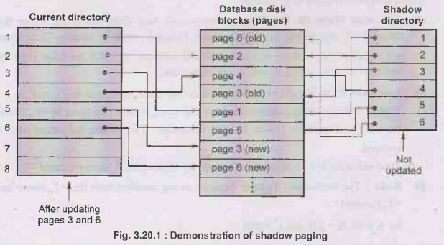

Slide 18
Shadow Paging process/steps
Begin Transaction
Update in Shadow Pages
Transaction Commit
Transaction Abort or Recovery

Slide 19
Recovery Algorithm
we have identified transactions that need to be redone and those that need to be undone, but we have not given a precise algorithm for performing these actions.
We are now ready to present the full recovery algorithm using log records for recovery from transaction failure and a combination of the most recent checkpoint and log records to recover from a system crash.
The recovery algorithm described in this section requires that a data item that has been updated by an uncommitted transaction cannot be modiﬁed by any other transaction, until the ﬁrst transaction has either committed or aborted.

Slide 20
Recovery Algorithm
Transaction Rollback
  The log is scanned backward, and for each log record of Ti of the form <Ti , Xj , V1, V2> that is found:
  a. The value V1 is written to data item Xj, and
  b. Aspecial redo-only log record<Ti , Xj , V1>is written to the log, where V1 is the value being restored to data item Xj during the rollback. These log records are sometimes called compensation log records. Such records do not need undo information, since we never need to undo such an undo operation. We shall explain later how they are used.
  2. Once the log record <Ti start> is found the backward scan is stopped, and a log record <Ti abort> is written to the log.
Notes:
data item
that has been updated by an uncommitted transaction cannot be modified by
any other transaction,

Slide 21
Recovery Algorithm
Recovery After a System Crash
  In the redo phase, the system replays updates of all transactions by scanning the log forward from the last checkpoint.
  The log records that are replayed include log records for transactions that were rolled back before system crash, and those that had not committed when the system crash occurred.
  This phase also determines all transactions that were incomplete at the time of the crash, and must therefore be rolled back.
  In the undo phase, the system rolls back all transactions in the undo-list. It performs rollback by scanning the log backward from the end.
  Whenever it finds a log record belonging to a transaction in the undo list, it performs undo actions just as if the log record had been found during the rollback of a failed transaction.

Slide 22
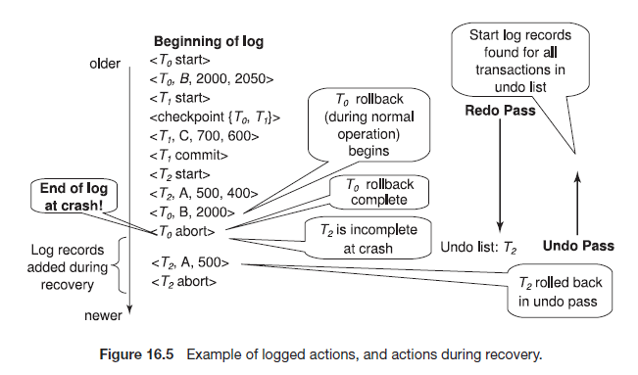

Slide 23
Recovery Algorithm
Optimizing Commit Processing
Commit Processing happens when a transaction is finalized or confirmed

Slide 24
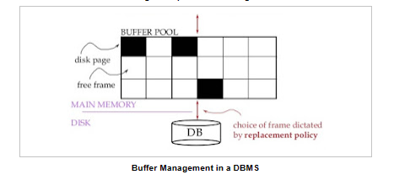
Buffer Management
The buffer manager is the software layer that is responsible for bringing pages from physical disk to main memory as needed.
The buffer manages the available main memory by dividing the main memory into a collection of pages, which we called as buffer pool.
The main memory pages in the buffer pool are called frames.

Slide 25
Buffer Management
Data must be in RAM for DBMS to operate on it!
Buffer manager hides the fact that not all data is in RAM.
log records to a log buffer in main memory, where they stay temporarily until they are output to stable storage.
Database Buffering
Operating System Role in Buffer Management

Slide 26
Failure with Loss of Nonvolatile Storage
One approach to database dumping requires that no transaction may be active during the dump procedure, and uses a procedure similar to checkpointing:
  1. Output all log records currently residing in main memory onto stable storage.
  2. Output all buffer blocks onto the disk.
  3. Copy the contents of the database to stable storage.
  4. Output a log record <dump> onto the stable storage.
Most database systems also support an SQL dump, which writes out SQL DDL statements

Slide 27
Remote backup systems
Several issues must be addressed in designing a remote backup system:
See text books

Slide 28
Early Lock Release and Logical Undo Operations
Logical Undo Log Records
  Logging of information about op-erations is called logical logging.
  In contrast, logging of old-value and new-value infor-mation is called physical logging, and the corresponding log records are called physical log records.
Transaction Rollback With Logical Undo
Logical Operations

Slide 29
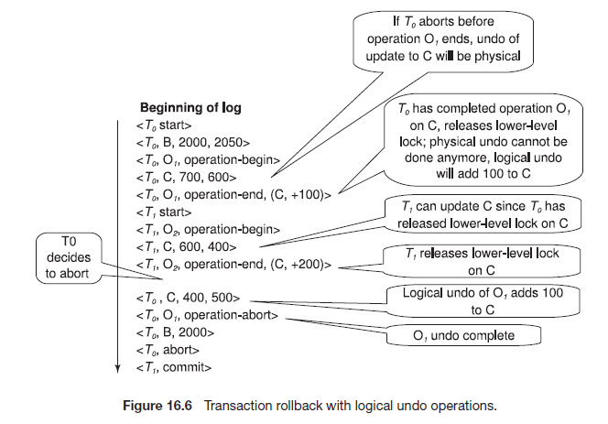

Slide 30
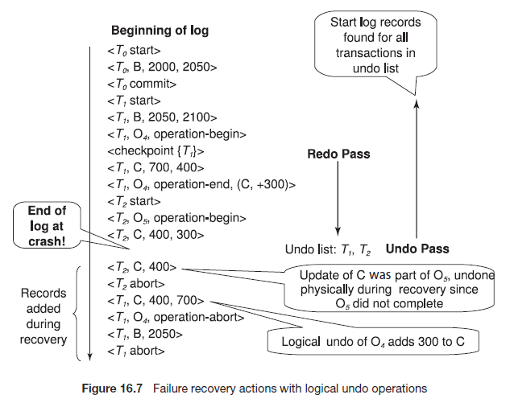

Slide 31
Algorithms for Recovery and Isolation Exploiting Semantics
The state of the art in recovery methods is best illustrated by the ARIES recovery method.
ARIES recovers from a system crash in three passes.
  • Analysis pass: This pass determines which transactions to undo, which pages were dirty at the time of the crash, and the LSN from which the redo pass should start.
  • Redo pass: This pass starts from a position determined during analysis and per-forms a redo, repeating history, to bring the database to a state it was in before the crash.
  • Undo pass: This pass rolls back all transactions that were incomplete at the time of crash.
Notes:
WAL protocol

