Slide 1
PRODUCT CASE STUDY
Bulk User Information
Update
Enabling administrators to modify attributes across dozens to hundreds of employees at once — with validation, approval workflows, scheduling, and downstream propagation.
Working Prototype
20+ Edge Cases
Data Propagation

Slide 2
QUESTION 1 — APPROACH
Three Approaches Evaluated
Option A: Spreadsheet-Only
Option B: Filter + Rules Only
✓ Hybrid: Both Methods
Download CSV → edit offline → re-upload.
Select via filters → apply uniform operations.
User picks the best tool within one flow.
✓ Pros
✓ Pros
✓ Pros
• Handles per-user values
• Fast for uniform changes
• Best of both worlds
• Familiar Excel workflow
• In-app validation
• All use cases covered
✕ Cons
✕ Cons
• Flexible for any size
• Error-prone
• Can't handle per-user values
✕ Cons
• No real-time validation
• Doesn't scale for mixed changes
• More complex to build
• Bad for uniform changes
Why Hybrid: Uniform changes ("give all L3s a 5% raise") → filters. Per-user changes ("each person gets different comp") → CSV. One wizard, two paths.

Slide 3
QUESTION 2 — PRODUCT FLOW
Flow Walkthrough
A guided 4-step wizard: Select Users → Define Changes → Preview & Submit → Status
📋 Edit History
→
👥 Select Users
→
✏️ Define Changes
→
👁️ Preview
→
✅ Status

Slide 4
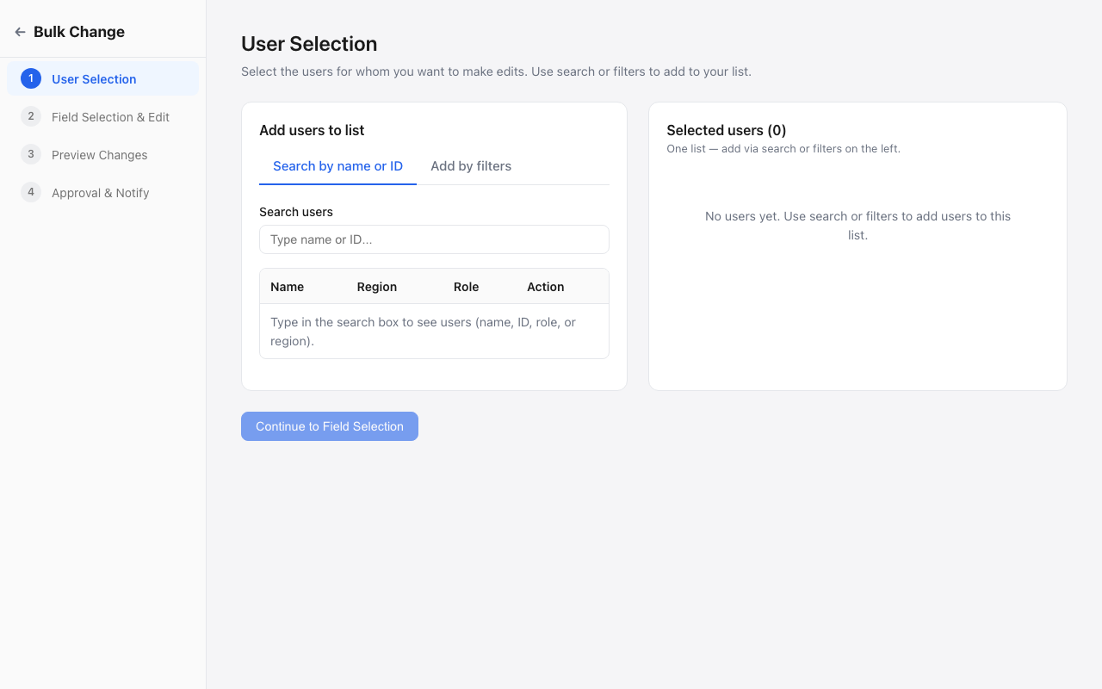
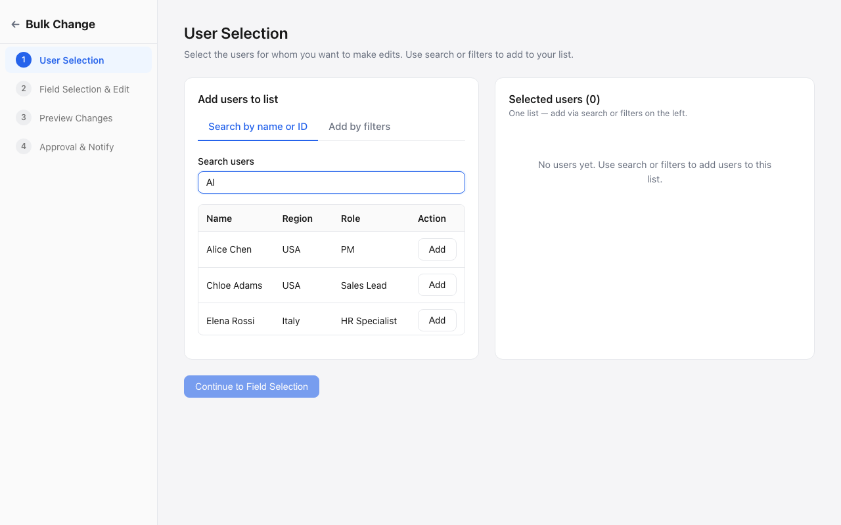
Step 1
Select Users
Two Methods
• Search by name, ID, role, or country
• Filter by Country, Department, Role (with L1/L2/L3 hierarchy)
• Combined AND-logic filters
• Individual add or bulk add from filter results
Edge Cases
! Max 500 users — hard limit with warning
✓ Duplicate prevention — "Already added" inline
✓ Smart CTA — disables when all filtered users already selected
✓ Filters persist after applying — not cleared
✓ Empty states for no search results / no filter matches

Slide 5
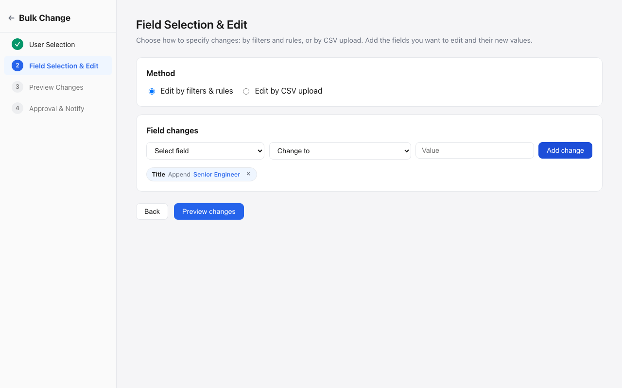
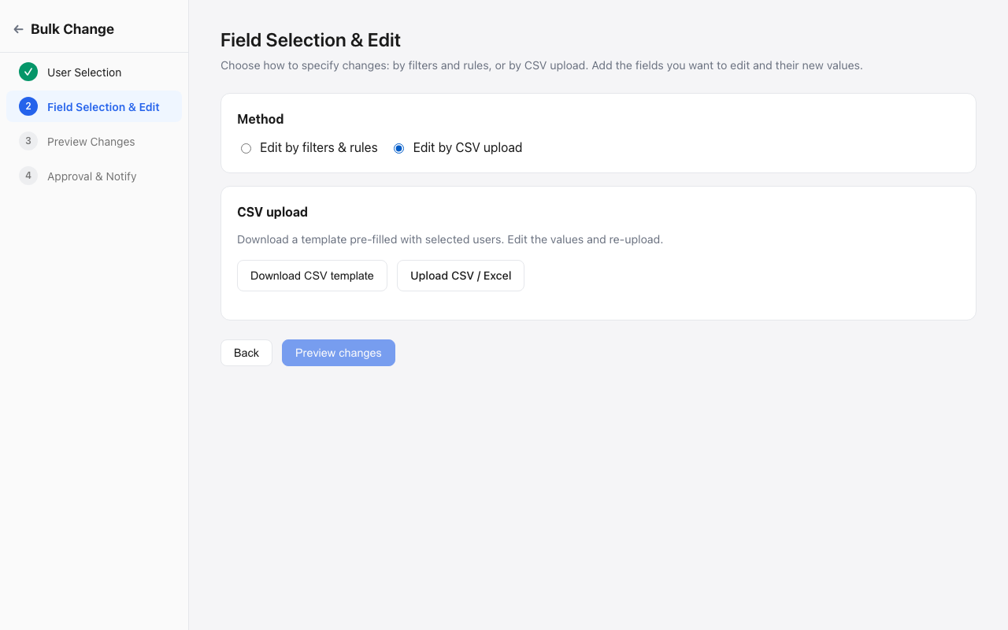
Step 2
Define Changes
Method A: Filter + Rules
Method B: CSV Upload
12 fields · 10 operations · Sensitive fields flagged
Edge Cases
⚠ Currency conflict — blocks absolute ops for mixed currencies
⚠ Duplicate field — warns when same field added again
! File size: 5 MB max · Format: .csv/.xls/.xlsx only
✓ Partial CSV errors — continue with valid rows, exclude bad
✓ Auto-strips "Errors" column on corrected re-upload

Slide 6
CSV WORKFLOW
Template → Upload → Validate → Error Handling
📥 Template Download
Validation Rules
Pre-filled with selected users. Headers: User ID, Name, Compensation, Title, Department, Location.
• Headers must match template exactly
• User ID: non-empty, must exist in selected users
• Compensation: valid positive number
• Required: Name, Title, Department, Location
• Max file size: 5 MB
• Format: .csv, .xls, .xlsx only
❌ Error Sheet
"Errors" column prepended · Red/green color coding · Download as .xls
✅ Final Change Sheet
Only rows with actual changes · Modified cells highlighted yellow · Available from Edit History
Recovery Options
• "Continue with N valid rows" — excludes errors
• "Download error sheet" — for offline correction
• "Re-upload corrected" — auto-strips Errors column

Slide 7
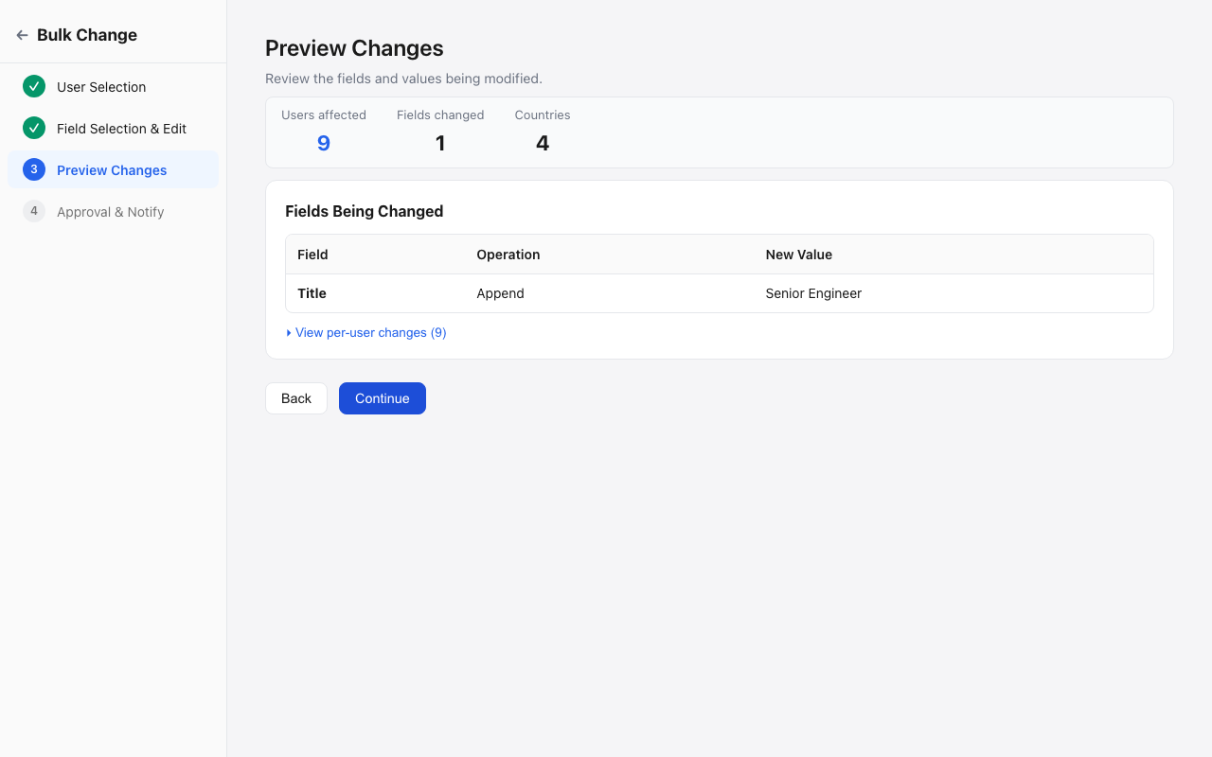
Step 3a
Preview — Review Changes
What's Shown
• Impact stats: users affected, fields changed, countries, excluded
• Fields table: each field, operation, value
• "Sensitive" badge on critical fields
• Expandable per-user change preview (old → new)
Edge Cases
! Zero edits in filter mode → redirects to Step 2
! Zero users after exclusions → submit disabled
! CSV with no changes → "No field changes detected"

Slide 8
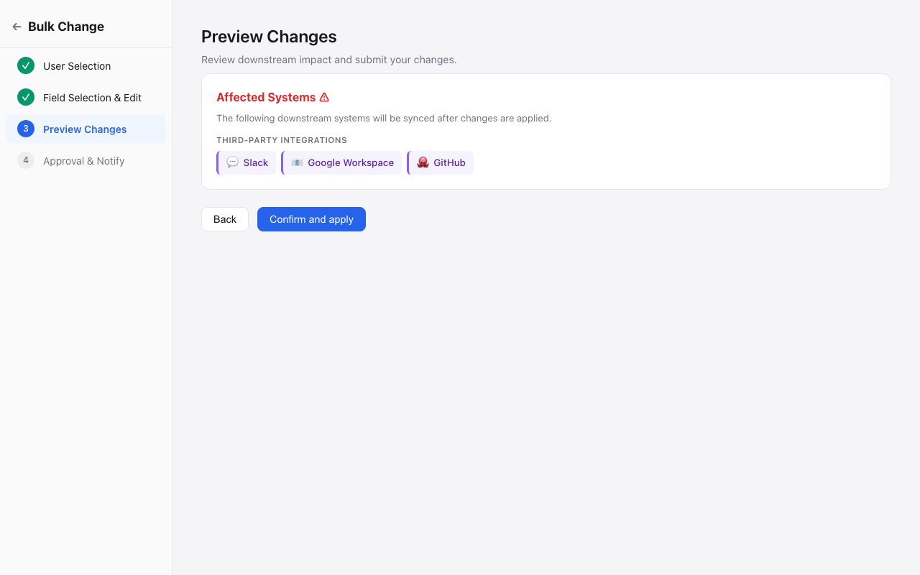
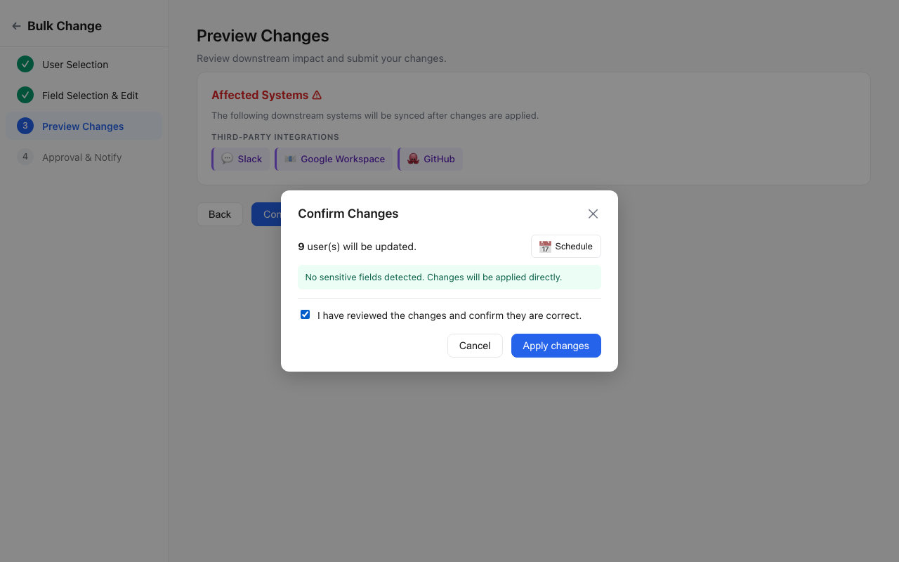
Step 3b
Impact & Submit
Affected Systems ⚠
Field → system mapping shows exactly which downstream systems will sync after changes.
💰 Payroll
🏥 Benefits
💻 Devices
💬 Slack
📧 Google
🐙 GitHub
Confirmation Modal
• User count + sensitive field warning
• 📅 Schedule button — pick future date
• Checkbox confirmation required
• CTA: "Submit for approval" / "Apply" / "Schedule"
Scheduling never bypasses approval.
Sensitive fields → approval required regardless.

Slide 9
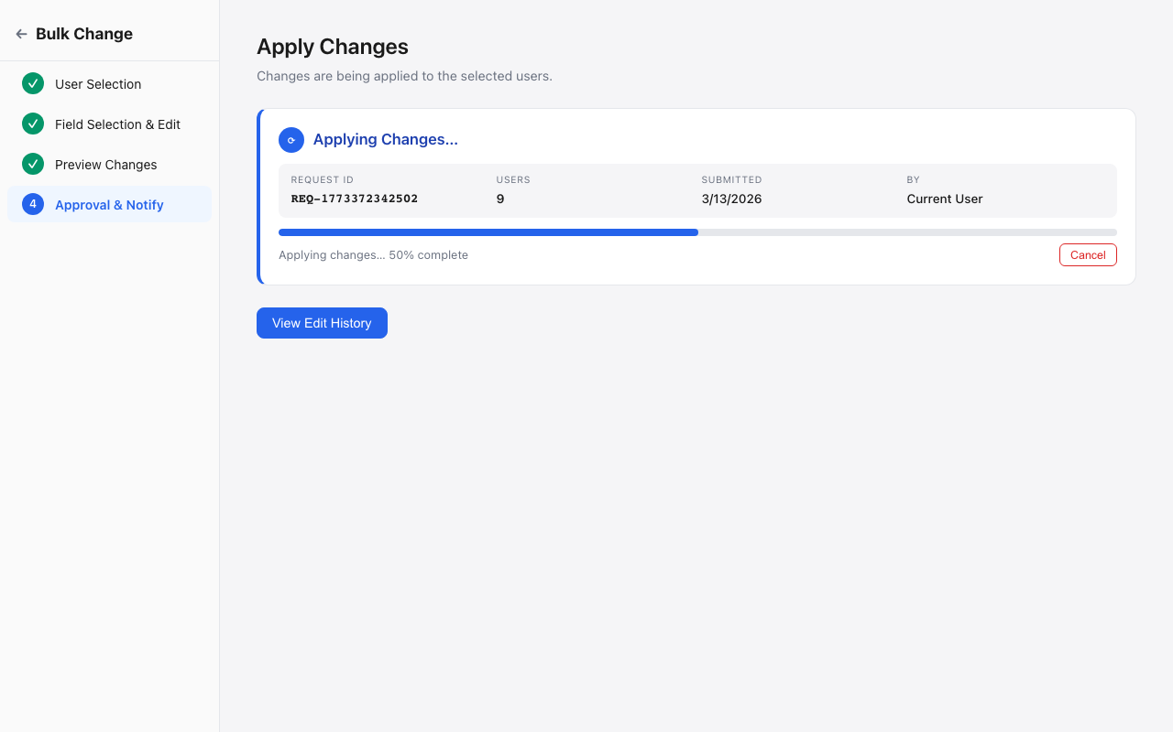
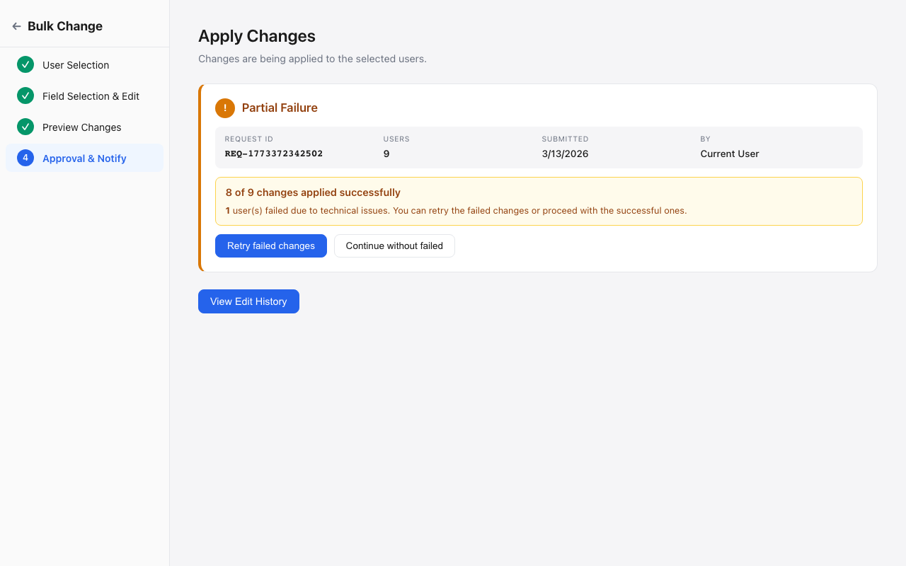
Step 4
Approval & Application
Decision Matrix
Sensitive? | Scheduled? | Result
No | No | Apply immediately
No | Yes | Scheduled
Yes | No | Pending approval
Yes | Yes | Sched + Pending
Edge Cases
⚠ Partial failure — ~15% fail. Retry or continue without.
✓ Cancel mid-processing — stops, no changes applied
✓ Failed count resets on retry
! Reversal blocked for sensitive fields (comp, currency, status)

Slide 10
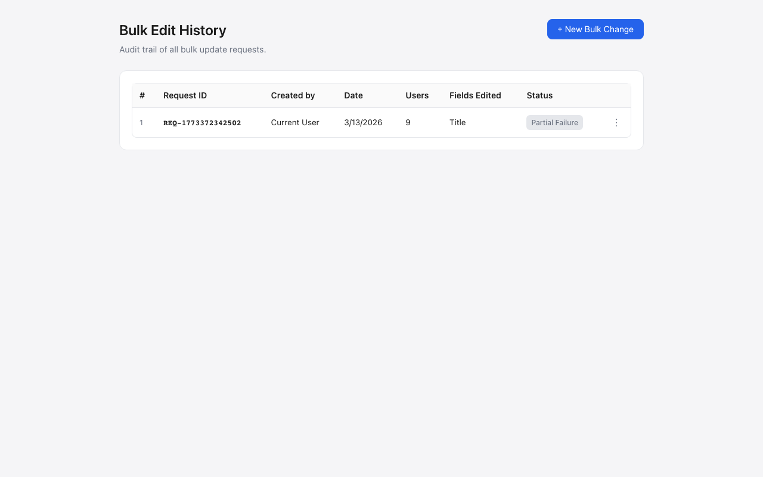
Home
Edit History — Audit Trail
Features
• Full table: Request ID, Created By, Date, Users, Fields, Status
• 📥 Download change sheet — styled .xls, changed cells highlighted
• ↩️ Reverse changes — blocked for sensitive fields
• + New Bulk Change — resets, starts fresh
Status Badges
Applied
Partial
Pending
Scheduled
Rejected
Cancelled

Slide 11
QUESTION 3
Data Propagation Challenges & Solutions
Challenges
Solutions
1. Atomicity
🔄 Async Job Queue + Retry
Comp change must hit Payroll AND Benefits. Partial sync = compliance risk.
Each sync = independent job. Exponential backoff. Decouples core from propagation.
2. Rate Limiting
🔀 Dependency Graph (DAG)
500 users × 3 integrations = 1,500+ API calls. Limits cause delays.
Process in topological order. Parent fails → child syncs held.
3. Ordering
🛡️ Idempotent Operations
Status: Payroll before Devices. Bulk amplifies dependency complexity.
Every sync safe to retry. Change-request-ID for deduplication.
4. API Outages
📅 Scheduling as Buffer
GitHub down shouldn't block everything. Partial propagation = inconsistency.
Batch during off-peak. Reduces rate-limit pressure. Lands before payroll cut-offs.

Slide 12
QUESTION 3 — CONTINUED
Field → System Impact Matrix
This mapping drives the "Affected Systems" preview shown to admins before submit.
Field | First-Party Systems | Third-Party | Risk
Compensation | Payroll, Benefits | — | High
Status | Payroll, Benefits, Devices | Slack, Google, GitHub | High
Title | — | Slack, Google, GitHub | Low
Department | Cost Center | Slack, Google | Medium
Location | Payroll, Benefits, Devices | — | Medium
Manager / Team | — | Slack, Google | Low
Work Mode | Devices | — | Low
Why this matters: Admins see exactly which systems are affected before submitting. They can schedule for off-hours if many critical systems are involved.

Slide 13
SUMMARY
Key Takeaways
🔀
Hybrid Approach
🛡️
Smart Approval
Filter + Rules & CSV. One flow, two paths.
Only sensitive fields need approval. Scheduling never bypasses it.
⚠️
20+ Edge Cases
🔗
Propagation Aware
Currency conflicts, partial failures, file validation, cancellation.
Field → system mapping. Async queues, retry, dependency ordering.
📅
Scheduling
📋
Full Audit Trail
Future dates. Off-peak processing. Approval + schedule independent.
Every request tracked. Change sheets. Reversals with guardrails.
Working prototype available for live demo →

