Slide 1
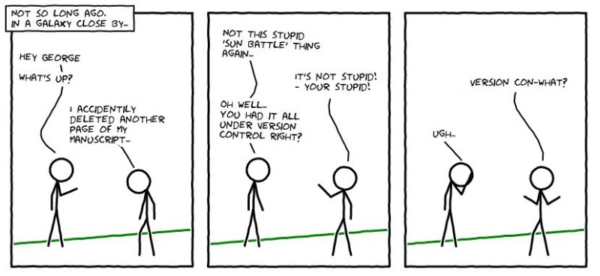

Slide 2



Git & GitHub Session by GitHub/PrajjwalDatir
Through ASCI COEP

Slide 3
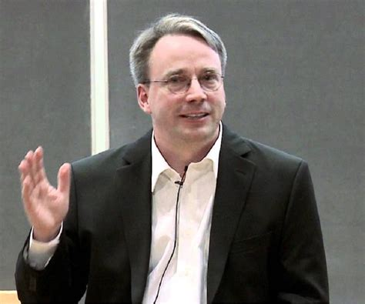
Git vs GitHub
Git
  version control system
  By Linus Torvalds
GitHub
  repository site to host Git Repositories
  Now Owned by Microsoft

Slide 4

How to Install?
Did it really get installed?
-> git --version
Let’s define ourselves first…
-> git config --global user.email "you@example.com"
  -> git config --global user.name "Your Name"

Slide 5
Let’s Make a Local Repository
first let’s make a git folder.
-> git init
Create a file
  -> touch asci.txt
add a file to the folder
  -> git add asci.txt
  -> git commit -m “new file added”
  Misc : git commit, git commit asci.txt, git commit –am “file added”

Slide 6
Ignore Unnecessary Stuff?
Create a file called .gitignore
  Write the file names that should be ignored by git
  Commit the file

Slide 7
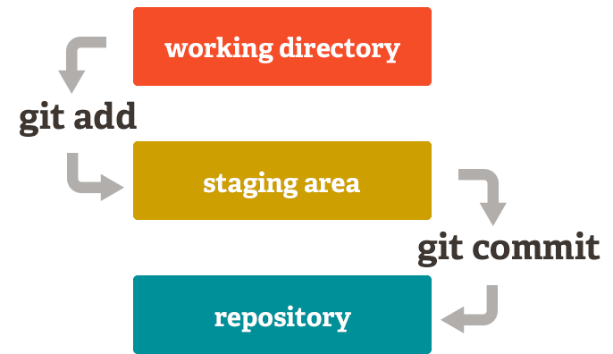
Flow…

Slide 8
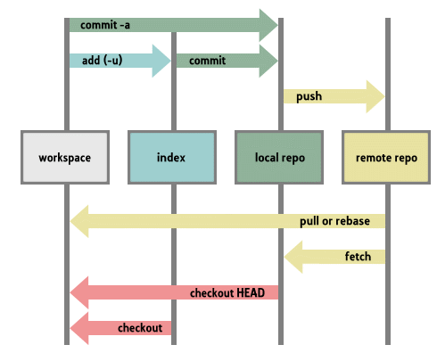

Slide 10
Pulling a repository/editing
lets pull a repository from github
  git pull https://github.com/PrajjwalDatir/Git-by-ASCI
  git remote add origin https://github.com/PrajjwalDatir/Git-by-ASCI
Edit the file asci.txt
git commit –am ‘something changed’
git push origin

Slide 11

Remove a file
git rm asci.txt
git commit –m ‘removed’
git push origin

Slide 12

Go back to
Git log
  Show logs git ☺
See the commit id
  git reset --hard c1ac571d9af5fe1126ecdf64c57d6ef4a5990a60 && git clean –f
  (try on your own later)
Destroys the local Repo.

Slide 13
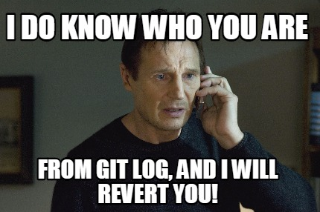

One step back!
An easy way to revert last commit (1)
  git revert HEAD~1..HEAD
  git push origin

Slide 14
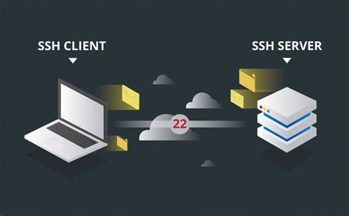
Don’t want to enter username?
One Way
http://stackoverflow.com/questions/11403407/git-asks-for-username-everytime-i-push (not so safe)
Better Way : SSH Keys
https://www.freecodecamp.org/news/git-ssh-how-to/

Slide 15
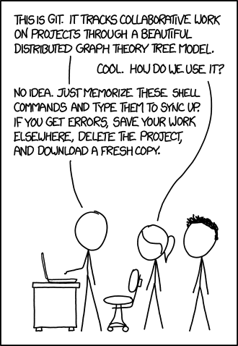
Ready To Go 🚀

Slide 16

Fork?

Slide 17
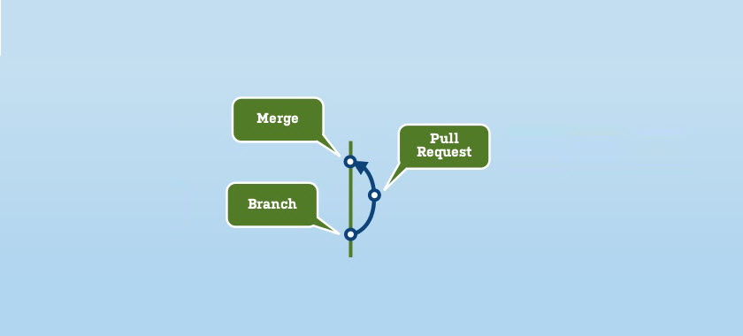
Pull Request & Merge?

Slide 18


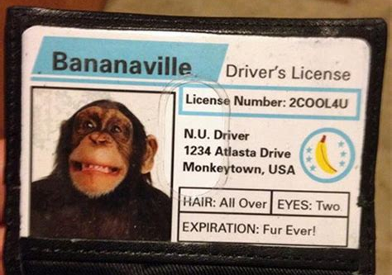
Misc : Bug tracking, Issues, License

Slide 19

Open Source Contribution:
WHAT?
WHY?
HOW?

