Slide 1

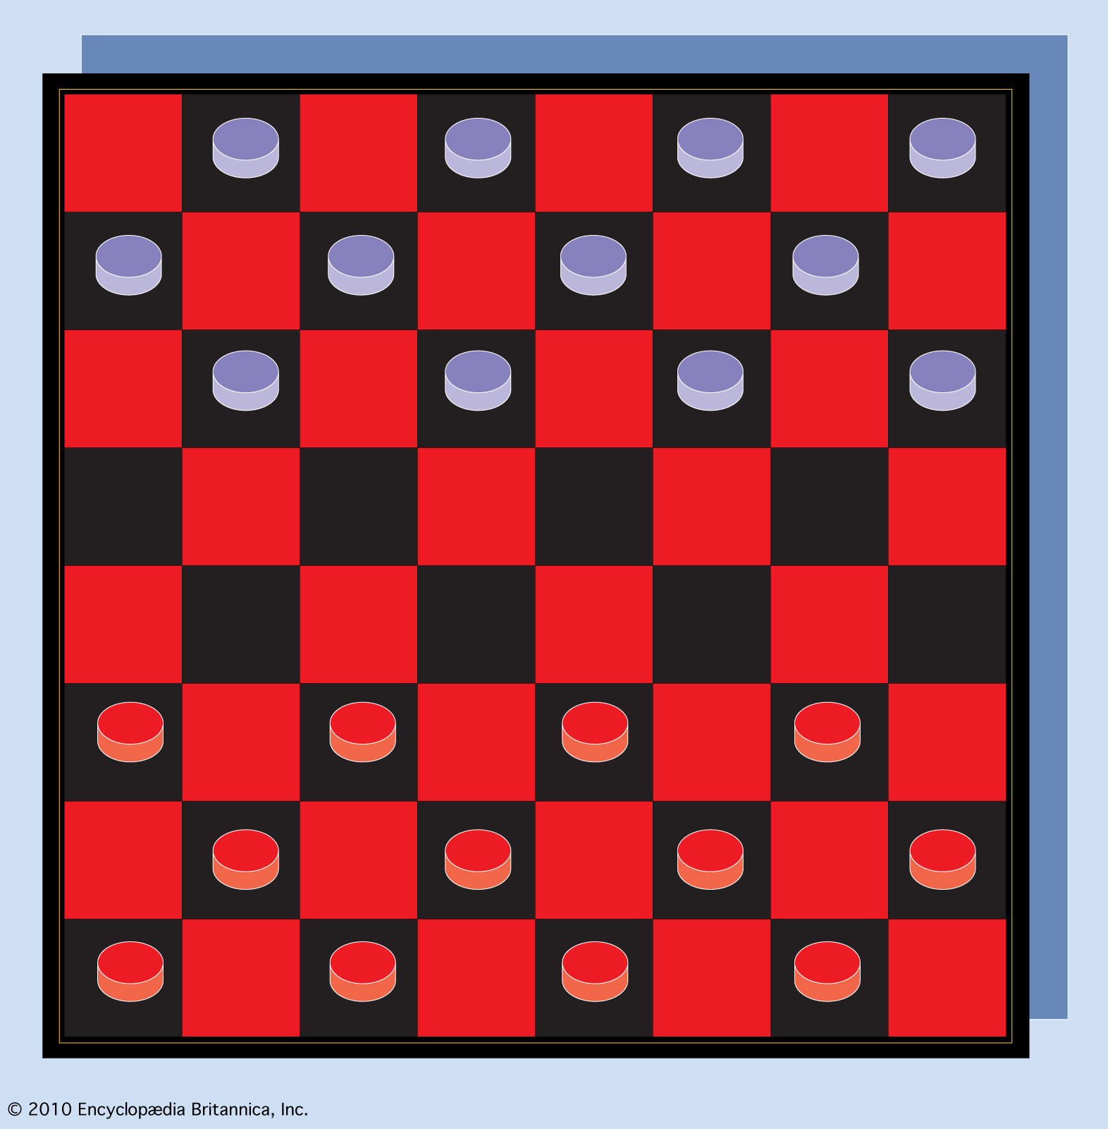
AI Mini Project
Viren Rajesh Patil
MIS: 111803155
TIC TAC TOE & CHECKERS USING MINIMAX ALGORITHM

Slide 2
Minimax Algorithm
Why Minimax ?
Minimax is a kind of backtracking algorithm that is used in decision making and game theory to find the optimal move for a player, assuming that your opponent also plays optimally. It is widely used in two player turn-based games such as Tic-Tac-Toe, Checkers, Chess etc.
In Minimax the two players are called maximizer and minimizer. The maximizer tries to get the highest score possible while the minimizer tries to do the opposite and get the lowest score possible.
Every board state has a value associated with it. In a given state if the maximizer has upper hand then, the score of the board will tend to be some positive value. If the minimizer has the upper hand in that board state then it will tend to be some negative value. The values of the board are calculated by some heuristics which are unique for every type of game.

Slide 3
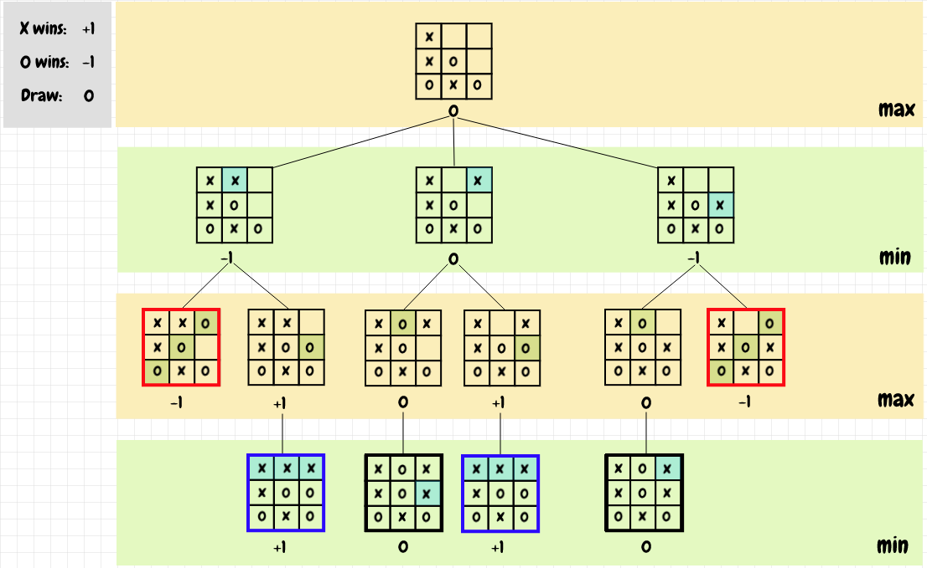
Minimax Algorithm(Tic Tac Toe)

Slide 4
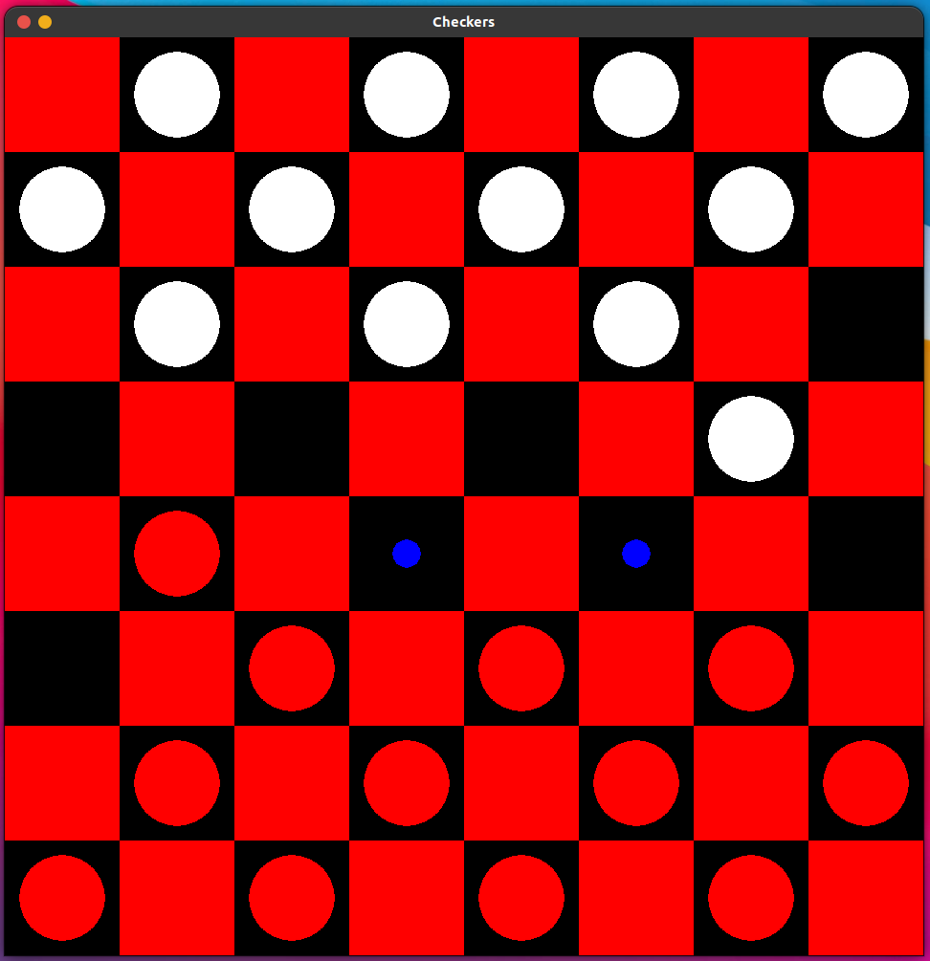
Minimax Alogirthm(Checkers)
In the Checkers Game, one player(human player) is the max player and the opponent is the min player(the AI agent).
The human player plays optimally and tries to play a move which maximizes his/her utility, whereas the AI i.e. the min player tries to do the opposite i.e. it tries to minimize the utility by playing a move which reduces the score of the opponent.
In simple terms a min player tries to play every move with a intention of not letting the max player win in any situation.
The image on the left shows a still from the game that I have made
The White Player is the AI and the Red Player is the Human Player.
The blue dots shown are the possible moves that human can play if he selects this piece.

Slide 5
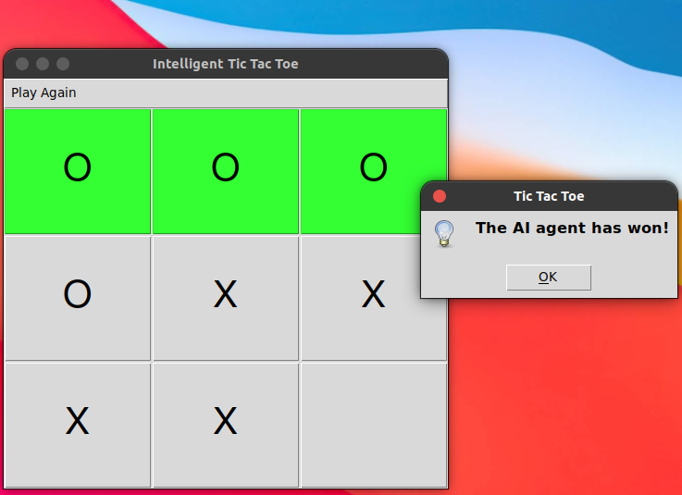
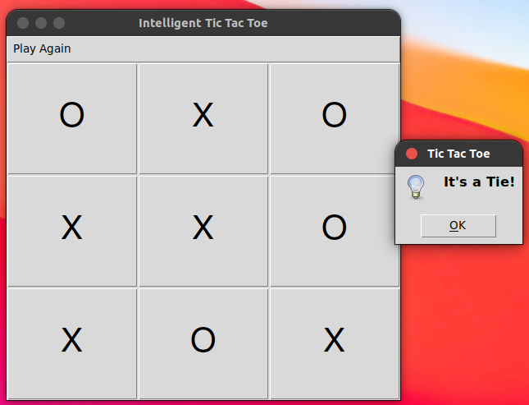
Tic Tac Toe
A still from the the game that I made.
The O player is AI agent.
The X player is the human player.
The image shows the scenario when the AI wins.
This image shows a scenario whent no one wins and it’s a tie situation.

Slide 6
Conclusion
I learnt how to implement the Minimax algorithm on games which are turn based and decision based.
I would like to make further improvements to the Checkers game by using Minimax Algorithm with alpha-beta pruning to make it more efficient and make it perform well.
THANK YOU SIR!

