Slide 1
Credit Card Default Prediction

Slide 2
Objective:
Development of a predictive model for monitoring whether the customer is credible or not. The model will determine whether a customer is going to make any default in their payment or customer will pay their bill on time.
Benefits:
Detection of upcoming defaults.
Gives better insight of customers base.
Helps in easy flow for managing resources.
Manual inspection if default is identified .

Slide 3
Data Sharing Agreement :
Sample file name (ex CreditCard_20062021_101010)
Length of date stamp(8 digits)
Length of time stamp(6 digits)
Number of Columns
Column names
Column data type

Slide 4
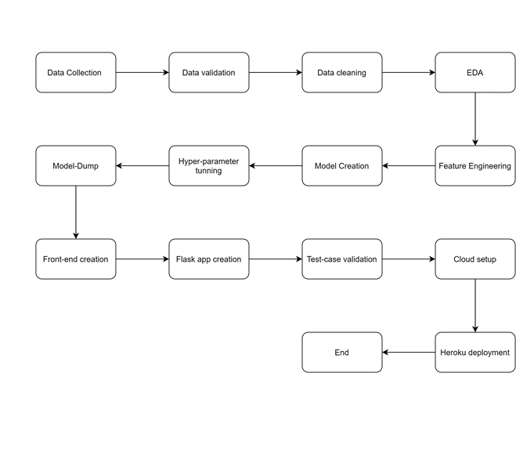
Architecture
Streamlit App

Slide 5
Data Validation and Data Transformation :
Name Validation - Validation of files name as per the DSA. We have created a regex pattern for validation. After it checks for date format and time format if these requirements are satisfied, we move such files to "Good_Data_Folder" else "Bad_Data_Folder.“
Number of Columns – Validation of number of columns present in the files, and if it doesn't match then the file is moved to "Bad_Data_Folder.“
Name of Columns - The name of the columns is validated and should be the same as given in the schema file. If not, then the file is moved to "Bad_Data_Folder".
Data type of columns - The data type of columns is given in the schema file. It is validated when we insert the files into Database. If the datatype is wrong, then the file is moved to "Bad_Data_Folder".
Null values in columns - If any of the columns in a file have all the values as NULL or missing, we discard such a file and move it to "Bad_Data_Folder".

Slide 6
Data Insertion in Database:
Table creation :- Table name “CreditCard_Training" is created in the database for inserting the files. If the table is already present then new files are inserted in the same table.
Insertion of files in the table - All the files in the "Good_Data_Folder" are inserted in the above-created table. If any file has invalid data type in any of the columns, the file is not loaded in the table

Slide 7
Model Training:
Data Export from Db :
The accumulated data from db is exported in csv format for model training
Data Preprocessing
Performing EDA to get insight of data like identifying distribution , outliers ,trend
among data etc.
Check for null values in the columns. If present impute the null values.
Encode the categorical values with numeric values.
Perform Standard Scalar to scale down the values.

Slide 8
Model Selection –
After the clusters are created, we find the best model for each cluster. By using 2 algorithms “Random Forest Classifier” and "XGBoost Classifier". For each cluster both the hyper tunned algorithms are used. We calculate the AUC scores for both models and select the model with the best score. Similarly, the model is selected for each cluster. All the models for every cluster are saved for use in prediction.

Slide 9
Prediction:
The testing files are shared in the batches and we perform the same Validation operations ,data transformation and data insertion on them.
The accumulated data from db is exported in csv format for prediction
We perform data pre-processing techniques on it.

