Slide 1
Hospital Patient Admission Trends
Medical Science | AI/ML Project

Slide 2

Project Overview
Analyze hospital patient admissions by month, department, age group, and diagnosis to identify trends and patterns.

Slide 3
Goal
1.When the highest number of patients are admitted.
2.Which hospital department receives the most patients.
3.Which age group has the highest admission rate.
4.Which diseases are more common during specific seasons or months.
5.How patient admissions may change in the future.

Slide 4
Objectives
• Monthly admission trends
• Department-wise analysis
• Age group distribution
• Seasonal illness patterns
• Future admission prediction

Slide 5
Dataset Description
Hospital admission records containing Admission Date, Department, Age, Diagnosis, Gender, and related attributes.
There are 10,000 rows
And 20 columns

Slide 6
Data Preprocessing
• Handle missing values
• Remove duplicates
• Create Month column
• Create Age_Group column

Slide 7
Exploratory Data Analysis
• Monthly admissions
• Department-wise admissions
• Age-group distribution
• Diagnosis trends

Slide 8
Visualizations
• Bar Charts
• Pie Charts
• Crosstab Analysis for seasonal diseases

Slide 9
Machine Learning
Linear Regression model used to predict future patient admissions based on historical trends.

Slide 10
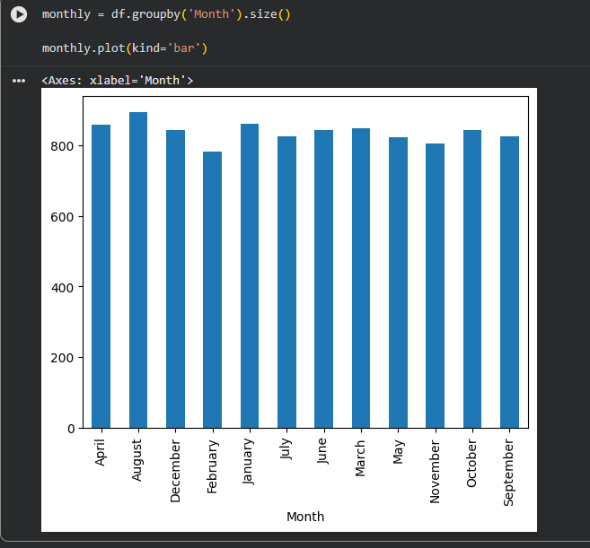
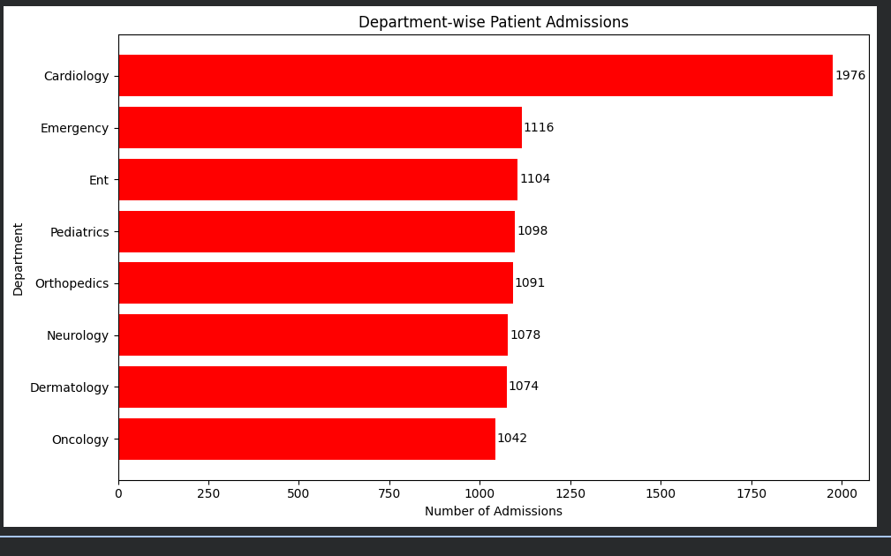
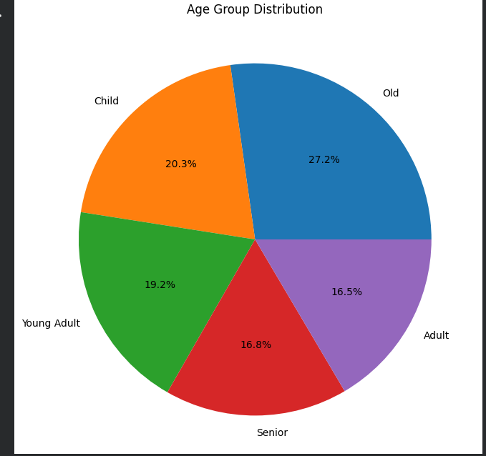
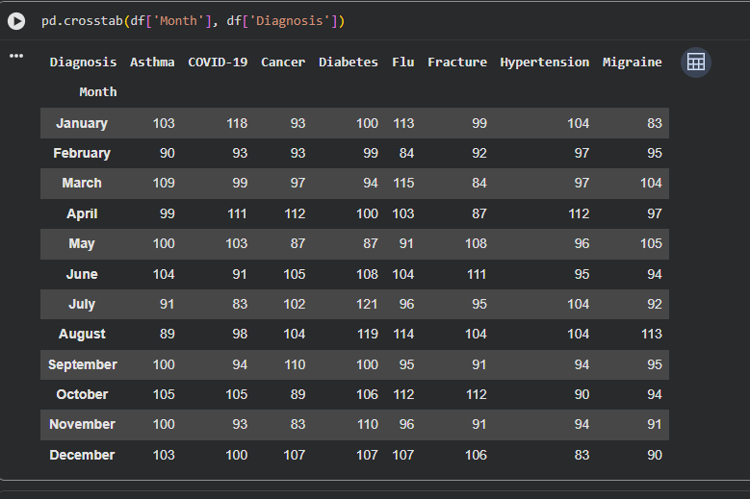
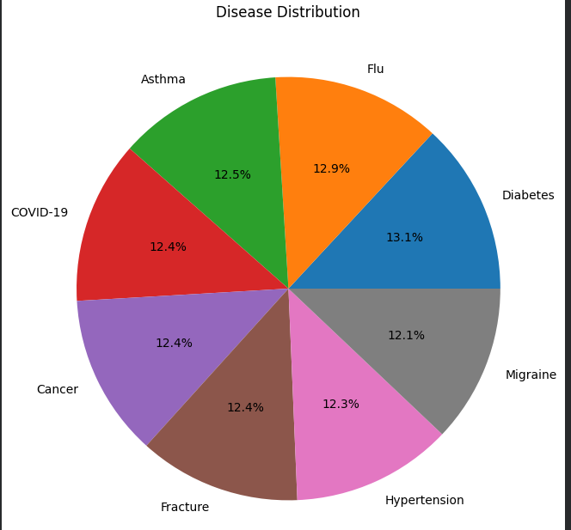
Outputs

Slide 11
Conclusion
The project provides data-driven insights to support hospital resource planning, staffing, and healthcare decision-making.

