Slide 1

DATA ANALYST INTERNSHIP
By,
Prajna I G Bhat

Slide 2
INTRODUCTION
Diabetes, a chronic condition characterized by elevated blood sugar levels, is becoming an increasingly serious global health concern due to its growing prevalence. This condition impacts not only individual well-being but also places considerable strain on healthcare systems, economies, and societies at large. Early detection and timely intervention are essential for managing diabetes and reducing its impact. By identifying individuals at risk before symptoms develop, healthcare providers can take preventive actions, recommend lifestyle changes, and administer treatments to delay or even prevent the onset of the disease.
The objective is to address data-related questions by writing SQL queries to extract and retrieve the required information. The software being utilized is MySQL version 8.0.

Slide 3
OVERVIEW
In this project, we will apply SQL querying and data analysis techniques to explore a comprehensive dataset that includes demographic, clinical, and lifestyle information. The dataset comprises 100,000 records and 11 attributes, including details such as Date of Birth, gender, body mass index (BMI), blood glucose levels, hypertension (blood pressure), smoking history, and more.
In the following section, we will present questions and corresponding solutions for the assessment.

Slide 4
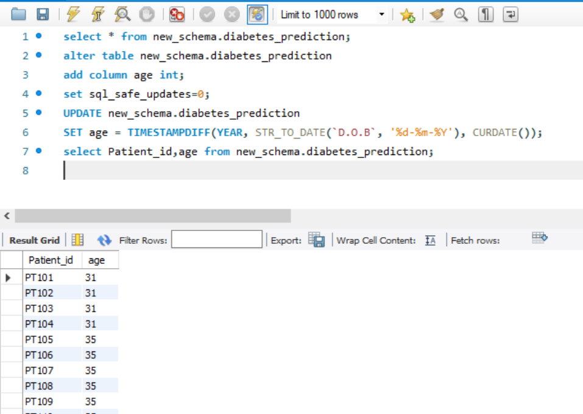
1.Retrieve the Patient_id and ages of all patients.

Slide 5
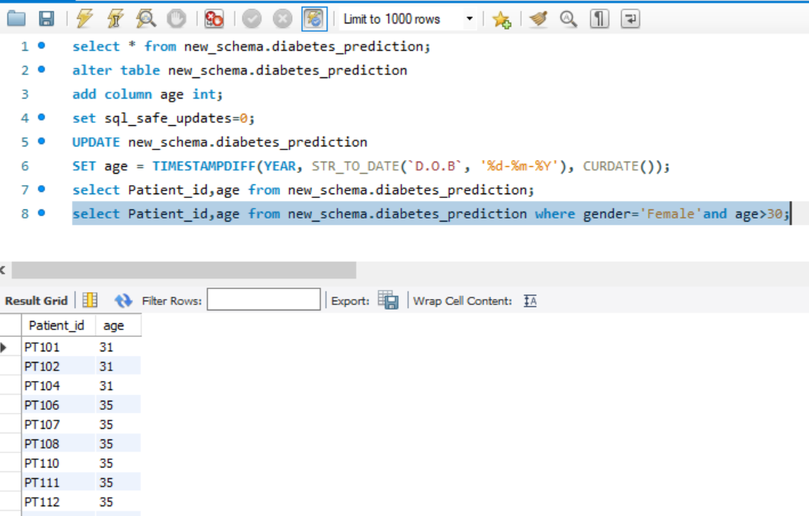
2.Select all female patients who are older than 30.

Slide 6
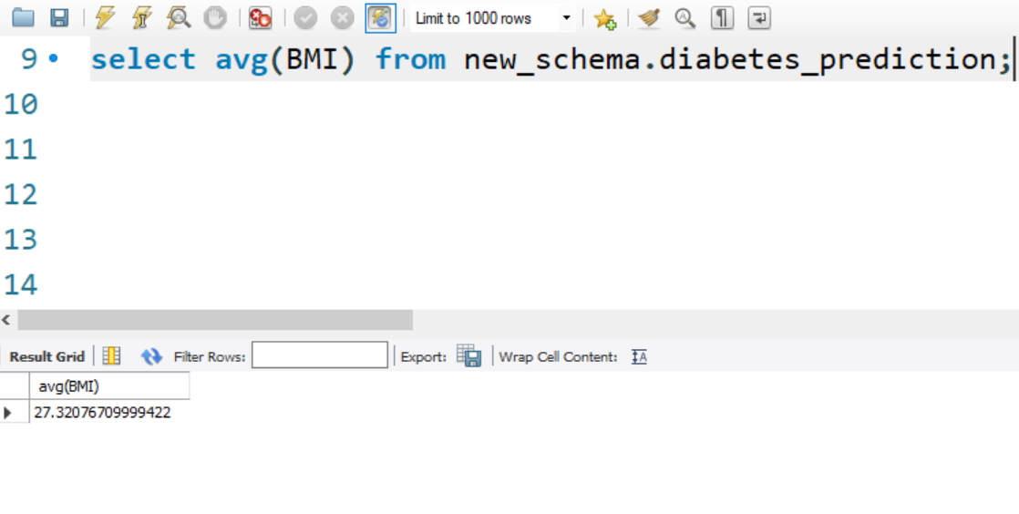
3. Calculate the average BMI of patients.

Slide 7
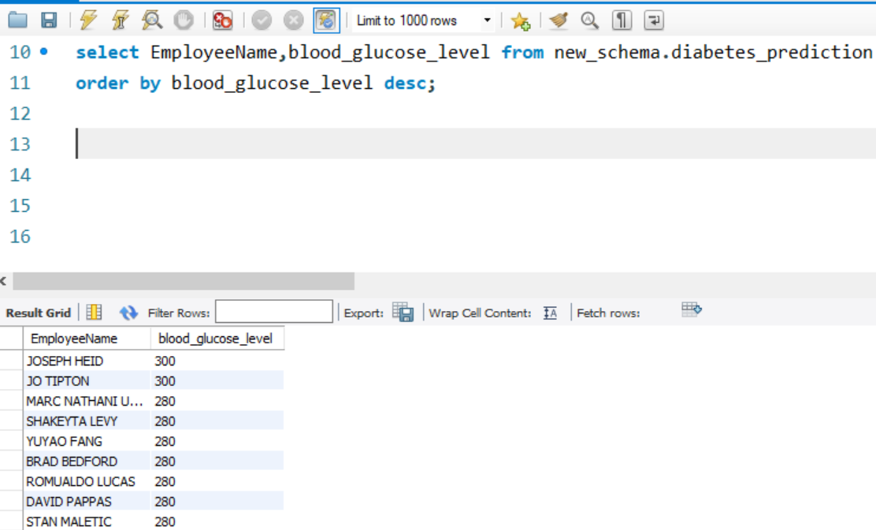
4. List patients in descending order of blood glucose levels.

Slide 8
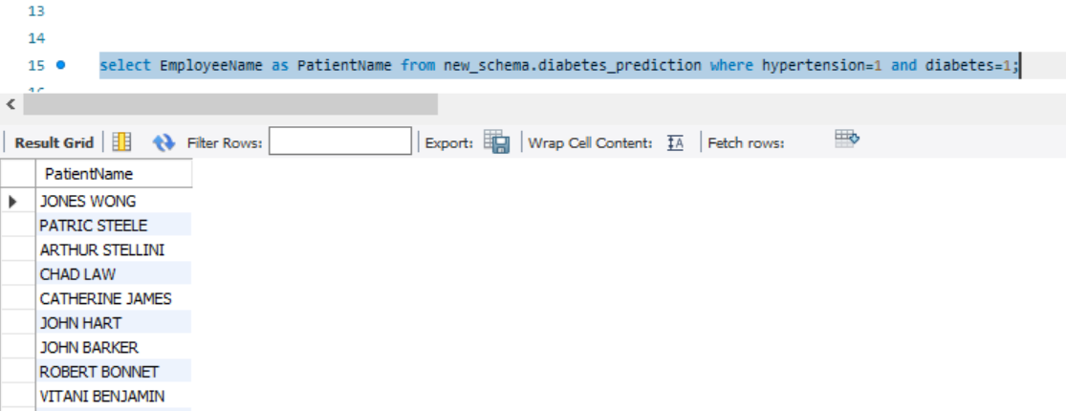
5. Find patients who have hypertension and diabetes.

Slide 9
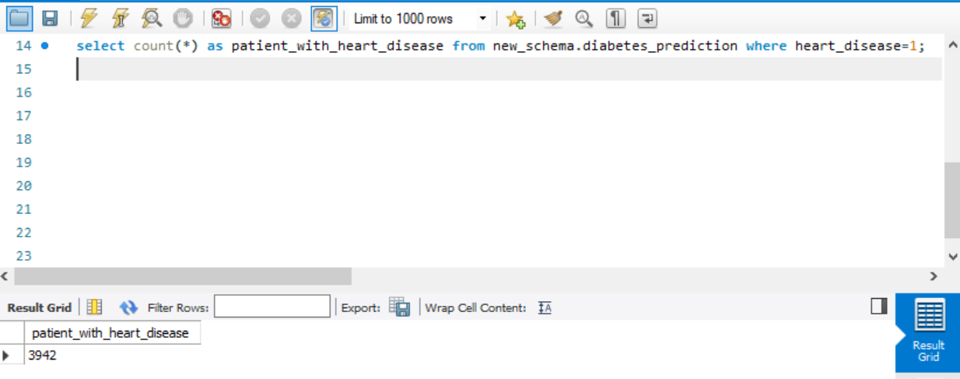
6. Determine the number of patients with heart disease.

Slide 10
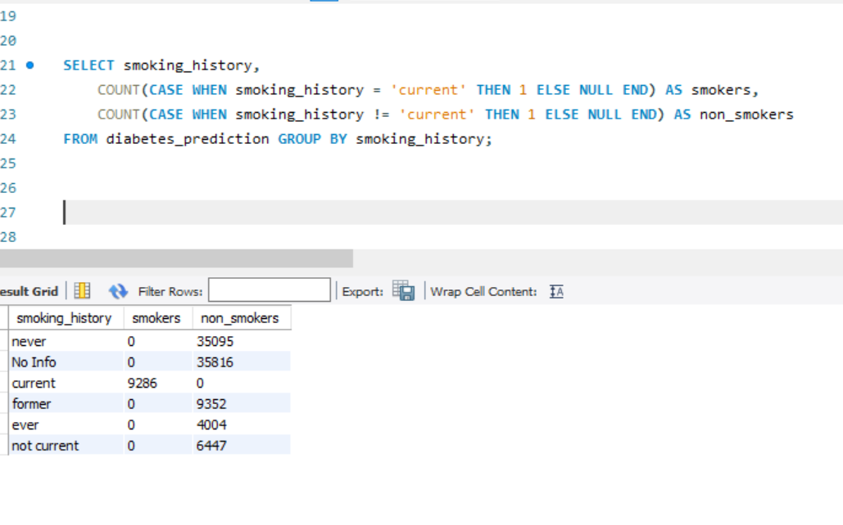
7. Group patients by smoking history and count how many smokers and nonsmokers there are.

Slide 11
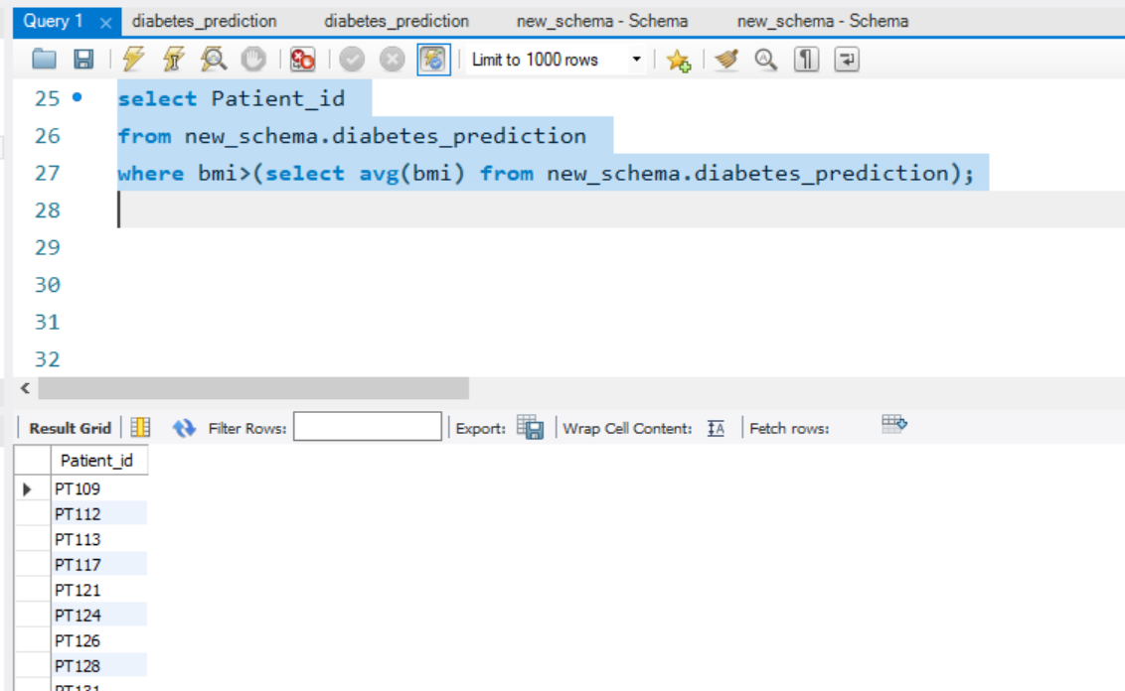
8. Retrieve the Patient_id of patients who have a BMI greater than the average BMI.

Slide 12
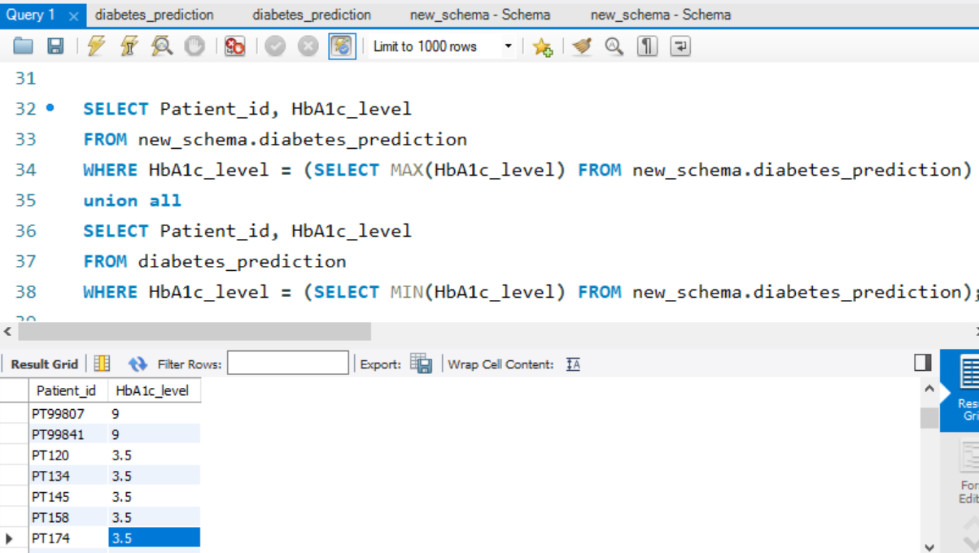
9. Find the patient with the highest HbA1c level and the patient with the lowest HbA1clevel.

Slide 13
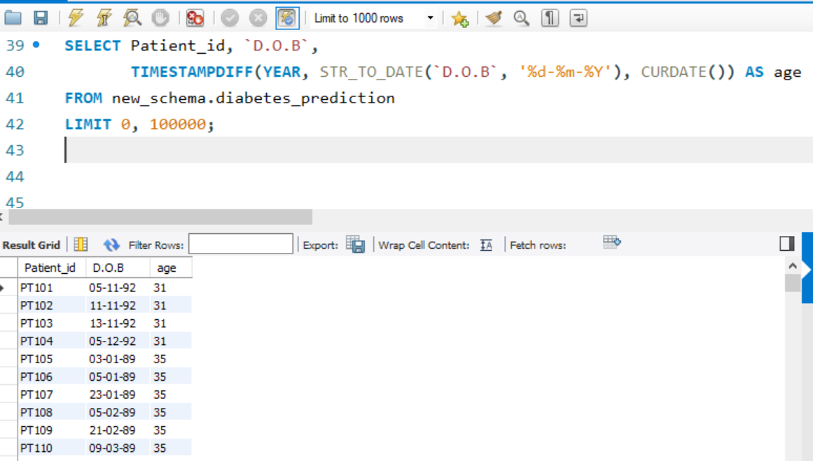
10. Calculate the age of patients in years (assuming the current date as of now).

Slide 14
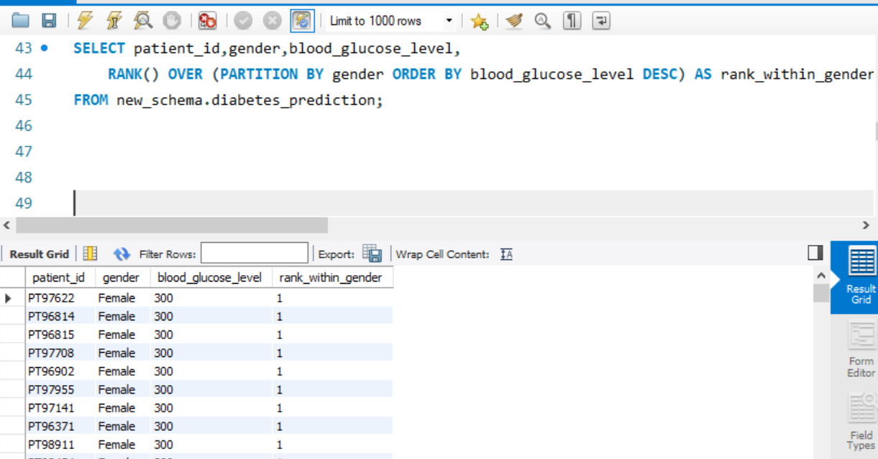
11. Rank patients by blood glucose level within each gender group.

Slide 15
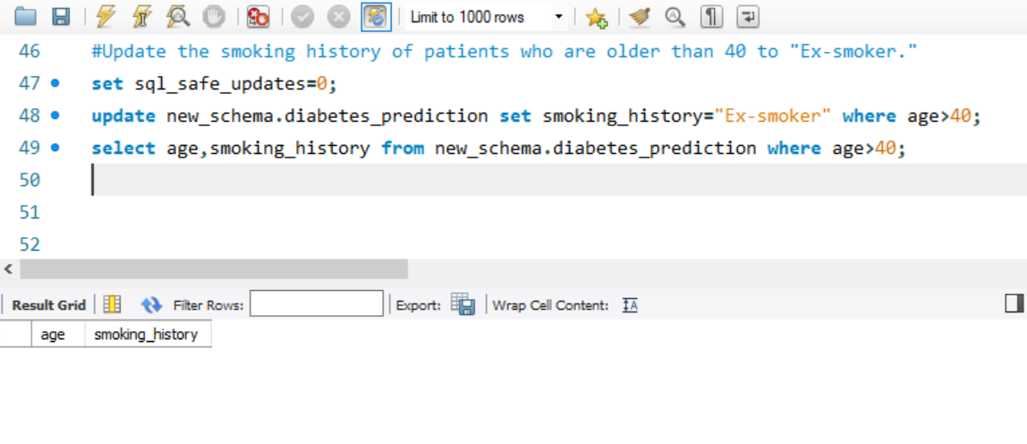
12. Update the smoking history of patients who are older than 40 to "Ex-smoker."

Slide 16
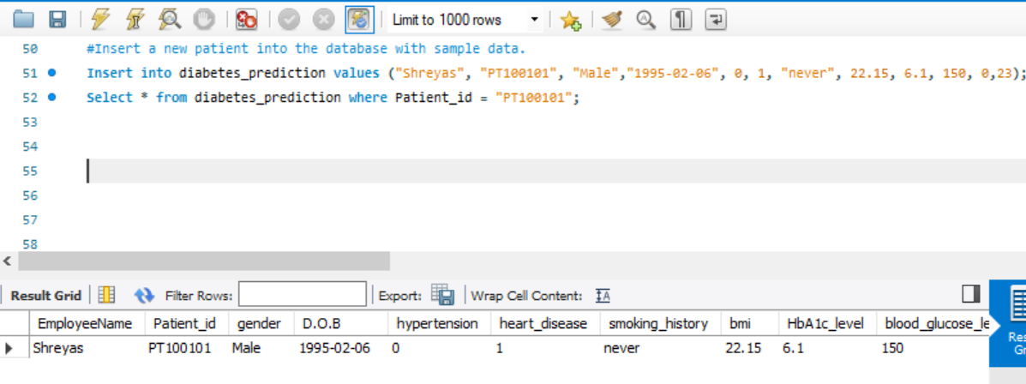
13. Insert a new patient into the database with sample data.

Slide 17
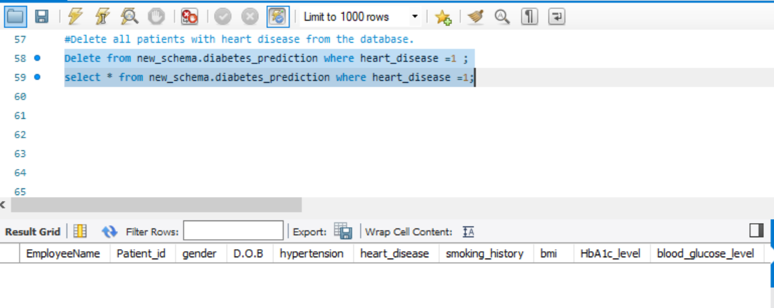
14. Delete all patients with heart disease from the database.

Slide 18
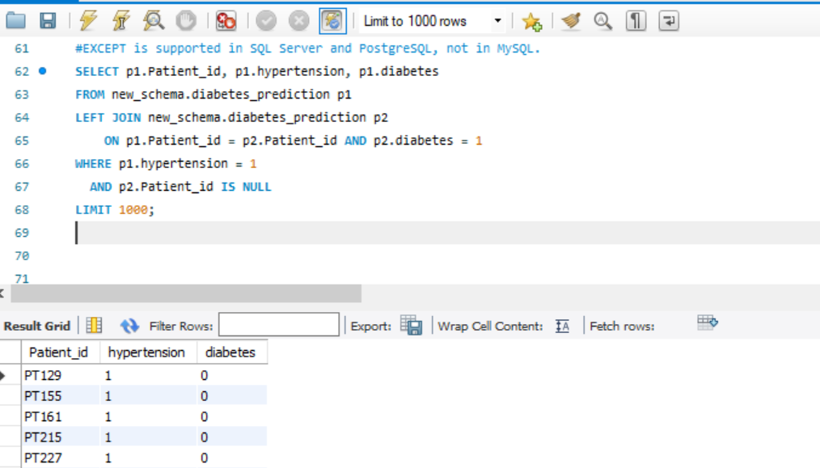
15. Find patients who have hypertension but not diabetes using the EXCEPT operator.

Slide 19
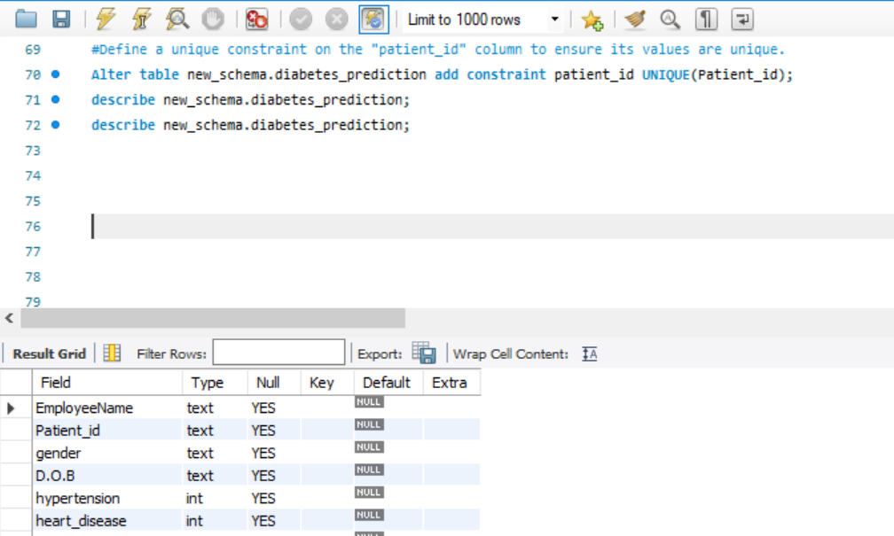
16. Define a unique constraint on the "patient_id" column to ensure its values are unique

Slide 20
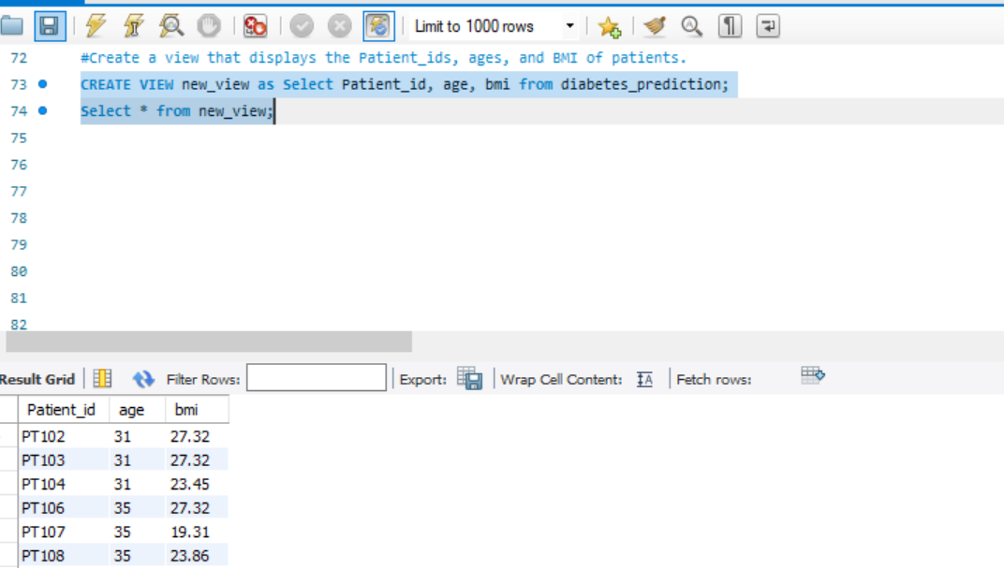
17. Create a view that displays the Patient_ids, ages, and BMI of patients.

Slide 21
18. Suggest improvements in the database schema to reduce data redundancy and improve data integrity.
To optimize your database schema, consider the following improvements:
1. Normalization: Ensure your database is normalized to at least the Third Normal Form (3NF). This process involves organizing data into logical groupings to minimize redundancy and reduce data duplication.
2. Foreign Key Usage: Implement foreign keys to maintain referential integrity between related tables. This ensures that the relationships between data are consistent and valid.
3. Elimination of Repeating Groups: Avoid storing multiple values in a single field. Instead, create separate tables for related data. This approach improves flexibility and reduces redundancy.
4. Consistent Naming Conventions: Apply consistent and descriptive naming conventions for tables, columns, and relationships. This practice enhances the clarity and maintainability of your schema.
By adopting these strategies, you can achieve a more efficient, redundant-free, and well-organized database schema that maintains data integrity.

Slide 22
19. Explain how you can optimize the performance of SQL queries on this dataset.
1. Craft Efficient Queries:
- Avoid using `SELECT ` and instead specify only the columns you need to reduce data retrieval overhead.
- Optimize joins by choosing the appropriate join types (e.g., `INNER JOIN`, `LEFT JOIN`) based on the relationships between tables.
- Enhance execution plans by applying query optimization techniques such as sub-queries, indexes, and query hints (if supported).
- Minimize the use of functions in `WHERE` clauses, as they can sometimes prevent the use of indexes and degrade query performance.
2. Select Appropriate Data Types:
Ensure that each column uses the most suitable data type for its specific purpose. Choosing the right data types can optimize both storage space and query performance. For example, use integers instead of strings for numeric data whenever possible.

Slide 23
3. Implement Indexes:
Index columns that are frequently used in WHERE, ORDER BY, and JOIN clauses. Indexing helps speed up data retrieval by enabling the database engine to quickly locate and access relevant rows.
4. Normalize the Database:
Normalize your database to minimize data redundancy and enhance query efficiency. Organize data into logical groups to reduce duplication and ensure that updates and inserts maintain data consistency across tables.
5. Analyze and Optimize Query Plans:
Regularly review the execution plans of your queries to identify potential bottlenecks. Use tools like `EXPLAIN` or `EXPLAIN PLAN` to understand how the database engine executes your queries, and adjust your indexes, query structure, or database schema as needed to enhance performance.

Slide 24
THANK YOU

