Slide 1

Predicting Mortality in Critically Ill Patients with Sepsis-Associated Acute Kidney Injury
4/24/2024
‹#›
By: Prajna Gopal Hardikar, Urvi Latnekar, Amber Patel, Danica Liau, Tiffany Su
(Group - 4)
Notes:
Danica

Slide 2
Outline
Introduction
Literature Review
Data
Modeling
Results
Conclusion and Discussion
Notes:
Danica

Slide 3
Introduction
‹#›
Notes:
Danica

Slide 4
Problem
Problem Statement:
Machine learning algorithm to predict mortality in critically ill patients with sepsis-associated acute kidney injury.
Objective:
To find the most optimal machine learning model for the dataset in order to predict mortality in patients to provide care for high at-risk individuals earlier.
Notes:
Danica

Slide 5
Need for the Study
SA-AKI → Sepsis-Associated Acute Kidney Injury
A condition where kidney function deteriorates as a result of sepsis.
Sepsis can lead to systemic inflammation, decreased blood flow to vital organs, and the release of harmful substances into the bloodstream.
Kidneys play a crucial role in filtering waste products and excess fluids from the blood.
When compromised, it can lead to acute kidney injury.
25%-75% of people are affected by SA-AKI, depending on severity and type
Notes:
Danica

Slide 6
Conditions for SA-AKI
Sepsis
ICD9 Code = 99591, 99592
AKI
Increase in serum creatinine by ≥ 0.3 mg/dL within 48 hours.
OR
Increase in serum creatinine to ≥ 1.5 times baseline, which is known or presumed to have occurred within the prior seven days.
Notes:
Danica

Slide 7
Literature Review
‹#›
Notes:
Tiffany

Slide 8
Literature Review Summary
Study | Method | Results
Li, X., Wu, R., Zhao, W. et al. (2023) [1] | Logistic Regression, SVM, KNN, Decision Tree, Random Forest, XGBoost, LASSO Regression | Logistic Regression (AUC 0.730), SVM (AUC 0.680), KNN (AUC 0.601), Decision Tree (AUC 0.585), Random Forest (AUC 0.778), XGBoost (AUC 0.794), SOFA score (AUC: 0.701); SAPS II (AUC: 0.706)
[1] Li, X., Wu, R., Zhao, W. et al. Machine learning algorithm to predict mortality in critically ill patients with sepsis-associated acute kidney injury. Sci Rep 13, 5223 (2023).https://doi.org/10.1038/s41598-023-32160-z
Notes:
Tiffany

Slide 9
Process Flow
MIMIC IV Data (Demographics, Vitals, Lab Results)
Data Engineering
Transformation
（BiGQuery）
EDA
Data Preprocessing
Model Building
Model Evaluation
Notes:
Tiffany

Slide 10
Data
‹#›
Notes:
Prajna

Slide 11
Introduction to Data
MIMIC-IV contains patient data from 2008 - 2019 including patient demographics, diagnoses, lab results, treatments, procedures, etc.
Tables Used in Our Study:
Patients - To get patients demographics details
Diagnosis - To get patients affected by sepsis and other comorbidities
ICU - Patients admitted in ICU
Chartevents - To get the vitals
Labevents - To get the laboratory results
Used BigQuery to get fetch all the features.
Performed Data Transformation like pivoting to get the final dataframe.
Notes:
Prajna

Slide 12
Dataset
Patients from MIMIC IV Database
Total ICU Patients
(n = 50,920)
Age > 18 years & ICU Stay > 48 hours (n = 30,290)
SA-AKI Patients
(n = 10,761)
Notes:
Prajna

Slide 13
Feature Selection
Began with 34 Features:
Performed Feature Selection by:
Considering Expert Opinion - From Dr. Alaei
Deducing SAPS II and SOFA scores and removed redundant features
Now we have 24 Features!
Notes:
Prajna

Slide 14
Features - SOFA and SAPS II
Sequential Organ Failure Assessment (SOFA) Score
Respiratory component : pO2
Coagulation component : Platelet count
Liver component : Bilirubin-Total
Renal component : Albumin/Creatinine, Urine
Simplified Acute Physiology Score (SAPS)
Age, Heart rate, Systolic BP, Body Temperature, WBC Count, Potassium, Sodium, Calculated Bicarbonate, Whole Blood
Notes:
Prajna

Slide 15
Features
Demographic:
Gender
Age
Comorbidities:
Diabetes
Hypertension
Chronic kidney disease
Notes:
Prajna

Slide 16
Features
Lab Features:
Albumin
Creatinine
Hemoglobin
INR(PT)
PT
PTT
Platelet Count
Sodium
Urea Nitrogen
Notes:
Prajna

Slide 17
Features
Clinical Features:
Arterial Blood Pressure diastolic
Arterial Blood Pressure systolic
Heart Rate
Heart rate Alarm - High
Respiratory Rate
SpO2 Desat Limit
Temperature Celsius
Notes:
Prajna

Slide 18
Model Pipeline
Data Preprocessing Methods:
Encode Categorical Variables
Handle Missing Values using miceforest algorithm
Outlier Removal using IQR
Feature Scaling: Standard Scaler to normalise the data
Notes:
Urvi

Slide 19
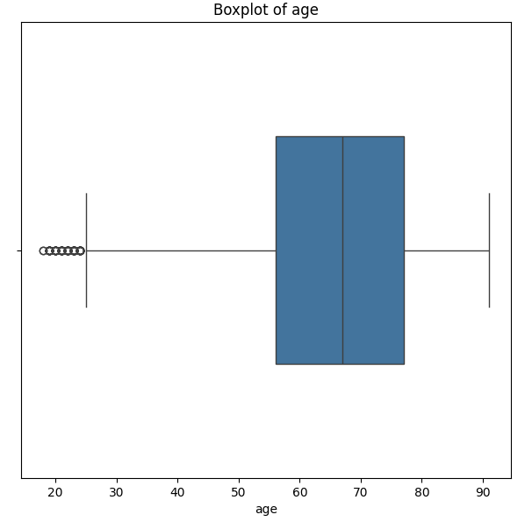
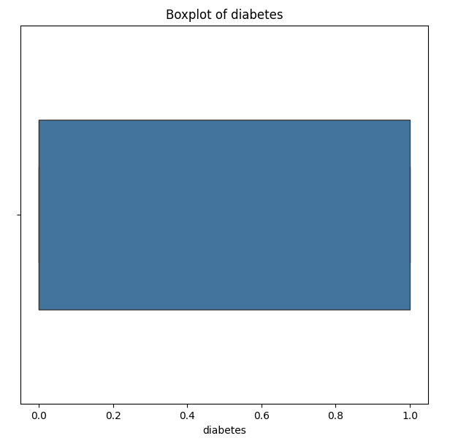
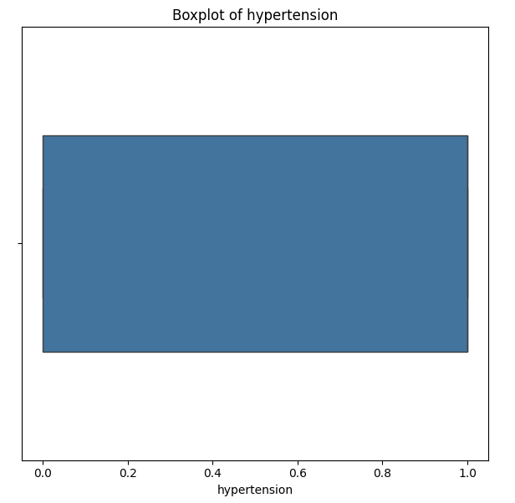
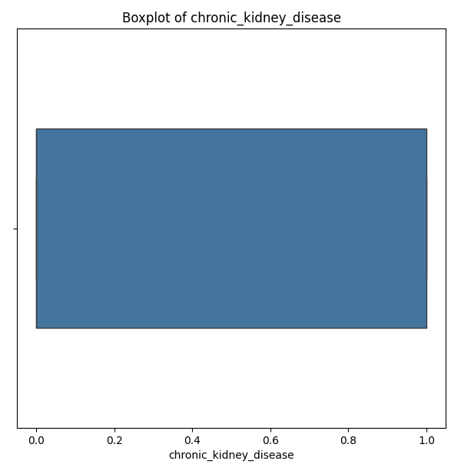
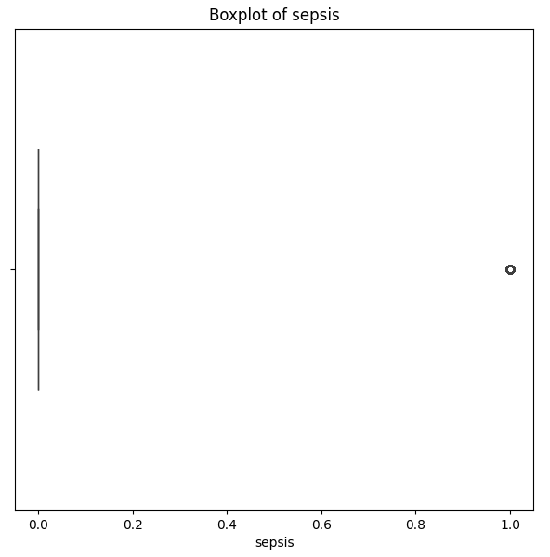
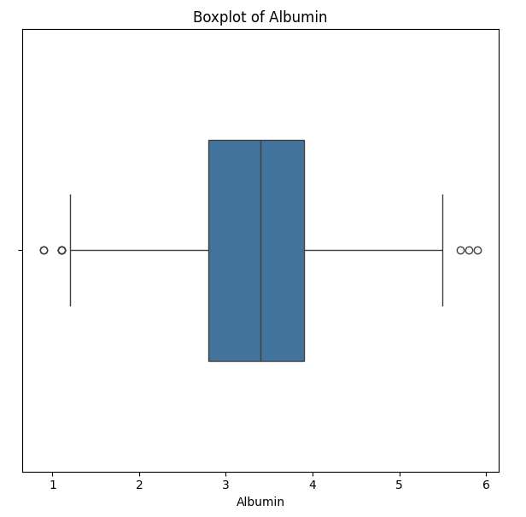
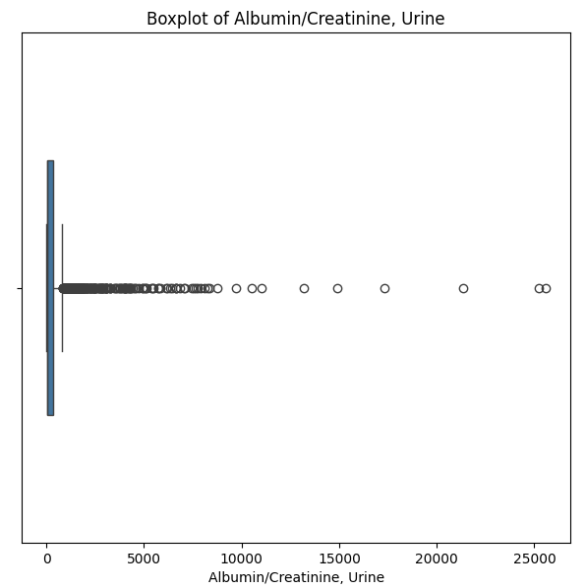
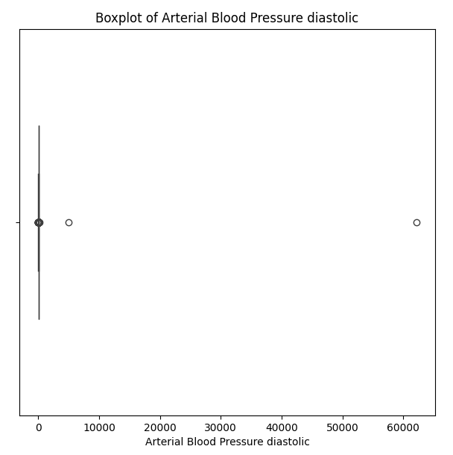
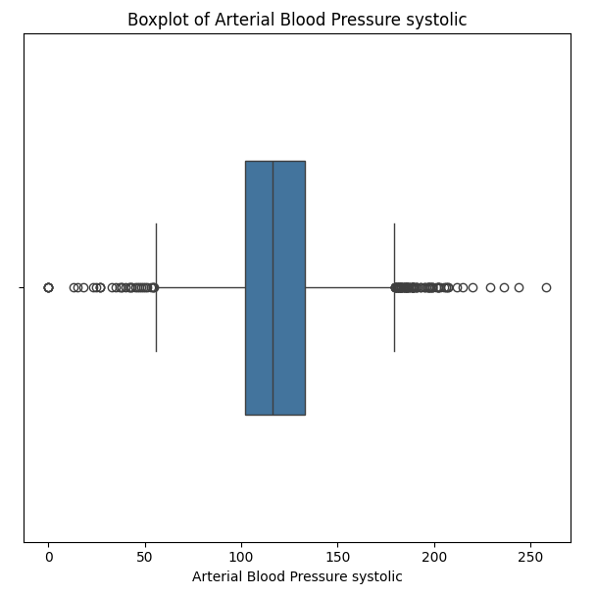
Before Outlier Deletion
Notes:
Urvi

Slide 20
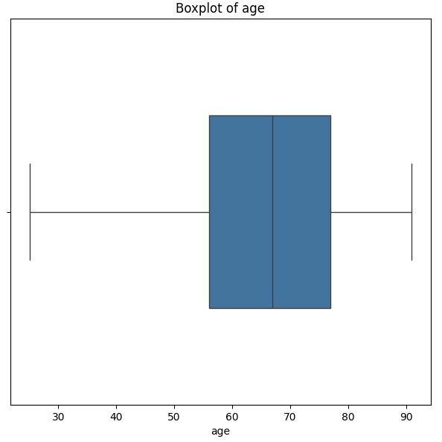
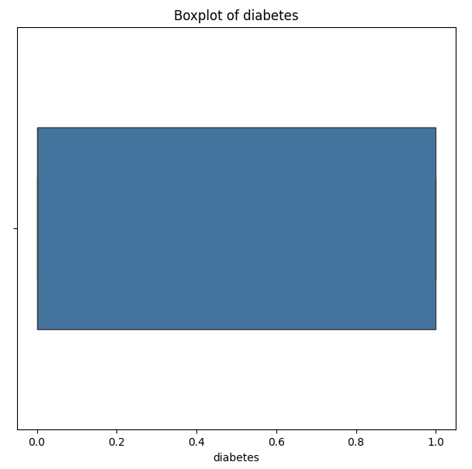
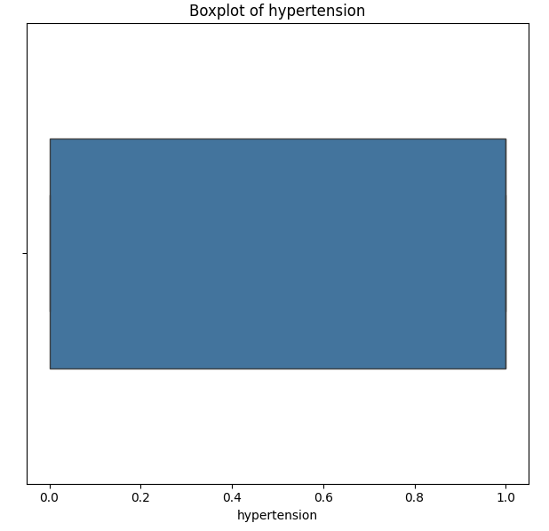
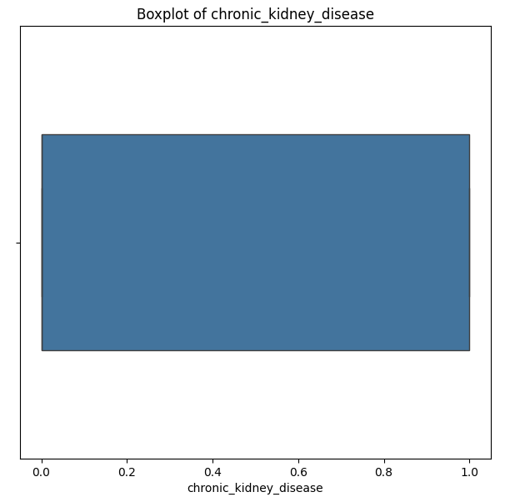
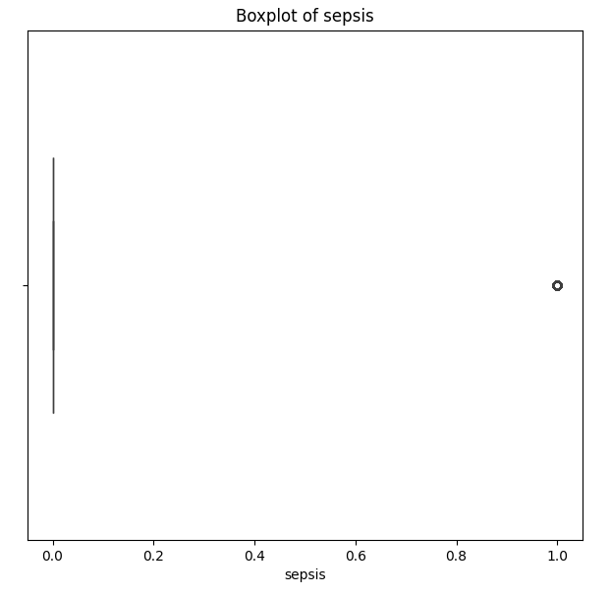
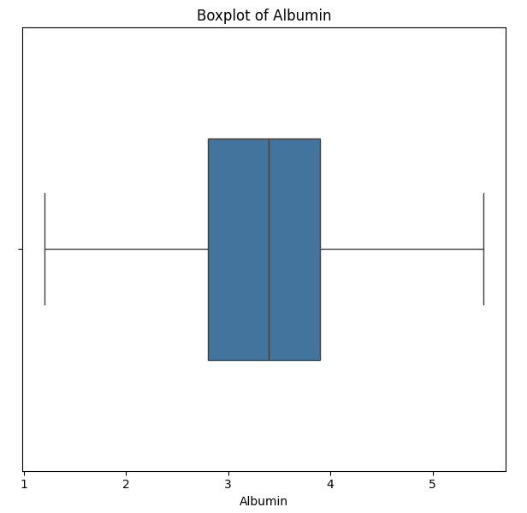
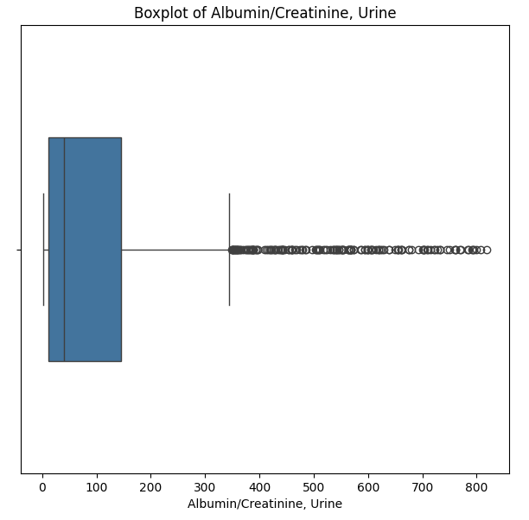
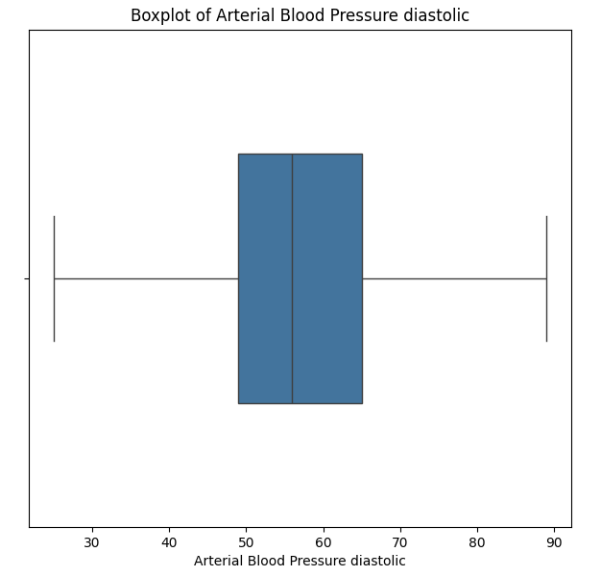
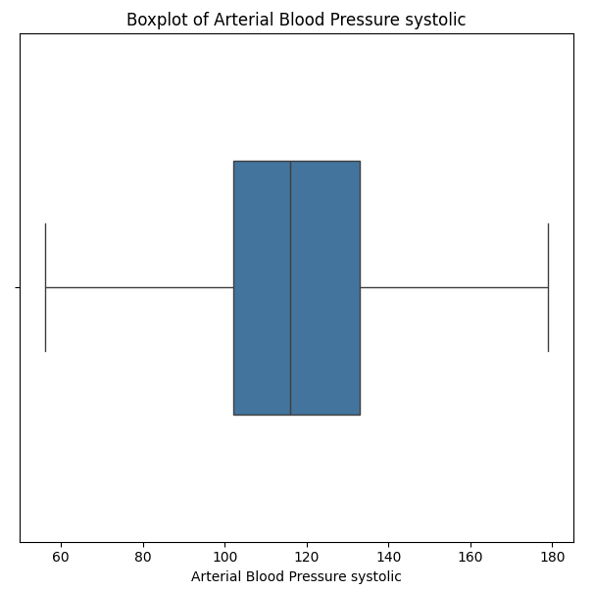
After Outlier Deletion with IQR
Notes:
Urvi

Slide 21
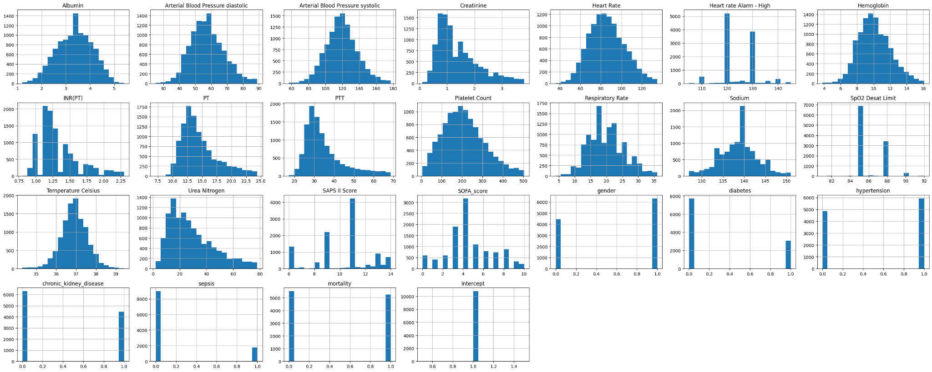
Data Distribution after Imputation
Notes:
Urvi

Slide 22
Miceforest for Missing Values
Objective:
Used for imputing missing values in datasets
MICEForest Algorithm Used:
Combined the MICE imputation approach with random forests.
Utilized random forests to impute missing values.
Captured complex relationships and patterns in the data, leading to more accurate imputations.
Notes:
Urvi

Slide 23
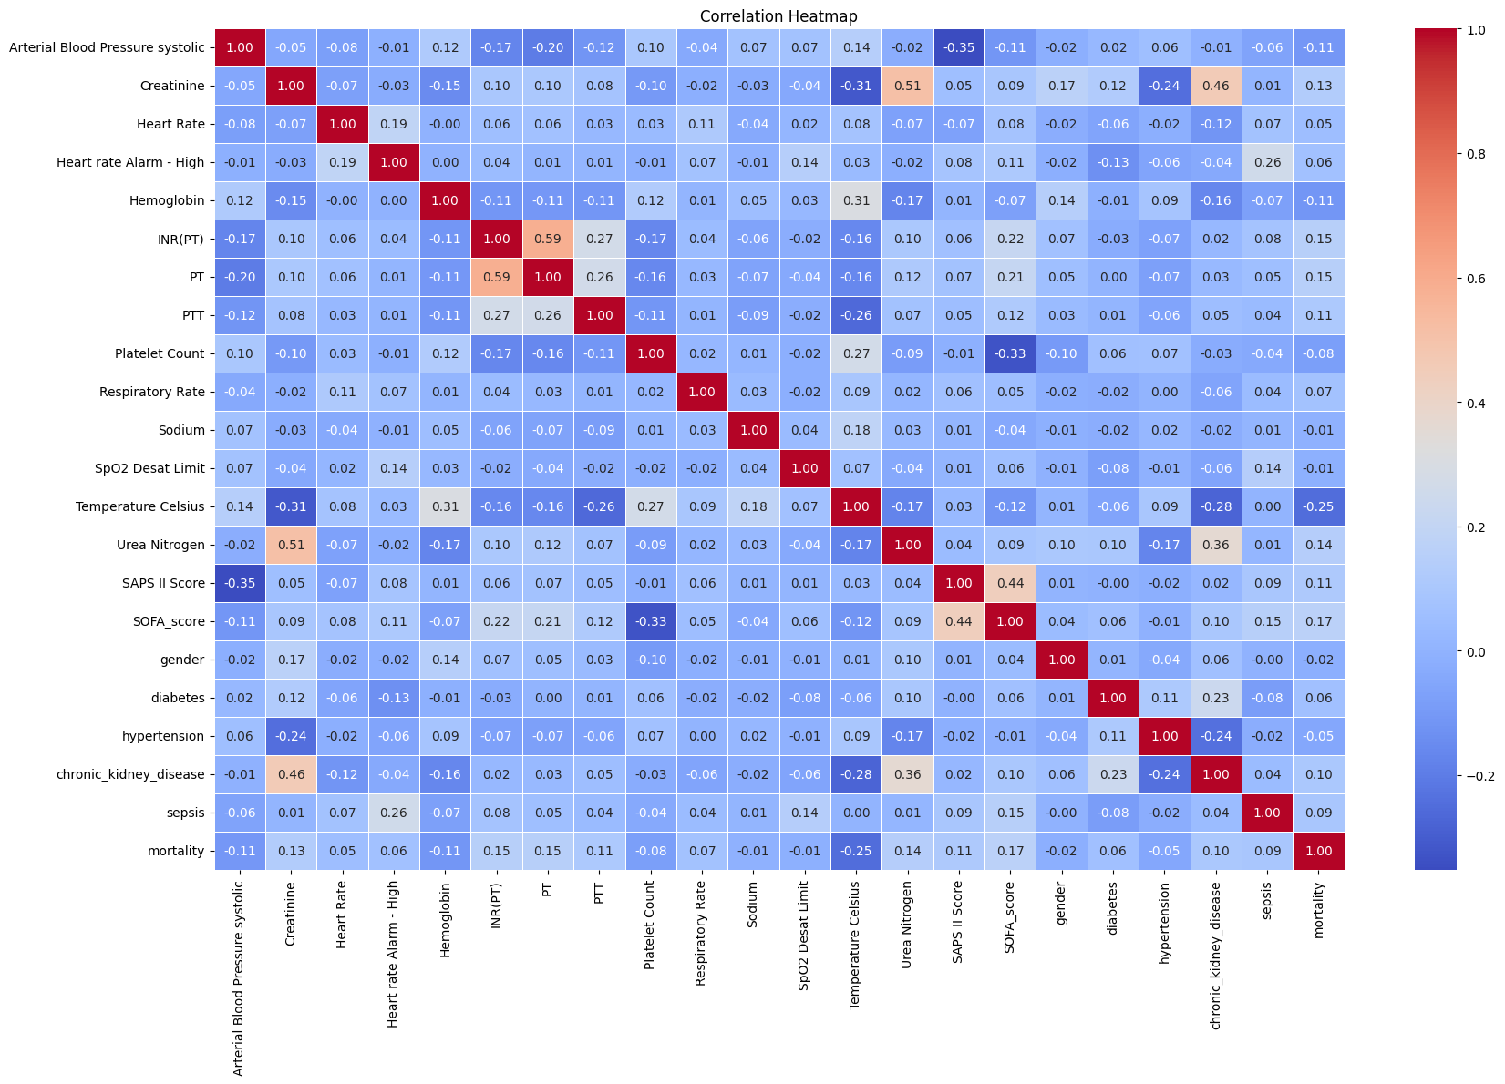
Correlation Heatmap
Notes:
Urvi

Slide 24
Modeling
‹#›
Notes:
Urvi

Slide 25
Model Building
Models built :
Logistic Regression
SVM
KNN
Decision Tree
Random Forest
XGBoost
Cat Boost
LightGBM
Gradient Boost
Ada Boost
Used GridSearch for tuning hyperparameters
Used the best estimators to train the model to get best AUC.
Notes:
Urvi

Slide 26
Model Evaluation
All models are evaluated using below metrics:
Accuracy: Measure of the overall correctness of a classification model.
AUC Score: Measures the area under the Receiver Operating Characteristic (ROC) curve. It represents the ability of the model to distinguish between positive and negative classes, with higher values indicating better performance
ROC Curve: Graphical representation of the true positive rate (sensitivity) against the false positive rate (1-specificity) for different threshold values
Notes:
Urvi

Slide 27
Results
‹#›
Notes:
Amber

Slide 28
Results
Model | Our AUC | Study AUC
Logistic Regression | 0.741 | 0.730
SVM | 0.740 | 0.680
KNN | 0.627 | 0.601
Decision Tree | 0.633 | 0.585
Random Forest | 0.742 | 0.778
XGBoost | 0.762 | 0.794
Cat Boost | 0.765 | -
LightGBM | 0.821 | -
Gradient Boosting | 0.761 | -
Ada Boost | 0.711 | -
Notes:
Amber

Slide 29
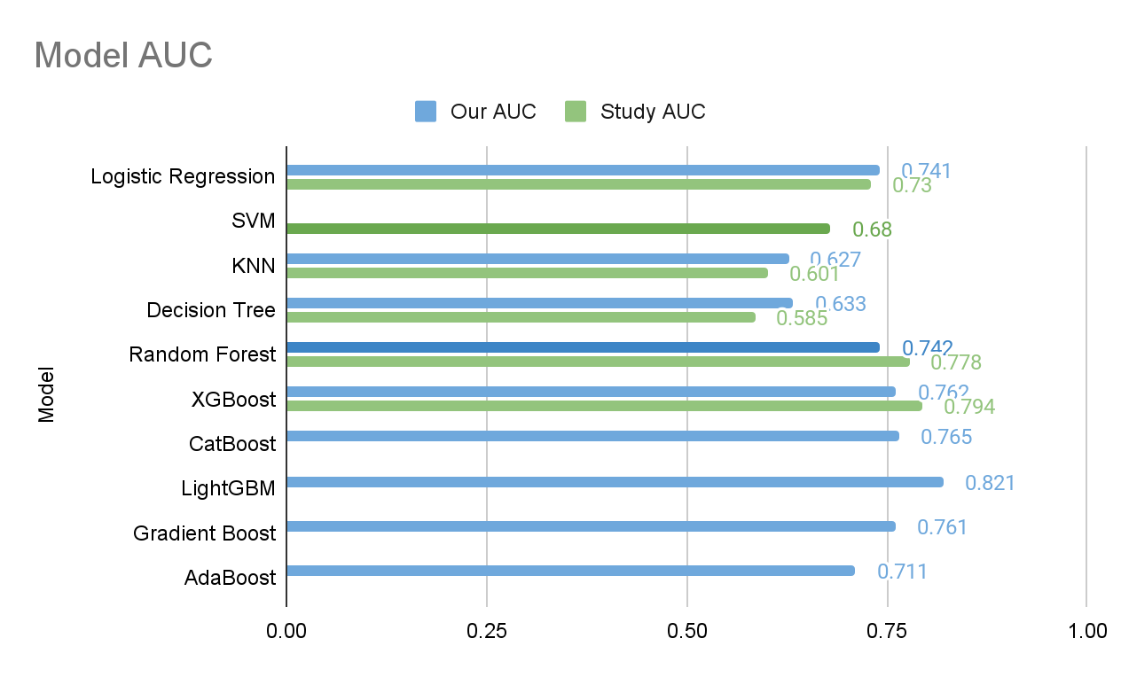
Results
Notes:
Amber

Slide 30
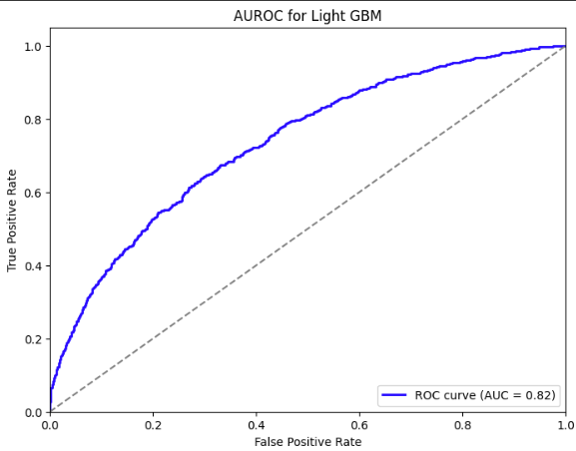
Results
Best Model:
LightGBM
AUC-ROC - 0.821
Notes:
Amber

Slide 31
Conclusion and Discussion
‹#›
Notes:
Amber

Slide 32
Conclusion & Discussion
Comparison with Prior Research:
We added 4 more ML models.
Our Study: LightGBM had the best AUC.
Baseline Study: XGBoost had the best AUC.
Limitations:
Selecting relevant features from a potentially large pool of variables since there are many clinical parameters and laboratory values available.
Correlated features can lead to overfitting and increased computational complexity.
Proposed Future Improvements:
Utilize advanced feature engineering techniques and automated feature selection algorithms to identify the most informative features from high-dimensional healthcare datasets.
Could improve model interpretability, reduce overfitting, and enhance prediction performance.
Notes:
Amber

Slide 33
Thank you!
‹#›
Notes:
Amber

Slide 34
References
[1] Li, X., Wu, R., Zhao, W. et al. Machine learning algorithm to predict mortality in critically ill patients with sepsis-associated acute kidney injury. Sci Rep 13, 5223 (2023).https://doi.org/10.1038/s41598-023-32160-z
[2] Jiang W., Zhang, C., Yu, J., Shao, J., & Zheng, R. (2023). Development and validation of a nomogram for predicting in-hospital mortality of elderly patients with persistent sepsis-associated acute kidney injury in intensive care units: A retrospective cohort study using the MIMIC-IV database. BMJ Open, 13(3), 1. doi:https://doi.org/10.1136/bmjopen-2022-069824
[3] Wang Z, Weng J, Yang J, Zhou X, Xu Z, Hou R, Zhou Z, Wang L, Chen C, Jin S. Acute kidney injury-attributable mortality in critically ill patients with sepsis. PeerJ. 2022;10:e13184. Published online 2022 Mar 25. doi: 10.7717/peerj.13184.
[4] Zhou H, Liu L, Zhao Q, Jin X, Peng Z, Wang W, Huang L, Xie Y, Xu H, Tao L, Xiao X, Nie W, Liu F, Li L, Yuan Q. Machine learning for the prediction of all-cause mortality in patients with sepsis-associated acute kidney injury during hospitalization. Front Immunol. 2023 Apr 3;14:1140755. doi: 10.3389/fimmu.2023.1140755. PMID: 37077912; PMCID: PMC10106833.
[5] Xiao-Qin Luo, Ping Yan, Shao-Bin Duan, Yi-Xin Kang, Ying-Hao Deng, Qian Liu, Ting Wu, and Xi Wu. "Development and Validation of Machine Learning Models for Real-Time Mortality Prediction in Critically Ill Patients With Sepsis-Associated Acute Kidney Injury." Frontiers in Medicine, Section: Intensive Care Medicine and Anesthesiology, Volume 9, 2022, Article ID 853102. https://doi.org/10.3389/fmed.2022.853102.
Notes:
Amber

