Slide 1
TEACHING MACHINES READING COMPREHENSION
Mid Point Spotlight
Avinash Dhulehole
Prajnya Satish
Shreya Verma
Vikhyat Goyal

Slide 2
What we have done so far?
Literature Review:
We reviewed following papers-
1. Shuohang Wang, Jing Jiang, Machine Comprehension using Match-LSTM and Answer Pointers, ICLR 2017
2. Karl Moritz Hermann, Tomas Kocisky, Edward Grefenstette, Lasse Espeholt, Will Kay, Mustafa Suleyman, and Phil Blunsom. Teaching machines to read and comprehend. In Proceedings of the Conference on Advances in Neural Information Processing Systems, pp. 1693–1701, 2015
3. Oriol Vinyals, Navdeep Jaitly, Meire Fortunato, Pointer Networks, Jan 2017
After thorough research, we decided to follow the first paper with few architectural modifications according to our dataset.

Slide 3
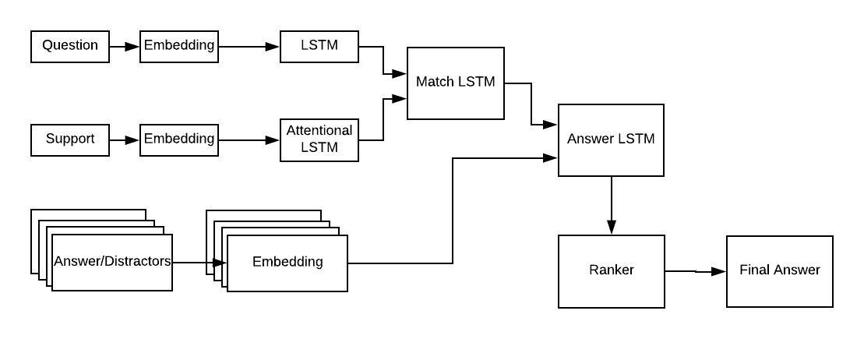
What we have done so far
Architecture
Our design is a layered architecture with three layers:
The first LSTM layer takes in Question and Support (Text) as an input and spits out tokenized vectors for both.
The Second LSTM layer takes in available answer options and converts them into tokenized vectors to be compared with the output of the first layer.
The third layer includes a custom ranking algorithm which selects the best answer out of the option.

Slide 4
What we have done so far
Dataset:
We used the Glove (6B) dataset to generate word embeddings.
The glove dataset includes pre trained word-vectors. The input text files include news corpora, wikipedia and several other online web scraped datasets.
The SciQ dataset from AllenAI is used for this dataset.
Some amount of data cleaning was required for this. Some of the questions were missing their corresponding context paragraph so had to remove them from the data.
Code so far:
We cleaned the data.
Implemented the first layer:
Tokenized the questions, support and answers and obtained their embeddings.
Passed the questions and support as input to the LSTM to get vectorized representations of the data.
Result so far:
Our dataset is now in the state as expected by the layers with no discrepancy.
Tokenized questions and support.

Slide 5
Our Next Steps
We need advice on
Research and come-up with the best ranker algorithm.
Implementing the remaining layers and evaluating them individually.
This divide makes sure we extract just the best information at each layer.
Stitching the layers together and getting initial model accuracy.
Improve the performance by studying and customizing parameters.
Is ranking the best approach to predict the answer to MCQ questions?
What kind of derived features can we use to have better results?
Do you have any ideas for specific evaluation metrics we can use for evaluating the performance?
Thank you for review and feedback!!

