Slide 1
Cyclone operations analytics
& documentation RAG assistant
Task 1 · 3.6 years of 5-minute cyclone sensor data: shutdowns, operating states, contextual anomalies, 1-hour forecasts
Task 2 · Retrieval-augmented Q&A over 11 cyclone manuals / SOPs with citations and guardrails (open-source models only)
Prajot Shrivastava · Data Science take-home submission

Slide 2
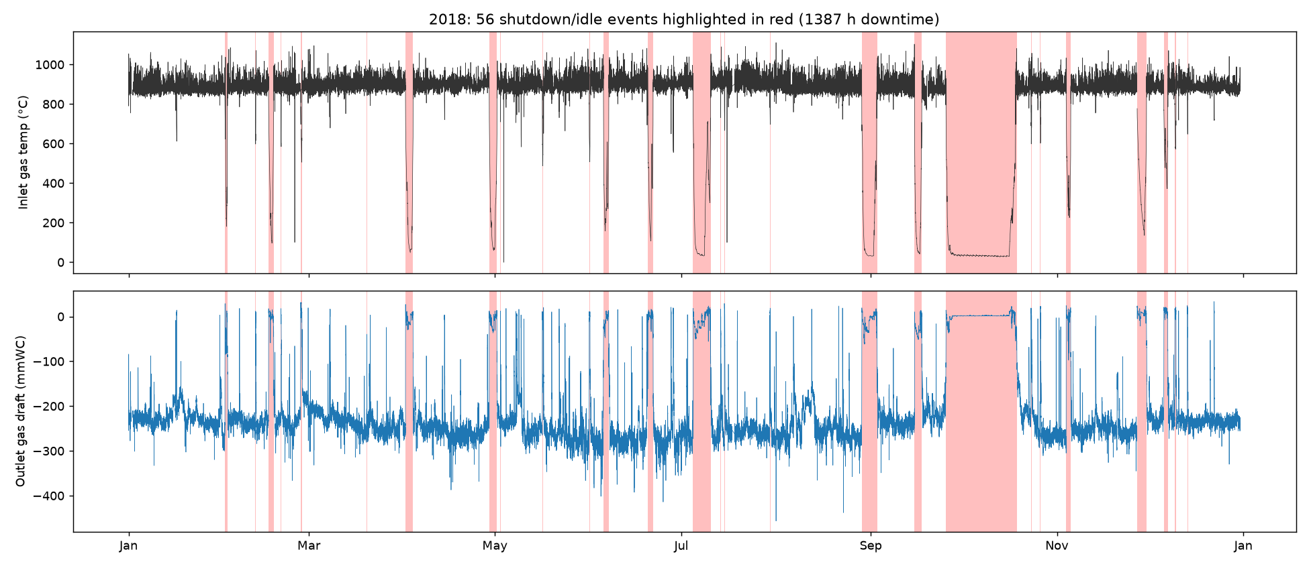
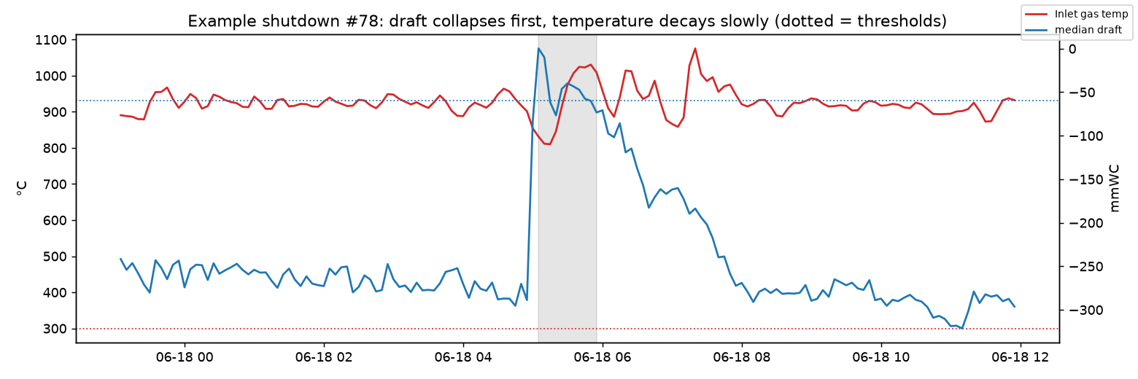
Data preparation & shutdown detection
Task 1
• Strict 5-min grid 377,719 rows, 2017-01-01 → 2020-08-07; no duplicates or off-grid stamps; 3 missing days (every 31 Dec) re-inserted as NaN (861 slots).
• Historian status text → NaN 8,195 cells such as 'Not Connect', 'I/O Timeout'.
• Physical & plausibility rules negative / saturated (1375 °C) temps, +488 mmWC draft spike, material temp >250 °C below gas temp while running (1,493 pts), stuck values ≥ 3 h.
• Outliers flagged, not deleted extremes can be real process events - left for the anomaly detector; gaps ≤ 15 min interpolated.
• Shutdown rule median draft > −60 mmWC (ID fan off) OR inlet gas < 300 °C; merge gaps < 30 min; min 30 min. Draft collapses first; gas stays hot for hours, so temperature alone mislabels cooling as running.
• Result 154 events, 6,840 h down (21.68 % of time); 33 stops > 24 h hold ~95 % of downtime; 73 short trips < 2 h.
Prajot Shrivastava · Data Science take-home · Cyclone analytics + documentation RAG
2

Slide 3
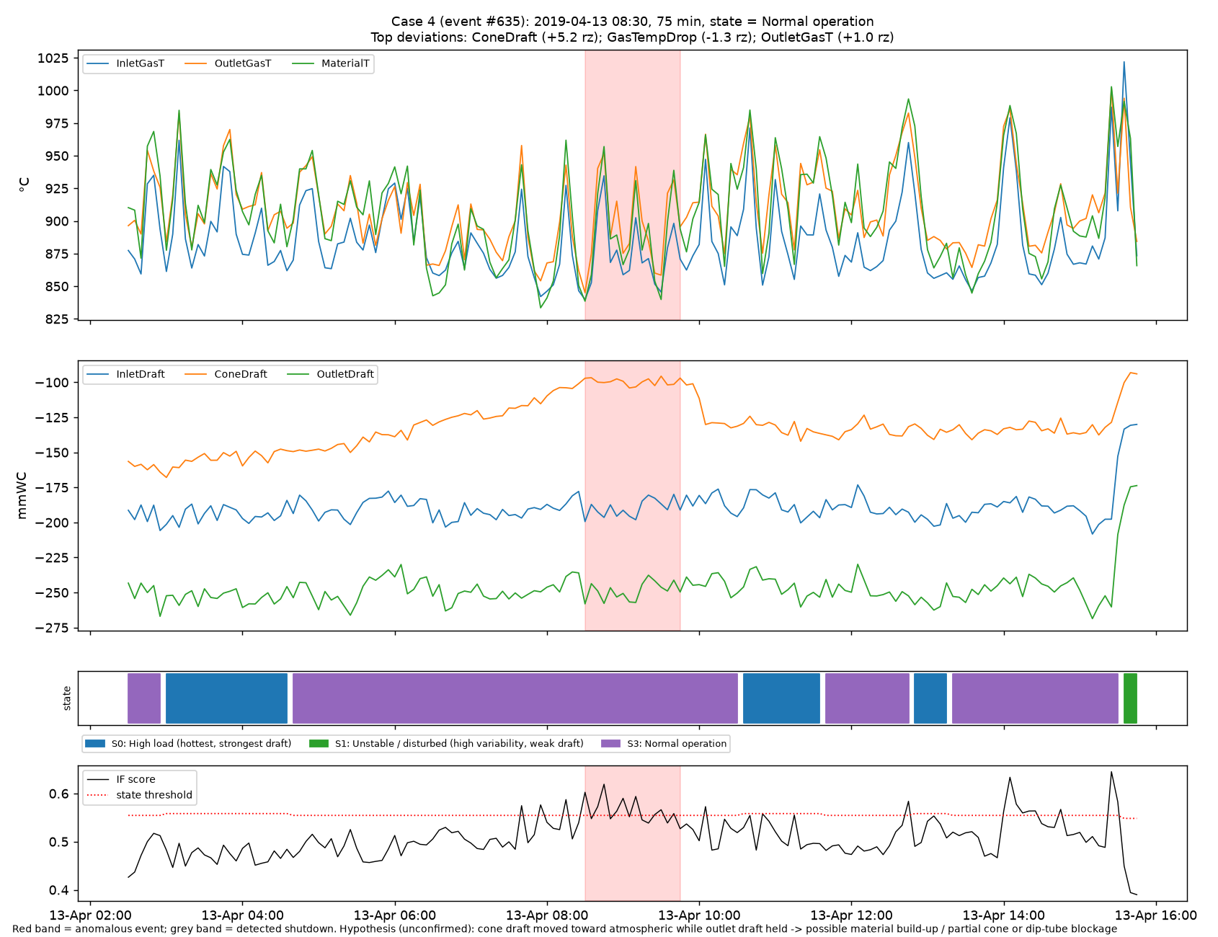
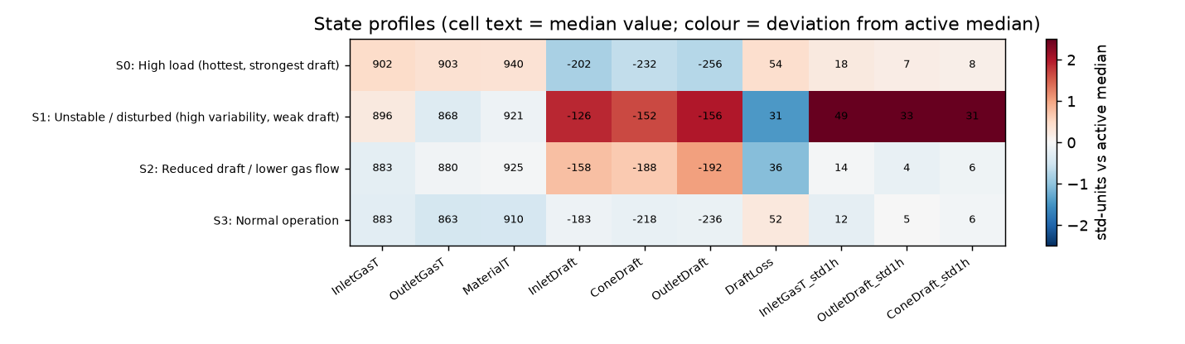
Analysis strategy: states → contextual anomalies → forecasts
Task 1
Operating states (clustering)
Contextual anomalies
1-hour forecast (12 steps)
• Active data only (shutdowns removed)
• 10 features: 1-h means of 6 sensors + cyclone ΔP, 1-h std of inlet temp, outlet & cone draft
• KMeans, k = 2…8 scored; k = 4 chosen (silhouette 0.18 vs 0.24 at k=3) because it separates a hot/strong-draft regime; k ≥ 5 split off sensor faults
• 35-min majority filter removes label flicker
• Per-state Isolation Forest (13 features incl. deltas, ΔT, ΔP)
• Flag = top-1 % IF score in that state AND a variable > 5 robust-σ from the state median - OR any level > 10 robust-σ (sustained single-sensor drifts)
• Points merged into events; most-implicated variables, context (pre-stop / post-restart) attached
• 5 case studies chosen by severity, one per failure signature
• Target: inlet gas temperature
• Train 2017-2019 (1-h purge), test Jan-Aug 2020, non-overlapping hourly origins
• Persistence vs Ridge AR-X vs HistGradientBoosting (direct, one model per horizon, predicts Δ from now)
• Features: target lags/rolling stats, other sensors, causal on/off flags, hour of day
Prajot Shrivastava · Data Science take-home · Cyclone analytics + documentation RAG
3

Slide 4
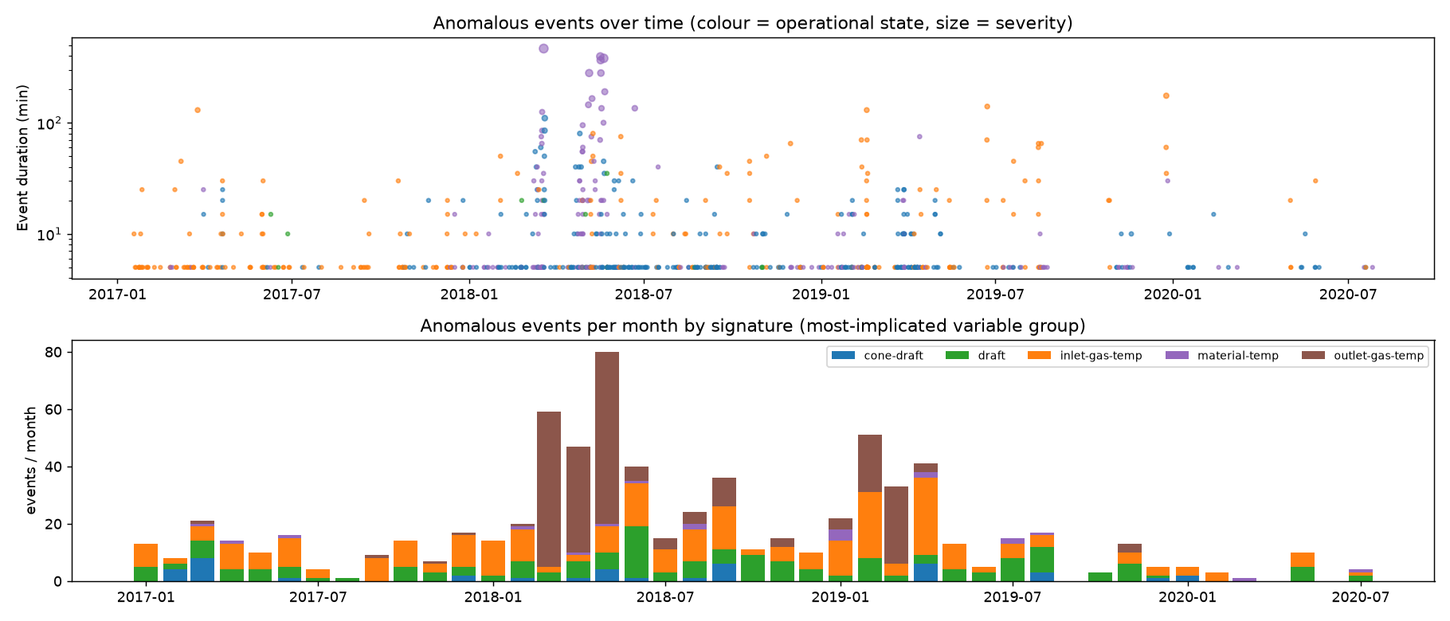
Findings: shutdowns, states and anomalies
Task 1
• Anomalies cluster around stops and restarts 12.9 % of events fall in the 2 h before a stop (vs 1.1 % of running time), and 17.7 % within 6 h after a restart (vs 3.2 %). 57.8 % of stops had an anomaly in the preceding 2 h - partly the stop's own onset, so a candidate early-warning signal, not proof.
• Restarts are fragile 30.5 % of restarts are followed by another stop within 24 h; median run between stops 79 h.
• Instrument faults dominate the worst events 156 outlet-gas-temperature events in Mar-Jun 2018: outlet reads 300-400 °C below inlet while inlet, material and drafts stay normal → thermocouple problem, not process. Flat 0 / 650 / 800 °C readings are signal substitutions.
• Operating point drifts over years 'Reduced draft' regime ≈ 80 % of 2017 running time; 'High load' (hottest, strongest draft) ≈ 68 % in 2020 → models need periodic re-baselining.
• Process signature worth alarming slow cone-draft rise toward atmospheric while outlet draft holds (case 4: −160 → −100 mmWC over ~6 h, then a step back) = likely cone build-up / partial blockage.
State | % active | median episode (min) | anom. events / 1000 h
High load | 36.1 | 100 | 33.4
Unstable / disturbed | 2.4 | 65 | 22.0
Reduced draft / lower gas flow | 33.6 | 108 | 31.3
Normal operation | 27.9 | 85 | 27.3
Prajot Shrivastava · Data Science take-home · Cyclone analytics + documentation RAG
4

Slide 5
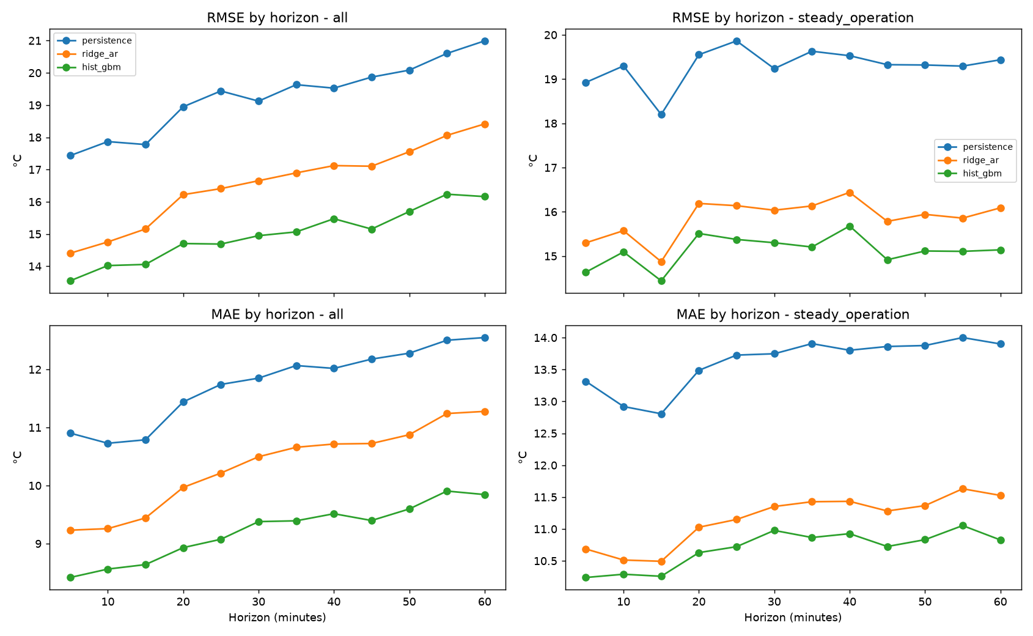
1-hour forecast of inlet gas temperature
Task 1
Model | RMSE all | MAE all | RMSE steady | RMSE transition | MAE transition
persistence | 19.3 | 11.8 | 19.3 | 19.3 | 4.3
ridge_ar | 16.6 | 10.3 | 15.9 | 19.3 | 7.1
hist_gbm | 15.0 | 9.2 | 15.1 | 14.5 | 3.3
• Gradient boosting wins RMSE −22 % vs persistence over all 12 horizons (5,193 hourly test origins, °C).
• Linear AR-X helps in steady running but is no better than persistence around stops/starts - it cannot represent the regime switch; trees can (using the on/off flags).
• Persistence is hard to beat at 5 min the signal carries ±15 °C high-frequency noise, so even h=1 RMSE is ~14-17 °C: the floor is measurement/process noise, not model capacity.
• Challenges shutdowns (cliff-like drops), regime drift across years, sensor faults in the target, non-stationary variance. Next: regime-aware models, quantile intervals, retrain monthly.
Prajot Shrivastava · Data Science take-home · Cyclone analytics + documentation RAG
5

Slide 6
RAG architecture (prototype runs end-to-end on a laptop CPU)
Task 2
OFFLINE · ingestion & indexing
Document sources
Drive / SharePoint / S3
manuals · SOPs · guides
Parse & clean
pypdf text, header/footer &
TOC removal · OCR for scans
Chunking
sentence-aware, ~180 words
40-word overlap · page meta
Embeddings
bge-small-en-v1.5 (384-d)
batch job · doc-hash dedupe
Indexes
Vector: FAISS → Qdrant/pgvector
Sparse: BM25 · metadata store
ONLINE · query answering
User question
operator / engineer
natural language
Input guardrail
policy & safety-bypass block
prompt-injection · PII
Hybrid retrieval
dense + BM25 top-20 each
reciprocal-rank fusion
Rerank + gate
cross-encoder MiniLM
score < τ → 'not in docs'
Grounded LLM
Qwen2.5-0.5B (prototype)
7-8B AWQ via vLLM (prod)
Output guardrails
NLI entailment per sentence
citations · safety note
Graceful fallbacks
blocked → policy message · low rerank score → 'not found in documentation' · unsupported LLM sentences removed; < 50 % supported → verbatim source quotes
Answer + citations
doc · page · snippet
status & guardrail flags
Monitoring & evaluation
offline golden set: precision@k · recall@k · MRR · NLI faithfulness · refusal accuracy | online: fallback & refusal rate, citation clicks, thumbs up/down, p50/p95 latency, unanswered-query clusters → doc gaps
Prajot Shrivastava · Data Science take-home · Cyclone analytics + documentation RAG
6

Slide 7
Retrieval strategy, guardrails & evaluation
Task 2
• Corpus the 11 PDFs from the provided Drive folder (215 pages → 355 chunks); one is an AES-encrypted PDF, one is a maritime cyclone-storm SOP (term ambiguity).
• Chunking sentence-aware ~180 words, 40-word overlap, never across pages → every answer cites doc + page.
• Retrieval BM25 + bge-small dense, reciprocal-rank fusion, MiniLM cross-encoder rerank, top-4 to the LLM.
• No answer rerank score below threshold → 'not in the documentation' (no LLM call); weakly related → quote the closest passages instead of answering. Plant terms ('draft') expanded to manual terms.
• Hallucination control each answer sentence must be entailed (NLI DeBERTa-v3-xsmall) by the passage it cites; unsupported sentences removed, < 50 % supported → verbatim quotes.
• Sensitive queries interlock/safety bypass, harm, credentials/PII and prompt injection blocked; safety-critical topics answered with a lock-out / permit-to-work note.
Retriever (k=3) | P@3 doc | R@3 doc | Hit@3 | MRR@10
bm25 | 0.78 | 0.92 | 0.88 | 0.87
dense | 0.71 | 0.97 | 0.88 | 0.79
hybrid | 0.75 | 0.97 | 0.94 | 0.88
hybrid+rerank | 0.77 | 0.98 | 0.94 | 0.85
Guardrail gate: answerable passed 17/17, out-of-scope refused 4/4, sensitive blocked 4/4.
End-to-end (Qwen2.5-0.5B, 17 questions): every answer cited; 94% cite a relevant document; 76% LLM answers survived NLI, 24% fell back to quotes; median latency 3.6 s on CPU.
Caveat: 17 author-labelled questions and hand-written block rules - indicative, not a benchmark; reranking did not beat plain hybrid on this small, keyword-heavy set.
Prajot Shrivastava · Data Science take-home · Cyclone analytics + documentation RAG
7

Slide 8
Scaling, cost and next steps
Task 2 + wrap-up
10× documents
100+ concurrent users
Cost control
Next steps (both tasks)
• ~3.5 k chunks → ~35-50 k: still small for a vector DB
• Incremental ingestion by doc hash; batch embedding on CPU or spot GPU
• HNSW (Qdrant / pgvector) + metadata filters (equipment, doc type, plant)
• OCR + layout parser for scanned pages and tables; multilingual embedder (bge-m3) for bilingual SOPs
• Stateless retrieval pods autoscale on CPU
• LLM: vLLM continuous batching, 7-8B AWQ on 24 GB GPUs, scale on queue depth
• Semantic cache + streaming + rate limits
• Load-test p95 latency before sizing (not done in this prototype)
• Serverless / scale-to-low for ingestion and retrieval
• GPU pool sized for peak shift, reduced off-shift; spot for re-indexing
• Router: extractive or small model for look-ups, larger model only when needed
• Track cost per answered question alongside quality metrics
• Validate shutdown events & anomaly hypotheses with the operator log
• Deploy draft-collapse + cone-draft-trend alarms; instrument health checks
• Grow the RAG golden set with operators (50-100 Qs) and recalibrate thresholds
• Link the two: anomaly alert → RAG suggests the relevant troubleshooting section
Limitations to keep in mind
Task 1: no operator / maintenance logs, so shutdown causes and anomaly root causes are hypotheses from sensor data only; clustering silhouette is low (states are regimes on a continuum). Task 2: 17-question author-labelled eval set and thresholds set by inspecting it; regex-based safety policy; 18 image-only pages not OCR'd; 0.5B generator needs the NLI filter (24 % of answers fall back to quotes).
Prajot Shrivastava · Data Science take-home · Cyclone analytics + documentation RAG
8

