Slide 2
Mobility Aid Recognition
Project Team: The Deadliners

Slide 3
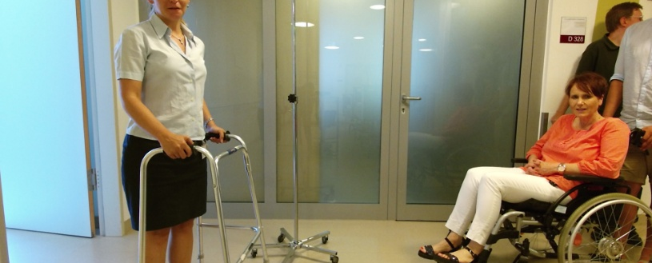
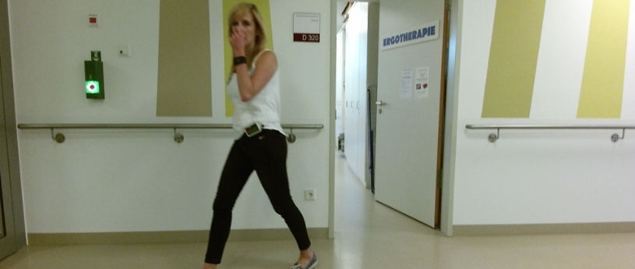
Objective
Fine-tuned a ResNet-18 model using the Freiburg Mobility Aids Dataset.
Binary image classification
  Class 0: No mobility aid present
  Class 1: At least one mobility aid present
Class 1 example
Class 0 example
Notes:
We fine-tuned a ResNet-18 model using the Freiburg Mobility Aids Dataset. Our task was binary image classification: Class 0 represents images without a mobility aid, while Class 1 represents images containing at least one mobility aid. After training, we evaluated the model and explored different ways to visualize its behaviour.

Slide 4
Analysis Approach – AI-Aided
1. Error Analysis
Where does the model make mistakes, and what might explain them?
False positives and false negatives
Temporal prediction behaviour
Category-specific errors
Image-quality analysis
2. Robustness Analysis
How do changes to the input images affect model predictions?
Modifying input images
Testing sensitivity to visual changes
Comparing prediction changes
Evaluating model robustness
Notes:
The Ai-assisted Pair approached the model analysis from two different perspectives.
First, we conducted an error analysis. Here, we wanted to understand where the model makes mistakes and what might explain these errors. We looked at false positives and false negatives, investigated prediction behaviour across video sequences, and examined category-specific errors and image quality.
Second, we performed a robustness analysis. Instead of looking only at existing prediction errors, we changed the input images and investigated how these modifications affected the model's predictions.
Together, these two approaches allowed us to investigate both why the model might fail and how sensitive it is to changes in its inputs.

Slide 5
Results – AI-Aided
1. Error Analysis – Main findings
No consistent visual patterns explaining the prediction errors were identified.
Errors sometimes appeared in temporal clusters.
Crutches had the highest false-negative rate
Lower sharpness was associated with more false negatives.
Key Visualization: Temporal Prediction path and error galleries.
2. Robustness Analysis – Main findings
All testet perturbations reduced accuracy compared with the original images.
Gaussian blur caused the largest decrease
Gaussian noise caused the smallest decrease.
Accuracy remained above 92 % under all tested conditions
Key Visualizations: Confusion matrix and robustness comparison bar chart.
Notes:
The error analysis revealed several interesting patterns. Although the model achieved 95.4% accuracy, its performance was considerably weaker for images without mobility aids.
When visually inspecting the misclassified images, we couldn't identify one consistent visual pattern that explained the errors. However, the temporal analysis showed that errors sometimes appeared in clusters. We also found that crutches had the highest false-negative rate, and that false-negative images tended to have lower sharpness.
These observations helped us identify potential weaknesses, even though we couldn't establish one general explanation for the model's errors.
In the robustness analysis, we investigate how changes to the input images affected model performance. The original images served as the reference condition, with an accuracy of 95.4 %.
Then we tested three modifications: increased brightness, Gaussian noise, and Gaussian blur. Accuracy decreased to 93.49 % with increased brightness, 94.72% with Gaussian noise, and 92.88% with Gaussian blur.
Among the tested conditions, Gaussian blur caused the largest decrease in accuracy, while Gaussian noise had the smallest effect. Accuracy remained above 92% in all conditions.

Slide 6
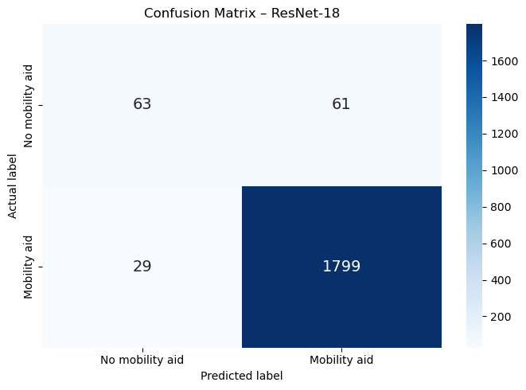
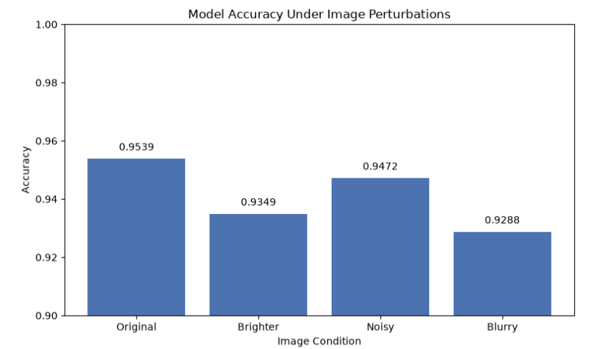
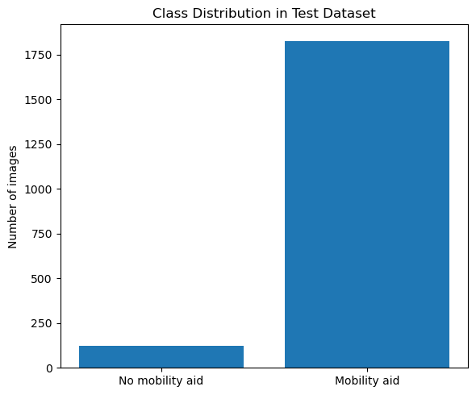
Overall Model Performance
1952 evaluated images
Strong class imbalance:
  93.6% Class 1,
  6.4% Class 0
Overall Accuracy: 95.4%
Notes:
The model achieved an overall accuracy of 95.4% on the 1,952 evaluated images.
However, when looking at the confusion matrix, we can see that the model correctly classified 1,799 images containing mobility aids, but only 63 images without mobility aids.
The reason becomes clearer when looking at the class distribution. Almost 94% of the dataset belongs to Class 1, meaning that the dataset is highly imbalanced.
So, despite the high accuracy, the model performs considerably worse at recognizing images without mobility aids. This is why we need to look more closely at its prediction errors.
These findings show that overall accuracy alone does not tell the full story, especially given the class imbalance. In addition to examining differences between the classes, we investigated another aspect of model performance: its sensitivity to changes in the input images. The bar chart compares accuracy on the same test images under four conditions. Compared with 95.4% on the original images, accuracy decreased to 93.49% with increased brightness, 94.72% with Gaussian noise, and 92.88% with Gaussian blur. These robustness results will be discussed in more detail later.

Slide 7
Analysis Approach – Human only
Notes:
The Ai-assisted Pair approached the model analysis from two different perspectives.
First, we conducted an error analysis. Here, we wanted to understand where the model makes mistakes and what might explain these errors. We looked at false positives and false negatives, investigated prediction behaviour across video sequences, and examined category-specific errors and image quality.
Second, we performed a robustness analysis. Instead of looking only at existing prediction errors, we changed the input images and investigated how these modifications affected the model's predictions.
Together, these two approaches allowed us to investigate both why the model might fail and how sensitive it is to changes in its inputs.

Slide 8
Results – Human only
Notes:
The error analysis revealed several interesting patterns. Although the model achieved 95.4% accuracy, its performance was considerably weaker for images without mobility aids.
When visually inspecting the misclassified images, we couldn't identify one consistent visual pattern that explained the errors. However, the temporal analysis showed that errors sometimes appeared in clusters. We also found that crutches had the highest false-negative rate, and that false-negative images tended to have lower sharpness.
These observations helped us identify potential weaknesses, even though we couldn't establish one general explanation for the model's errors.

Slide 9
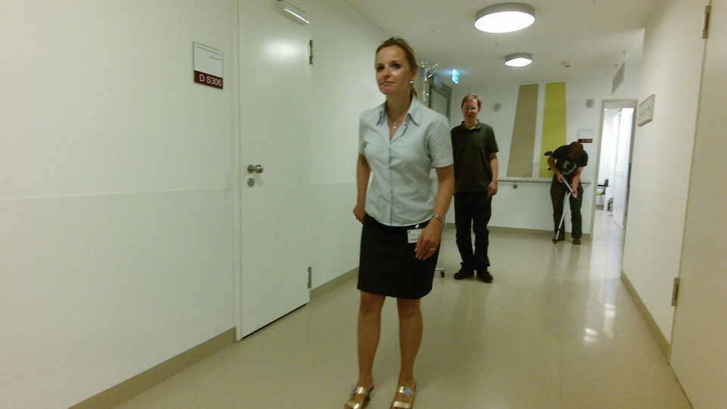
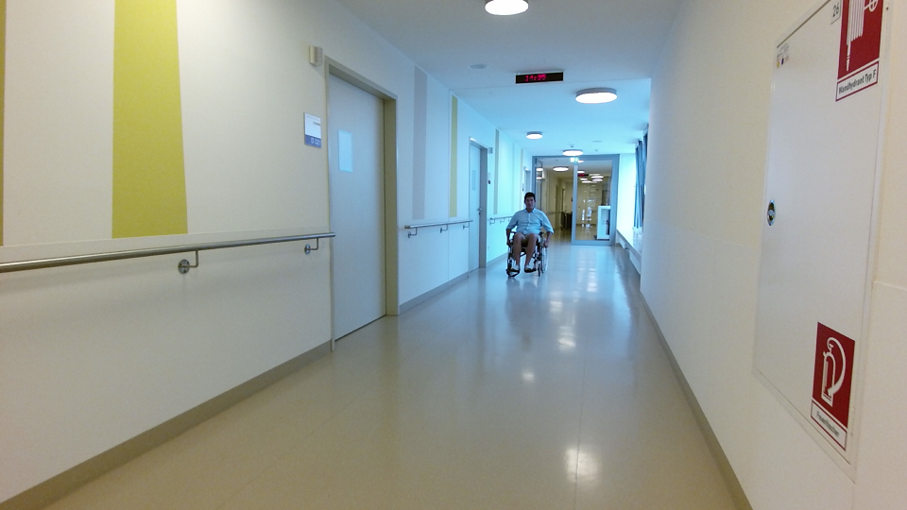
Main Visualization: Error Galleries
Where Does the Model Make Mistakes?
False Positives (61):
False Negatives (29):
Annotated: Class 0 → Predicted: Class 1
Annotated: Class 1 → Predicted: Class 0
Notes:
Here we can see examples of the two types of prediction errors: 61 false positives and 29 false negatives.
When inspecting the images, we couldn't identify one consistent visual pattern explaining the errors.
However, in the false-positive example on the left, a person in the background appears to be using crutches, even though the annotation labels the image as Class 0. This suggests that some apparent errors might actually be caused by incomplete annotations.

Slide 10
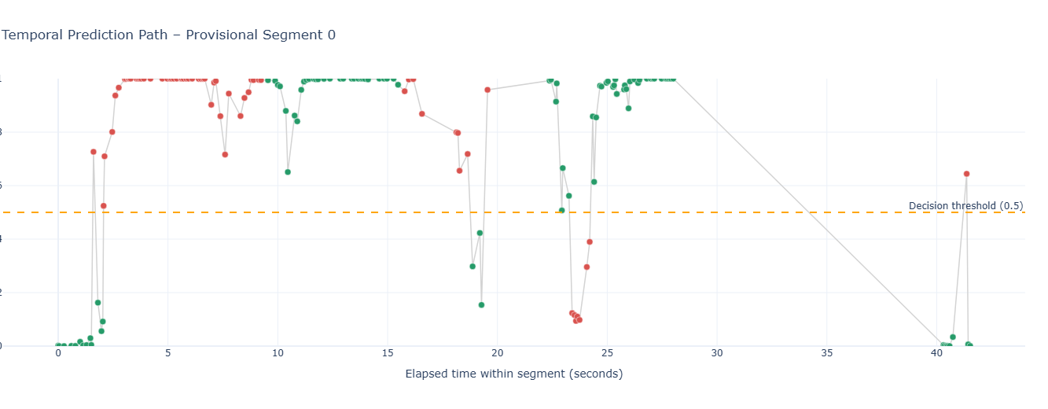
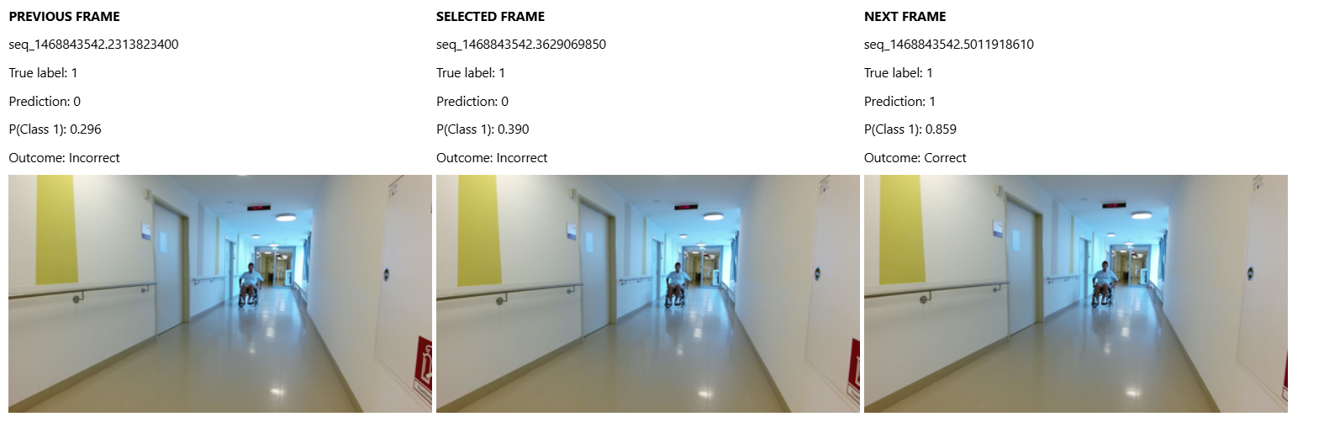
Main Visualization: Temporal Prediction Path
How Consistent Are the Model's Predictions Across Consecutive Frames?
Notes:
Since our images originate from video sequences, we wanted to investigate whether prediction errors were randomly distributed or appeared in temporal patterns.
We identified five provisional recording segments based on timestamp gaps. When visualizing the predictions over time, we noticed that errors sometimes appeared in clusters, particularly in certain segments.
To investigate this further, we created an interactive visualization that allows us to select individual frames and compare them with the previous and next frames, including their predictions and confidence scores.

