Slide 1
Capstone Project: Market Mix Modeling Final Submission Report
To model the impact of different levels on the sales figure of Eleckart
Group Members: Saleha Razvi, Prajakta Prabhu, Pratik Patil

Slide 2
Project analysis slide 2
Business Objective
To create a market mix model for ElecKart (an e-commerce firm based out of Ontario, Canada) for 3 product sub-categories - Camera Accessory, Gaming Accessory and Home Audio - to observe the actual impact of various marketing variables over one year (July 2015 to June 2016) and recommend the optimal budget allocation for different marketing levers for the next year.
The objective is thus classified into the following sub-goals:
Performance driver analysis:
Which KPIs drive the top-line performance?
Impact analysis on marketing ROI:
What is the quantitative impact of each commercial lever on revenue?
Optimizing marketing spends:
How to best allocate the marketing budget to gain the highest outcome?

Slide 3
Project analysis slide 3
Problem Solving Methodology
The approach for this project has been designed to follow the CRISP-DM Framework. The various stages of the framework are represented below in a sequential flow:
Understanding the Business Data
Data Preparation & Feature Engineering
Exploratory Data Analytics & Visualization
MARKET ANALYSIS
ECOLOGICAL ANALYSIS
Model Deployment (out-of-scope for this project)
Model Evaluation and Model Selection
Preparing Regression Models for Prediction & Determining Important KPIs

Slide 4
Project analysis slide 4
Understanding Data
The following data files were available to us for analysis of budget optimization:
Main Consumer file with order details on a daily basis
Media Investment file with the amount invested in each advertising medium for the past year
Sale Calendar file showing dates from the past year when there was a promotional offer
NPS file showing net promotion score and company stock value for last year
Weather file having detailed weather reports from last year in the state of Ontario, Canada
Product
# of units sold
Delivery days and SLAs
Categories/sub categories
Verticals
Procurement SLA
Marketing Channel Investments
Customer sentiment (NPS)
Discounts
Adstock
Promotion
4Ps of
Marketing
Price
Pin code
Order Payment Type
Week of the year – seasonality
Holiday/Events
Sale calendarA
Gmv
Product mrp
Place (& Time)

Slide 5
Project analysis slide 5
Data Preparation & Cleanup
Handling Incorrect values in some columns
Imputing "\N" value in deliverybdays & deliverycdays by 0
Treating incorrect GMV values (where gmv > product_mrp * units) by imputing the faulty MRP values with GMV/units
Handling Negative values for product_procurement_sla, deliverybdays & deliverycdays by dropping them
Handling large values(0.3%) for product_procurement_sla by dropping them
De-Duplication of Data
After converting all column values to lower case, we see that there are around 99283 (6.33%) rows that are duplicates. We went De-Duplication ahead and dropped them
Treating Null values and Whitespaces
Initially there weren’t any NULL values in the dataframe. However, there were quite a few Whitespaces present in some of the columns in the dataframe
We first converted these whitespaces to NaNs and dropped these values
Dropping Insignificant columns
Dropping Columns with Single Unique Value (as it doesn’t add any information to the analysis)
Dropping some of the ‘Id’ Columns which are insignificant to the analysis

Slide 6
Project analysis slide 6
Data Preparation & Cleanup
Outlier Treatment
Since we have already deleted some records on erroneous grounds, in order that we don't lose any further data, we chose not to delete outlier values.
For the variables - 'SLA', 'deliverybdays', 'deliverybdays', 'gmv', 'product_mrp’, ‘list_price’ where outliers are present, we CAPPED the value above 99 percentile to the value corresponding to 99 percentile.
Thus the outliers couldn’t affect the predictive model while at the same time there was enough data to build a generalized model.
Selecting One Year Data
Selecting 1 Year Data from July, 2015 - June, 2016. In the process, 592 records were dropped.
Converting Categorical Attributes to Numerical Form
Binary encoding for categorical variable with 2 levels.
One Hot Encoding for categorical variable with multiple levels by creating dummy variables.
Additional Data Preparation for Model Building
Merging Order dataset with all other secondary dataframes.
Extracting 3 separate dataframes for 3 product subcategories – camera accessory, home audio and gaming accessory.
Roll Up Daily Order Data to Weekly Level by aggregating the numeric variables based on Week#
Scaling and Dividing the master dataframes into train and test dataset for all 3 products subcategories.

Slide 7
Project analysis slide 7
Feature Engineering: Creation of new KPIs
Week#:
Generating Week# column from the order date
List Price:
List Price = GMV * Units
Payday Week:
If Payday falls within the week, then payday week = 1, else 0
Holiday Week:
If Holiday falls within the week, then payday week = 1, else 0
Product Type – Luxary / Mass-market:
If GVM value is greater than 80 percentile, then luxury, else mass-market
Discount:
Discount = (product_mrp-list price) / product_mrp
SMA#:
3 & 5-weeks Simple Moving Average for all Advertising media channels, NPS and Stock Index
EMA#:
8-weeks Exponential Moving Average for all Advertising media channels
Lag Variables:
Lag Variables (lag by 1, 2 & 3 days) for all KPIs were taken for Distributive Lag Models
Adstock Values:
Calculating Ad Stock value for all Advertising media (assuming ad stock rate as 50%)

Slide 8
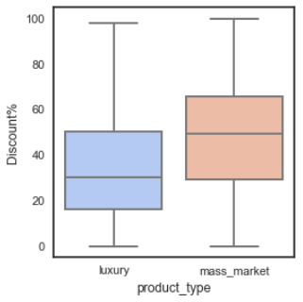
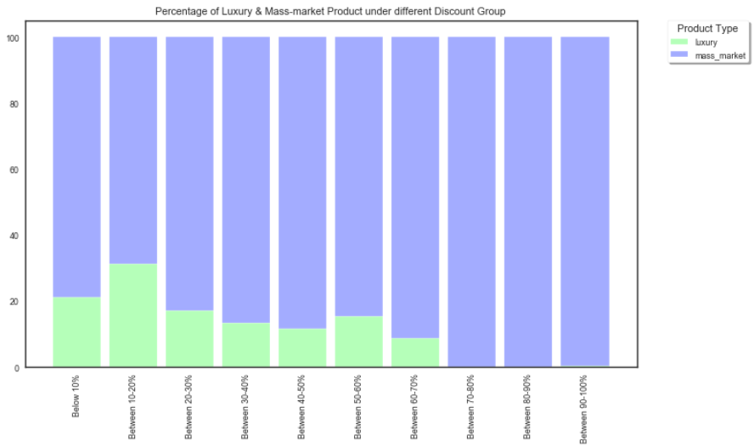
Project analysis slide 8
Visualization: An Insight into the Data
Discount % for Various Product Types
Median Revenue is maximum when Average discount% is between 10-20%. But beyond that, average revenue slowly starts to decline.
The sales on the other hand shows a steady increase with increase in Discount percentage till it peaks at 50-60% after which it starts to fall again.
Maximum number of luxury products were offered a discount between 10-20%.
This shows that at higher discount, although the sales are good, the revenue collapses signifying a loss for the company. An average discount of 10-20% is the most profitable for the company.
The median discount percentage offered for luxury items is less compared to that of Mass Market Products. This is a known trend among luxury products or luxury brands to offer limited or no discounts to retain the exclusivity of their products.
The median discount percentage offered for luxury items is less than that of Mass Market Products. This is a known trend among luxury products or luxury brands, to offer limited discounts, to retain the exclusive of their products.

Slide 9
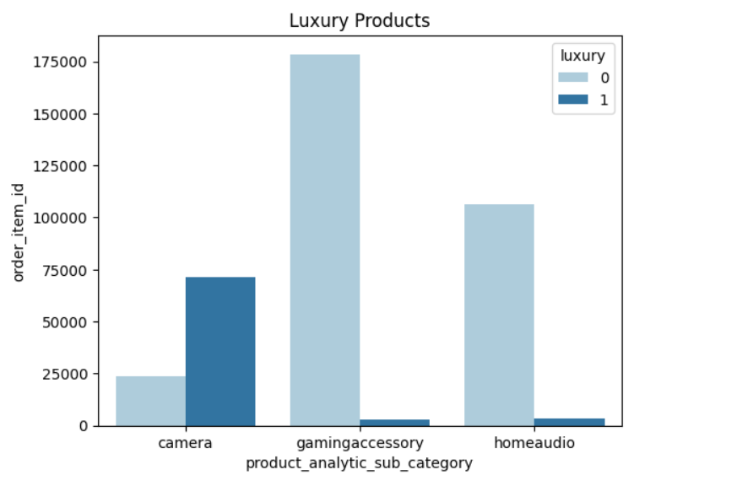
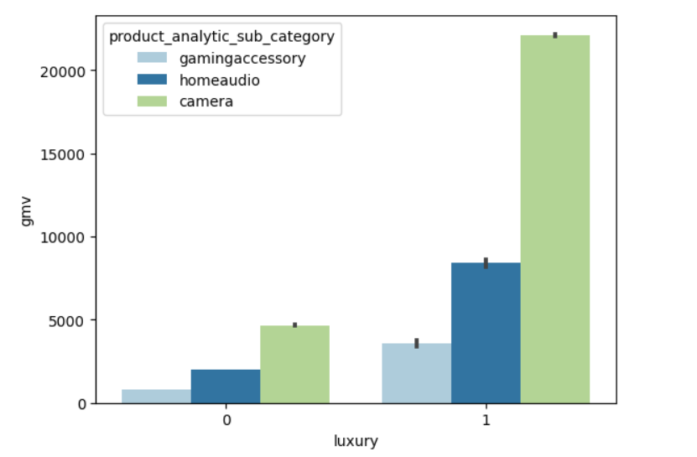
Project analysis slide 10
Visualization: An Insight into the Data
All products having MRP greater than 80 percentile are considered as luxury products.
Most of the luxury products belong to the product vertical Camera.
Overall , luxury products generate more revenue.

Slide 10
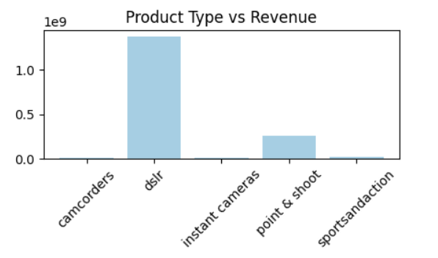
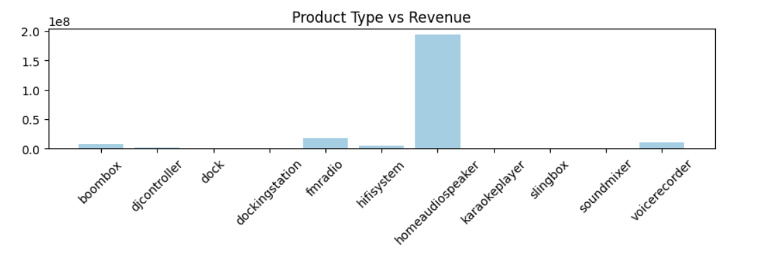
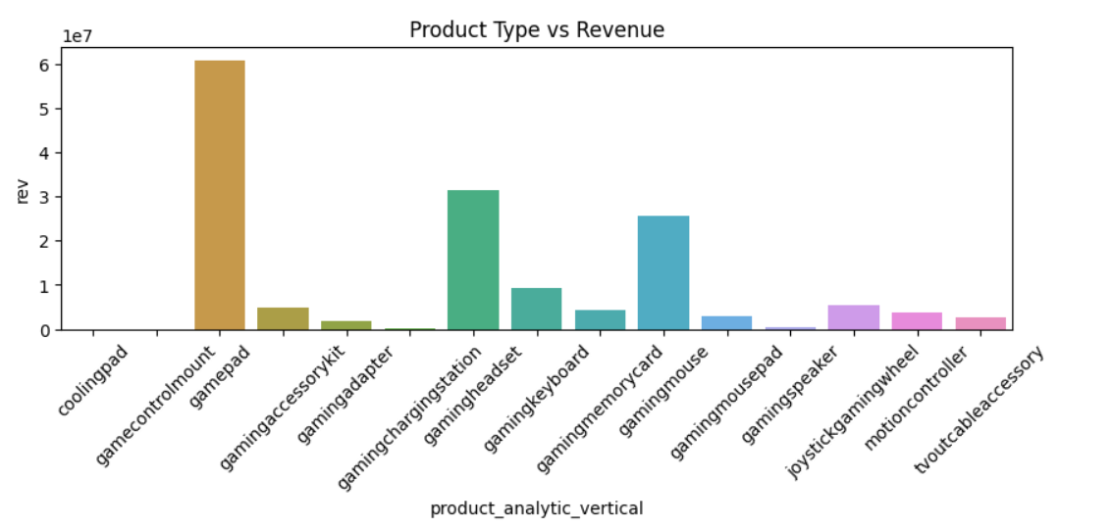
Project analysis slide 10
Visualization: An Insight into the Data
Camera
Home Audio
Gaming Accessories
High demand products on each category :
In camera, DSLR and Point & Shoot are in high demand from which DSLR provides more revenue.
For home audio ,FmRadio and Speakers demands are huge where speakers are responsible for most of the revenue.
In Gaming Accessories, Headset, mouse and gamepad are in demand where gamepad generating more revenue.

Slide 11
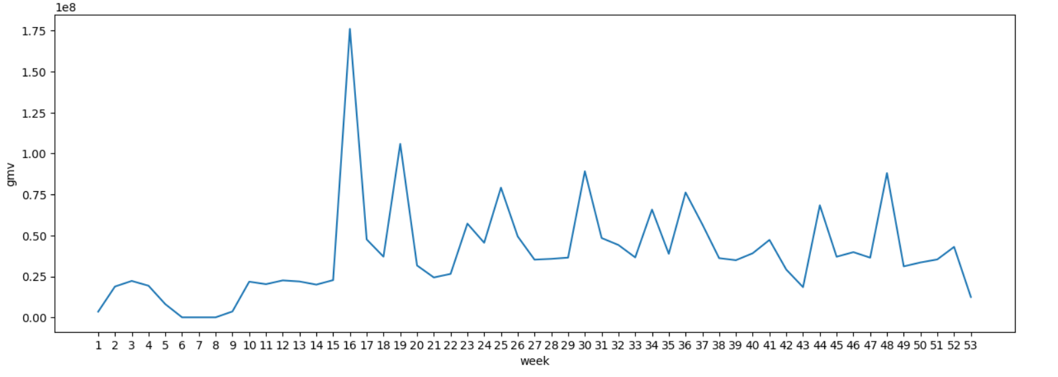
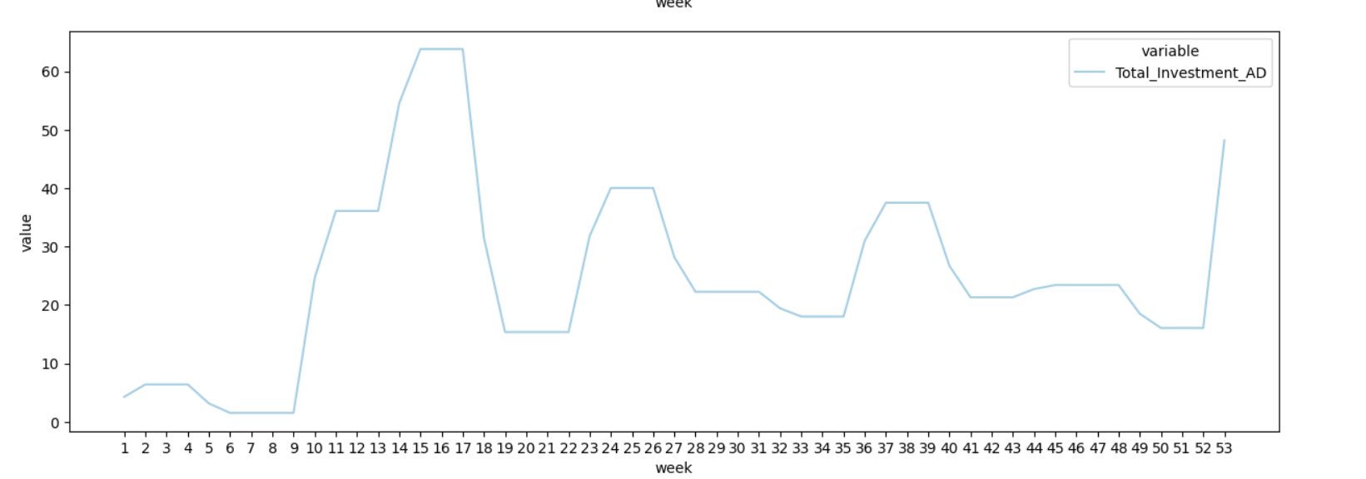
Visualization: An Insight into the Data
Trends in Advertisement Investments in Various Media Channels Over the Weeks
Revenue spiked during week 16 specially where investments on ads where also more. But the pattern wasn’t constant on total investments on ads as week 19 though there wasn’t much invested on total ad campaigns , revenue was good, similarly week 48.
Hence, overall investment on Ads doesn’t make impact on revenue , so it can be on which channel the team is spending.

Slide 12
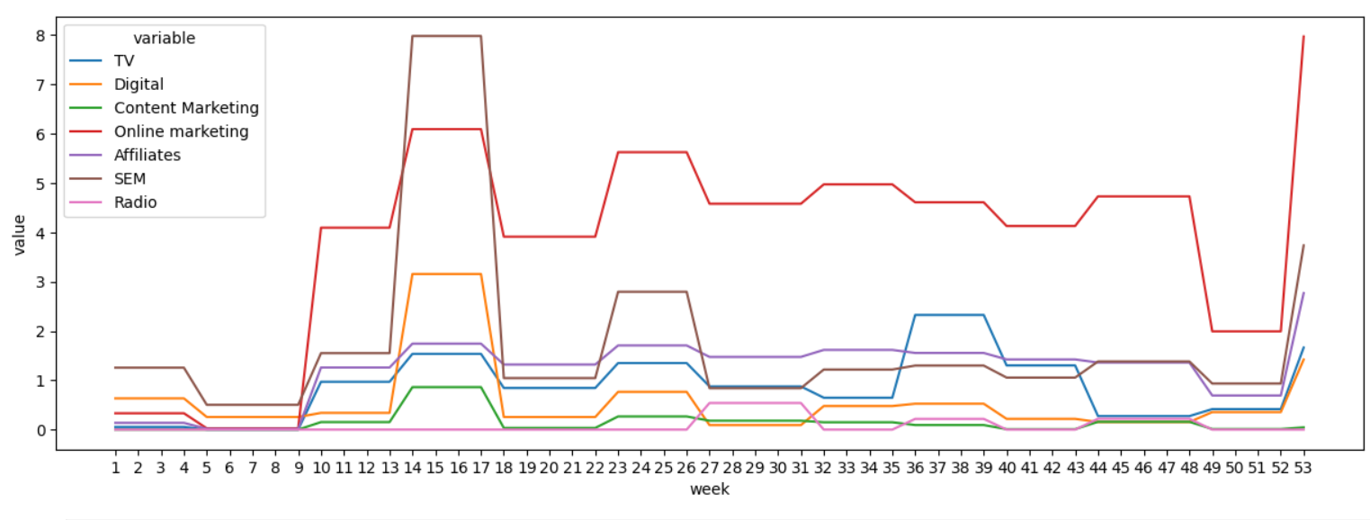
Visualization: An Insight into the Data
Trends in Advertisement Investments in Various Media Channels Over the Weeks
Online marketing is highest spent channel except for week 6. Affiliates and Radio spends were consistent for most of the weeks.
TV spent was highest during week 36 and revenue also was high.
SEM investments were also high till 27 post that it was constant and tv, radio channels were focused.

Slide 13
A Brief Description of the Models Built
Distributive Lag Model (Additive)
In the distributed lag model, not only is the dependent variable entered in its lagged version, but the independent variables are as well. This is a more generalizable model and captures the carry-over effect of all the variables:
Yt = α+ µ1Yt-1 + µ2Yt-2 + µ3Yt-3 + ....
+ β1X1t + β1X1t-1 + β1X1t-2 + ....
+ β2X2t + β2X2t-1 + β2X2t-2 + ....
+ β3X3t + β3X3t-1 + β3X3t-2 + ....
+ β4X4t + β4X4t-1 + β4X4t-2 + ....
+ β5X5t + β5X5t-1 + β5X5t-2 + ....
+ ϵ
Distributive Lag Model (Multiplicative)
Distributive Lag Model(Multiplicative) will help us capture the interactions between current and carry over effects of the KPIs.
Yt = α+ µ1ln(Yt-1) + µ2ln(Yt-2) + µ3ln(Yt-3) + ....
+ β1ln(X1t) + β1ln(X1t-1) + β1ln(X1t-2) + ....
+ β2ln(X2t) + β2ln(X2t-1) + β2ln(X2t-2) + ....
+ β3ln(X3t) + β3ln(X3t-1) + β3ln(X3t-2) + ....
+ β4ln(X4t) + β4ln(X4t-1) + β4ln(X4t-2) + ....
+ β5ln(X5t) + β5ln(X5t-1) + β5ln(X5t-2) + ....
+ ϵ'

Slide 14
Model Dashboard
The following table contains the details of all models built, their accuracy scores and the top 6 KPIs returned by them:
We notice that all the 3 chosen models for the 3 sub-categories are Multiplicative models.
This fact tells us that there exists some interaction between the KPIs for all the 3 model.
These models tell us about the growth of revenue vs the interactive growth of the KPIs.
The criteria for choosing the model is based on the accuracy parameters – R2 score & MSE score – and the business relevance of the important attributes chosen by the model.
Also, we tried to choose models with cross-validation because even though the ones without, sometimes give us good scores, they are not very dependable & generalizable, owing to the limited dataset.
By referring to the model dashboard, we finalize the following models for the 3 mentioned product subcategories - Camera Accessory, Gaming Accessory & Home Audio:
Dataset | Additive |  | Multiplicative
 | R | MSE | R | MSE
Train | 0.99 | 0 | 0.99 | 0
Test | 0.94 | 0.06 | 0.99 | 0.15
Train | 0.98 | 0.02 | 0.99 | 0.01
Test | 0.83 | 0.11 | 0.91 | 0.08
Train | 0.96 | 0.03 | 0.99 | 0.01
Test | 0.96 | 0.06 | 0.99 | 0.01
Camera |  | Home Audio |  | Game
Additive | Multiplicative | Additive | Multiplicative | Additive | Multiplicative
Additive | Multiplicative | Discount | Discount | Discount | Discount
DSLR | Luxury | Karaoke Player | Boombox | Mean Temp | Online Marketing
Discount | DSLR | Hifi System | Luxury | Gamepad | Gamepad
Point & Shoot | Discount | Content Marketing | Digital | Motion Controller | Affiliates
TV | Point & Shoot | Online Marketing | Dock | Joystick Gaming Wheel | Joystick Gaming Wheel
Total Rain | TV | Number of sales | Sponsorship | Gaming Accessory Kit | Motion Controller

Slide 15
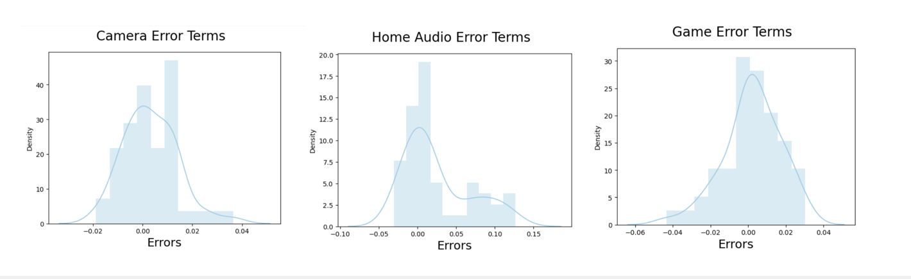
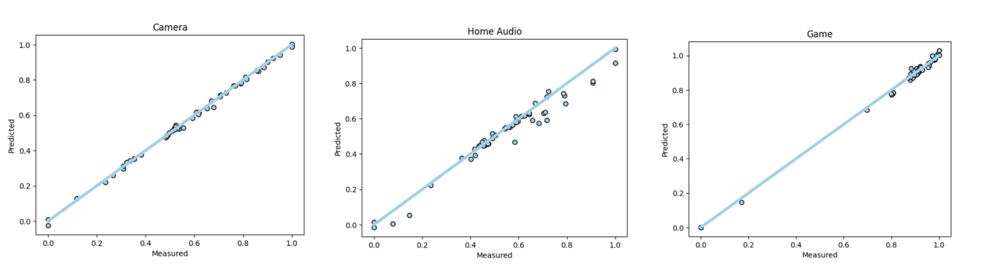
Model Validation
Plotting the distribution of the error terms. The error terms follow a normal distribution with mean at 0 barring a few outlier values.
Plotting a scatter plot with actual and predicted price values from the dataset to check the spread and drawing the best fitted line through it.

Slide 16
Equation for the Best-Fitted Line
Considering the top 5 KPIs from the models for our 3 product subcategories, we can see that the equation of our best-fitted lines is as follows:
Camera Accessory
Revenue = 0.0 + (-0.295 × discount) + (0.260 × product_vertical_dslr) + (0.069
× product_vertical_point_and_shoot) + (0.98 × luxury_product) + (-0.01 × TV)
Home Audio
Revenue = 0.0 + (0.856 × discount) + (0.082 × luxury) + (0.100× product_vertical_boombox) + (-0.065 × product_vertical_dock) + (0.073 × Digital_AD) + (-0.053 × Sponsorship_AD)
Gaming Accessory
Revenue = 0.0 + (0.503 × discount) + (0.540 × product_vertical_gamepad) + (0.077 × product_vertical_joystick) + (-0.060 × product_vertical_motioncontroller) + (-0.693× Online_marketing_AD) + (0.665 × Affiliates_AD)
This equation implies how the revenue can grow with a unit growth in any of these independent KPIs with all other KPIs held constant.

Slide 17
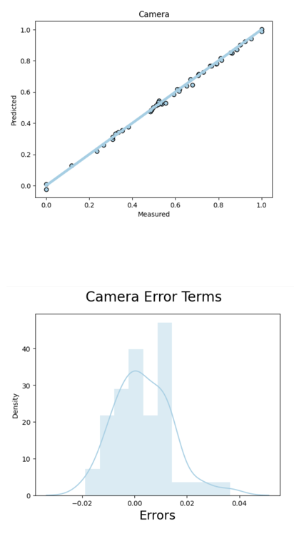
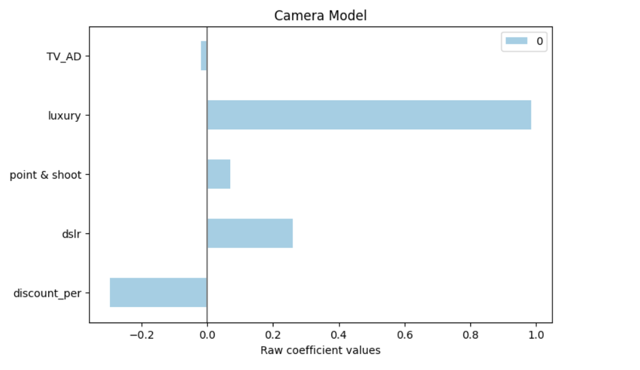
Recommendation
Camera Accessory
Company should promote `dslr’ and ‘point & shoot’ as its gives more revenue compared to other products combined.
A higher percentage of Discounts may not generate higher revenue.
Luxury products can be focused for marketing. Also TV is not a great channel to increase the revenue.

Slide 18
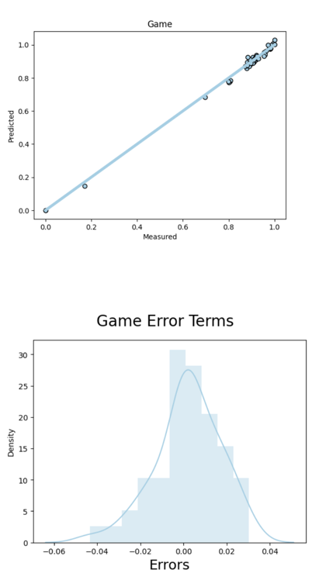
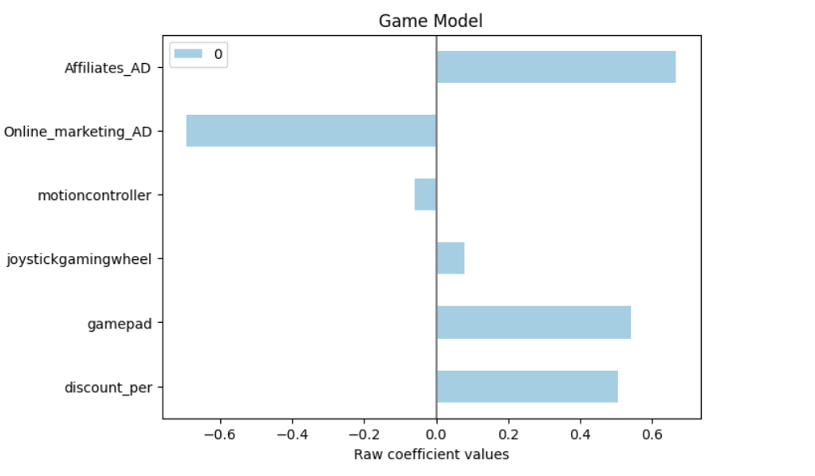
Recommendation
Gaming Accessory
The company should promote `Gaming Headset` and ` Joystick gaming wheel` as they fetch the highest revenue. On the contrary, `Motion Controllers` results in loss.
Advertisement spending on Affiliates has a positive cumulative impact on revenue. Online marketing spends on the other hand has a negative cumulative effect.
A higher percentage of Discounts in general given for this sub-category producing more revenue.

Slide 19
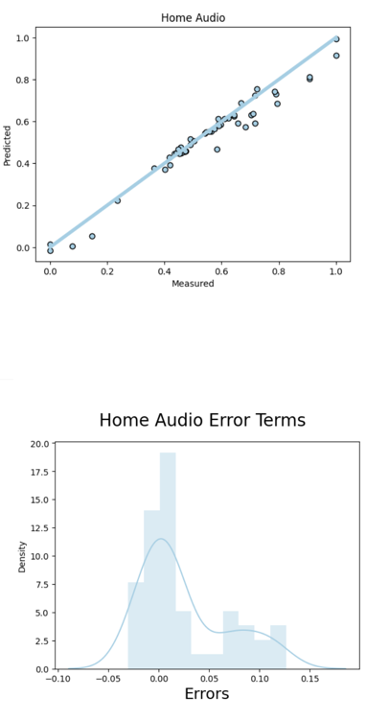
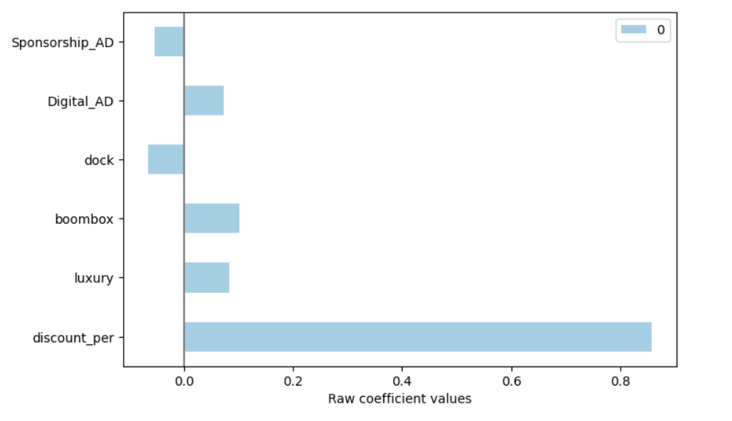
Recommendation
Home Audio
Company should promote `Boombox’ and all high luxury(mrp on higher side) products like ‘DJController’, , ‘Karaokeplayer’, ‘Soundmixer’ and ‘Slingbox’ which can generate high revenue. Boombox is negatively impacting revenue.
Discounts are attracting the customers in home audio section.
Advertisement spends on Digital has a positive impact on revenue while sponsorship is impacting in a negative way.

Slide 20
Thank You

