Slide 1
Interface

Slide 2
Interface
An interface in Java is a blueprint of a class. It has static constants and abstract methods.
The interface in Java is a mechanism to achieve abstraction. There can be only abstract methods in the Java interface, not method body. It is used to achieve abstraction and multiple inheritance in Java.

Slide 3
Why use Java interface?
There are mainly three reasons to use interface. They are given below.
It is used to achieve abstraction.
By interface, we can support the functionality of multiple inheritance.
It can be used to achieve loose coupling.

Slide 4
How to declare an interface?
An interface is declared by using the interface keyword. It provides total abstraction means all the methods in an interface are declared with the empty body, and all the fields are public, static and final by default.
A class that implements an interface must implement all the methods declared in the interface.
Syntax:
interface <interfaceName>{}

Slide 5
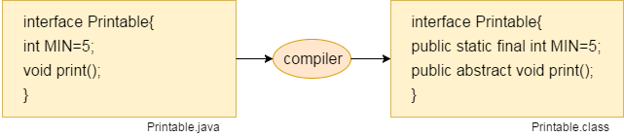
Internal addition by the compiler
The Java compiler adds public and abstract keywords before the interface method. Moreover, it adds public, static and final keywords before data members.

Slide 6
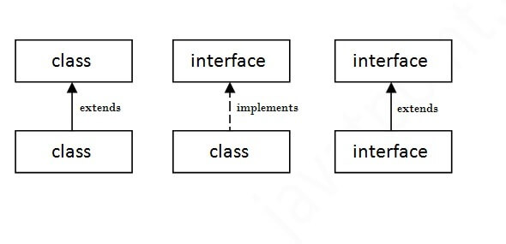
The relationship between classes and interfaces

