Slide 1
JAVA Training

Slide 2
Array
An array is a group of like-typed variables that are referred to by a common name. Arrays of any type can be created and may have one or more dimensions. A specific element in an arrays accessed by its index. Arrays offer a convenient means of grouping related information.

Slide 3
One-Dimensional Arrays
A one-dimensional array is, essentially, a list of like-typed variables. To create an array, you first must create an array variable of the desired type. The general form of a one-dimensional array declaration is:
Syntax: type var-name[];
array-var = new type[size];
Example: int month_days[];
month_days = new int[12];

Slide 4
Program Example
class Array {
public static void main(String args[]) {
int month_days[];
month_days = new int[12];
month_days[0] = 31;
month_days[1] = 28;
month_days[2] = 31;
month_days[3] = 30;
month_days[4] = 31;
month_days[5] = 30;
month_days[6] = 31;
month_days[7] = 31;
month_days[8] = 30;
month_days[9] = 31;
month_days[10] = 30;
month_days[11] = 31;
System.out.println("April has " + month_days[3] + " days.");
}}

Slide 5
Improved Version Of The Previous Program
class AutoArray {
public static void main(String args[]) {
int month_days[] = { 31, 28, 31, 30, 31, 30, 31, 31, 30, 31,
30, 31 };
System.out.println("April has " + month_days[3] + " days.");
}}

Slide 6
Average an array of values.
class Average {
public static void main(String args[]) {
double nums[] = {10.1, 11.2, 12.3, 13.4, 14.5};
double result = 0;
int i;
for(i=0; i<5; i++)
result = result + nums[i];
System.out.println("Average is " + result / 5);
}}

Slide 7
Multidimensional Arrays
Multidimensional arrays are actually arrays of arrays.
To declare a multidimensional array variable, specify each additional
index using another set of square brackets. For example, the following declares a two-dimensional array variable called twoD.
int twoD[][] = new int[4][5];

Slide 8
Demonstrate a Two dimensional Array
class TwoDArray {
public static void main(String args[]) {
int twoD[][]= new int[4][5];
int i, j, k = 0;
for(i=0; i<4; i++)
for(j=0; j<5; j++) {
twoD[i][j] = k;
k++;
}
for(i=0; i<4; i++) {
for(j=0; j<5; j++)
System.out.print(twoD[i][j] + " ");
System.out.println();
}}}

Slide 9
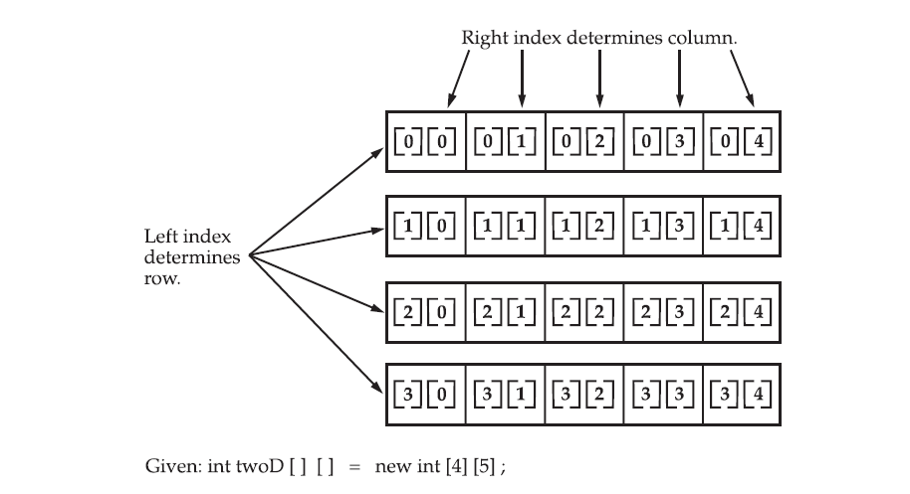
When you allocate memory for a multidimensional array, you need only specify the memory for the first (leftmost) dimension. You can allocate the remaining dimensions seprately.
A conceptual view of a 4 by 5, two-dimensional array in the figure.

Slide 10
Manually Allocate Differing Size Second Dimensions.
class TwoDAgain {
public static void main(String args[]) {
int twoD[][] = new int[4][];
twoD[0] = new int[1];
twoD[1] = new int[2];
twoD[2] = new int[3];
twoD[3] = new int[4];
int i, j, k = 0;
for(i=0; i<4; i++)
for(j=0; j<i+1; j++) {
twoD[i][j] = k;
k++;}
for(i=0; i<4; i++) {
for(j=0; j<i+1; j++)
System.out.print(twoD[i][j] + " ");
System.out.println();
}}}

Slide 11
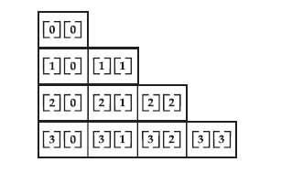
Output:
0
1 2
3 4 5
6 7 8 9
The array created by this program looks like this:

Slide 12
Alternative Array Declaration Syntax
There is a second form that may be used to declare an array:
type[ ] var-name;
Here, the square brackets follow the type specifier, and not the name of the array variable. For example, the following two declarations are equivalent:
int al[] = new int[3];
int[] a2 = new int[3];
Declaring several arrays at the same time. For example,
int[] nums, nums2, nums3; // create three arrays
int nums[], nums2[], nums3[];

