Slide 1
Introduction to class

Slide 2
Class Fundamental
The most important thing to understand about a class is that defines a new data type. Once defined, this new type can be used to create objects of that type.
Class is a template for an object, and an object is an instance of a class.
A class is declared by the use of the class keyword.

Slide 3
A general form of class
class Classname{
type instance-variable1;
type instance-variable2;
//……
type instance-variableN;
type methodname1(parameter-list){
// body of method
}
type methodname2(parameter-list){
//body of method
}
………….
}

Slide 4
The data, or variables, defined within a class are called instance variables. The code is contained within methods.
Collectively, the methods and variables defined within a class are called members of the class.
In most classes, the instance variables are acted upon and accessed by the methods defined for that class. Thus, as a general rule, it is the methods that determine how a class’ data can be used.
Variables defined within a class are called instance variables because each instance of the class contains its own copy of these variables.
Thus, the data for one object is separate and unique from the data for another.

Slide 5
A Simple Class
Here is a class called Box that defines three instance variables: width, height, and depth. Currently, Box does not contain any methods.
Class Box{
double width;
double hight;
double depth;
}

Slide 6
A class defines a new type of data. In this case, the new data type is called Box.
You will use this name to declare objects of type Box. It is important to remember that a class declaration only creates a template; it does not create an actual object.
Box mybox = new Box(); // mybox will be an instance of Box

Slide 7
Declaring Objects
When you create a class, you are creating a new data type. You can use this type to declare objects of that type. However, obtaining objects of a class is a two-step process.
First, you must declare a variable of the class type. This variable does not define an object. Instead, it is simply a variable that can refer to an object.
Second, you must acquire an actual, physical copy of the object and assign it to that variable. You can do this using the new operator. The new operator dynamically allocates memory for an object and returns a reference to it.
Box mybox; // declare reference to object
mybox = new Box(); // allocate a Box object

Slide 8
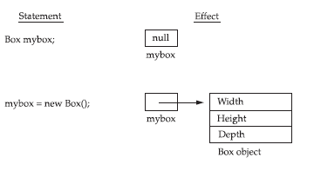
A Closer Look at new
As just explained, the new operator dynamically allocates memory for an object. It has this general form:
class-var = new classname();

Slide 9
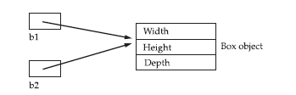
Assigning Object Reference Variables
Object reference variables act differently than you might expect when an assignment takes place. For example, what do you think the following fragment does?
Box b1 = new Box();
Box b2 = b1;

