Slide 1
String

Slide 2
String
In Java, string is basically an object that represents sequence of char values. An array of characters works same as Java string. For example:
char[] ch= {‘q',‘u',‘i',‘c',‘k',‘c','o',‘d',‘e',‘r'};
String s = new String(ch);
String s = " quickcoder" ; // is same as previous one

Slide 3
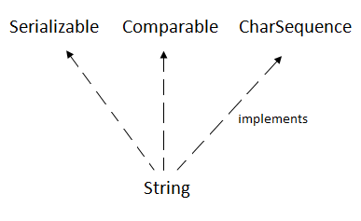
Java String class provides a lot of methods to perform operations on strings such as compare(), concat(), equals(), split(), length(), replace(), compareTo(), intern(), substring() etc.
The java.lang.String class implements Serializable, Comparable and CharSequence interfaces.

Slide 4
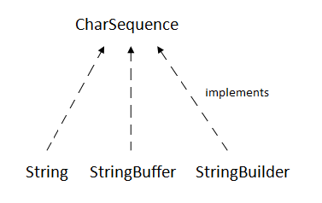
CharSequence Interface
The CharSequence interface is used to represent the sequence of characters. String, StringBuffer and StringBuilder classes implement it. It means, we can create strings in Java by using these three classes.

Slide 5
How to create a string object?
There are two ways to create String object:
By String literal
By new keyword

Slide 6
String Literal
Java String literal is created by using double quotes. For Example:
String s="welcome";
Each time you create a string literal, the JVM checks the "string constant pool" first. If the string already exists in the pool, a reference to the pooled instance is returned. If the string doesn't exist in the pool, a new string instance is created and placed in the pool.

Slide 7
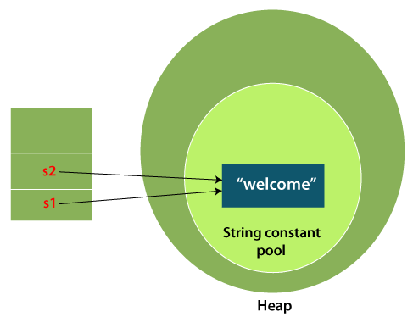
Example
String s1="Welcome";
String s2="Welcome";//It doesn't create a new instance

Slide 8
Why Java uses the concept of String literal?
To make Java more memory efficient (because no new objects are created if it exists already in the string constant pool).

Slide 9
By new keyword
String s = new String(“Welcome”);
In such case, JVM will create a new string object in normal (non-pool) heap memory, and the literal "Welcome" will be placed in the string constant pool. The variable s will refer to the object in a heap (non-pool).

Slide 10
Immutable String in Java
A String is an unavoidable type of variable while writing any application program. String references are used to store various attributes like username, password, etc.
In Java, String objects are immutable. Immutable simply means unmodifiable or unchangeable.
Once String object is created its data or state can't be changed but a new String object is created.

Slide 11
Example
class Testimmutablestring{
public static void main(String args[]){
String s="Sachin";
s.concat(" Tendulkar");//concat() method appends the string at the end
System.out.println(s);//will print Sachin because strings are immutable objects
}
}

Slide 12
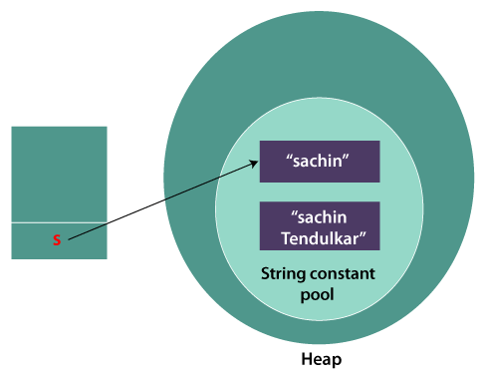
Now it can be understood by the diagram given below. Here Sachin is not changed but a new object is created with Sachin Tendulkar. That is why String is known as immutable.
As you can see in the above figure that two objects are created but s reference variable still refers to "Sachin" not to "Sachin Tendulkar".
But if we explicitly assign it to the reference variable, it will refer to "Sachin Tendulkar" object

Slide 13
Why String objects are immutable in Java?
Why String class is Final in Java?

Slide 14
StringBuffer Class
Java StringBuffer class is used to create mutable (modifiable) String objects. The StringBuffer class in Java is the same as String class except it is mutable i.e. it can be changed.
Important Constructors of StringBuffer Class
Constructor | Description
StringBuffer() | It creates an empty String buffer with the initial capacity of 16.
StringBuffer(String str) | It creates a String buffer with the specified string..
StringBuffer(int capacity) | It creates an empty String buffer with the specified capacity as length.

Slide 15
Important methods of StringBuffer class
Modifier and Type | Method | Description
public synchronized StringBuffer | append(String s) | It is used to append the specified string with this string. The append() method is overloaded like append(char), append(boolean), append(int), append(float), append(double) etc.
public synchronized StringBuffer | insert(int offset, String s) | It is used to insert the specified string with this string at the specified position. The insert() method is overloaded like insert(int, char), insert(int, boolean), insert(int, int), insert(int, float), insert(int, double) etc.
public synchronized StringBuffer | replace(int startIndex, int endIndex, String str) | It is used to replace the string from specified startIndex and endIndex.
public synchronized StringBuffer | delete(int startIndex, int endIndex) | It is used to delete the string from specified startIndex and endIndex.
public synchronized StringBuffer | reverse() | is used to reverse the string.

Slide 16
public int | capacity() | It is used to return the current capacity.
public void | ensureCapacity(int minimumCapacity) | It is used to ensure the capacity at least equal to the given minimum.
public char | charAt(int index) | It is used to return the character at the specified position.
public int | length() | It is used to return the length of the string i.e. total number of characters.
public String | substring(int beginIndex) | It is used to return the substring from the specified beginIndex.
public String | substring(int beginIndex, int endIndex) | It is used to return the substring from the specified beginIndex and endIndex.

Slide 17
StringBuilder Class
Java StringBuilder class is used to create mutable (modifiable) String. The Java StringBuilder class is same as StringBuffer class except that it is non-synchronized. It is available since JDK 1.5.

Slide 18
Important Constructors of StringBuilder class
Constructor | Description
StringBuilder() | It creates an empty String Builder with the initial capacity of 16.
StringBuilder(String str) | It creates a String Builder with the specified string.
StringBuilder(int length) | It creates an empty String Builder with the specified capacity as length.

Slide 19
Important methods of StringBuilder class
Method | Description
public StringBuilder append(String s) | It is used to append the specified string with this string. The append() method is overloaded like append(char), append(boolean), append(int), append(float), append(double) etc.
public StringBuilder insert(int offset, String s) | It is used to insert the specified string with this string at the specified position. The insert() method is overloaded like insert(int, char), insert(int, boolean), insert(int, int), insert(int, float), insert(int, double) etc.
public StringBuilder replace(int startIndex, int endIndex, String str) | It is used to replace the string from specified startIndex and endIndex.
public StringBuilder delete(int startIndex, int endIndex) | It is used to delete the string from specified startIndex and endIndex.
public StringBuilder reverse() | It is used to reverse the string.

Slide 20
Method | Description
public int capacity() | It is used to return the current capacity.
public void ensureCapacity(int minimumCapacity) | It is used to ensure the capacity at least equal to the given minimum.
public char charAt(int index) | It is used to return the character at the specified position.
public int length() | It is used to return the length of the string i.e. total number of characters.
public String substring(int beginIndex) | It is used to return the substring from the specified beginIndex.
public String substring(int beginIndex, int endIndex) | It is used to return the substring from the specified beginIndex and endIndex.

Slide 21
String Vs String Builder
No. | String | StringBuffer
1) | The String class is immutable. | The StringBuffer class is mutable.
2) | String is slow and consumes more memory when we concatenate too many strings because every time it creates new instance. | StringBuffer is fast and consumes less memory when we concatenate t strings.
3) | String class overrides the equals() method of Object class. So you can compare the contents of two strings by equals() method. | StringBuffer class doesn't override the equals() method of Object class.
4) | String class is slower while performing concatenation operation. | StringBuffer class is faster while performing concatenation operation.
5) | String class uses String constant pool. | StringBuffer uses Heap memory

Slide 22
StringBuffer Vs StringBuilder
Java provides three classes to represent a sequence of characters: String, StringBuffer, and StringBuilder.
No. | StringBuffer | StringBuilder
1) | StringBuffer is synchronized i.e. thread safe. It means two threads can't call the methods of StringBuffer simultaneously. | StringBuilder is non-synchronized i.e. not thread safe. It means two threads can call the methods of StringBuilder simultaneously.
2) | StringBuffer is less efficient than StringBuilder. | StringBuilder is more efficient than StringBuffer.
3) | StringBuffer was introduced in Java 1.0 | StringBuilder was introduced in Java 1.5

Slide 23
Java toString() Method
If you want to represent any object as a string, the toString() method comes into existence.
The toString() method returns the String representation of the object.
If you print any object, the Java compiler internally invokes the toString() method on the object. So overriding the toString() method, returns the desired output, it can be the state of an object etc. depending on your implementation.

Slide 24
Advantage
By overriding the toString() method of the Object class, we can return values of the object, so we don't need to write much code.

Slide 25
Understanding problem without toString() method
class Student{
int rollno;
String name;
String city;
Student(int rollno, String name, String city){
this.rollno=rollno;
this.name=name;
this.city=city;
}
public static void main(String args[]){
Student s1=new Student(101,"Rajan",“Manigram");
Student s2=new Student(102,“Hari",“Butwal");
System.out.println(s1);//compiler writes here s1.toString()
System.out.println(s2);//compiler writes here s2.toString()
} }

Slide 26

Output:
As you can see in the example, printing s1 and s2 prints the hashcode values of the objects but I want to print the values of these objects. Since Java compiler internally calls toString() method, overriding this method will return the specified values. Let's understand it with the example given below:

Slide 27
Example of Java toString() method
class Student{
int rollno;
String name;
String city;
Student(int rollno, String name, String city){
this.rollno=rollno;
this.name=name;
this.city=city;
}
public String toString(){//overriding the toString() method
return rollno+" "+name+" "+city;
}
public static void main(String args[]){
Student s1=new Student(101,"Rajan",“Manigram");
Student s2=new Student(102,“Hari",“Butwal");
System.out.println(s1);//compiler writes here s1.toString()
System.out.println(s2);//compiler writes here s2.toString()
}}

Slide 28

Output:
In the above program, Java compiler internally calls toString() method, overriding this method will return the specified values of s1 and s2 objects of Student class.

