Slide 1
Introduction to class

Slide 2
Class Fundamental
The most important thing to understand about a class is that defines a new data type. Once defined, this new type can be used to create objects of that type.
Class is a template for an object, and an object is an instance of a class.
A class is declared by the use of the class keyword.

Slide 3
A general form of class
class Classname{
type instance-variable1;
type instance-variable2;
//……
type instance-variableN;
type methodname1(parameter-list){
// body of method
}
type methodname2(parameter-list){
//body of method
}
………….
}

Slide 4
The data, or variables, defined within a class are called instance variables. The code is contained within methods.
Collectively, the methods and variables defined within a class are called members of the class.
In most classes, the instance variables are acted upon and accessed by the methods defined for that class. Thus, as a general rule, it is the methods that determine how a class’ data can be used.
Variables defined within a class are called instance variables because each instance of the class contains its own copy of these variables.
Thus, the data for one object is separate and unique from the data for another.

Slide 5
A Simple Class
Here is a class called Box that defines three instance variables: width, height, and depth. Currently, Box does not contain any methods.
Class Box{
double width;
double hight;
double depth;
}

Slide 6
A class defines a new type of data. In this case, the new data type is called Box.
You will use this name to declare objects of type Box. It is important to remember that a class declaration only creates a template; it does not create an actual object.
Box mybox = new Box(); // mybox will be an instance of Box

Slide 7
Declaring Objects
When you create a class, you are creating a new data type. You can use this type to declare objects of that type. However, obtaining objects of a class is a two-step process.
First, you must declare a variable of the class type. This variable does not define an object. Instead, it is simply a variable that can refer to an object.
Second, you must acquire an actual, physical copy of the object and assign it to that variable. You can do this using the new operator. The new operator dynamically allocates memory for an object and returns a reference to it.
Box mybox; // declare reference to object
mybox = new Box(); // allocate a Box object

Slide 8
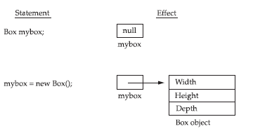
A Closer Look at new
As just explained, the new operator dynamically allocates memory for an object. It has this general form:
class-var = new classname();

Slide 9
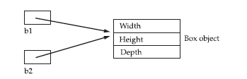
Assigning Object Reference Variables
Object reference variables act differently than you might expect when an assignment takes place. For example, what do you think the following fragment does?
Box b1 = new Box();
Box b2 = b1;

Slide 10
Methods
A method is a block of code that only runs when it is called.
You can pass data, known as parameters, into a method.
Methods are used to perform certain actions, and they are also known as functions.
Why use the method?

Slide 11
General Form of a method:
Type name(parameter-list) {
// Body of method
}

Slide 12
Adding a method to the Box class
class Box {
double width, height, depth;
// display volume of a box
void volume(){
System.out.println(“Volume is ” + width + height + depth);
}
}

Slide 13
Returning a Value
While the implementation of volume( ) does move the computation of a box’s volume inside the Box class where it belongs, it is not the best way to do it.
For example, what if another part of your program wanted to know the volume of a box, but not display its value?
A better way to implement volume() is to have it compute the volume of the box and return the result to the caller.

Slide 14
// Now, volume() returns the volume of a box
class Box {
double width;
double height;
double depth;
// compute and return volume
double volume() {
return width * height * depth;
}
}

Slide 15
Adding a Method That Takes Parameters
Parameters allow a method to be generalized.
That is, a parameterized method can operate on a variety of data and/or be used in a number of slightly different situations
For example:
Int square() Int square(int i)
{ {
return 10 * 10; return i * i;
} }

Slide 16
Constructor
A constructor is a block of codes similar to the method. It is called when an instance of the class is created.
At the time of calling the constructor, memory for the object is allocated in the memory.
Every time an object is created using the new() keyword, at least one constructor is called.
It calls a default constructor if there is no constructor available in the class. In such cases, Java compiler provides a default constructor by default

Slide 17
Types Of Constructor
There are two types of constructor:
No-args constructor
Parameterized constructor.

Slide 18
Rules for creating Java constructor
There are three rules defined for the constructor
Constructor name must be the same as its class name
A Constructor must have no explicit return type
A Java constructor cannot be abstract, static, final and synchronized

Slide 19
Default Constructor(no-args constructor)
A constructor is called Default Constructor when it doesn’t have any parameter.
Syntax:
<class_name>()
{
}

Slide 20
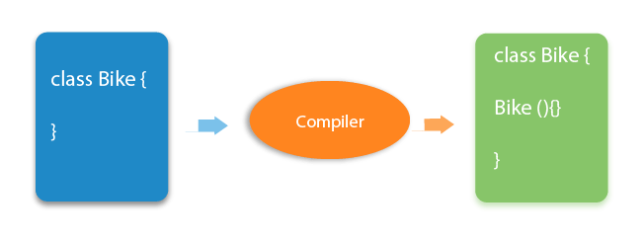

Slide 21
What is the purpose of a default constructor?
The default constructor is used to provide the default values to the object like 0, null, etc., depending on the type.

Slide 22
Example
class Employee{
int id;
String name;
void display(){System.out.println(id+" "+name);}
public static void main(String args[]){
Employee e1=new Employee();
Employee e2=new Employee();
e1.display();
e2.display();
} }

Slide 23
Parameterized Constructor
A constructor which has a specific number of parameters is called a parameterized constructor.
Why use the parametrized constructor?
The parameterized constructor is used to provide different values to distinct objects. However, you can provide the same values also.

Slide 24
Example
class Employee{
int id;
String name;
//creating a parameterized constructor
Employee(int i,String n){
id = i;
name = n;
}
//method to display the values
void display(){System.out.println(id+" "+name);}
public static void main(String args[]){
//creating objects and passing values
Employee e1 = new Employee (1,“Ram");
Employee e2 = new Employee (2,“Shyam");
e1.display();
e2.display();
} }

Slide 25
Constructor Overloading
A constructor is just like a method but without return type. It can also be overloaded like Java methods.
Constructor overloading is a technique of having more than one constructor with different parameter lists.
They are arranged in a way that each constructor performs a different task.
They are differentiated by the compiler by the number of parameters in the list and their types.

Slide 26
Example
class Employee{
int id;
String name;
int age;
//creating two arg constructor
Employee(int i,String n){
id = i;
name = n;
}
//creating three arg constructor
Employee(int i,String n,int a){
id = i;
name = n;
age=a;
} }

Slide 27
Copy Constructor
There is no copy constructor in Java. However, we can copy the values from one object to another like copy constructor in C++.
There are many ways to copy the values of one object into another in Java. They are:
By constructor
By assigning the values of one object into another
By clone() method of Object class

Slide 28
Example
// In this example, we are going to copy the values of one object into another using Java constructor
class Employee{
int id;
String name;
//constructor to initialize integer and string
Employee(int i,String n){
id = i;
name = n;
}
//constructor to initialize another object
Employee(Employee e){
id = e.id;
name =e.name;
}
void display(){System.out.println(id+" "+name);}
public static void main(String args[]){
Employee e1 = new Employee(111,"Karan");
Employee e2 = new Employee(e1);
e1.display();
e2.display(); }}

Slide 29
Copying values without constructor
class Employee{
int id;
String name;
Employee(int i,String n){
id = i;
name = n; }
Employee(){}
void display(){System.out.println(id+" "+name);}
public static void main(String args[]){
Employee e1 = new Employee(1,“Ram");
Employee e2 = new Employee();
e2.id=e1.id;
e2.name=e1.name;
e1.display();
e2.display();
} }

Slide 30
Questions
Difference between constructor and method in Java
Does constructor return any value?
Can constructor perform other tasks instead of initialization?
Is there Constructor class in Java?
What is the purpose of Constructor class?

