Slide 1
JAVA TRAINING

Slide 2
JAVA VARIABLE
A variable is a container which holds the value while the program is executed. A variable is assigned with a data type.
Variable is a name of memory location.

Slide 3
Types of Variable
There are three types of data types in java:
Local Variable
Instance Variable
Static Variable

Slide 4
Local Variable
A variable declared inside the body of the method is called local variable.
Example:
void method()
{
int n = 90;
}

Slide 5
Instance Variable
A variable declared inside the class but outside the body of the method, is called an instance variable. It is not declared as static.
Example:
class Demo{ public static void main(String args[])
{
int data = 50;
}
}

Slide 6
Static Variable
A variable that is declared as static is called a static variable. It cannot be local. You can create a single copy of the static variable and share it among all the instances of the class.
Memory allocation for static variables happens only once when the class is loaded in the memory.
Example:
public class A
{
static int num = 90;
public static void main(String args[])
{
}
}

Slide 7
Typecasting
Type casting is when you assign a value of one primitive data type to another type.
In Java, there are two types of casting:
Widening Casting(Automatically)
Norrowing Casting(manually)

Slide 8
Widening Casting
Converting a smaller type to a larger type size
byte -> short -> char -> int -> long -> float -> double
Example:
public class DemoWideningCasting{
public static void main(String[] args) {
int intValue = 9;
double doubleValue = intValue;
System.out.println(intValue); //outputs 9
System.out.println(doubleValue); //outputs 9.0
}
}

Slide 9
Norrowing Casting
Converting a larger type to a smaller size type
double -> float -> long -> int -> char -> short -> byte
Example:
public class DemoWideningCasting{
public static void main(String[] args) {
double doubleValue = 9.78;
int intValue =(int) doubleValue; // manual casting: double to int
System.out.println(doubleValue); //outputs 9.78
System.out.println(intValue); //outputs 9
}
}

Slide 10
Data Types
Data types specify the different sizes and values that can be stored in the variable. There are two types of data types in Java
Primitive data Types
Non-primitive data Types

Slide 11
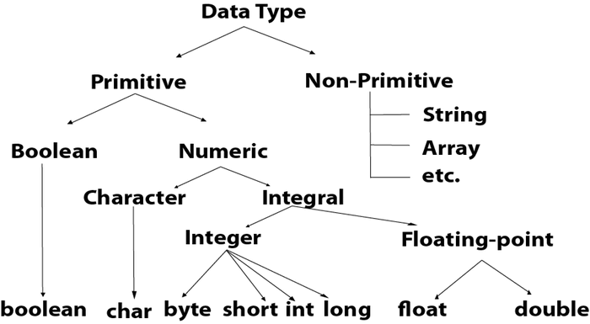

Slide 12
Primitive Data Types
Primitive data types are the building blocks of data manipulation.
These are the most basic data types available in Java language:
boolean
byte
char
short
int
long
float
double

Slide 13
Non-primitive
Classes
Interfaces
Arrays

Slide 14
Data Type | Default Value | Default size
boolean | false | 1 bit
char | '\u0000' | 2 byte
byte | 0 | 1 byte
short | 0 | 2 byte
int | 0 | 4 byte
long | 0L | 8 byte
float | 0.0f | 4 byte
double | 0.0d | 8 byte

Slide 15
Boolean
The Boolean data type is used to store only two possible values: true and false. This data type is used for simple flags that track true/false conditions.
Example: Boolean val = false
Byte
The byte data type is used to save memory in large arrays where memory savings is most required. It saves space because a byte is 4 times smaller than an integer. It can also be used in place of the "int" data type.
It is an 8-bit signed two's complement integer. Its value range lies between -128 to 127 (inclusive). Its minimum value is -128 and the maximum value is 127. Its default value is 0.
Example: byte a = 10

Slide 16
Short
The short data type is a 16-bit signed two's complement integer.
The short data type can also be used to save memory just like the byte data type. A short data type is 2 times smaller than an integer.
Example: short s = 10000, short r = -5000
Int
The int data type is a 32-bit signed two's complement integer.
The int data type is generally used as a default data type for integral values unless if there is no problem with memory. Its default value is 0.
Example: int num = 100000, int num2 = -200000

Slide 17
Long
The long data type is a 64-bit two's complement integer.
The long data type is used when you need a range of values more than those provided by int. Its default value is 0.
Example: long a = 100000L, long b = -200000L
Float
The float data type is a single-precision 32-bit IEEE 754 floating point. Its value range is unlimited. It is recommended to use a float (instead of a double) if you need to save memory in large arrays of floating point numbers. The float data type should never be used for precise values, such as currency. Its default value is 0.0F.
Example: float f1 = 254.5f

Slide 18
Double
The double data type is a double-precision 64-bit IEEE 754 floating point. Its value range is unlimited. The double data type is generally used for decimal values just like float. The double data type also should never be used for precise values, such as currency. Its default value is 0.0d.
Example: double d1 = 12.3
Char
The char data type is a single 16-bit Unicode character. Its value-range lies between '\u0000' (or 0) to '\uffff' (or 65,535 inclusive).The char data type is used to store characters.
Example: char letterA = 'A'

Slide 19
Why char uses 2 byte in java and what is \u0000 ?
It is because Java uses the Unicode system, not the ASCII code system. The \u0000 is the lowest range of the Unicode system.

Slide 20
Unicode System
Unicode is a universal international standard character encoding that is capable of representing most of the world's written languages.
Why java uses Unicode System?
Before Unicode, there were many language standards:
ASCII (American Standard Code for Information Interchange) for the United States.
ISO 8859-1 for Western European Language.
This caused two problems:
A particular code value corresponds to different letters in the various language standards.
The encodings for languages with large character sets have variable length.Some common characters are encoded as single bytes, other require two or more byte.
To solve these problems, a new language standard was developed i.e. Unicode System
In unicode, character holds 2 byte, so java also uses 2 byte for characters.
Lowes Value: \u0000 Highest Value: \uFFFFF

Slide 21
Operators
Operator in Java is a symbol that is used to perform operations.
For example: +, -, *, / etc.
Types Of Operator:
Unary Operator
Arithmetic Operator
Shift Operator
Relational Operator
Bitwise Operator
Logical Operator
Ternary Operator
Assignment Operator

Slide 22
Operator Precedence
Operator Type | Category | Precedence
Unary | postfix | expr++ expr--
 | prefix | ++expr --expr +expr -expr ~ !
Arithmetic | multiplicative | * / %
 | additive | + -
Shift | shift | << >> >>>
Relational | comparison | < > <= >= instanceof
 | equality | == !=
Bitwise | bitwise AND | &
 | bitwise exclusive OR | ^
 | bitwise inclusive OR | |
Logical | logical AND | &&
 | logical OR | ||
Ternary | ternary | ? :
Assignment | assignment | = += -= *= /= %= &= ^= |= <<= >>= >>>=

Slide 23
Unary Operator
The Java unary operators require only one operand. Unary operators are used to perform various operations:
incrementing/decrementing a value by one
negating an expression
inverting the value of a Boolean
Example: ++ and –
public class OperatorExample{
public static void main(String args[]){
int x=10;
System.out.println(x++);//10 (11)
System.out.println(++x);//12
System.out.println(x--);//12 (11)
System.out.println(--x);//10
}
}

Slide 24
Example 2: ~ and!
public class OperatorExample{
public static void main(String args[]){
int a=10;
int b=-10;
boolean c=true;
boolean d=false;
System.out.println(~a);//-11 (minus of total positive value which starts from 0)
System.out.println(~b);//9 (positive of total minus, positive starts from 0)
System.out.println(!c);//false (opposite of boolean value)
System.out.println(!d);//true
}}

