Slide 1
Science Day Hackathon 2025
P.S.1 - Change Detection in Satellite Imagery
By: Prajakta Mali
Shailja Mamgain
Bhoomika Ghale

Slide 2
Background
Data Used
Change detection is the process of identifying differences in land cover or surface features over time using satellite images
Helps in environmental monitoring, urban expansion analysis, disaster management, and deforestation studies
Satellite | : | Sentinel-2
Agency | : | European Space Agency (ESA)
Spatial Resolution | : | 10m, 20m, 60m (depending on the band)
Spectral Bands | : | 13 bands (Visible, NIR, SWIR)
Revisit Time | : | 5 days (at the equator)
Swath Width | : | 290 km

Slide 3
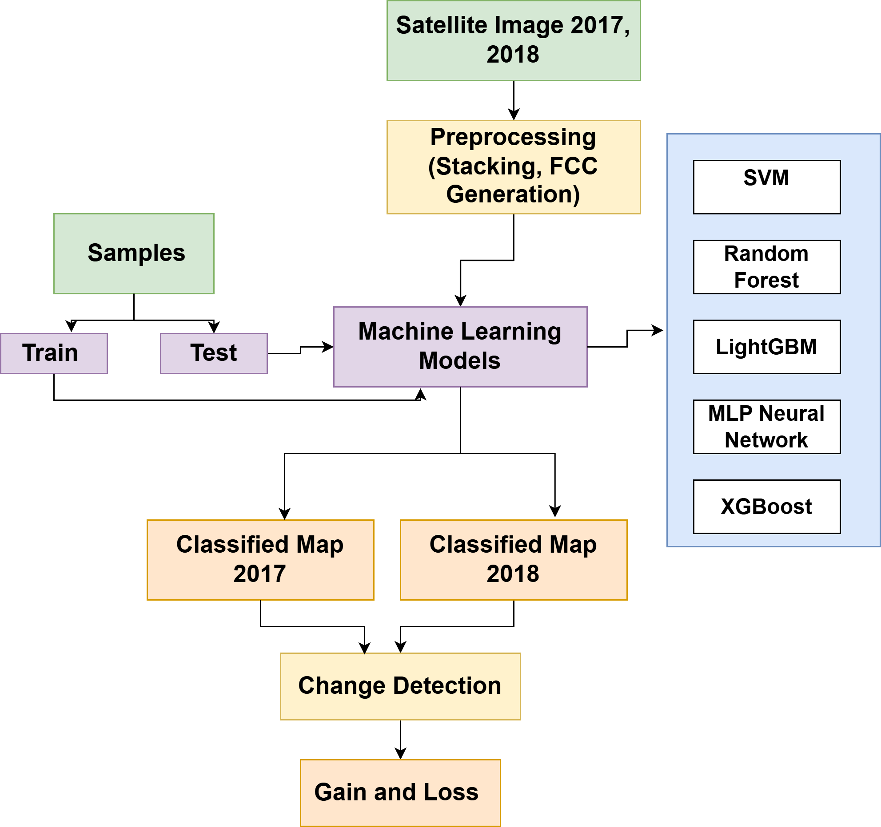
Methodology

Slide 4
Models used
Model | Type | Advantages | Limitations
SVM (Support Vector Machine) | Supervised ML | Effective for small datasets, handles non-linearity well | Computationally expensive for large datasets
Random Forest (RF) | Ensemble ML | Robust, reduces overfitting, interpretable | Slower for large datasets; may struggle with high-dimensional data
LightGBM (LGBM) | Gradient Boosting | Fast training, handles large datasets well | Can be sensitive to hyperparameters
MLP Neural Network | Deep Learning | Can learn complex patterns | Requires more data and computational power
XGBoost | Gradient Boosting | High accuracy, handles missing values well | Computationally intensive for large datasets

Slide 5
Model Performance & Classification Results
Model Performance (Accuracy)
2017
SVM: 93.55%
Random Forest: 95.70%
LightGBM: 95.70%
MLP Neural Network: 94.62%
XGBoost: 93.55%
2018
SVM: 94.12%
Random Forest: 96.30%
LightGBM: 96.10%
MLP Neural Network: 95.20%
XGBoost: 94.00%
Best Performing Models:
Random Forest & LightGBM

Slide 6
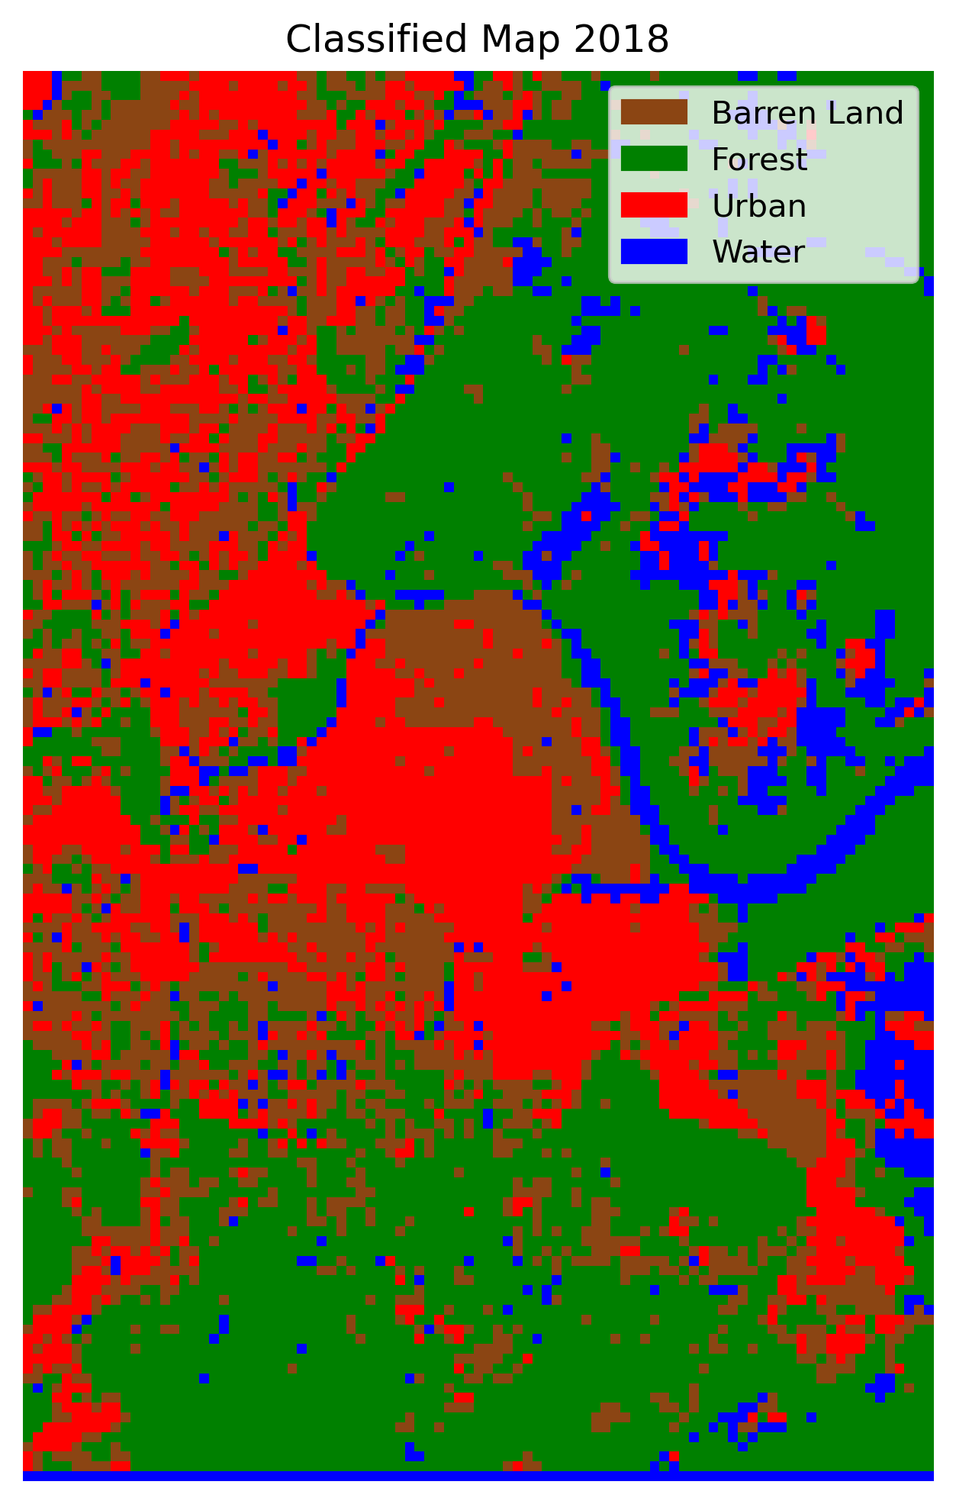
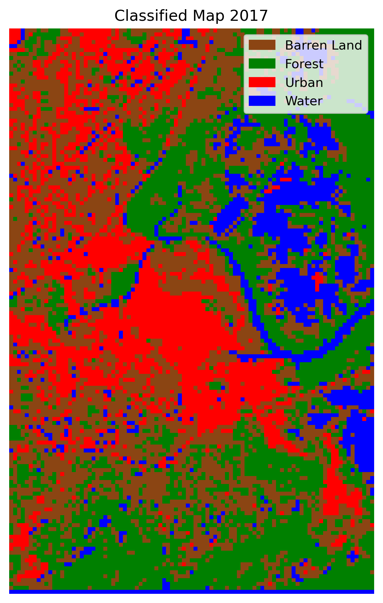
Classified Maps (Random Forest Method)

Slide 7
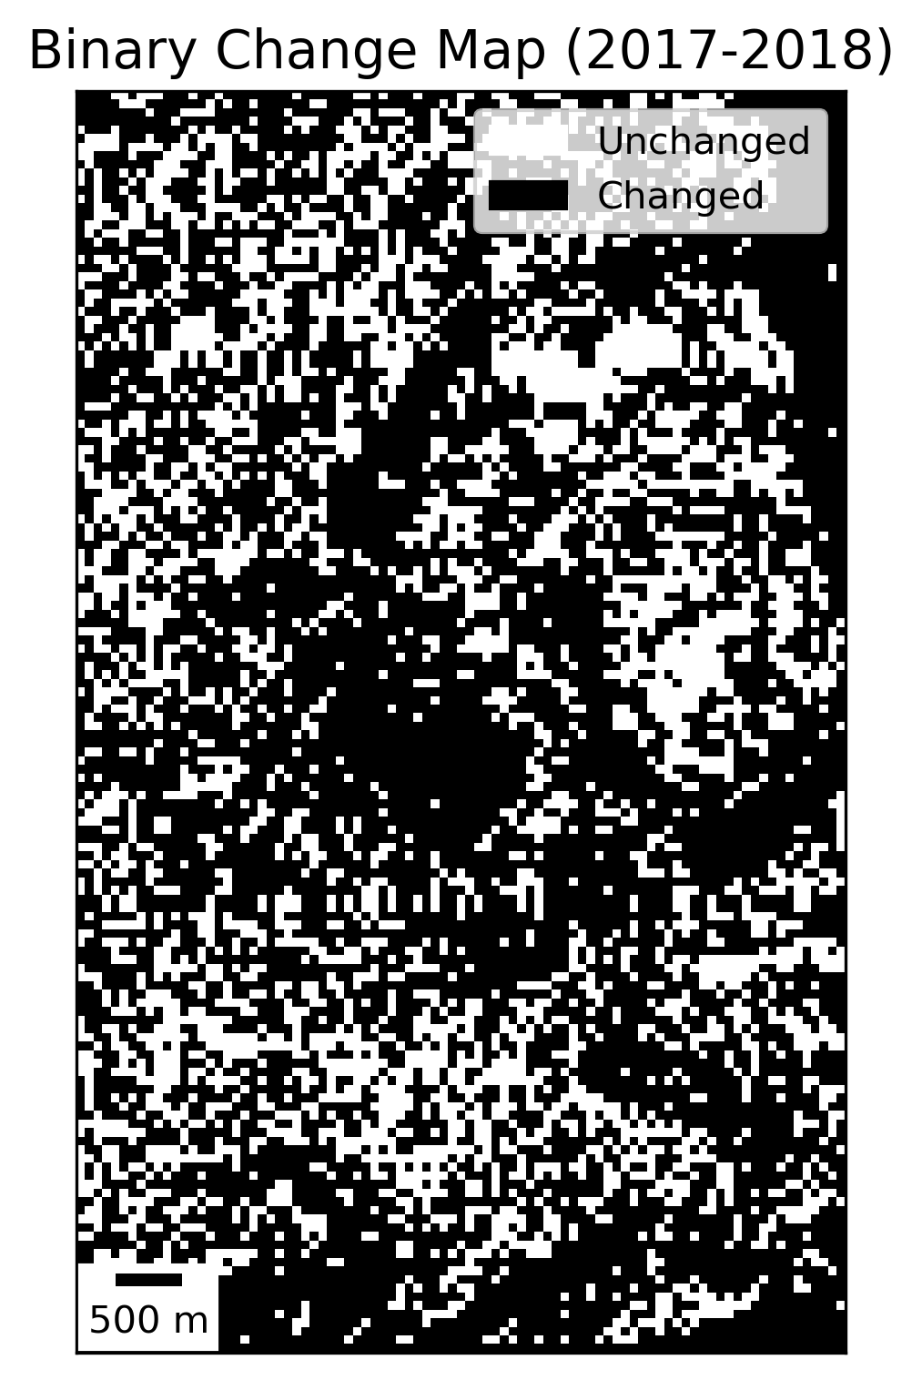
Binary Change Map for 2017 and 2018

Slide 8
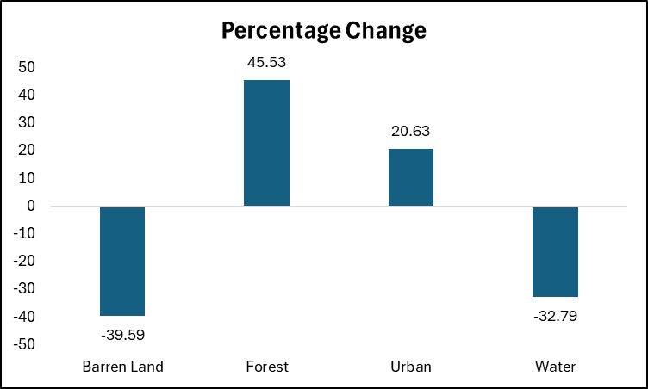
Area Gain and Loss Analysis (2017-2018)
Class | 2017 Area (m²) | 2018 Area (m²) | Area Gain (m²) | Area Loss (m²)
Barren Land | 498,100 | 300,900 | 0 | 197,200
Forest | 424,700 | 618,100 | 193,400 | 0
Urban | 262,700 | 316,900 | 54,200 | 0
Water | 153,700 | 103,300 | 0 | 50,400
Key Observations
Barren Land: Significant loss of 197,200 m² in the past year.
Forest: 193,400 m² gain, indicating forest expansion.
Urban: Urban areas grew by 54,200 m².
Water: Water bodies lost 50,400 m², likely due to reduced water levels.

Slide 9
Conclusion
The random forest model outperformed other models (support vector machine, LightGBM, MLP neural network, and XGBoost) for classification.
Forest experienced the largest growth (45.54%), while barren land and water showed significant declines (39.59% and 32.79%, respectively), highlighting shifts in land use and environmental factors.
Urban areas increased by 20.63%, indicating moderate expansion of urbanization or infrastructure.

