Slide 1

PURBANCHAL UNIVERSITY INSTITUTE OF SCIENCE
AND TECHNOLOGY​
​
KISt COLLEGE OF INFORMATION TECHNOLOGY
A Presentation On: INVENTORY MANAGEMENT SYSTEM
SUBMITTED BY:
Khum Bahadur Bista [341695]
Prajum Bhaila [341702]
Shilbiya Rai [341715]
SUBMITTED TO:
Faculty of Science and Technology, Purbanchal University

Slide 2

TABLE OF CONTENTS
01 Introduction
02 Problem Statement
03 Objectives
04 Scope and Limitations
05 Methodology
06 Literature Review
07 System Analysis
08 System Design
09 Algorithm / Flowchart
10 Implementation
11 Testing and Results
12 Conclusion, Future Work, References

Slide 3
INTRODUCTION
The Inventory Management System (IMS) is a Java desktop application that helps a small shop keep records of products, categories, customers, users and sales orders in one place.
Users log in with a role (Super Admin or Admin), record products under categories, select a customer and add items to a cart. The system reduces stock automatically and generates a PDF bill.
Built with Java Swing (NetBeans), MySQL through JDBC, and the iText library for PDF bills, using a clean object-oriented structure (screen classes, dao and common packages).

Slide 4
PROBLEM STATEMENT
Small shops still keep stock and sales in paper registers or loose spreadsheets, which causes:
Time consumption: searching products, customers or old bills and writing bills by hand is slow.
Redundancy and inconsistency: the same details are repeated in many places.
Calculation errors: manual totals and stock counts lead to wrong bills.
Poor tracking: no easy order history per customer or live stock quantity.
No access control: anyone can change records; owner and staff rights are not separated.

Slide 5
OBJECTIVES
To build a secure login module that allows only active users and shows menus according to the user role.
To manage users, categories, products and customers with validation of names, mobile numbers, e-mail, quantity and price.
To maintain product stock and reduce it automatically on every order, rejecting orders above available quantity.
To provide a cart-based order module that calculates totals, saves the order against a customer and generates a PDF bill.

Slide 6
SCOPE AND LIMITATIONS
Scope
Limitations
Seven modules: Login/Logout, User, Category, Product, Customer, Order (cart and billing) and View Order.
Users: Super Admin (owner, all modules) and Admin (staff, no User module).
Runs on a single computer with a local MySQL server.
Desktop only; no web or multi-branch support.
No suppliers, purchase orders, returns, discounts, tax or online payment.
Passwords stored as plain text; no delete or search option.
PDF bills saved to a fixed D:\ folder (Windows).

Slide 7
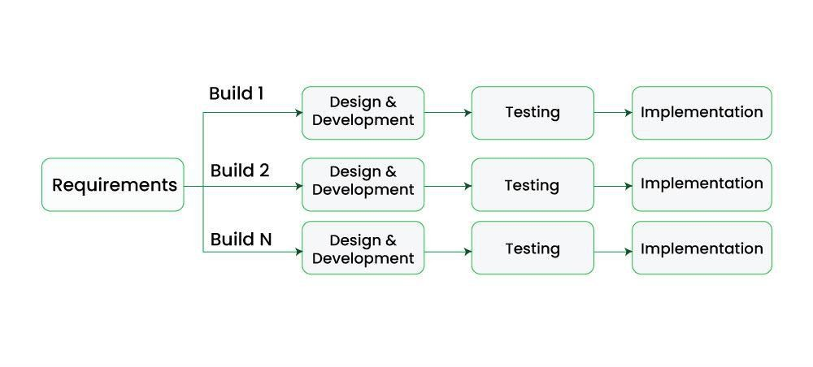
METHODOLOGY
Incremental model: the system splits into independent modules, so a working core was delivered early and extended in stages.
Increment 1: login and product management
Increment 2: customer management
Increment 3: order processing and PDF billing
Increment 4: reports and improvements
Each increment: analysis, design, coding, unit testing, then integration testing with earlier increments.
Incremental development: Build 1 to Build N

Slide 8
LITERATURE REVIEW
Inventory-control literature (Axsäter, Toomey, Mapes) stresses accurate stock records, timely replenishment and continuous monitoring, which a computerised system supports. [1]–[5]
Research gap: large systems are costly and complex, while small shops still rely on manual methods. IMS offers a simple, free, offline Java desktop option.
Feature | Spreadsheet | Zoho Inventory | Odoo Inventory | Proposed IMS
Stock tracking | Manual | Yes | Yes | Yes (auto deduction)
PDF bill | No | Yes | Yes | Yes (iText)
User roles / login | No | Yes | Yes | Yes
Works offline on one PC | Yes | No (cloud) | Partly | Yes
Cost | Free | Subscription | License / sub. | Free tools
Setup for small shop | Easy | Medium | Complex | Easy

Slide 9
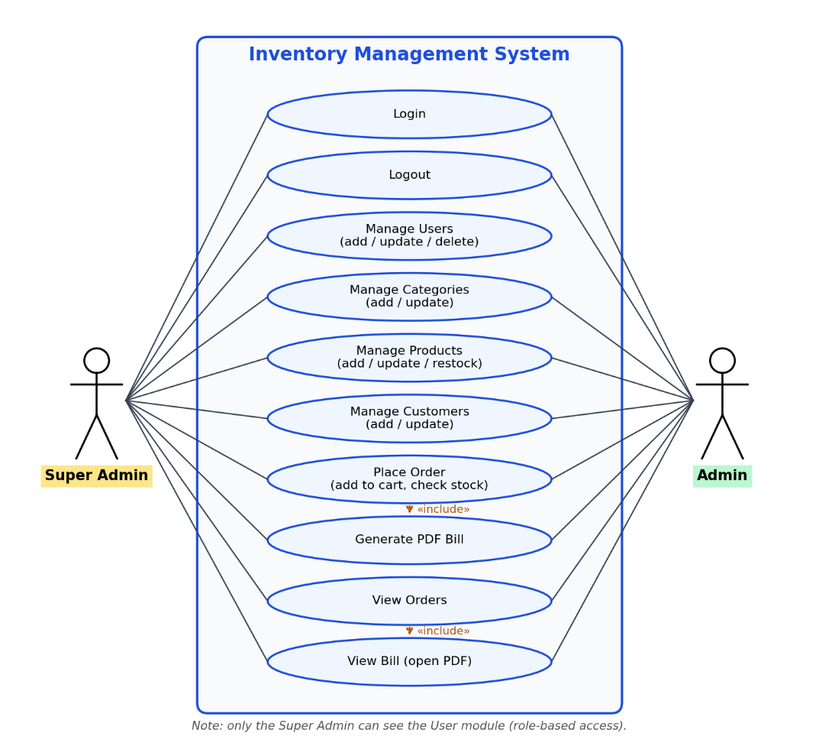
SYSTEM ANALYSIS
Login: e-mail and password; only Active users.
Users: add, update, set status (Super Admin only).
Category / Product / Customer: add, view, update; stock top-up.
Order: stock check, cart, total, save, PDF bill.
View Order: customer-wise history and bills.
Non-functional: validation, error handling, usability, portability.
Feasibility: free tools, ordinary PC, one-semester schedule.
Use case diagram

Slide 10
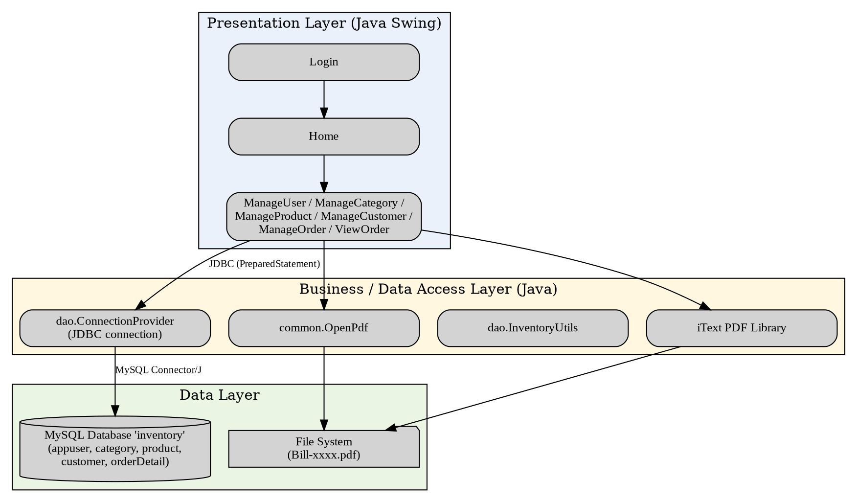
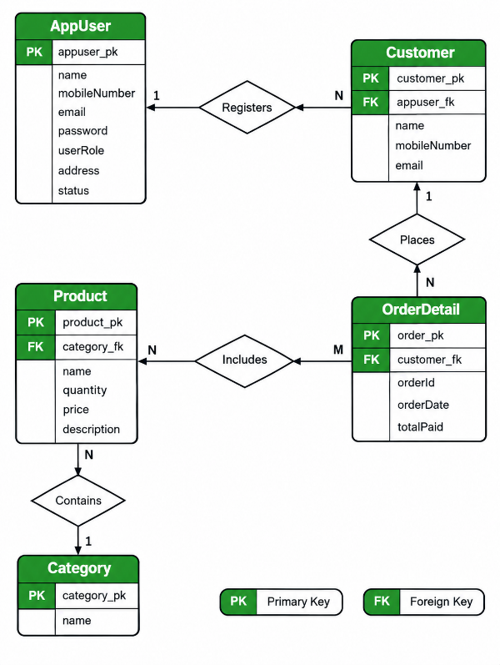
SYSTEM DESIGN
2-tier architecture: Swing + JDBC + MySQL
Database "inventory": 5 tables - appuser, category, product, customer, orderDetail.
Relations: category 1:N product; customer 1:N orderDetail.
Normalised up to Third Normal Form.
ER diagram

Slide 11
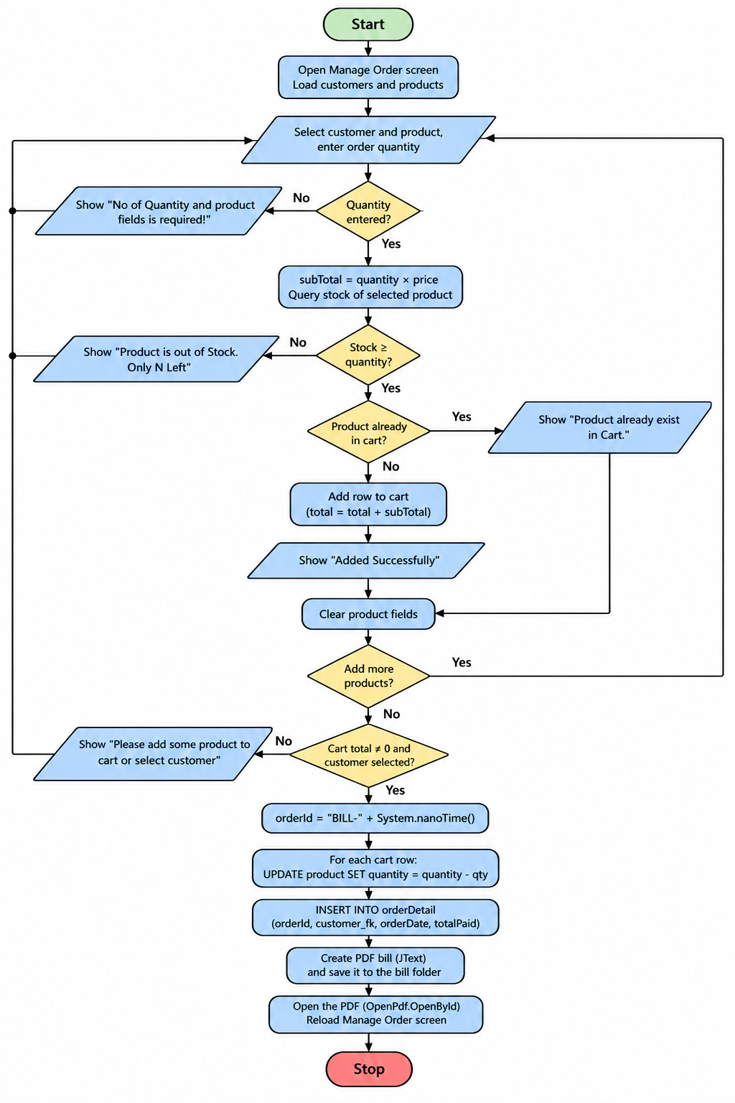
FLOWCHART
Add to cart: sub-total = quantity x price; reject if quantity exceeds stock or product already in cart; update running total.
Save order: generate bill id "Bill-" + nanoTime; reduce stock of each cart item; insert into orderDetail; create and open the PDF; reset screen.
Login: validate e-mail with regex, query appuser for an Active user, open Home with the role.

Slide 12
IMPLEMENTATION
Tool / Concept | Purpose / Use
Java (JDK), Apache NetBeans | Application development; Swing GUI builder
MySQL + Connector/J 8.0.20 | Database storage via JDBC (PreparedStatement, joins)
iText library | Generates the PDF bill
Swing + event handling | JFrame, JTable, JComboBox, JOptionPane; row-click and button events
OOP concepts | Inheritance (screens extend JFrame), constructor overloading, packages dao / common
Validation + exceptions | Regex checks (mobile 97/98 + 10 digits, e-mail); try-catch dialogs
Graphviz / Git | UML, ER and flow diagrams; version control

Slide 13
TESTING AND RESULTS
Test | Input | Expected | Result
Name accepts letters | Ram Sharma | Accepted | Pass
Mobile must start 97/98 | 9641234567 | Rejected | Pass
E-mail without @ | admin.mail.com | Rejected | Pass
Negative quantity | -5 | Rejected | Pass
Decimal price | 499.50 | Accepted | Pass
Non-numeric order quantity | abc | Error message | Fail
17 of 18 unit tests passed.
Failed case (U18): parseInt() is outside the try block, so a non-numeric quantity throws an exception without a message.
11 system tests prepared (login, stock limit, duplicate cart item, order and PDF, roles, logout).
Result: all objectives met; exception handling needs improvement.

Slide 14
CONCLUSION AND FUTURE ENHANCEMENTS
Conclusion
Future Enhancements
IMS replaces manual stock and billing records with a database-driven desktop application.
It provides role-based login, master-data management, a stock-checking cart, order history and PDF bills.
The team applied Java OOP, Swing, JDBC, regex validation, file output, UML modelling and testing.
Security: hashed passwords, PreparedStatement for login, config-based credentials.
Reliability: database transactions, foreign keys, safe numeric input.
Features: search, delete, low-stock alerts, suppliers, discounts and tax.
Reports: daily sales and stock export to PDF or Excel.
Platform: web or mobile version with a cloud database.

Slide 15
REFERENCES
[1] S. Axsäter, Inventory Control, Springer New York, 2000.
[2] J. W. Toomey, Inventory Management: Principles, Concepts and Techniques, Springer New York, 2024.
[3] J. Mapes, Inventory Control Systems, Wiley Encyclopedia of Management, John Wiley & Sons, 2020.
[4] S. Axsäter, Inventory Control, 3rd Edition, Springer International Publishing, 2015.
[5] C. D. K. Snook, Inventory Management: Principles and Practices, Routledge, 2019.
[6] Zoho Corporation, Zoho Inventory - Online Inventory Management Software, 2026.
[7] Odoo S.A., Odoo Inventory - Inventory Management Software, 2026.

Slide 16

THANK YOU
Inventory Management System

