Slide 1

Smart Remote Skin Disease Diagnosis using Vision Analytics and IoT-Based Health Monitoring
TEAM 14
ROLL NO. | NAME | SRN
544 | SUMANTH SHET | 01FE23BCS280
545 | MALLIKARJUN G PATIL | 01FE23BCS283
549 | PRAJWAL ARAVATTI | 01FE23BCS299
563 | MD IMRAN | 01FE23BCS378
UNDER THE GUIDANCE OF:
Geeta Sanakki

Slide 2

INTRODUCTION:
Skin-related diseases are often difficult to detect early, especially in remote or underserved areas where dermatologists are scarce.
Many patients delay consultation due to lack of access, high costs, or lack of awareness.
While existing AI systems analyze skin images, they often rely on expensive clinical equipment (dermoscopes).
Our Approach is an integrated, accessible system that utilizes a simple smartphone camera (EIOT device) combined with AI vision analytics to provide immediate risk screening.
The system connects the patient directly to a backend AI model and routes results to a doctor for final validation, making remote diagnosis seamless.
School of Computer Science and Engineering
4

Slide 3
PROBLEM STATEMENT:
The delay in diagnosing skin diseases leads to severe health complications. There is need to develop a low-cost system that uses a standard camera as an IoT device to capture images, uses AI to analyze them, and provides immediate, accessible feedback (including medicine recommendations and voice-assisted reports) while keeping a doctor in the loop.
School of Computer Science and Engineering
3

Slide 4
Literature Survey
School of Computer Science and Engineering
3

Slide 5
Literature Survey - 1 :
Title: Dermatologist-level classification of skin cancer with deep neural networks
Author: Esteva, A., et al. (Nature 2017)
Results: Achieved an Area Under the Curve (AUC) of 0.96 for carcinoma classification and 0.94 for melanoma classification on the proprietary dataset, matching the diagnostic accuracy of 21 board-certified dermatologists.
Dataset: Utilized a massive proprietary dataset of 129,450 clinical images covering 2,032 different skin diseases.
Research Gaps: The study primarily relied on high-quality, clinical-grade images captured in controlled environments. It lacked real-time smartphone integration, IoT workflow elements, and did not address real-world deployment challenges like blurry images or low lighting.
Methodology: The authors employed transfer learning using a pre-trained Inception v3 Convolutional Neural Network (CNN) architecture. The model was trained end-to-end to classify skin lesions directly from images without any specialized feature extraction.
School of Computer Science and Engineering
8

Slide 6
Literature Survey - 2:
Title: PAD-UFES-20: A skin lesion dataset composed of patient data and clinical images collected from smartphones
Author: Pacheco, A. G., et al. (Data in Brief 2020)
Results: Using the PAD-UFES-20 dataset, the best baseline model (ResNet-50) achieved a balanced accuracy of 73% and an AUC of 0.85, highlighting the feasibility but showing a clear performance drop on uncalibrated smartphone images compared to clinical datasets.
Dataset: PAD-UFES-20 (2,298 samples of 6 different types of skin lesions).
Methodology: The researchers focused on the collection and baseline classification of skin lesions using images taken exclusively by smartphone cameras under varying real-world conditions. They evaluated several standard CNNs to establish baseline performance on this mobile-first data. Models Used are ResNet-50, VGG-16, MobileNet.
Research Gaps: The paper focuses heavily on the dataset curation and baseline models. It does not present a complete remote healthcare architecture, patient feedback interface, or doctor-in-the-loop IoT feedback system.
School of Computer Science and Engineering
8

Slide 7
Literature Survey - 3:
Title: A Hybrid Generative AI and Edge-IoT Architecture for Accessible Skin Disease Monitoring
Author: Chen, Y., et al. (Sensors / MDPI 2025) )
Results: The vision model achieved a classification accuracy of 91.8% and an F1-score of 0.90 on the combined mobile dataset. The generative component successfully summarized complex clinical jargon into patient-readable text in 98% of test cases.
Dataset: PAD-UFES-20 and HAM10000 (Combined dataset of ~12,000 images).
Methodology : Developed a novel end-to-end IoT architecture that uses EfficientNet for skin disease classification via smartphone cameras and integrates Generative AI (LLMs) to produce patient-friendly diagnostic summaries. Models used, EfficientNet-B0 (Vision), LLaMA-based LLM (Generative Text).
Research Gaps: The system relies heavily on a high-bandwidth connection to constantly query the heavy LLM backend for report generation, which can be a severe network bottleneck in remote rural areas with poor 3G/4G connectivity.
School of Computer Science and Engineering
8

Slide 8
Literature Survey - 4 :
Title: Real-Time Edge Computing Framework for Skin Lesion Classification Using IoT and Lightweight CNNs
Author: Al-Masri, E., et al. (IEEE Internet of Things Journal 2024)
Results: Achieved an accuracy of 94.2%, sensitivity of 92.5%, and specificity of 95.1% on the mixed dataset. The edge-deployment reduced inference latency to under 150ms on mobile devices.
Dataset: ISIC 2020 mixed with a custom diverse skin-tone dataset (15,000 images total).
Research Gaps: While latency is incredibly low, the system operates purely as an open-loop diagnostic tool without human oversight. It lacks a cloud-based "Doctor-in-the-loop" validation dashboard and patient-centric accessibility features like voice reporting.
Methodology: Proposed an edge-intelligence framework where lightweight deep learning models are deployed directly onto low-computing IoT devices (smartphones). It combined MobileNetV3 with an optimization algorithm for efficient feature extraction without relying on constant cloud connectivity.
School of Computer Science and Engineering
8

Slide 9
Research Gaps:
Over-reliance on perfectly calibrated clinical dermoscopes, failing to address the visual noise of standard smartphone cameras at the IoT edge.
Poor baseline model performance and domain shift when clinical AI models are tested on unassisted, real-world mobile images.
Imbalanced IoT topologies that either operate entirely offline or rely on heavy, high-latency cloud backends for analysis.
Use of bandwidth-heavy methods for patient accessibility, making them unsuitable for rural areas with limited 3G/4G connectivity.
Absence of a centralized "Doctor-in-the-loop" dashboard, where fully automated edge-AI systems bypass crucial medical oversight.
School of Computer Science and Engineering

Slide 10
OBJECTIVES:
Develop an accessible remote screening system utilizing a standard smartphone camera as the primary IoT device.
Implement an AI vision model capable of classifying skin diseases from unassisted, real-world smartphone images.
Build a seamless backend pipeline that receives images, processes them through the model, and returns actionable insights.
Create a user-friendly frontend for patients that not only displays the predicted disease and recommended medicines but also features voice-assisted reading of the report.
Develop a Doctor Dashboard to review patient cases, ensuring safe, doctor-in-the-loop final decision making.
School of Computer Science and Engineering

Slide 11
DATASET DESCRIPTION:
Dataset Name: SkinDisNet (available via Mendeley Data)
Overview: A multi-class clinical dataset focusing on common, high-incidence skin diseases, specifically designed to support low-cost AI diagnostic systems using standard camera inputs.
Image Data:
Contains 1,710 original clinical images of common skin conditions.
Covers key diagnostic categories including Eczema, Scabies, Ringworm (Tinea Corporis), and Dermatitis.
Images are pre-standardized to a 512x512 resolution, which significantly reduces the preprocessing load for real-time Edge AI inference.
School of Computer Science and Engineering

Slide 12
DATASET DESCRIPTION:
Clinical Metadata (CSV Details):
Alongside the images, the dataset includes structured patient data to refine the model's predictive accuracy through multimodal analysis.
Features include: Patient Age, Gender, and the specific Anatomical Location of the lesion.
Why this dataset? It perfectly aligns with our goal of diagnosing common, treatable conditions that allow for safe medicine recommendations. The smartphone-style clinical photos ensure our model is optimized for the "standard camera" approach required for our IoT device.
Link: SkinDisNet: A Multi-Class Clinical Images and Metadata for Skin Disease
School of Computer Science and Engineering

Slide 13
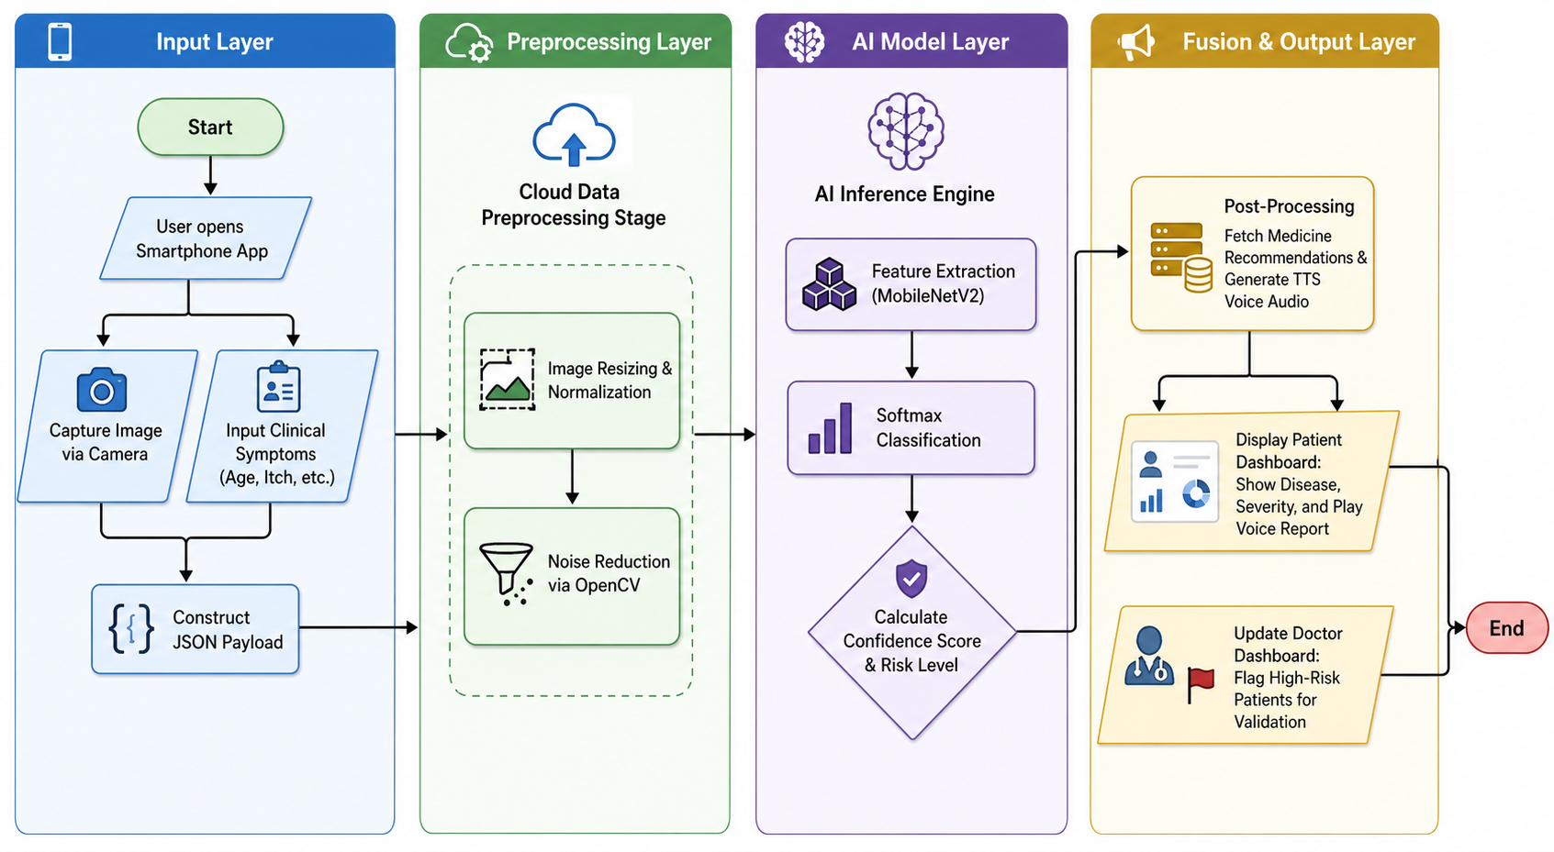
PROPOSED WORKFLOW:
School of Computer Science and Engineering
5

Slide 14
THANK YOU
School of Computer Science and Engineering
27

