Slide 1
Programming in Java
Module-1 Part-A
By,
Prof.Nagalingayya. M

Slide 2
MODULE 1
Syllabus:
An Overview of Java: Object-Oriented Programming, A First Simple Program, A Second Short Program, Two Control Statements, Using Blocks of Code, Lexical Issues, The Java Class Libraries.
Data Types, Variables, and Arrays: Java Is a Strongly Typed Language, The Primitive Types, Integers, Floating-Point Types, Characters, Booleans, A Closer Look at Literals, Variables, Type Conversion and Casting, Automatic Type Promotion in Expressions, Arrays, A Few Words About Strings

Slide 3
1.1 An Overview of Java
The key features of Java are security and portability(platform-independent nature).
When we download any application from the internet, there is a chance that the downloaded code contain virus.
But, downloading the Java code assures security.
Java program can run on any type of system connected to internet and thus provides portability.

Slide 4
The Platform independent nature can be interpreted by two things:
Operating System Independent: Independent of the operating system on which your sourcecode is being run.
Hardware Independent: Doesn't depend upon the hardware on which your java code is run upon i.e. it can run on any hardware configuration.

Slide 5
C and C++ are platform dependent languages as the file which compiler of C,C++ forms is a .exe(executable) file which is operating system dependent.
The C/C++ program is controlled by the operating system whereas, the execution of a Java program is controlled by JVM (Java Virtual Machine).

Slide 6
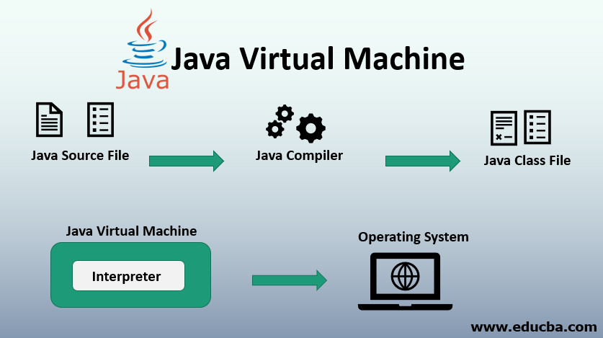

Slide 7
The JVM is the Java run-time system and is the main component of making the java a platform independent language.
For building and running a java application we need JDK(Java Development Kit)which comes bundled with Java runtime environment(JRE)and JVM.
With the help of JDK the user compiles and runs his java program.
As the compilation of java program starts the Java Bytecode is created i.e. a .class file is created by JRE.
Bytecode is a highly optimized set of instructions designed to be executed by JVM.

Slide 8
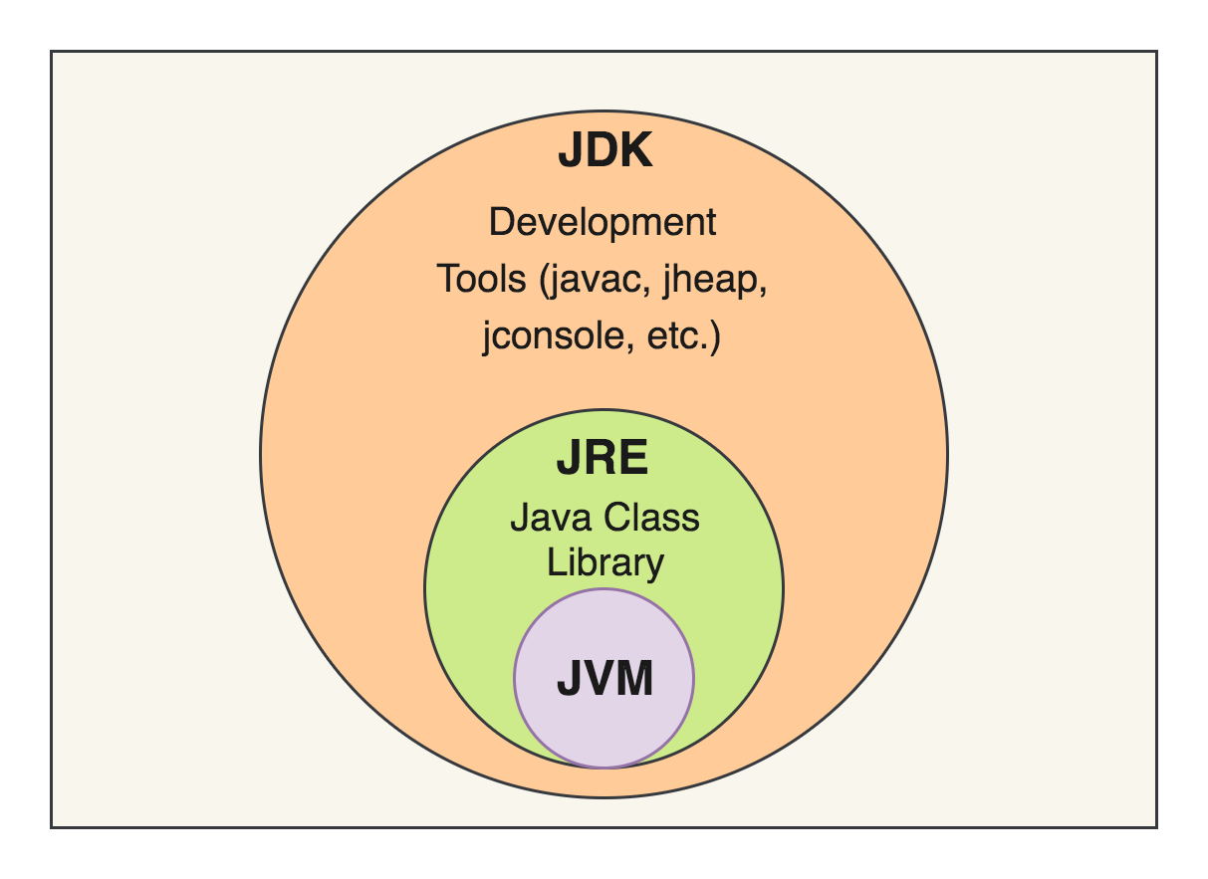

Slide 9
Now the JVM comes into play, which is made to read and execute this bytecode.
The JVM is linked with operating system and runs the bytecode to execute the code depending upon operating system.
Therefore, a user can take this class file( Bytecode file) formed to any operating system which is having a JVM installed and can run his program easily without even touching the syntax of a program and without actually having the source code.
The .class file which consists of bytecode is not user-understandable and can be interpreted by JVM only to build it into the machine code.

Slide 10
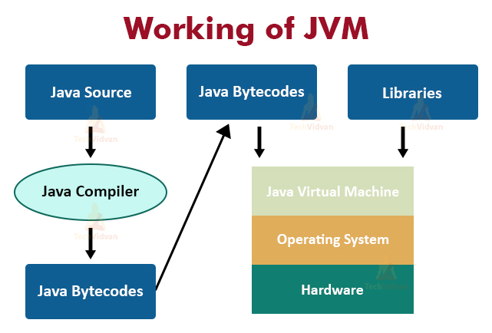

Slide 11
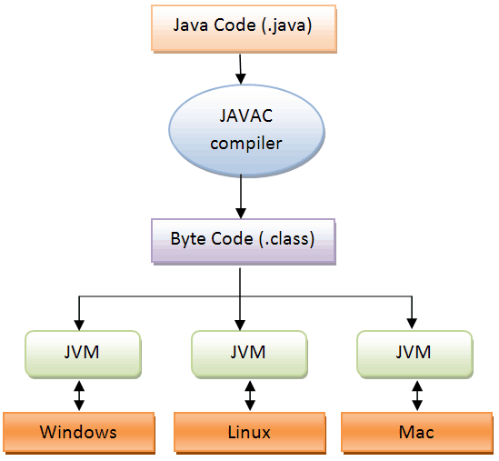
JAVA Program Execution

Slide 12
Object Oriented Programming:
Object-oriented programming (OOP) is at the core of Java.
In fact, all Java programs are to at least some extent object-oriented.
OOP is so integral to Java that it is best to understand its basic principles before you begin writing even simple Java programs.

Slide 13
Two Paradigms:
All computer programs consist of two elements: code and data.
Furthermore, a program can be conceptually organized around its code or around its data.
That is, some programs are written around “what is happening” and others are written around “who is being affected.”

Slide 14
These are the two paradigms that govern how a program is constructed.
  The first way is called the process-oriented model. This approach characterizes a program as a series of linear steps(that is, code).
  The process-oriented model can be thought of as code acting on data. Procedural languages such as C employ this model to considerable success.

Slide 15
Abstraction:
Abstraction is a process of hiding the implementation details and showing only functionality to the user.
Another way, it shows only important things to the user and hides the internal details for example sending sms, you just type the text and send the message. You don't know the internal processing about the message delivery.
Abstraction lets you focus on what the object does instead of how it does it.

Slide 16

The Three OOP Principles:
All object-oriented programming languages provide mechanisms that help you implement
Object-oriented model. They are encapsulation, inheritance, and polymorphism.
Encapsulation: in java is a process of wrapping code and data together into a single unit, for example capsule i.e. mixed of several medicines.

Slide 17
We can create a fully encapsulated class in java by making all the data members of the class private. Now we can use setter and getter methods to set and get the data in it.
The Java Bean class is the example of fully encapsulated class.
When you create a class, you will specify the code and data that constitute that class. Collectively, these elements are called members of the class.
Specifically, the data defined by the class are referred to as member variables or instance variables.
The code that operates on that data is referred to as member methods or just methods. (If you are familiar with C/C++, it may help to know that what a Java programmer calls a method, a C/C++ programmer calls a function.)
In properly written Java programs, the methods define how the member variables can be used. This means that the behavior and interface of a class are defined by the methods that operate on its instance data.

Slide 18
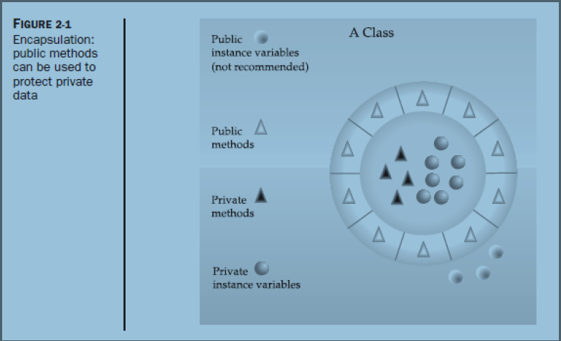

Slide 19
Inheritance:
Inheritance in java is a mechanism in which one object acquires all the properties and behaviors of parent object.
The idea behind inheritance in java is that you can create new classes that are built upon existing classes. When you inherit from an existing class, you can reuse methods and fields of parent class, and you can add new methods and fields also.
Inheritance represents the IS-A relationship, also known as parent-child relationship.

Slide 20
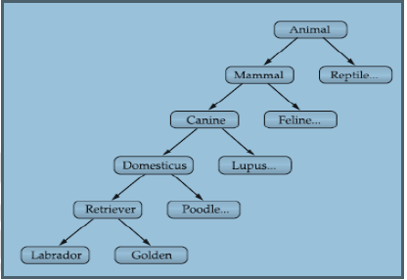
Why use inheritance in java?
For Method Overriding (so runtime polymorphism can be achieved).
For Code Reusability.
As mentioned earlier, most knowledge is made manageable by hierarchical (that is, top-down) classifications.

Slide 21
Polymorphism:
Polymorphism in java is a concept by which we can perform a single action by different ways.
Polymorphism is derived from 2 greek words: poly and morphs. The word "poly" means many and "morphs" means forms. So polymorphism means many forms.
There are two types of polymorphism in java: compile time polymorphism and runtime polymorphism. We can perform polymorphism in java by method overloading and method overriding.

Slide 22
A First Simple Program:
Now that the basic object-oriented underpinning of Java has been discussed, let’s look at
some actual Java programs. Let’s start by compiling and running the short sample program
/*
This is a simple Java program.
Call this file "Example.java".
*/
class Example {
// Your program begins with a call to main().
public static void main(String args[]) {
System.out.println("This is a simple Java program.");
}
} Namespace: set of classes / out : is a class / println is a method

Slide 23
Entering the Program:
For most computer languages, the name of the file that holds the source code to a program is immaterial.
However, this is not the case with Java.
The first thing that you must learn about Java is that the name you give to a source file is very important.
For this example, the name of the source file should be Example.java.

Slide 24
In Java, a source file is officially called a compilation unit. It is a text file that contains one or more class definitions. The Java compiler requires that a source file use the .java filename extension.
In Java, all code must reside inside a class. By convention, the name of that class should match the name of the file that holds the program. You should also make sure that the capitalization of the filename matches the class name.
The reason for this is that Java is case-sensitive. At this point, the convention that filenames correspond to class names may seem arbitrary. However, this convention makes it easier to maintain and organize your programs.

Slide 25
Compiling the Program:
To compile the Example program, execute the compiler, javac, specifying the name of the source file on the command line, as shown here:
C:\>javac Example.java
The javac compiler creates a file called Example.class that contains the bytecode version of the program.
As discussed earlier, the Java bytecode is the intermediate representation of your program that contains instructions the Java Virtual Machine will execute.
Thus, the output of javac is not code that can be directly executed.

Slide 26
To actually run the program, you must use the Java application launcher, called java.
To do so, pass the class name Example as a command-line argument, as shown here:
C:\>java Example
When the program is run, the following output is displayed:
This is a simple Java program.

Slide 27
A Second Short Program:
you should call this file Example2.java. /*
Here is another short example.
Call this file "Example2.java". */
class Example2 {
public static void main(String args[])
{
int num; // this declares a variable called num
num = 100; // this assigns num the value 100
System.out.println("This is num: " + num);
num = num * 2;
System.out.print("The value of num * 2 is ");
System.out.println(num);
}
}

Slide 28
When you run this program, you will see the following output:
This is num: 100
The value of num * 2 is 200
Let’s take a close look at why this output is generated. The first new line in the program
is shown here:
int num;
// this declares a variable called num

Slide 29
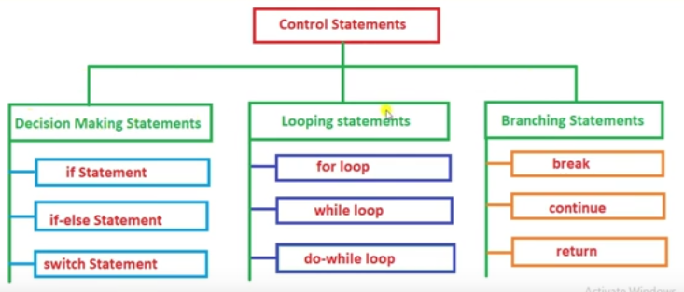
Control Statements in java

Slide 30
Two Control Statements:
The if Statement:
The Java if statement works much like the IF statement in any other language. Further, it is syntactically identical to the if statements in C, C++, and C#. Its simplest form is shown here:
if(condition) statement;
Here, condition is a Boolean expression. If condition is true, then the statement is executed. If condition is false, then the statement is bypassed. Here is an example:
if(num < 100)
System.out.println("num is less than 100");

Slide 31
In this case, if num contains a value that is less than 100, the conditional expression is true, and println( ) will execute.
If num contains a value greater than or equal to 100, then the println( ) method is bypassed.
As Java defines a full complement of relational operators which may be used in a conditional expression. Here are a few: a=b a==b
< | Less than
> | Greater than
== | Equal

Slide 32
Here is a program that illustrates the if statement
/*
Demonstrate the if.
Call this file "IfSample.java".
*/
class IfSample {
public static void main(String args[]) {
int x, y; x = 10; y = 20;
if(x < y) System.out.println("x is less than y");
x = x * 2;
if(x == y) System.out.println("x now equal to y");
x = x * 2;
if(x > y) System.out.println("x now greater than y");
// this won't display anything
if(x == y) System.out.println("you won't see this");
} }

Slide 33
The output generated by this program is shown here:
x is less than y
x now equal to y
x now greater than y

Slide 34
The for Loop:
The simplest form of the for loop is shown here:
for(initialization; condition; iteration) statement;
In its most common form, the initialization portion of the loop sets a loop control variable to an initial value.
The condition is a Boolean expression that tests the loop control variable.
  If the outcome of that test is true, the for loop continues to iterate.
  If it is false, the loop terminates.
The iteration expression determines how the loop control variable is changed each time the loop iterates.

Slide 35
/*
Demonstrate the for loop.
Call this file "ForTest.java".
*/
class ForTest
{
public static void main(String args[])
{
int x;
for(x = 0; x<10; x = x+1)
System.out.println("This is x: " + x);
}
}

