Slide 1
Module-1
PART-B
Data Types, Variables and Arrays

Slide 2
Java is a Strongly Typed Language:
Java is a strongly typed language.
Indeed, part of Java’s safety and robustness comes from this fact.
  First, every variable has a type, every expression has a type, and every type is strictly defined.
Second, all assignments, whether explicit or via parameter passing in method calls, are checked for type compatibility.
The Java compiler checks all expressions and parameters to ensure that the types are compatible.
Any type mismatches are errors that must be corrected before the compiler will finish compiling the class.

Slide 3
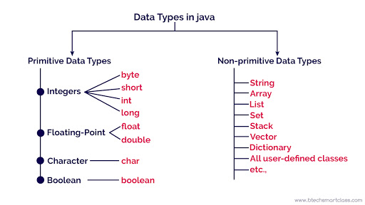

Slide 4
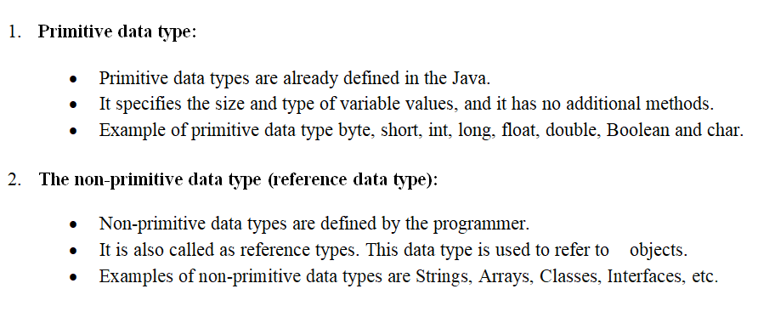

Slide 5
The Primitive Types:
There are eight primitive data types supported by Java.
Primitive data types are predefined by the language and named by a keyword.
  Byte
  Short
  Int
  Long
  Float
  Double
  Boolean
  char
Integers
Floating Point Numbers

Slide 6
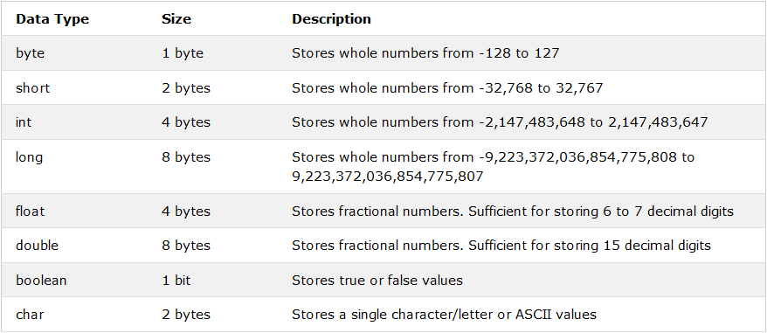
Primitive Data Types

Slide 7
byte: [1 byte]
Byte data type is an 8-bit signed two's complement integer
Minimum value is -128 (-2^7)
Maximum value is 127 (inclusive)(2^7 -1)
Default value is 0
Byte data-type is used to save space in large arrays, mainly in place of integers, since a byte is four times smaller than an integer
Example: byte a = 100 , byte b = -50

Slide 8
short: [2 bytes]
Short data type is a 16-bit signed two's complement integer
Minimum value is -32,768 (-2^15)
Maximum value is 32,767 (inclusive) (2^15 -1)
Short data type can also be used to save memory as byte data type. A short is 2 times smaller than an integer
Default value is 0
Example: short s = 10000, short r = -20000

Slide 9
Int [4 bytes]
Int data type is a 32-bit signed two's complement integer
Minimum value is - 2,147,483,648 (-2^31)
Maximum value is 2,147,483,647 (2^31 -1)
Integer is generally used as the default data type for integral values unless there is a concern about memory.
The default value is 0
Example: int a = 100000, int b = -200000

Slide 10
long: [8 bytes]
Long data type is a 64-bit signed two's complement integer
Minimum value is -9,223,372,036,854,775,808 (-2^63)
Maximum value is 9,223,372,036,854,775,807 (inclusive) (2^63 -1)
This type is used when a wider range than int is needed
Default value is 0L
Example: long a = 100000L, long b = -200000L

Slide 11
// Compute distance light travels using long variables.
class Light
{
public static void main(String args[])
{
int lightspeed;
long days;
long seconds;
long distance;
// approximate speed of light in miles per second
lightspeed = 186000;

Slide 12
days = 1000; // specify number of days here
seconds = days * 24 * 60 * 60; // convert to seconds
distance = lightspeed * seconds; // compute distance
System.out.print("In " + days);
System.out.print(" days light will travel about ");
System.out.println(distance + " miles.");
}
}
This program generates the following output:
In 1000 days light will travel about 16070400000000 miles.

Slide 13
float: [4 bytes]
Float data type is a single-precision 32-bit IEEE 754 floating point
Float is mainly used to save memory in large arrays of floating point numbers
Default value is 0.0f
Float datatype is never used for precise values such as currency
Example: float f1 = 234.5f

Slide 14
double: [8 bytes]
double data type is a double-precision 64-bit IEEE 754 floating point
This data type is generally used as the default data type for decimal values, generally the default choice
Double data type should never be used for precise values such as currency
Default value is 0.0d
Example: double d1 = 123.4

Slide 15
Here is a short program that uses double variables to compute the area of a circle:
// Compute the area of a circle.
class Area
{
public static void main(String args[])
{
double pi, r, a;
r = 10.8; // radius of circle
pi = 3.1416; // pi, approximately
a = pi * r * r; // compute area
System.out.println("Area of circle is " + a);
}
}

Slide 16
boolean: [1 bit]
boolean data type represents one bit of information
There are only two possible values: true and false
This data type is used for simple flags that track true/false conditions
Default value is false
Example: boolean one = true

Slide 17
Here is a program that demonstrates the boolean type:
// Demonstrate boolean values.
class BoolTest
{
public static void main(String args[])
{
boolean b;
b = false;
System.out.println("b is " + b);
b = true;
System.out.println("b is " + b);
// a boolean value can control the if statement
if(b)
System.out.println("This is executed.");
b = false;
if(b)
System.out.println("This is not executed.");
// outcome of a relational operator is a boolean value
System.out.println("10 > 9 is " + (10 > 9));
}
}

Slide 18
The output generated by this program is shown here:
b is false
b is true
This is executed.
10 > 9 is true

Slide 19
char: [2 bytes]
char data type is a single 16-bit Unicode character
Minimum value is '\u0000' (or 0)
Maximum value is '\uffff' (or 65,535 inclusive)
Char data type is used to store any character
Example: char letterA ='A'

Slide 20
For example, you can add two characters together, or increment the value of a character variable. Consider the following program:
// char variables behave like integers.
class CharDemo2
{
public static void main(String args[])
{
char ch1;
ch1 = 'X';
System.out.println("ch1 contains " + ch1);
ch1++; // increment ch1
System.out.println("ch1 is now " + ch1);
}
}

Slide 21
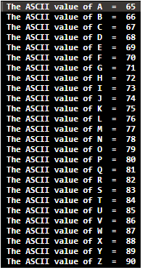
The output generated by this program is shown here:
ch1 contains X
ch1 is now Y
In the program, ch1 is first given the value X. Next, ch1 is incremented.
This results in ch1 containing Y, the next character in the ASCII (and Unicode) sequence.

Slide 22
Variables:
The variable is the basic unit of storage in a Java program.
A variable is defined by the combination of an identifier, a type, and an optional initializer.
In addition, all variables have a scope, which defines their visibility, and a lifetime.
Declaring a Variable:
In Java, all variables must be declared before they can be used. The basic form of a variable declaration is shown here:
type identifier [ = value][, identifier [= value] ...] ;

Slide 23
int a, b, c; // declares three ints, a, b, and c.
int d = 3, e, f = 5;
// declares three more ints, initializing d and f.
byte z = 22; // initializes z.
double pi = 3.14159;
// declares an approximation of pi.
char x = 'x'; // the variable x has the value 'x'.

Slide 24
Dynamic Initialization:
Although the preceding examples have used only constants as initializers, Java allows variables to be initialized dynamically, using any expression valid at the time the variable is declared.

Slide 25
// Demonstrate dynamic initialization.
class DynInit
{
public static void main(String args[])
{
double a = 3.0, b = 4.0;
// c is dynamically initialized
double c = Math.sqrt(a * a + b * b);
System.out.println("Hypotenuse is " + c);
}
} O/P Hypotenuse is 5

Slide 26
The Scope and Lifetime of Variables:
Many other computer languages define two general categories of scopes:
  global and local.
However, these traditional scopes do not fit well with Java’s strict, object-oriented model.

Slide 27
As a general rule, variables declared inside a scope are not visible (that is, accessible) to code that is defined outside that scope.
Thus, when you declare a variable within a scope, you are localizing that variable and protecting it from unauthorized access and/or modification.
Indeed, the scope rules provide the foundation for encapsulation.

Slide 28
Scopes can be nested. For example, each time you create a block of code, you are creating a new, nested scope.
When this occurs, the outer scope encloses the inner scope.
This means that objects declared in the outer scope will be visible to code within the inner scope.
However, the reverse is not true.
Objects declared within the inner scope will not be visible outside it.

Slide 29
To understand the effect of nested scopes, consider the following program:
class Scope
{
public static void main(String args[])
{
int x; // known to all code within main
x = 10;
if(x == 10)
{ // start new scope
int y = 20; // known only to this block
// x and y both known here.
System.out.println("x and y: " + x + " " + y);

Slide 30
x = y * 2;
}
//y = 100; // Error! y not known here
// x is still known here.
System.out.println("x is " + x);
}
}

Slide 31
Type Conversion and Casting:
If you have previous programming experience, then you already know that it is fairly common to assign a value of one type to a variable of another type.
If the two types are compatible, then Java will perform the conversion automatically.
For example, it is always possible to assign an int value to a long variable.
However, not all types are compatible, and thus, not all type conversions are implicitly allowed.

Slide 32
For instance, there is no automatic conversion defined from double to byte.
Fortunately, it is still possible to obtain a conversion between incompatible types.
To do so, you must use a cast, which performs an explicit conversion between incompatible types.
Java’s Automatic Conversions:
When one type of data is assigned to another type of variable, an automatic type conversion will take place if the following two conditions are met:
  The two types are compatible.
  The destination type is larger than the source type.

Slide 33
Casting Incompatible Types:
To create a conversion between two incompatible types, you must use a cast.
A cast is simply an explicit type conversion. It has this general form:
(target-type) value
Here, target-type specifies the desired type to convert the specified value to.
For example, the following fragment casts an int to a byte. If the integer’s value is larger than the range of a byte, it will be reduced modulo (the remainder of an integer division by the) byte’s range.
int a;
byte b;
// ...
b = (byte) a;
int a= 30; Long b; b=a; // a=30 and b=30 Compatible types

Slide 34
A different type of conversion will occur when a floating-point value is assigned to an integer type: truncation.
As you know, integers do not have fractional components.
Thus, when a floating-point value is assigned to an integer type, the fractional component is lost.
Int a=30.5;
System.out.println(a);
o/p: 30

Slide 35
class Conversion
{
public static void main(String args[])
{
byte b;
int i = 257;
double d = 323.142;
System.out.println("\nConversion of int to byte.");
b = (byte) i;
System.out.println("i and b " + i + " " + b);
System.out.println("\nConversion of double to int.");
i = (int) d;
System.out.println("d and i " + d + " " + i);
System.out.println("\nConversion of double to byte.");
b = (byte) d;
System.out.println("d and b " + d + " " + b);
}
}

Slide 36
This program generates the following output:
Conversion of int to byte.
i and b 257 1 257%256=1
Conversion of double to int.
d and i 323.142 323
Conversion of double to byte.
d and b 323.142 67 323%256=67
When the value 257 is cast into a byte variable, the result is the remainder of the division of 257 by 256 (the range of a byte), which is 1 in this case.
When the d is converted to an int, its fractional component is lost. When d is converted to a byte, its fractional component is lost, and the value is reduced modulo 256, which in this case is 67.

Slide 37
Automatic Type Promotion in Expressions:
In addition to assignments, there is another place where certain type conversions may occur: in expressions.
To see why, consider the following. In an expression, the precision required of an intermediate value will sometimes exceed the range of either operand. For example, examine the following expression:
byte a = 40;
byte b = 50;
byte c = 100;
int d = a * b / c;

Slide 38
As useful as the automatic promotions are, they can cause confusing compile-time errors.
For example, this seemingly correct code causes a problem:
byte b = 50;
b = b * 2; // Error! Cannot assign an int to a byte!
byte b = 50;
b = (byte)(b * 2);
which yields the correct value of 100.

Slide 39
The Type Promotion Rules:
Java defines several type promotion rules that apply to expressions.
They are as follows: First, all byte, short, and char values are promoted to int, as just described.
Then, if one operand is a long, the whole expression is promoted to long.
If one operand is a float, the entire expression is promoted to float.
If any of the operands is double, the result is double.

Slide 40
class Promote
{
public static void main(String args[])
{
byte b = 42;
char c = 'a'; ASCHII value of ‘a’ is 97
short s = 1024;
int i = 50000;
float f = 5.67f;
double d = .1234;
double result = (f * b) + (i / c) - (d * s);
System.out.println((f * b) + " + " + (i / c) + " - " + (d * s));
System.out.println("result = " + result);
}
}

Slide 41
double result = (f * b) + (i / c) - (d * s);
In the first sub expression, f * b, b is promoted to a float and the result of the sub expression is float.
Next, in the sub expression i / c, c is promoted to int, and the result is of type int.
Then, in d * s, the value of s is promoted to double, and the type of the sub expression is double.
Finally, these three intermediate values, float, int, and double, are considered.
The outcome of float plus an int is a float. Then the resultant float minus the last double is promoted to double, which is the type for the final result of the expression.

Slide 42
Array: Introduction
An ordered collection of values with two distinguishing characters:
  Ordered and fixed length
  Homogeneous. Every value in the array must be of the same type
The individual values in an array are called elements.
The number of elements is called the length of the array
Each element is identified by its position number in the array, which is called index. In Java, the index numbers begin with 0.

Slide 43
Arrays:
Arrays of any type can be created and may have one or more dimensions.
A specific element in an array is accessed by its index.
Arrays offer a convenient means of grouping related information.

Slide 44
One-Dimensional Arrays:
A one-dimensional array is, essentially, a list of like-typed variables.
To create an array, you first must create an array variable of the desired type.
The general form of a one-dimensional array declaration is
type var-name[ ];
Ex: int month_days[];

Slide 45
Although this declaration establishes the fact that month_days is an array variable, no array actually exists.
In fact, the value of month_days is set to null, which represents an array with no value.
To link month_days with an actual, physical array of integers, you must allocate one using new and assign it to month_days.
new is a special operator that allocates memory.
array-var = new type[size];

Slide 46
Here, type specifies the type of data being allocated, size specifies the number of elements in the array, and array-var is the array variable that is linked to the array.
That is, to use new to allocate an array, you must specify the type and number of elements to allocate.
month_days = new int[12];
After this statement executes, month_days will refer to an array of 12 integers.
Further, all elements in the array will be initialized to zero.
Obtaining an array is a two-step process.
  First, you must declare a variable of the desired array type.
  Second, you must allocate the memory that will hold the array, using new, and assign it to the array variable.

Slide 47
// Demonstrate a one-dimensional array. class Array { public static void main(String args[]) { int month_days[]; month_days = new int[12]; month_days[0] = 31; month_days[1] = 28; month_days[2] = 31; month_days[3] = 30; month_days[4] = 31; month_days[5] = 30; month_days[6] = 31; month_days[7] = 31; month_days[8] = 30; month_days[9] = 31; month_days[10] = 30; month_days[11] = 31; System.out.println("April has " + month_days[3] + " days."); } } | When you run this program, it prints the number of days in April. As mentioned, Java array indexes start with zero, so the number of days in April is month_days[3] or 30.

Slide 48
It is possible to combine the declaration of the array variable with the allocation of the array itself, as shown here:
int month_days[] = new int[12];
There is no need to use new.
  For example, to store the number of days in each month, the following code creates an initialized array of integers:

Slide 49
// An improved version of the previous program.
class AutoArray
{
public static void main(String args[])
{
int month_days[] = { 31, 28, 31, 30, 31, 30, 31, 31, 30, 31, 30, 31 };
System.out.println("April has " + month_days[3] + " days.");
}
}

Slide 50
Here is one more example that uses a one-dimensional array. It finds the average of a set of numbers.
// Average an array of values.
class Average
{
public static void main(String args[])
{
double nums[] = {10.1, 11.2, 12.3, 13.4, 14.5};
double result = 0;
int i;
for(i=0; i<5; i++)
result = result + nums[i];
System.out.println("Average is " + result / 5);
}
}

Slide 51
Sample Program
class MinArray
{
public static void main ( String[] args )
{
  int[] array = { 20, 19, 1, 5, 71, 27, 19, 95 } ;
  int min=array[0]; // initialize the current minimum
  for ( int index=0; index < array.length; index++ )
  if ( array[ index ] < min )
  min = array[ index ] ;
  System.out.println("The minimum of this array is: " + min );
}
}

Slide 52
Multidimensional Arrays:
A multidimensional array is an array of arrays. Each element of a multidimensional array is an array itself. For example,
Here, we have created a multidimensional array named a.
It is a 2-dimensional array, that can hold a maximum of 12 elements,
int[][] a = new int[3][4];

Slide 53
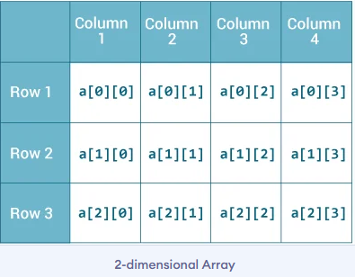
Remember, Java uses zero-based indexing, that is, indexing of arrays in Java starts with 0 and not 1.

Slide 54
Multidimensional Arrays:
In Java, multidimensional arrays are actually arrays of arrays.
To declare a multidimensional array variable, specify each additional index using another set of square brackets.
For example, the following declares a two dimensional array variable called twoD.
int twoD[][] = new int[4][5];

Slide 55
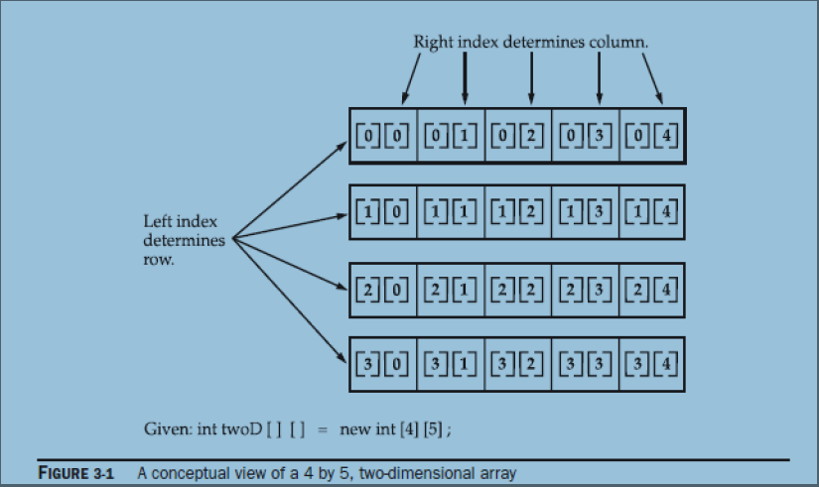
This allocates a 4 by 5 array and assigns it to twoD.
Internally this matrix is implemented as an array of arrays of int.

Slide 56
class TwoDArray { public static void main(String args[]) { int twoD[][]= new int[4][5]; int i, j, k = 0; for(i=0; i<4; i++) for(j=0; j<5; j++) { twoD[i][j] = k; k++; } for(i=0; i<4; i++) { for(j=0; j<5; j++) System.out.print(twoD[i][j] + " "); System.out.println(); } } } | This program generates the following output: 0 1 2 3 4 5 6 7 8 9 10 11 12 13 14 15 16 17 18 19

Slide 57
When you allocate memory for a multidimensional array, you need only specify the memory for the first (leftmost) dimension.
You can allocate the remaining dimensions separately.
For example, this following code allocates memory for the first dimension of twoD when it is declared.
It allocates the second dimension manually.
int twoD[][] = new int[4][];
twoD[0] = new int[5];
twoD[1] = new int[5];
twoD[2] = new int[5];
twoD[3] = new int[5];

Slide 58
// Manually allocate differing size second dimensions.
class TwoDAgain
{
public static void main(String args[])
{
int twoD[][] = new int[4][];
twoD[0] = new int[1];
twoD[1] = new int[2];
twoD[2] = new int[3];
twoD[3] = new int[4];
int i, j, k = 0;
for(i=0; i<4; i++)
for(j=0; j<i+1; j++)

Slide 59
{
twoD[i][j] = k;
k++;
}
for(i=0; i<4; i++)
{
for(j=0; j<i+1; j++)
System.out.print(twoD[i][j] + " ");
System.out.println();
}
}
}
This program generates the following output: 0 1 2 3 4 5 6 7 8 9

Slide 60
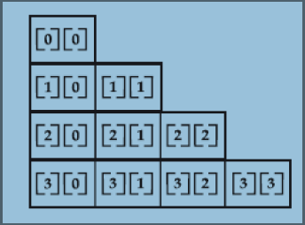
The array created by this program looks like this:

