Slide 1
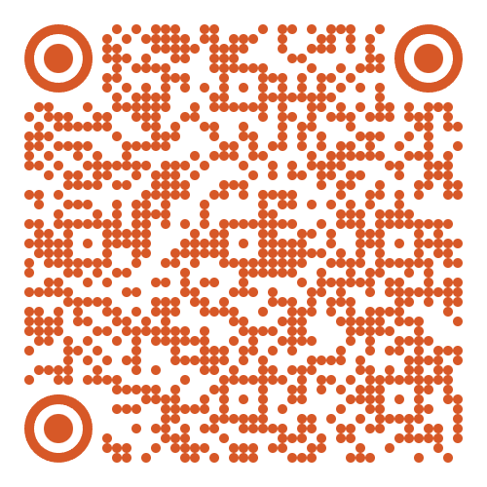
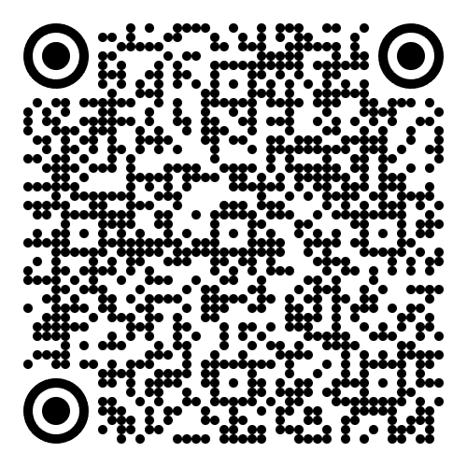
Python Foundations for Data Science
Week(1): Introduction to Python & Programming Concepts
Wednesday, 15 April 2026, 14:00–17:15

Slide 2

Name Pronunciation
Ghadeer
IPA: /ʁa-deer/
Breakdown:
/ʁ/ : a voiced sound produced in the back of the throat, like the French r in rouge. which closely resembles the Arabicغ . It is not the English hard “g” as in “go ”.
“a” : like the “a” in father.
/deer/ : stressed syllable, “deer” as in the animal, with a long /iː/ vowel.
You may call me Dr. G ! ☺

Slide 3

About Me
PhD in Computer Science, Heidelberg University.
Research Associate at Heidelberg Institute for Theoretical Studies.
My PhD focused on biomedical text and class imbalance problems.
I enjoy teaching and find knowledge exchange genuinely rewarding.
I believe no question is a bad question.
I learn as much from failed experiments as from successful ones.
I enjoy hiking and spending time in nature where I do my best thinking.

Slide 4

Lab Rules
You are expected to arrive on time and come prepared, having completed any required pre-lab reading or setup.
You should engage actively with the lab tasks, follow instructions carefully, and attempt all exercises independently before seeking assistance.
Discussion and peer support are encouraged; however, each student must submit their own work.
You should manage your time effectively to complete the assigned tasks within the allocated session.
All lab work must be submitted on time via your own course's GitHub Repository.
Workstations should be kept tidy before you leave.
You are expected to maintain a professional attitude, respect others, and minimise distractions during the session.

Slide 5
Agenda
Three quick anonymous polls Getting to know you and breaking the 🧊
“Variable about me“ Card Fill in the card and share the answer with your neighboring colleague.
Why Python? Opening Hook
What is a Variable? Variables & Data Types
Arithemtic and Boolean Operations Arithmetic & logical operators
Why Type Conversion Matters? Type Casting
Putting it All Together Exercises

Slide 6
What brought you to this programme?

Slide 7
Rate your Python experience

Slide 8
What do you want to build by the end of this module?
Take a screenshot and bring it back on the last day of the module to see how far you have come.

Slide 9

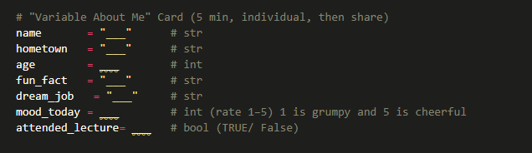
“ Variables about me “ card
Tasks:
Fill in the card within maximuim 5 minutes.
Share the card with your neighboring colleague .
You may share it with two colleagues.

Slide 10
Why Python in Data Science & AI?
Rich Ecosystem
NumPy · Pandas · Matplotlib · Scikit-learn · TensorFlow, all in one language
Readable Syntax
Code reads almost like English. Less time decoding syntax, more time solving problems
Industry Standard
Used at Google, Meta, Nasa #1 language in Kaggle surveys
Huge open-source community. A solution to almost any problem is a search way.

Slide 11
Core Data Types
A variable is a named label that points to a value stored in memory.
Analogy: Think of a variable as a labelled box. The label is the name (e.g., age), the box holds the value (e.g. 69). You can re-label the box at any time.
# Declaring variables
first_name = 'Tom' # str
age = 69 # int
height = 1.83 # float
is_married = False # bool
skills = ['Actor', 'Director'] # list
info = {'city': 'Berlin'} # dict
print(type(info)) # <class 'dict'>
Python is dynamically typed, no need to declare the type explicitly. The interpreter infers it.
Use type() to inspect any variable's type.

Slide 12
Core Data Types
Type | Description | Example | Result
int | Whole numbers | age = 69 | 69
float | Decimal numbers | height = 1.83 | 1.83
str | Text (in quotes) | name = 'Tom' | 'Tom'
bool | True or False only | married = False | False
list | Ordered, mutable | nums = [1, 2, 3] | [1, 2, 3]
tuple | Ordered, immutable | films = ('A', 'B') | ('A', 'B')
dict | Key → Value pairs | {'city': 'Berlin'} | {'city': 'Berlin'}
first_name → 'Tom' <class 'str'>
age → 69 <class 'int'>
height → 1.83 <class 'float'>
is_married → False <class 'bool'>
What is the difference between a list and a tuple?
When would you use a dict instead of a list?
In Week1.ipynb, navigate to the section “Variables and Basic Data Types” and experiment with the code in the two cells below.
In Week1_Exercise.ipynb, you have 7 minutes to solve “Problems 1 &2”.

Slide 13
Core Data Types
f-strings are the recommended way to embed variables in strings.
Syntax: Prefix with f and wrap variables in { }.
# Old style — verbose
name = "Tom"
age = 69
print("Hello, my name is " + name + " and I am " + str(age))
# f-string — clean & modern
print(f"Hello, my name is {name} and I am {age}.")
print(f"Height: {1.83:.1f} metres") # format float
print(f"2 + 2 = {2 + 2}") # expressions work too!
▶ Output
Hello, my name is Tom and I am 69.
Height: 1.8 metres
2 + 2 = 4
Rule of thumb: use f-string whenever you need to mix variables and text.

Slide 14
Essential String Operations
A string is a sequence of characters.
Assume we have a language string variable as language=‘Python’, it is equivalent to [‘P ‘, ‘y ‘, ‘t ‘, ‘h ‘, ‘o ‘, ‘n ‘].
Operation | Syntax / Example | Description | Output Example
Length | len(language) | returns the number of characters | 6
Indexing (first) | language[0] | accesses the first character | 'P'
Indexing (last) | language[-1] | accesses the last character | 'n'
Slicing (range) | language[0:3] | extracts characters from index 0 to 2 | 'Pyt'
Slicing (end) | language[-3:] | extracts the last three characters | 'hon'
Slicing (step) | language[::2] | selects every second character | 'Pto'
first_name → 'Tom' <class 'str'>
age → 69 <class 'int'>
height → 1.83 <class 'float'>
is_married → False <class 'bool'>

Slide 15
Essential String Operations (Cont.)
Operation | Syntax / Example | Description | Output Example
Concatenation | first_name + ' ' + last_name | combines strings with explicit separator | 'John Doe'
Remove whitespace | sentence.strip() | removes leading and trailing spaces | 'hello, world!'
Uppercase | sentence.strip().upper() | converts all characters to uppercase | 'HELLO, WORLD!'
Title case | sentence.strip().title() | capitalises each word | 'Hello, World!'
Replace substring | replace('world','Python') | replaces part of a string | 'hello, Python!'
Split string | 'hello world'.split() | splits into a list of words | ['hello', 'world']
In Week1.ipynb, navigate to the section “Modern String Formatting: f-strings” & “Essential String Operations” and experiment with the code in the cells below.

Slide 16
Arithematic Operators
Operator | Name | Example (a=7,b=2) | Result
+ | Addition | 7 + 2 | 9
- | Subtraction | 7 - 2 | 5
* | Multiplication | 7 * 2 | 14
/ | True Division | 7 / 2 | 3.5 ← always float!
// | Floor Division | 7 // 2 | 3 ← drops decimal
% | Modulus | 7 % 2 | 1 ← remainder only
** | Exponentiation | 7 ** 2 | 49
first_name → 'Tom' <class 'str'>
age → 69 <class 'int'>
height → 1.83 <class 'float'>
is_married → False <class 'bool'>
a, b = 7, 2
print(f"{a} / {b} = {a / b}") # 3.5
print(f"{a} // {b} = {a // b}") # 3
print(f"{a} % {b} = {a % b}") # 1
▶ Output
7 / 2 = 3.5
7 // 2 = 3
7 % 2 = 1
How does the modulo operator work?

Slide 17
Understanding Modulo (%)
Modulo gives you the REMAINDER after integer division.
7 % 3 : Step by Step
Step 1: 7 ÷ 3 = 2 (with a leftover)
Step 2: 3 × 2 = 6
Step 3: 7 − 6 = 1 ← this is 7 % 3
In other words, 3 fits into 7 twice because 3*2=6
The remainder is 7-6=1
Thus, 7%3=1
In Week1.ipynb, navigate to the section “Arithmetic Operations” and experiment with the code in the cells below.
In Week1_Exercise.ipynb, you have 15 minutes to solve “Problems 3&4”.

Slide 18
Boolean Comparisons
Operator | Meaning | Example | Result
== | Equal to | 3 == 3 | True
!= | Not equal | 3 != 2 | True
> | Greater than | 5 > 3 | True
< | Less than | 2 < 1 | False
>= | Greater or equal | 5 >= 5 | True
<= | Less or equal | 4 <= 3 | False
first_name → 'Tom' <class 'str'>
age → 69 <class 'int'>
height → 1.83 <class 'float'>
is_married → False <class 'bool'>
x, y = 10, 15
print(f"x > y → {x > y}")
print(f"x == 10 → {x == 10}")
▶ Output
x > y → False
x == 10 → True
What is the difference between a=15 and a==15?

Slide 19
Logical Operators
Operator | Rule | Example | Result
and | Both must be True | True and False | False
or | At least one must be True | True or False | True
not | Flips the value | not True | False
a, b = 8, 12
print(a < 10 and b > 10) # True and True → True
print(a > 5 or b < 10) # True or False → True
print(not (a == 8)) # not True → False
# Chained comparison (Pythonic!)
num = 7
print(5 < num < 10) # equivalent to: 5 < num and num < 10
▶ Output
True
True
False
True
first_name → 'Tom' <class 'str'>
age → 69 <class 'int'>
height → 1.83 <class 'float'>
is_married → False <class 'bool'>
Simple Tracing: what does not (5 < 7 and 7 < 10) evaluate to?
How about not (5 < 7) or 7 < 10 ?
In Week1.ipynb, navigate to the section “Boolean Comparisons & Logical Operators” and experiment with the code in the cells below.
In Week1_Exercise.ipynb, you have 15 minutes to solve “Problems 5&6”.

Slide 20
Pause / Break
See you in 15 minutes ☺!
Please be on time.
Wednesday, 15 April 2026, 14:00–17:15

Slide 21
Why Type Casting matters?
Data from files, APIs, or user input almost always arrives as strings even when it's a number. You must cast it before computing.
# Simulating data from a CSV file
user_age = "25" # this came in as a string
# ❌ This crashes!
# result = user_age + 5
# TypeError: can only concatenate str (not "int") to str
# ✅ Fix: cast first
user_age_int = int(user_age)
result = user_age_int + 5
print(f"Age in 5 years: {result}")
▶ Output
Age in 5 years: 30
Function | Converts to | Example | Result
int() | Integer | int('20') | 20
float() | Float | float('3.5') | 3.5
str() | String | str(42) | '42'
bool() | Boolean | bool(0) | False

Slide 22
Truthiness – bool() on Anything
Python can evaluate any value as True or False. This is called truthiness.
❌ Falsy values
#0 · 0.0 · "" · [] · {} · None
bool(0) → False
bool("") → False
bool([]) → False
✅ Truthy values
Everything else!
bool(1) → True
bool(-5) → True
bool("hi") → True
bool(" ") → True
bool([1,2,3]) → True
Surprise: bool(" ") → True! A string with only a space is NOT empty, it has content. This matters when validating user input.

Slide 23
Int() Truncates and Variable Reassignment
int() truncates does not round
Variables are just labels that can be re-pointed
# int() TRUNCATES, it does NOT round!
print(int(44.4)) # 44 ✅
print(int(44.9)) # 44 ← not 45!
print(round(44.9)) # 45 ← use round() to round
# Variable reassignment — labels vs objects
x = 5
print(f"x = {x}, id = {id(x)}")
x = 10
print(f"x = {x}, id = {id(x)}")
# id() changed → x now points to a NEW object
# The integer 5 itself was never modified
▶ Output
44
44
45
▶ Output
x = 5, id = 140234...
x = 10, id = 140235...
(different memory address)
1. Why does Python say integers are ‘immutable’ if you can clearly reassign $x$? 2. What exactly is immutable, the variable or the object?
In Week1.ipynb, navigate to the section “Data Type Conversions (Type Casting)” and experiment with the code in the cells below.
In Week1_Exercise.ipynb, you have 15 minutes to solve “Problems 7-11”.
Notes:
x = 5 x = 7
you are not modifying the integer 5. Instead, you are re-binding the name x to a different object, namely the integer 7. The original object 5 remains unchanged in memory.
Immutability means that once an integer object is created, its value cannot be altered. There is no operation that transforms the object representing 5 into 7. Rather, a new object is created, and the variable is updated to reference it. ###### It is the object that is immutable, not the variable.
A variable in Python is simply a reference or label bound to an object. It can be reassigned freely.
An object (in this case, an integer) is immutable, meaning its internal state cannot change after creation.
Thus, immutability is a property of the object itself, whereas variables remain mutable in the sense that they can point to different objects over time.

Slide 24
Operator Precedence (PEMDAS)
Priority | Rule | Operator(s)
1st | Parentheses | ( )
2nd | Exponentiation | **
3rd | Multiplication / Division | * / // %
4th | Addition / Subtraction | + -
# Let's evaluate together — predict before running!
# (5 + 3) * 2**3 - 4/2
# Step 1 — Parentheses: (5+3) = 8
# Step 2 — Exponent: 2**3 = 8
# Step 3 — Multiply: 8 * 8 = 64
# Step 4 — Divide: 4/2 = 2.0
# Step 5 — Subtract: 64 - 2.0 = 62.0
result = (5 + 3) * 2**3 - 4/2
print(result) # 62.0
▶ Output
62.0
In Week1_Exercise.ipynb, you have 7 minutes to solve “Problem 12”.

Slide 25
Integration Challenge: Banking Transaction
Problem (13) in Week1_Exercise.ipynb combines:
Variables
Type casting
Boolean Comparison
Arithmetic Operations
Print Formatting
62.0
In Week1_Exercise.ipynb, you have 7 minutes to solve “Problem 13”.
What if withdrawal_amount was '1500'? Which variables change, and which don't? What would can_withdraw be?

Slide 26
What did we learn today?
Environment
Variables
Jupyter Notebook, integrated within Visual Studio Code, serves as the primary coding environment
Named labels pointing to typed values in memory
Data Types
f-strings
int · float · str · bool · list · tuple · dict
Modern, clean string formatting with embedded expressions
62.0
Arithmetic
Booleans
7 operators: + − * / // % ** : know when / returns float
Comparisons (== != > < >= <=) and logic (and or not)
Type Casting
Immutability
int() float() str() bool() : essential for data cleaning
Variables are labels; integers are immutable objects

Slide 27
Take-Home Assignments
Solve both problems and push them to your private individual repository. The deadline is Sunday, 19.04.2026, at 23:59. For more details, please have a look at our course’s GitHub Repository
P14
Student Enrollment
Combine age (string → int), credits (int), and two booleans to determine if a student can enroll.
Skills tested: Type casting · Boolean logic · Variables
Mixed Calculation Challenge
P15
Cast a='14' and c='3' to numeric, then compute result1=(a+b)*c, result2=(b**c)/a, result3=(a*c)%b.
Skills tested: All arithmetic operators · Type casting · Predicting output types

Slide 28
Coming Up : Week (2) What if your code makes decisions? · if / elif / else · for loops · while loops · Functions

Slide 29
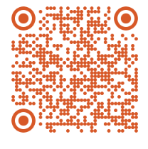
Your Voice Matters: Lab Session Feedback

Slide 30
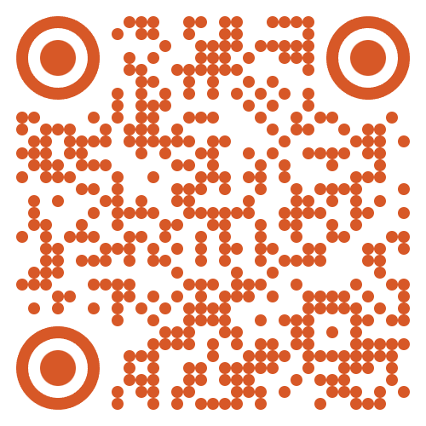
Dr. Ghadeer Mobasher
ghadeer.mobasher@srh-hochschulen.de
https://www.linkedin.com/in/ghadeermobasher/
LGS 6, 2. OG, Arc 213

