Slide 1
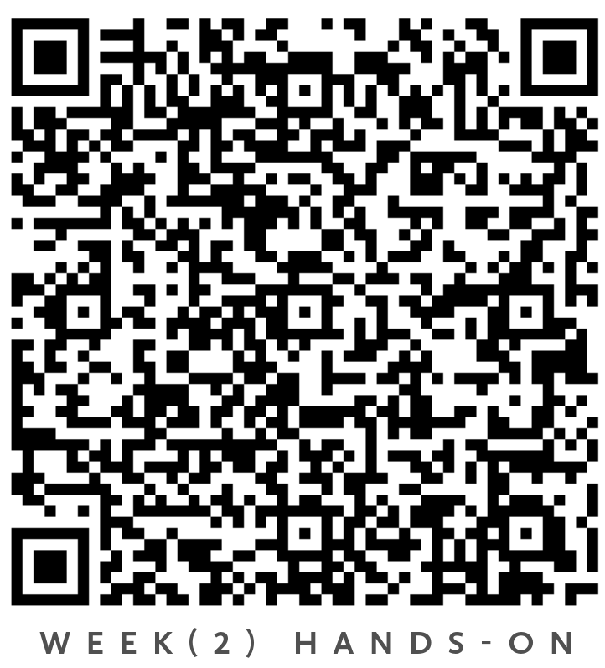
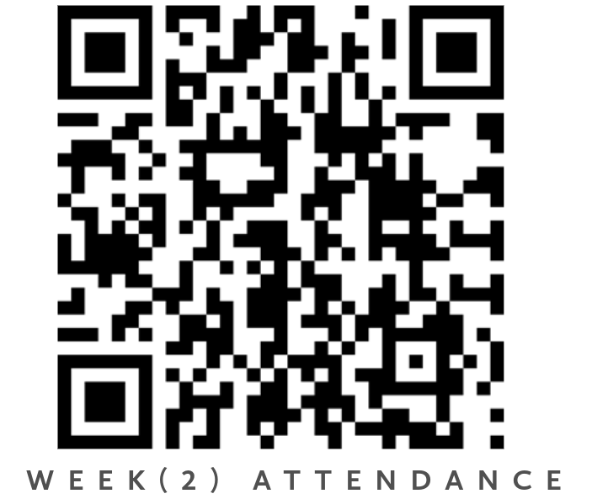
Python Foundations for Data Science
Week(2): Control Flow & Logic
Tuesday, 28 April 2026, 14:00–17:15

Slide 2
Agenda
Logical Reasoning in Programming Conditional statements, decision structures, and shorthand conditional (Ternary operator)
Loops in Programming For Loop, Nested Loops, Loop Control statements, and While Loop
Basic List Comprehensions as Compact Logic Expressions List Comprehension
Putting it All Together Mini Challenge
Your Voice Matters! Instant Honest Feedback

Slide 3
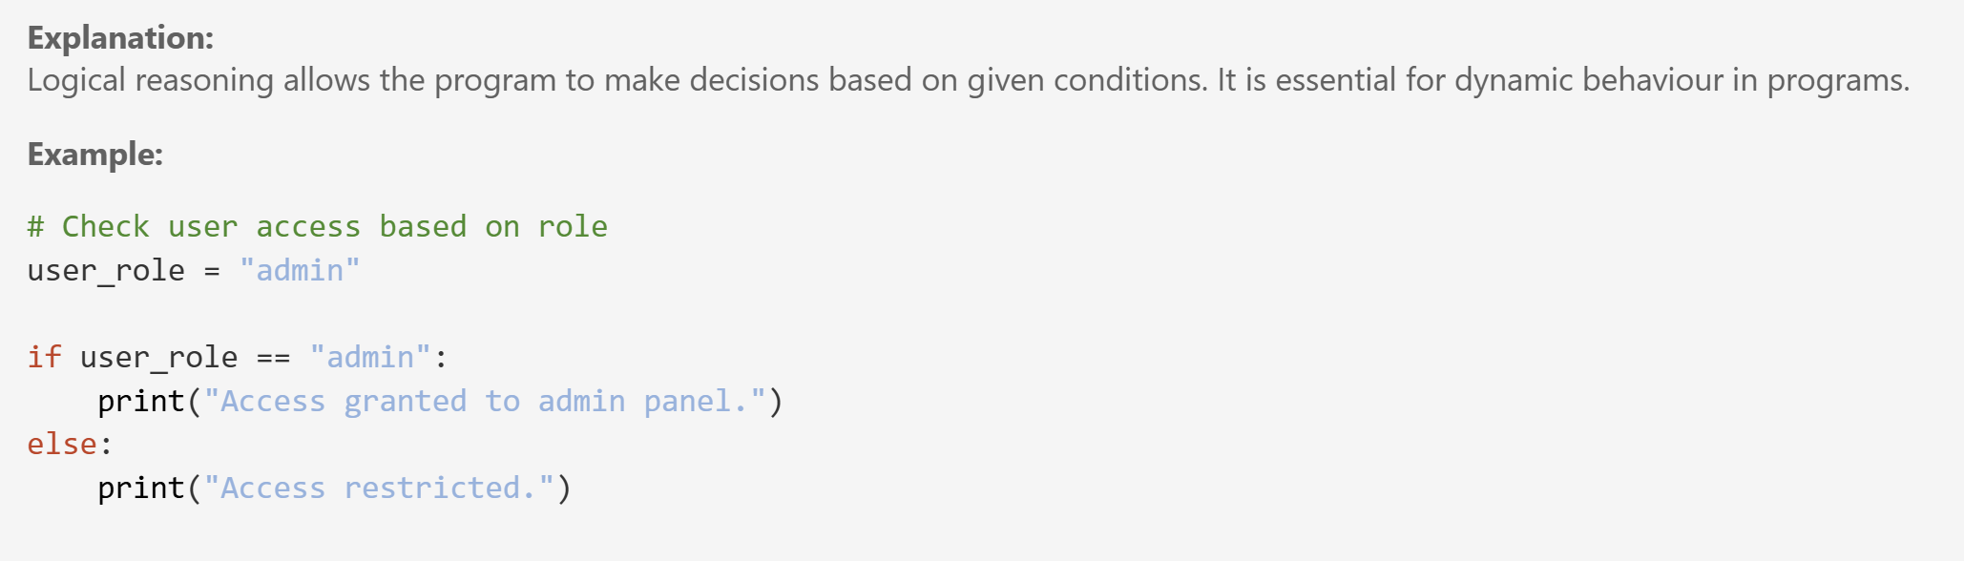
Logical Reasoning in Programming

Slide 4
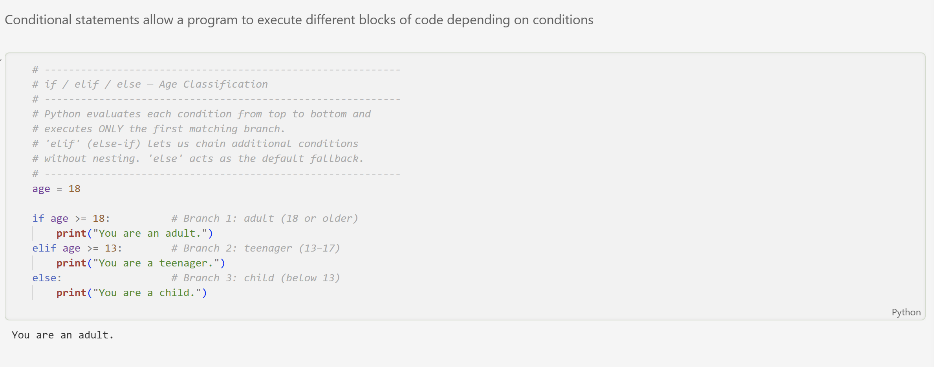
Conditional Statements and Decision Structures

Slide 5
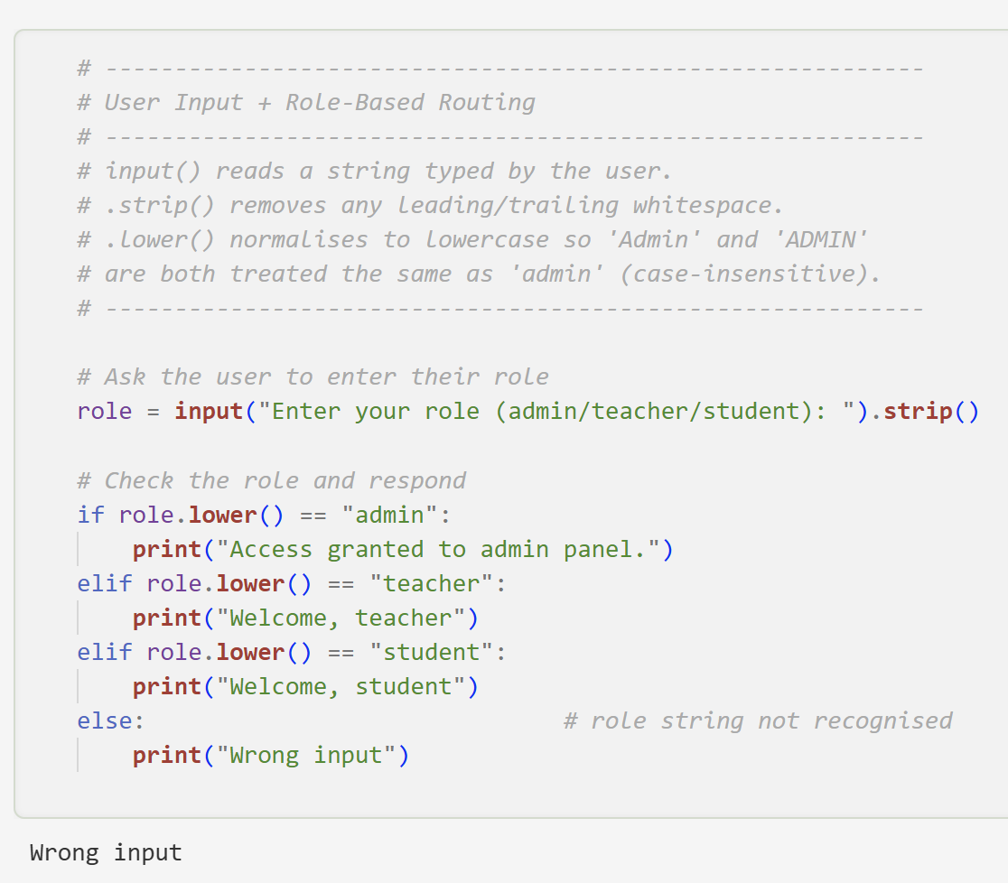
User Input and Role-Based Routing
In Week2.ipynb, check the beginning of the notebook until the section “Shorthand Conditional (Ternary Operator) in Python”
In Week2_Exercise.ipynb, you have 20 minutes to solve “Section A”.

Slide 6
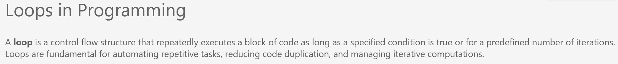
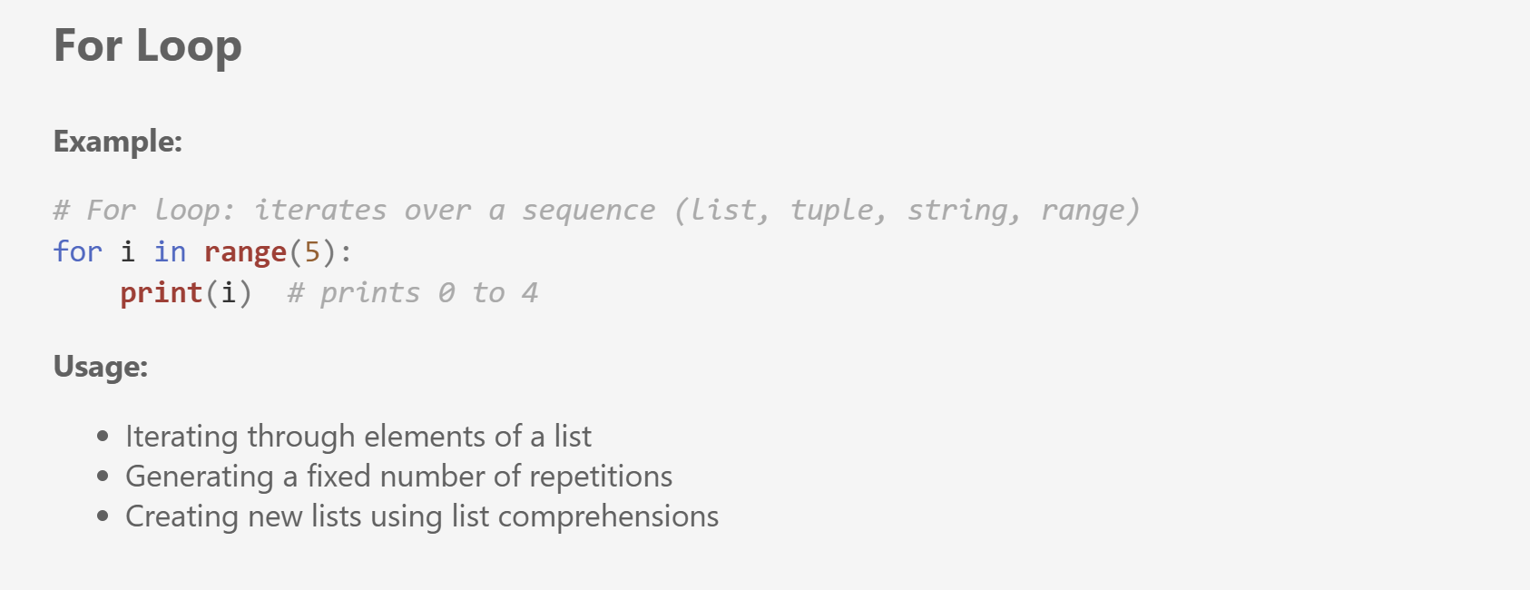
Loops in Progamming

Slide 7
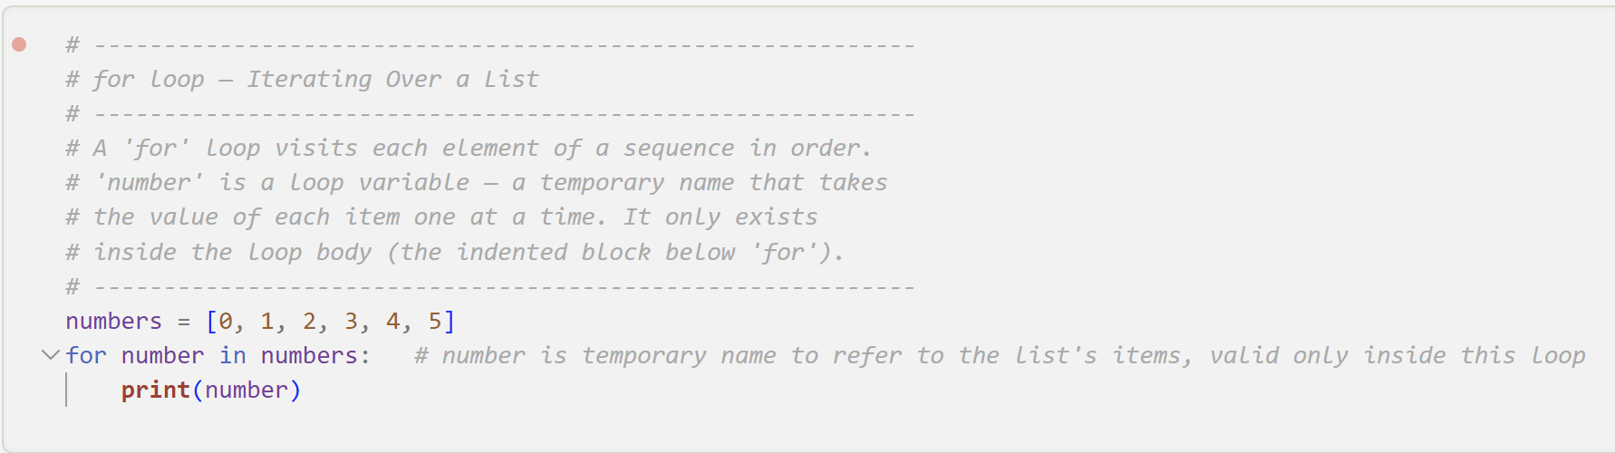
For Loop ( Iterating over a List)

Slide 8
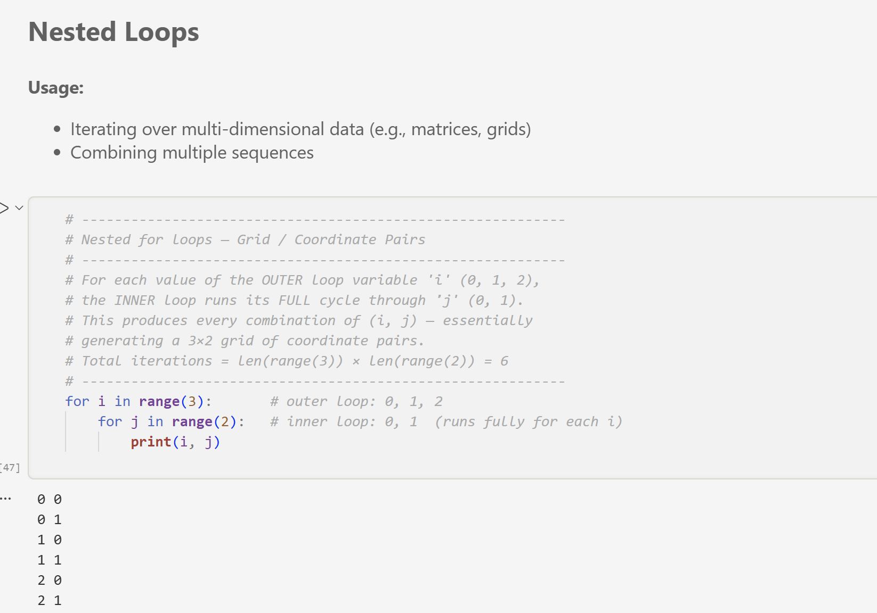
Nested Loops

Slide 9
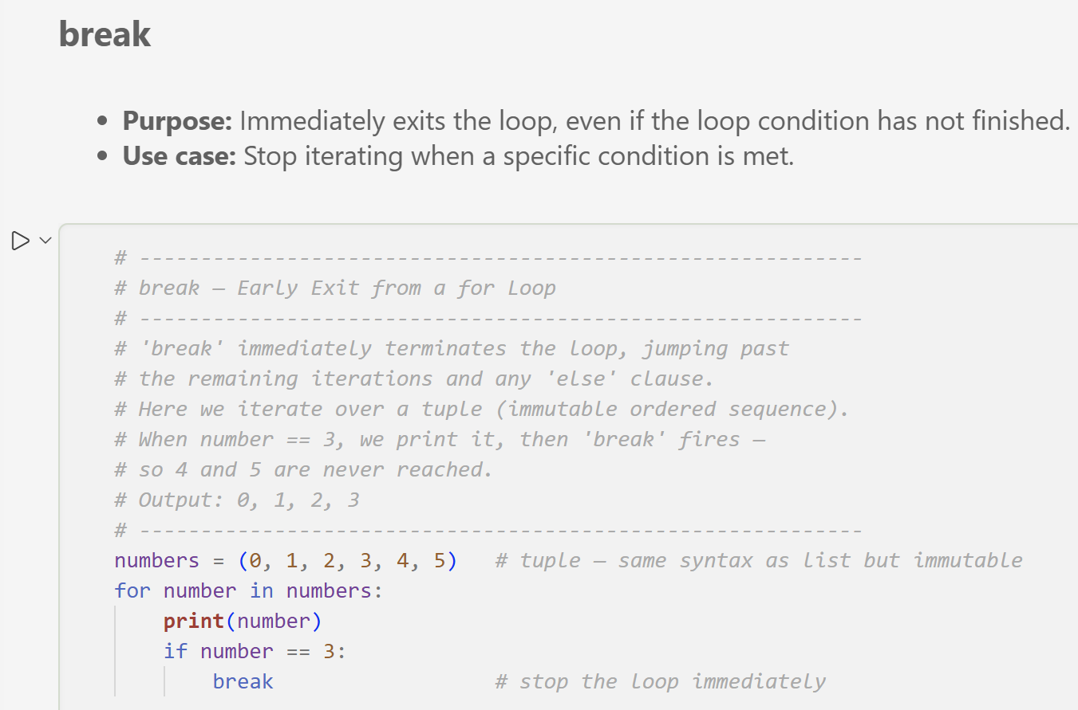
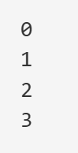
Loop Control Statements: Break

Slide 10
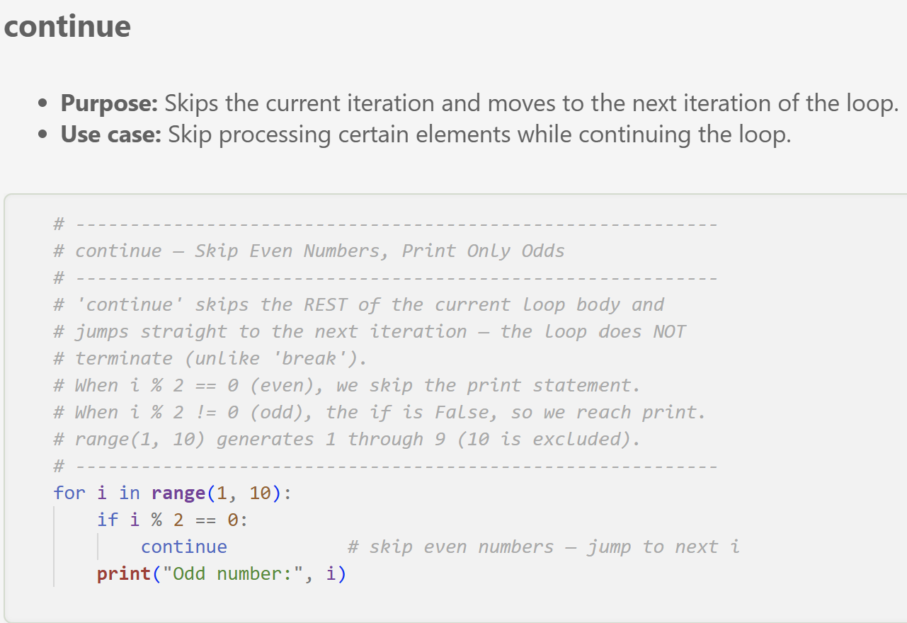
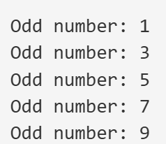
Loop Control Statements: Continue

Slide 11
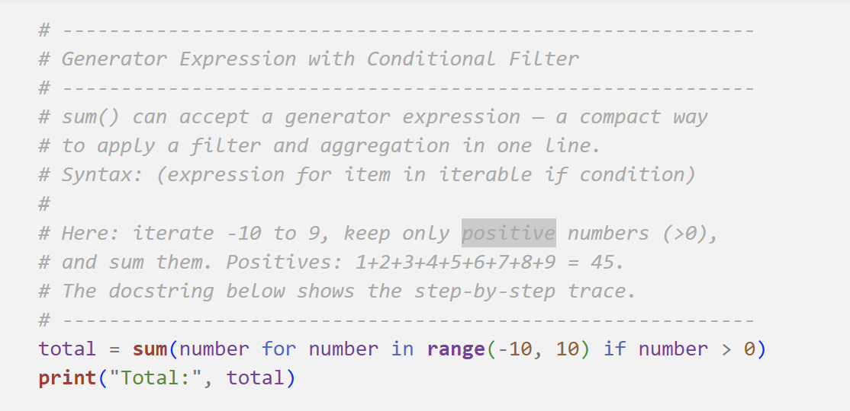
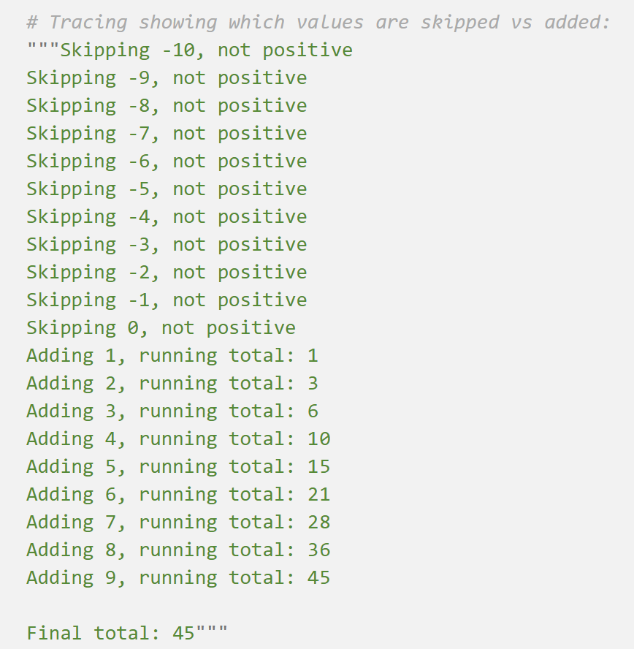
Generator Expression: Conditional Filtering

Slide 12
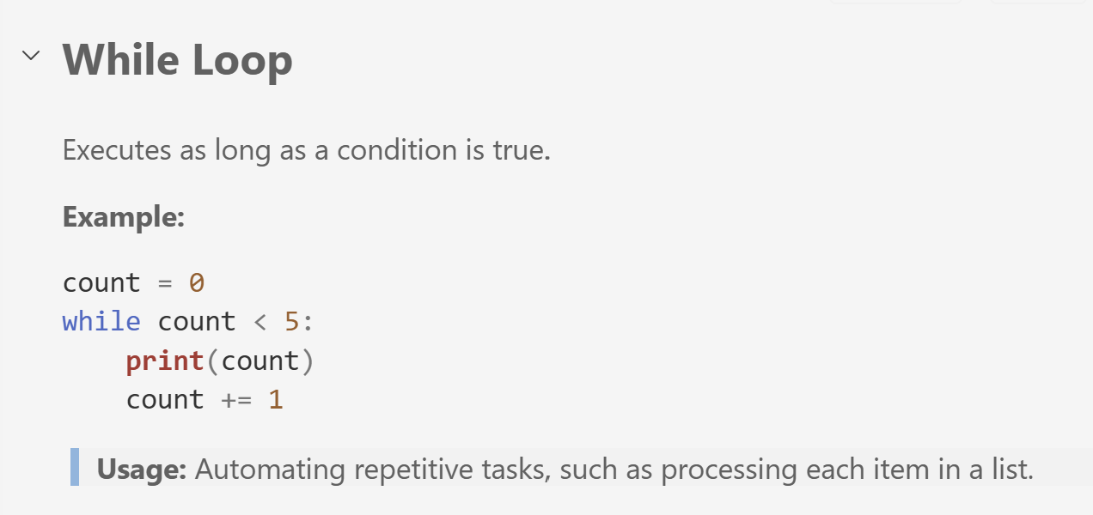
While Loop

Slide 13
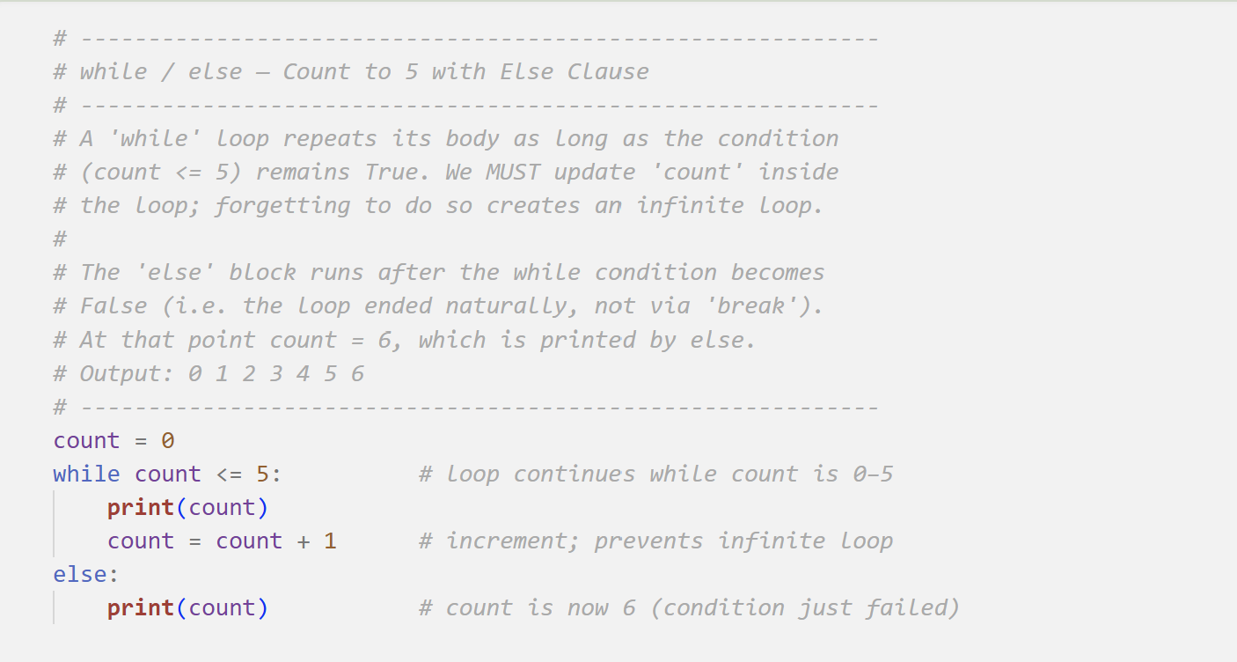
While / else
Trace the output without running the code.
How to early exit from a while loop?
In Week2.ipynb, check the section “Loops in Programming”
In Week2_Exercise.ipynb, you have 30 minutes to solve “Section B”.

Slide 14
Pause / Break
See you in 15 minutes ☺!
Please be on time.
Wednesday, 15 April 2026, 14:00–17:15

Slide 15
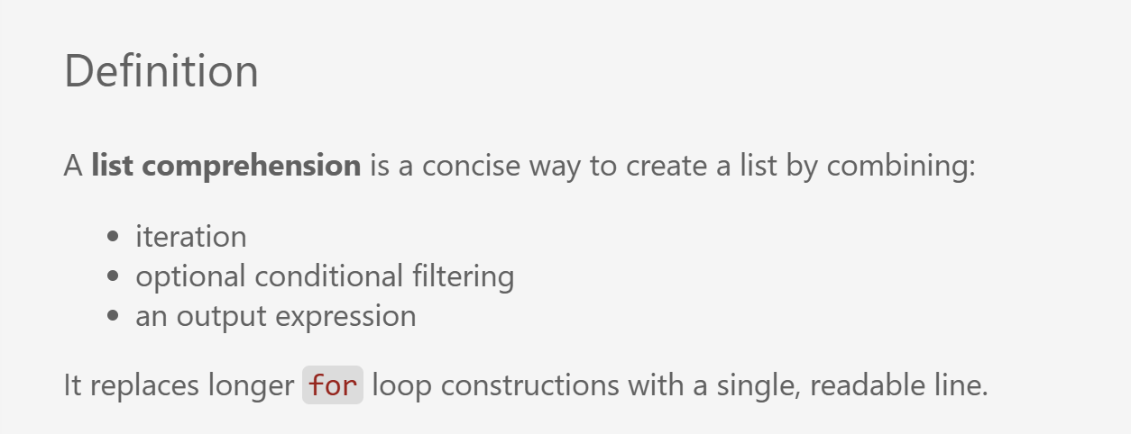
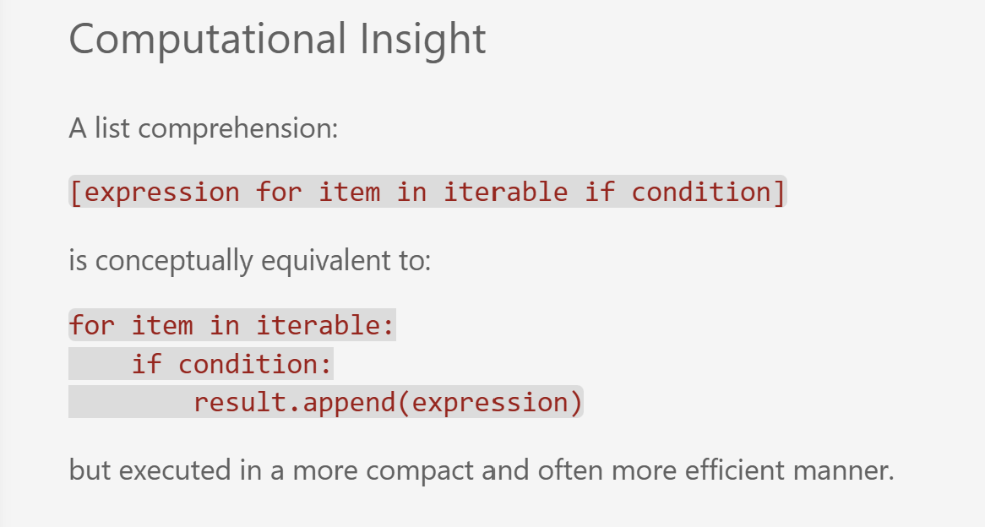
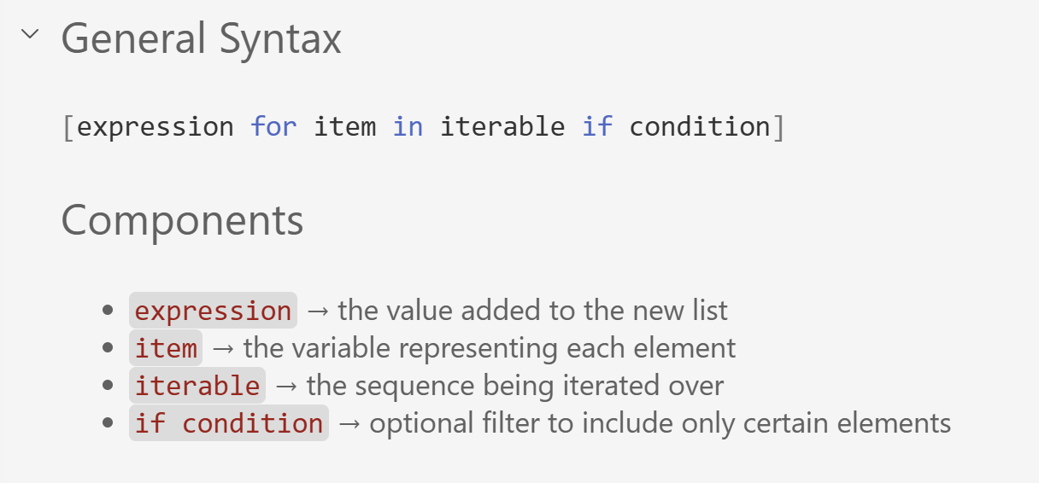
Basic List Comprehensions

Slide 16
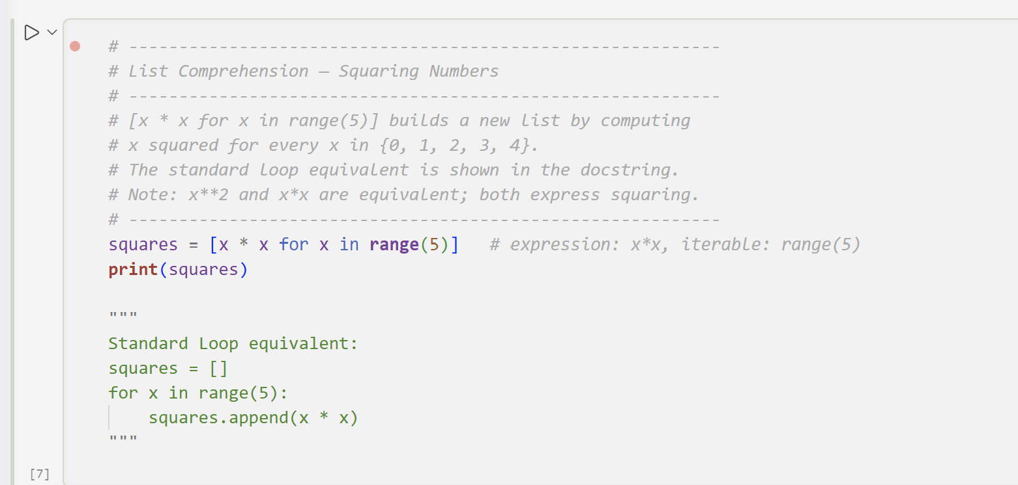

Basic List Comprehension- Squaring Numbers
In Week2.ipynb, check the section “Basic List Comprehensions as Compact Logic Expressions”
In Week2_Exercise.ipynb, you have 35 minutes to solve
“Section C”.

Slide 17
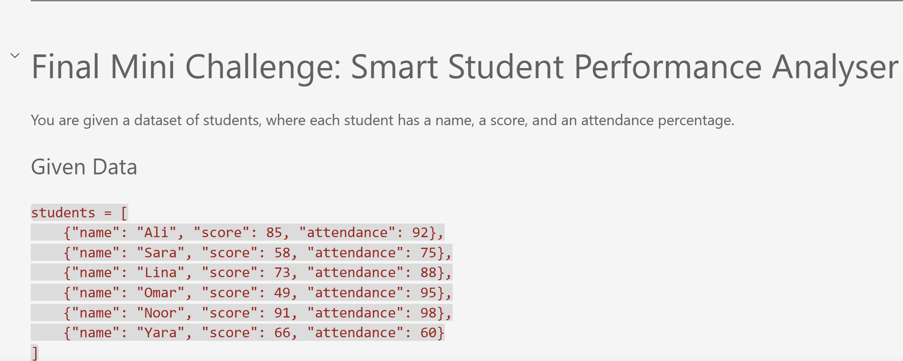
Final Mini Challenge: Smart Student Performance Analyser
In Week2_Exercise.ipynb, you have 25 minutes to solve the “Final Mini Challenge”

Slide 18
What did we learn today?
Logical Reasoning in Programming
Loops in Programming
Conditional statements, decision structures, and shorthand conditional (Ternary operator)
For Loop, Nested Loops, Loop Control statements, and While Loop
62.0
Basic List Comprehensions
Compact Logic Expressions

Slide 19
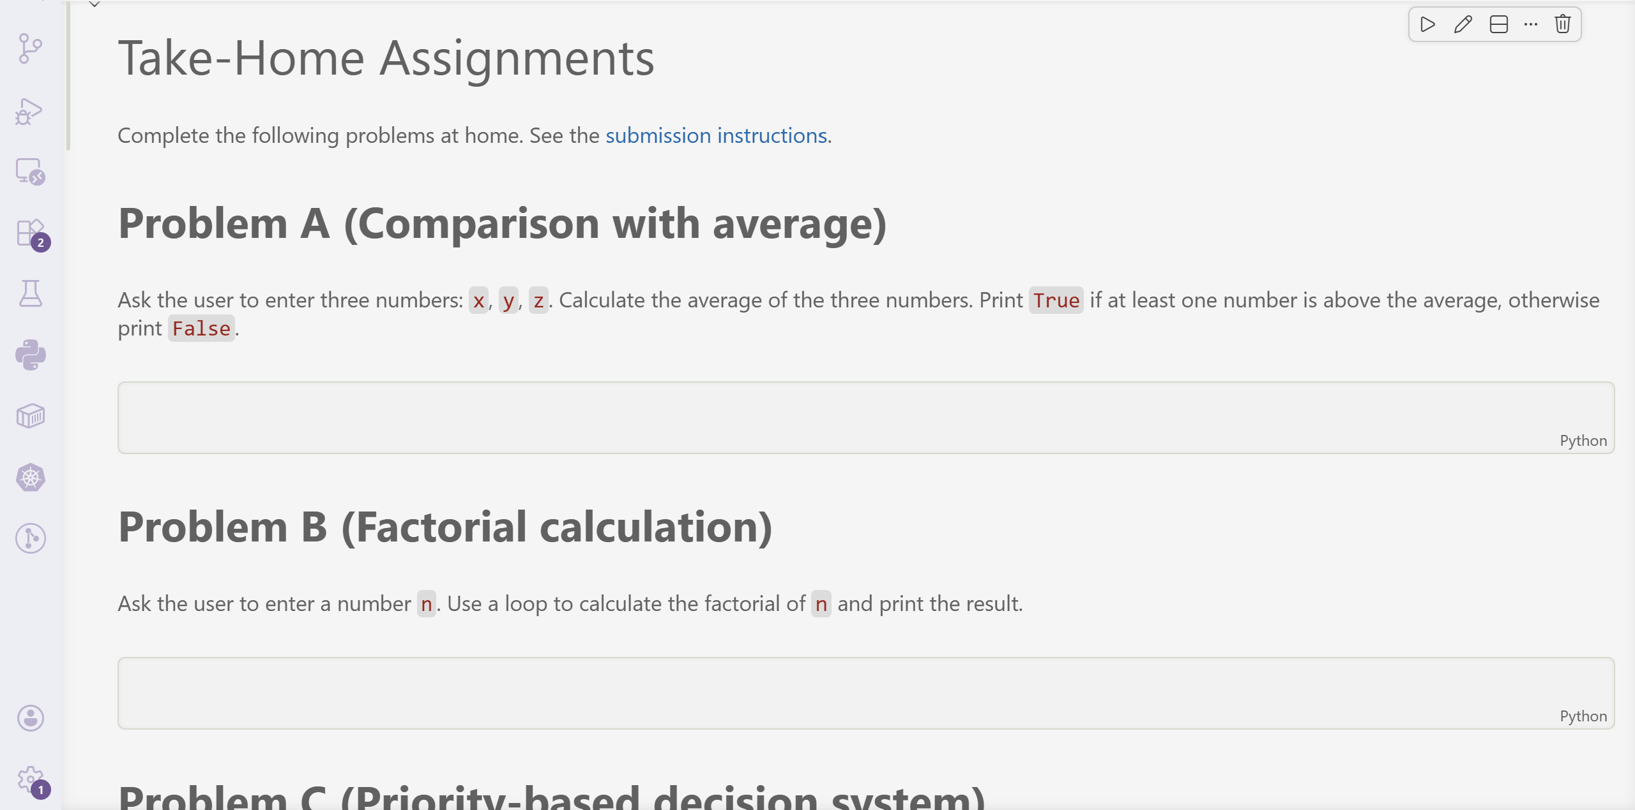
Take-Home Assignments
Solve Problems A-E in “Take-Home Assignments “ section and push them to your private individual repository in Week(2) directory. The deadline is Sunday, 03.05.2026, at 23:59. For more details, please have a look at our course’s GitHub Repository and submission instructions.

Slide 20
Coming Up : Week (3) So far, we have worked primarily with individual variables and basic control flow. How would you design a system that stores and organises multiple related pieces of information? • Lists and indexing principles • Tuples and immutability • Dictionaries and key–value modelling • Sets and uniqueness • Nested data structures for real-world data modelling

Slide 21
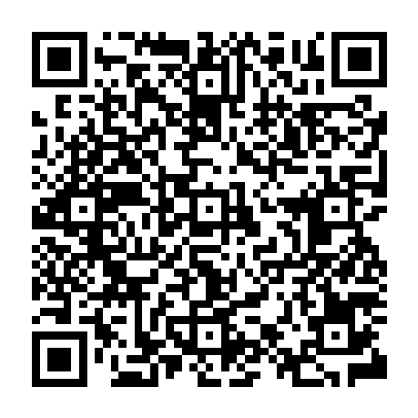
Your Voice Matters: Lab Session Feedback

Slide 22
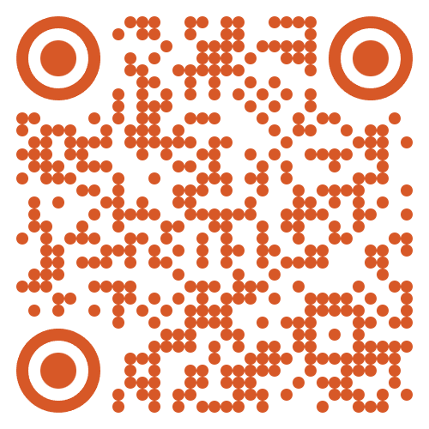
Dr. Ghadeer Mobasher
ghadeer.mobasher@srh-hochschulen.de
https://www.linkedin.com/in/ghadeermobasher/
LGS 6, 2. OG, Arc 213

