Slide 1
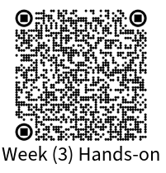
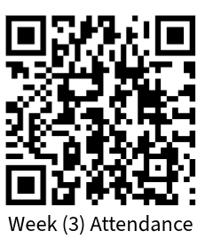
Python Foundations for Data Science
Week(3): Core Data Structures
Thursday, 30 April 2026, 09:30–12:45

Slide 2
Agenda
Lists and indexing principles Lists and corresponding operations
Tuples and immutability Tuples vs Lists
Sets and Uniqueness Sets and corresponding operations
Dictionaries Key-value modelling
Nested Data Structures Real-world Data Modelling
Putting it all together Final Mini Challenge: Student Event Registration System
Your Voice Matters! Instant Honest Feedback

Slide 3
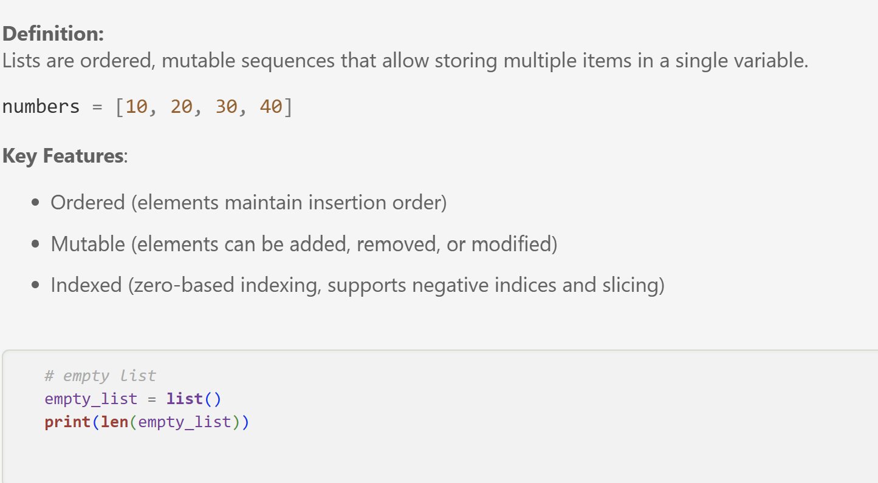
Lists

Slide 4
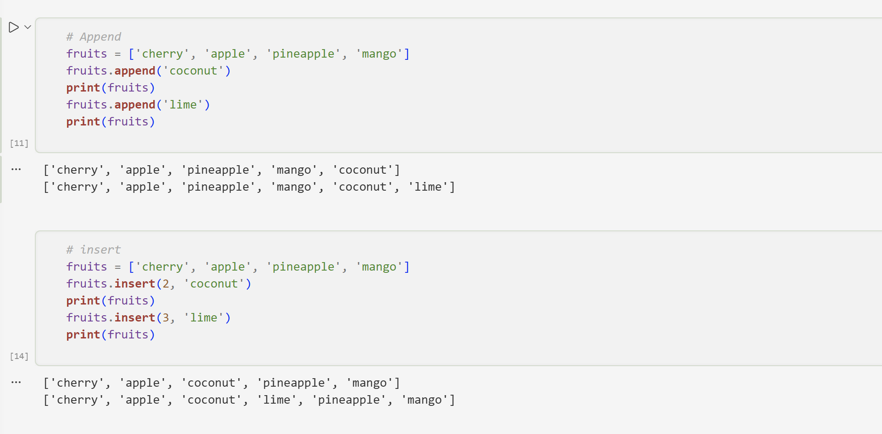
Append and Insert Operations

Slide 5
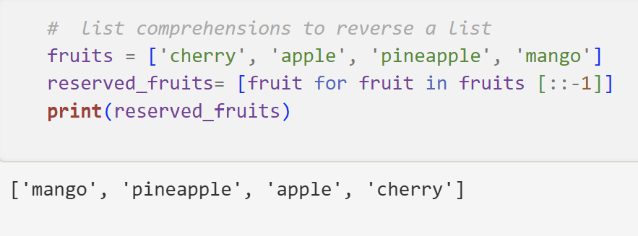
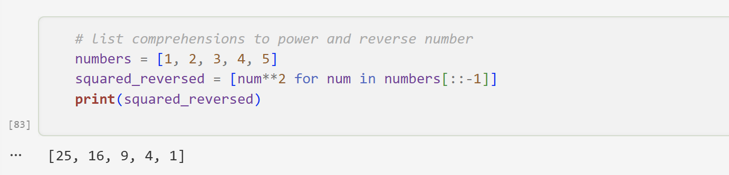
List Comprehension
In Week3.ipynb, check the beginning of the notebook until the section “1. Lists”
In Week3_Exercise.ipynb, you have 20 minutes to solve “Section A: Lists”.

Slide 6
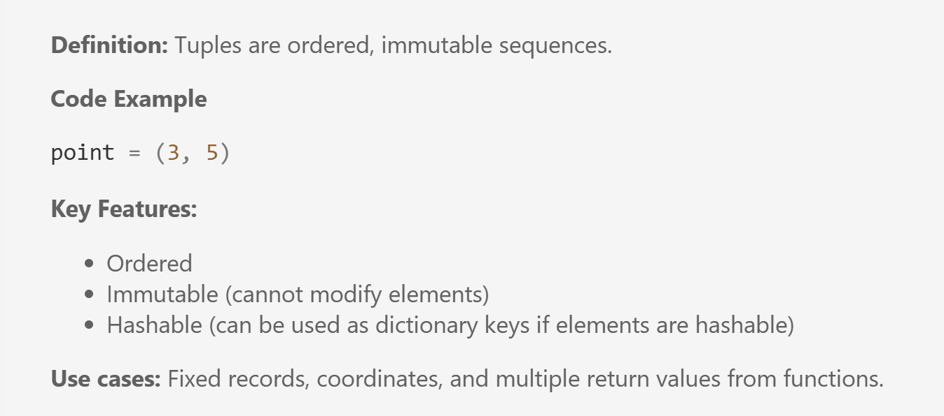
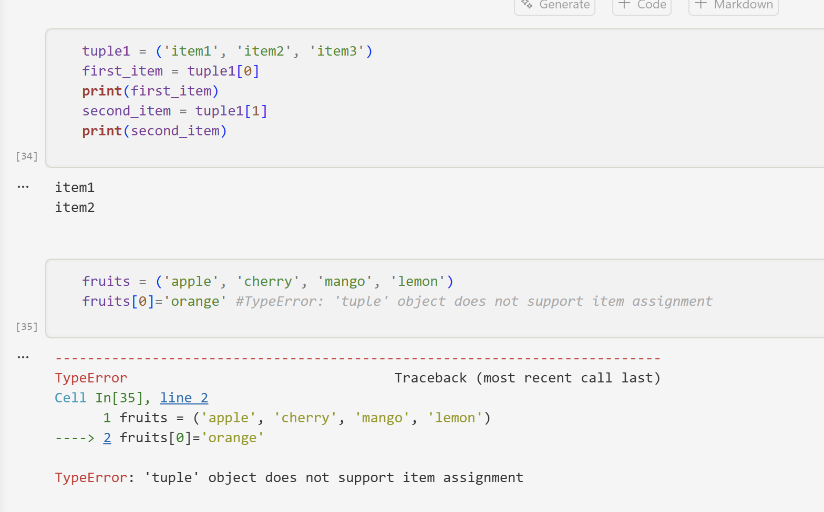
Tuples

Slide 7
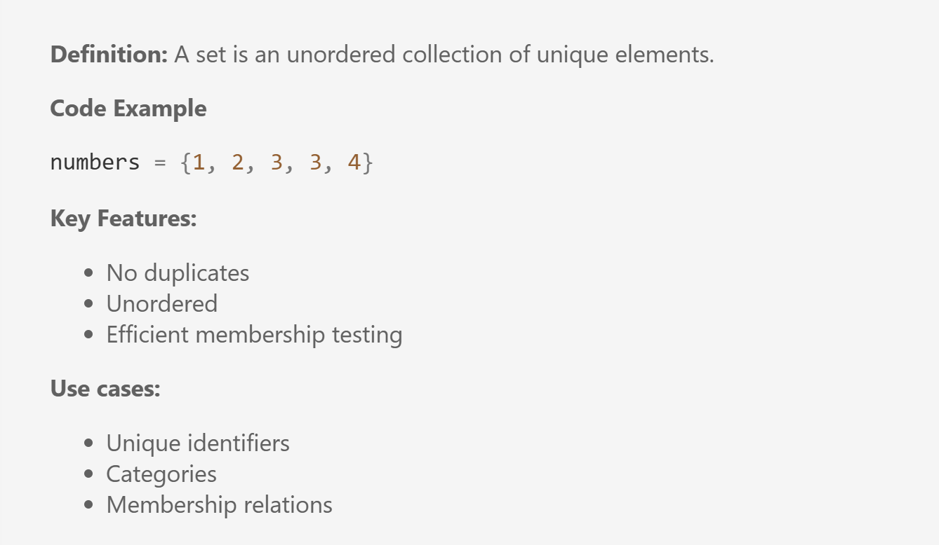
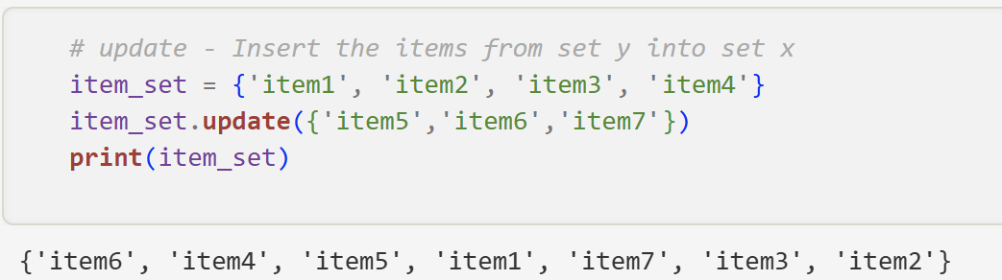
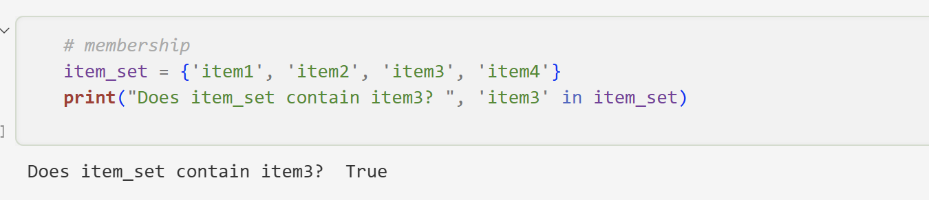
Sets
In Week3.ipynb, check sections ( “2. Tuples and Immutability“ and “3. Sets“)
In Week3_Exercise.ipynb, you have 30 minutes to solve “Section B: Tuples” and “Section C: Sets” .

Slide 8
Pause / Break
See you in 15 minutes ☺!
Please be on time.
Wednesday, 15 April 2026, 14:00–17:15

Slide 9
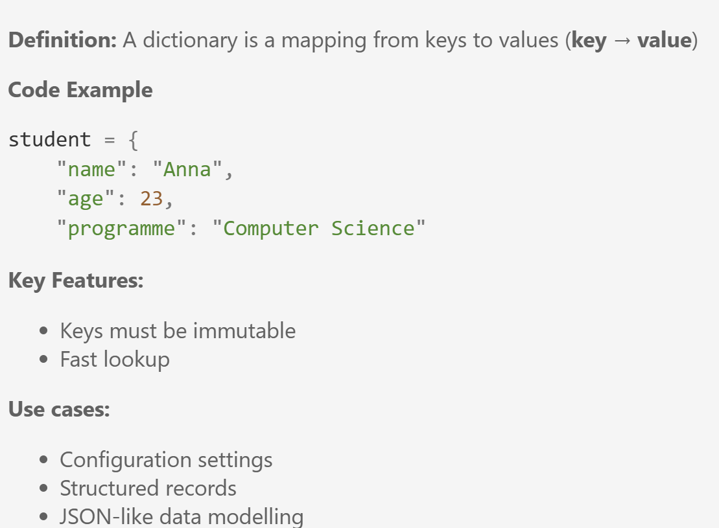
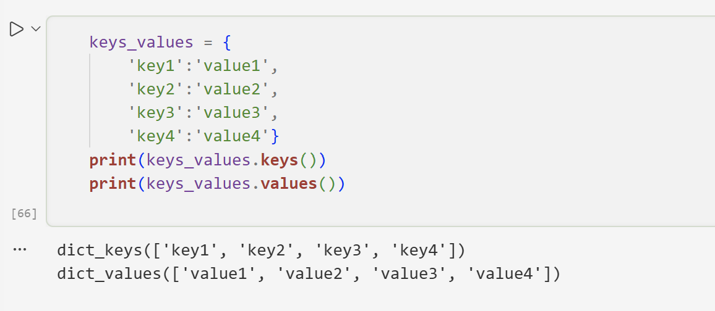
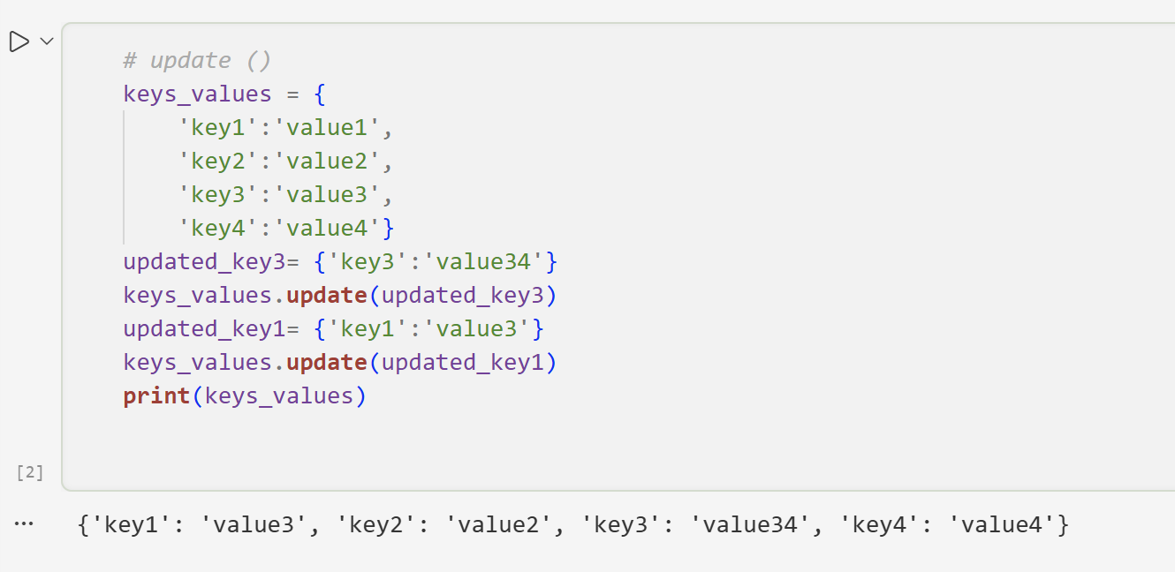
Dictionaries

Slide 10
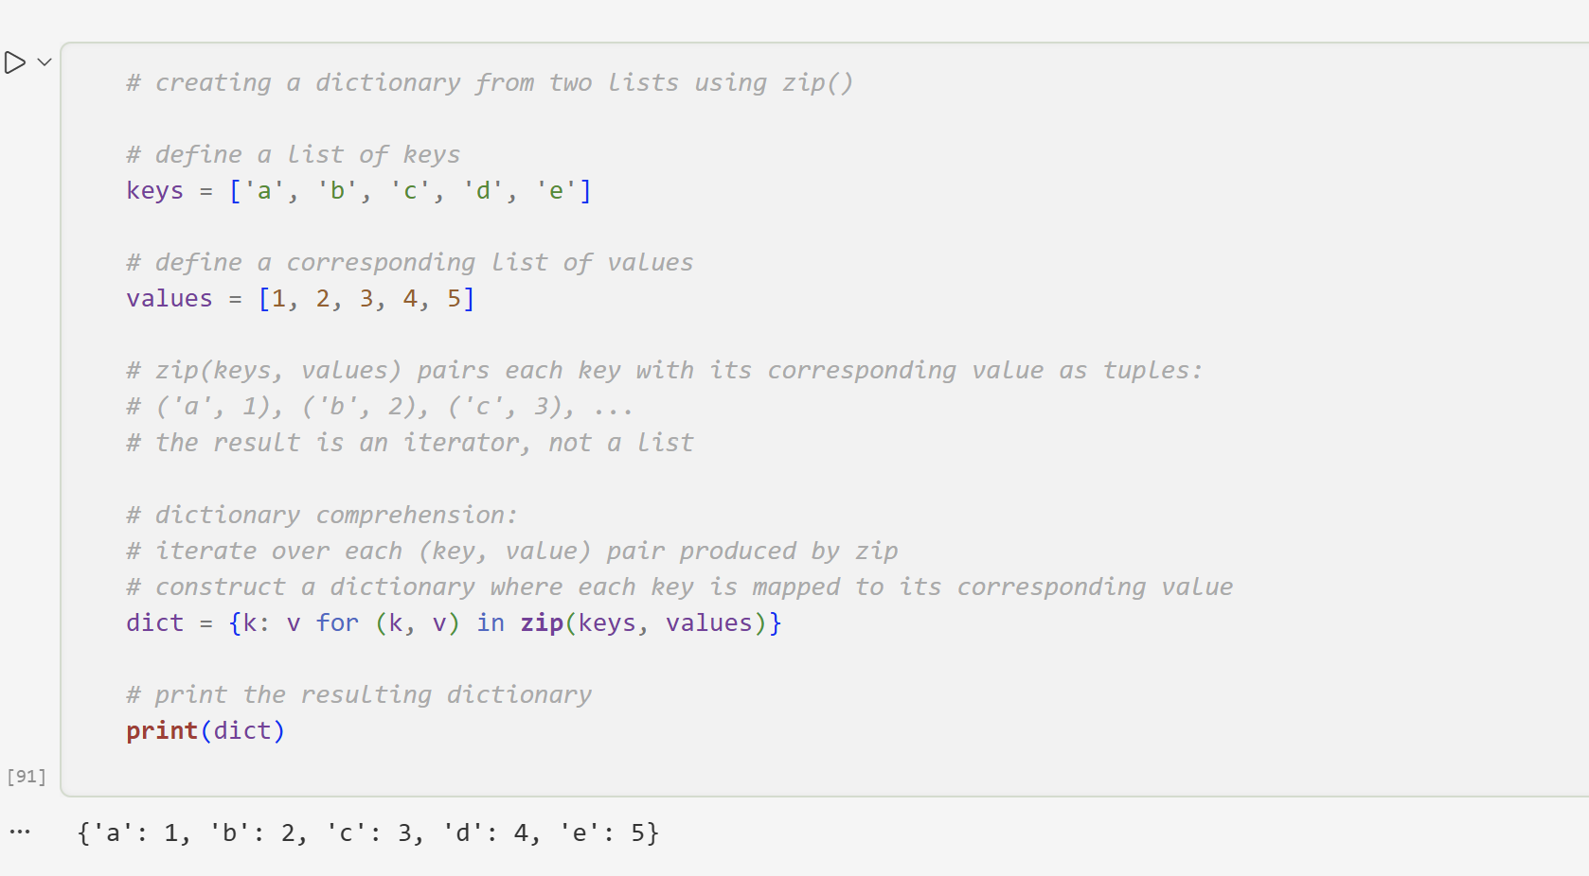
Dictionary Comprehension

Slide 11
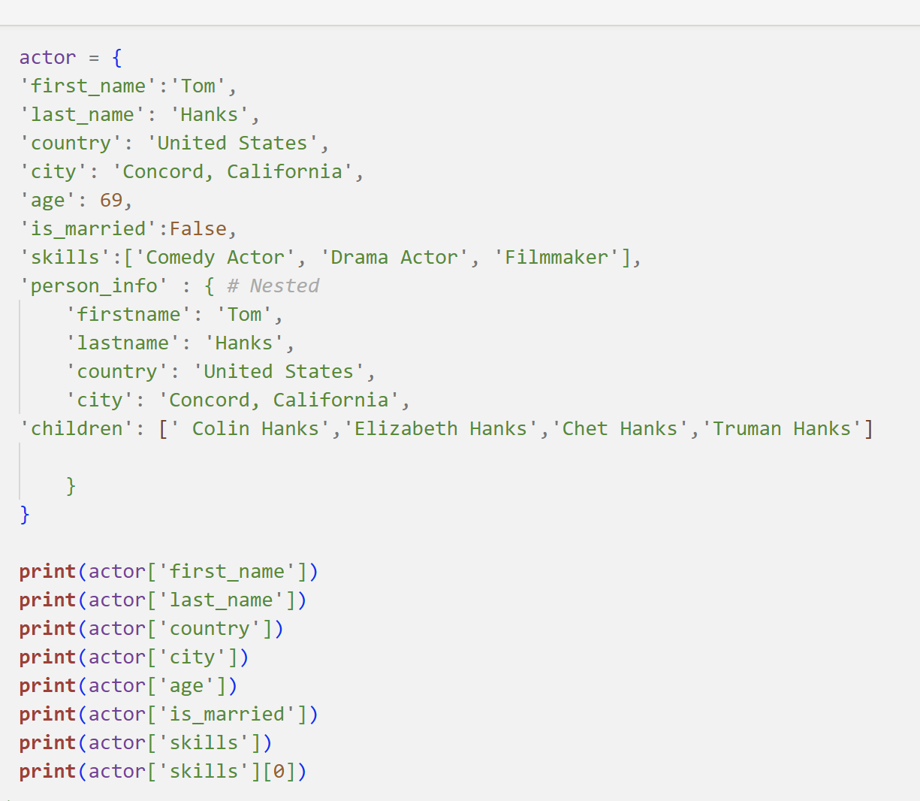
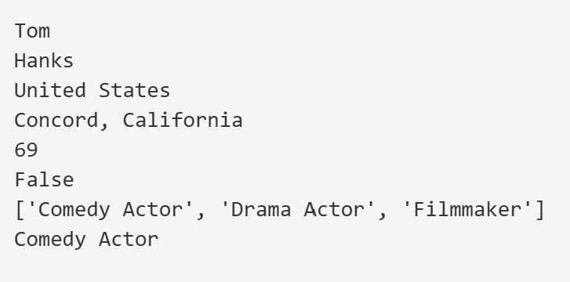
Nested Dictionary

Slide 12
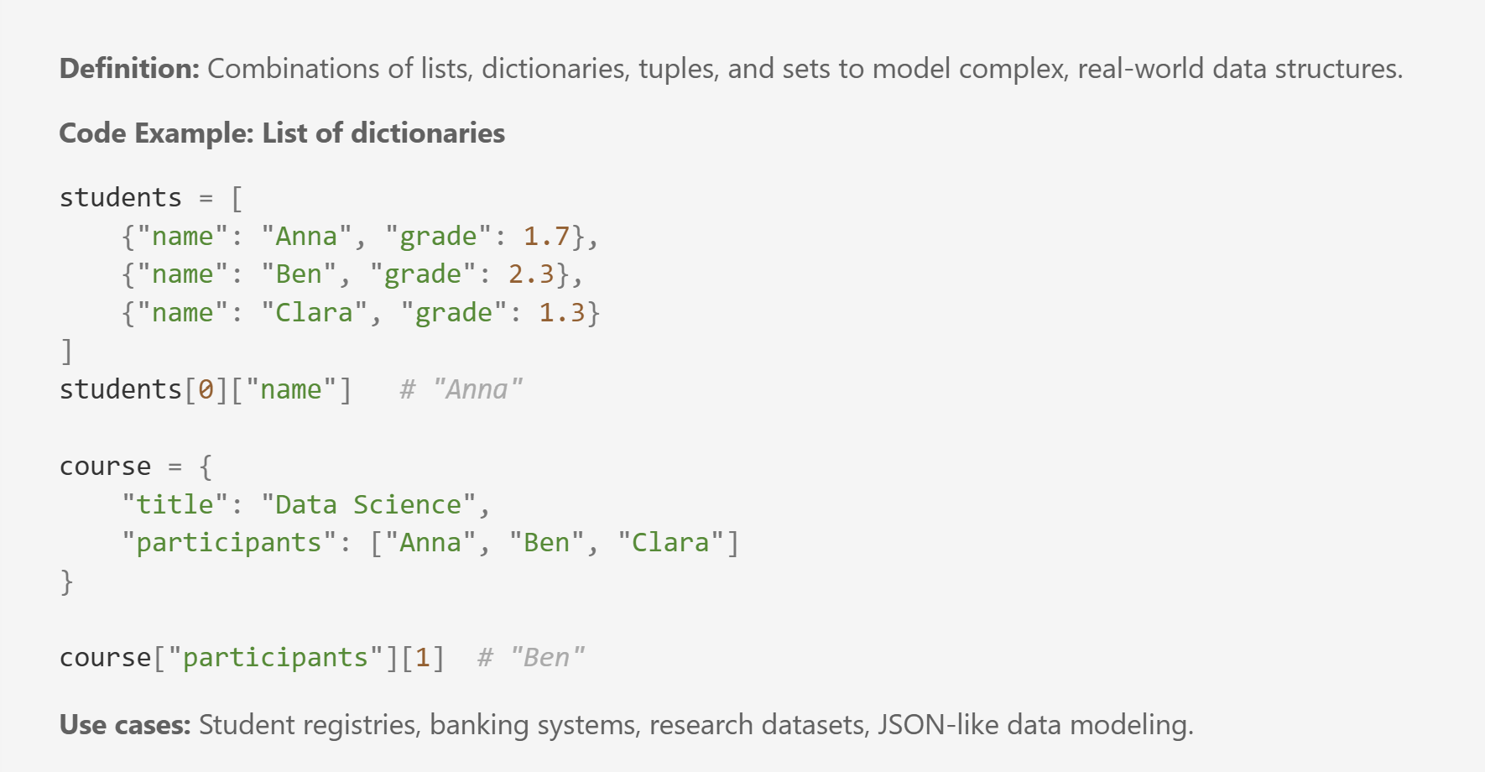
Nested Data Structure

Slide 13
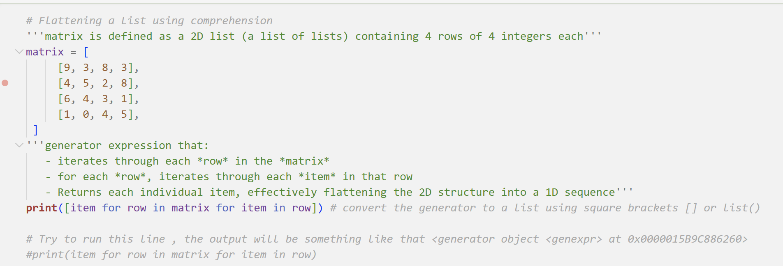
Flattening a Matrix using Comprehension
A precise explanation is:
matrix is the outer iterable
row is each element in matrix (each inner list)
row then becomes a new iterable
item is each element inside that row
for each row in matrix, iterate over each item in that row, and collect item.
In Week3.ipynb, check sections ( “4. Dictionaries“ and “5. Nested DS“)
In Week3_Exercise.ipynb, you have 35 minutes to solve “Section D: Dictionaries” and “Section E: Nested Lists & Dictionaries” .

Slide 14
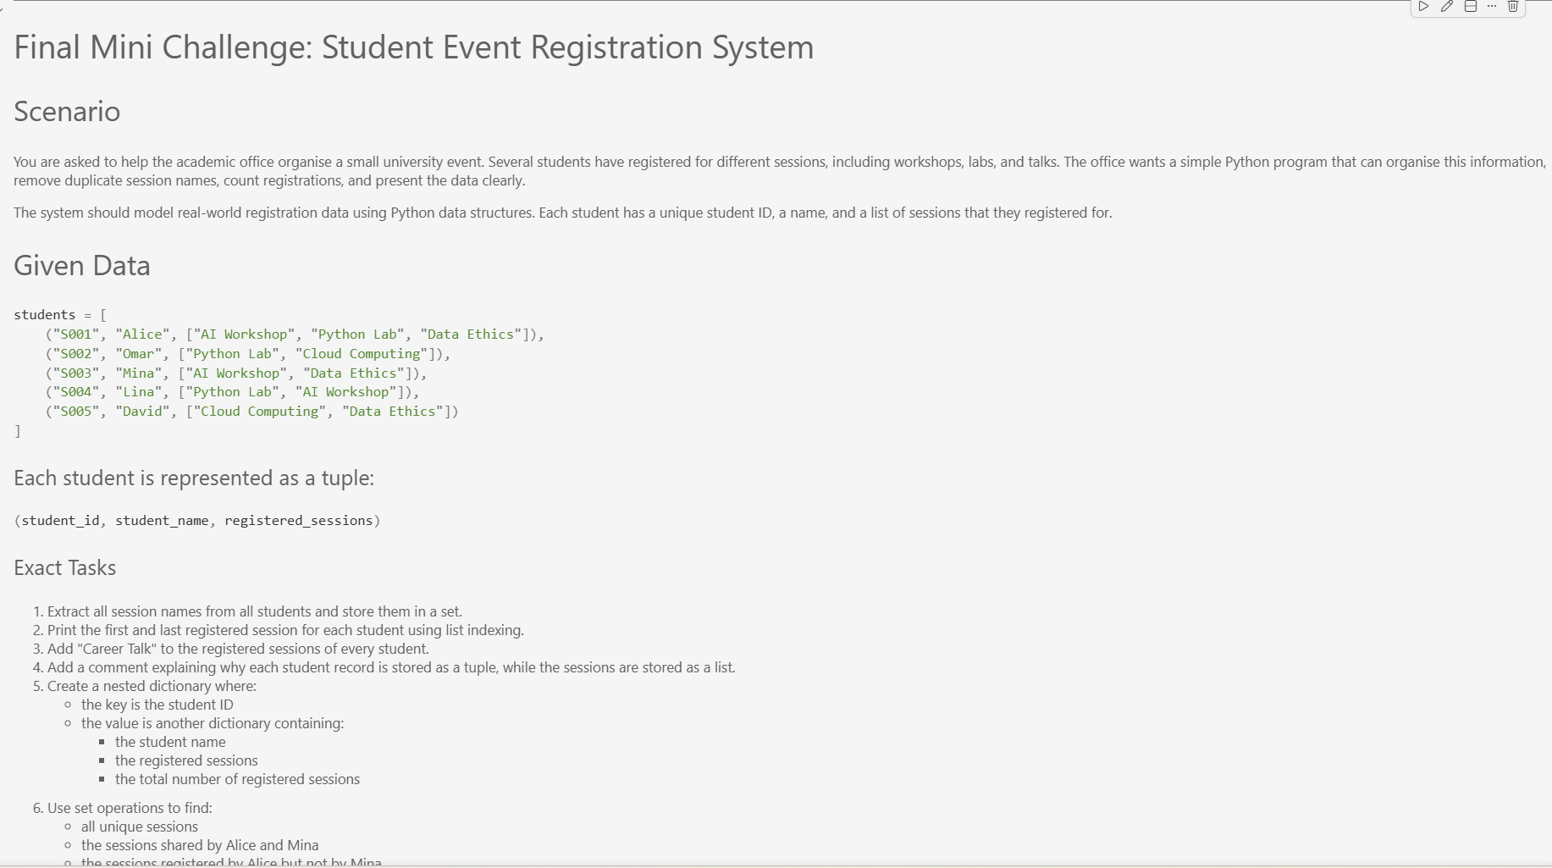
Final Mini Challenge: Student Event Registration System
In Week3_Exercise.ipynb, you have 35 minutes to solve the “Final Mini Challenge”

Slide 15
What did we learn today?
Lists and indexing Principles
Tuples and Immutability
Lists and corresponding operations
Tuples vs Lists
62.0
Sets and Uniqueness
Dictionaries
Sets and corresponding operations
Key-value Modelling
Nested Data Structures
Real-world Data Modelling

Slide 16
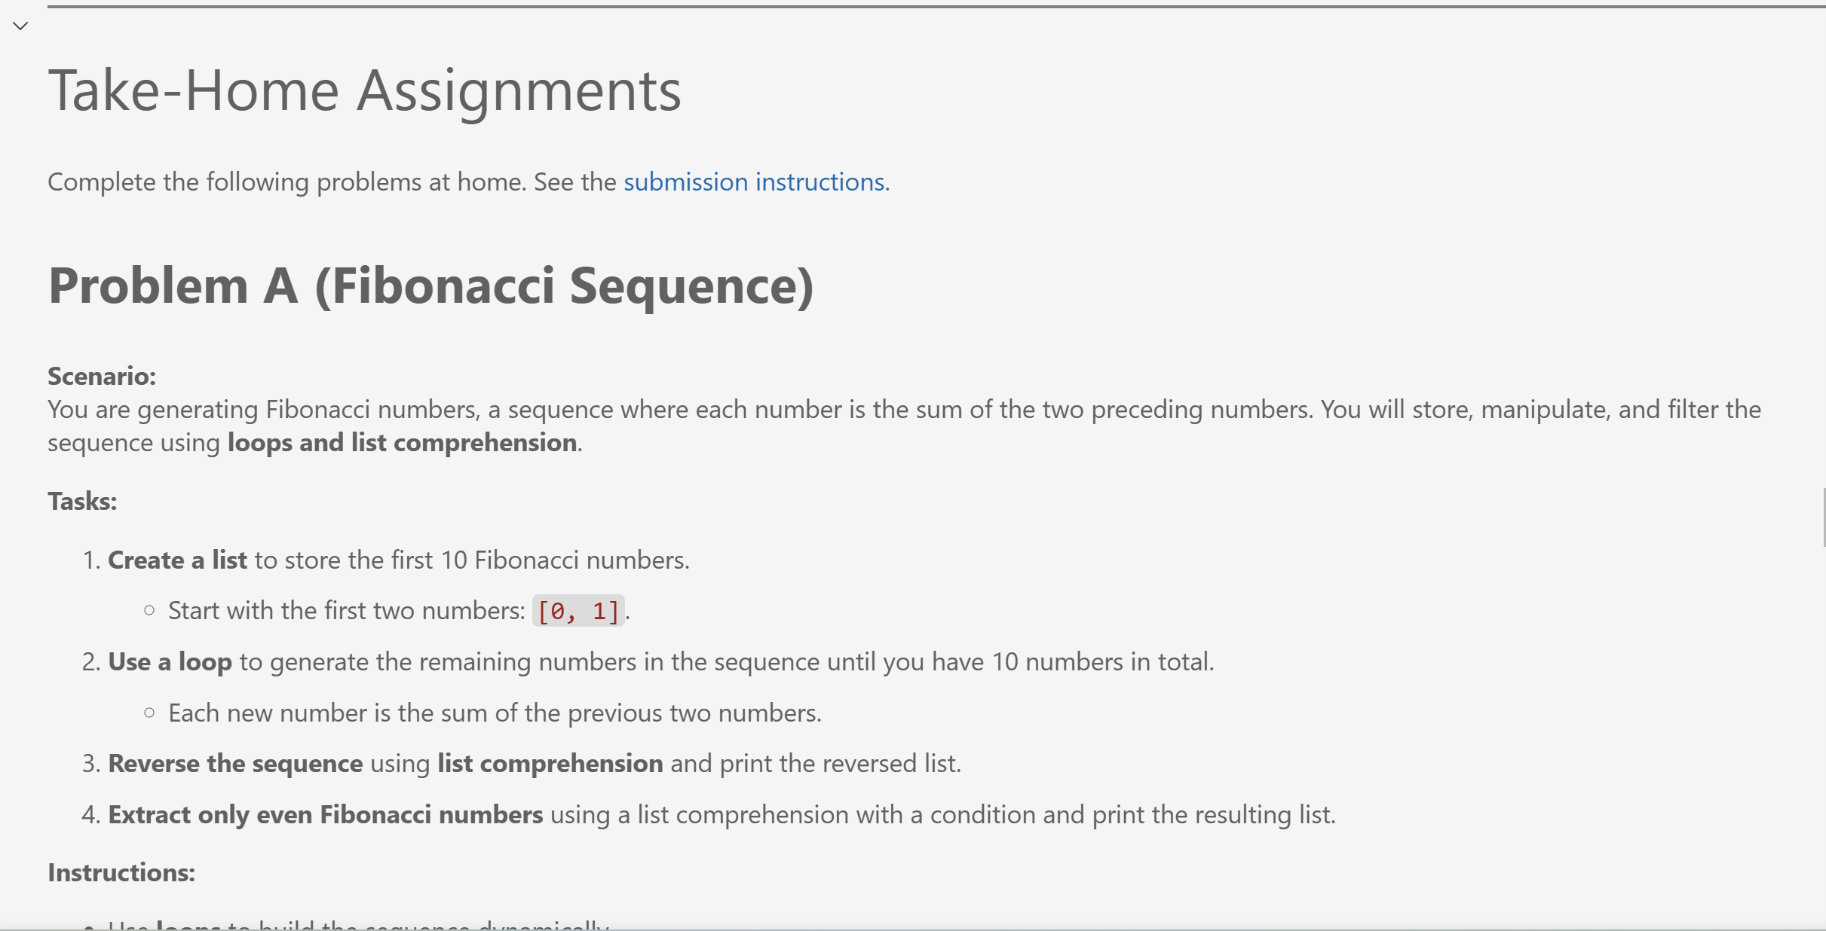
Take-Home Assignments
Solve Problems A-E in “Take-Home Assignments “ section and push them to your private individual repository in Week(3) directory. The deadline is Wednesday, 06.05.2026, at 23:59. For more details, please have a look at our course’s GitHub Repository and submission instructions.

Slide 17
Coming Up : Week (4) So far, we have worked with core data structures to store and organise related information. How can functions help us reuse this logic and divide a program into smaller, manageable parts? • Purpose of functions • Parameters and return values • Variable scope • Default parameters • Lamda Expressions • Writing reusable and modular code

Slide 18
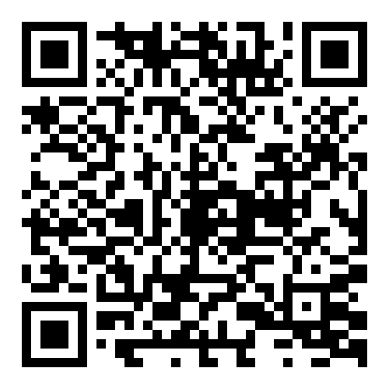
Your Voice Matters: Lab Session Feedback

Slide 19

Dr. Ghadeer Mobasher
ghadeer.mobasher@srh-hochschulen.de
https://www.linkedin.com/in/ghadeermobasher/
LGS 6, 2. OG, Arc 213

