Slide 1
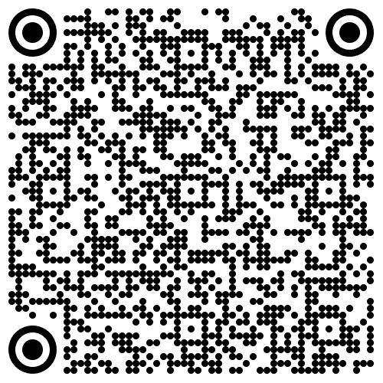
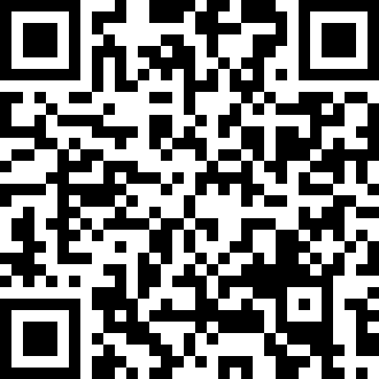
Python Foundations for Data Science
Week(4): Functions & Modular Programming
Thursday, 7th May 2026, 09:30–12:45
Week (4)- Hands-on
Week (4)- Attendance

Slide 2
Agenda
Purpose of Functions Functions
Function Parameters & Return Values Parameters and return values
Variable Scope Local and Global variables
Functions with Default Parameters Default Parameters
Functions passing an Arbitary Number of Arguments Arbitary Number of Arguments
Lambda Expression Anonymous functions for short operations
Putting it all together Final Mini Challenge: University Lab Submission Tracking System
Your Voice Matters! Instant Honest Feedback

Slide 3
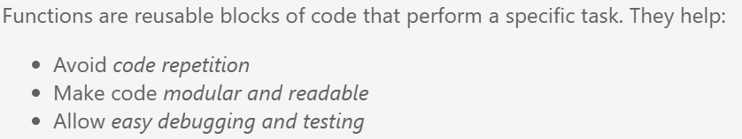
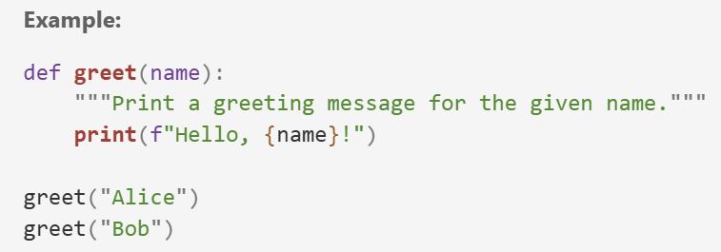
Functions
What is the function name? Does this function return any value?

Slide 4
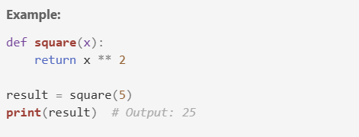
Parameters and Return Values
Parameters
Return Values

Slide 5
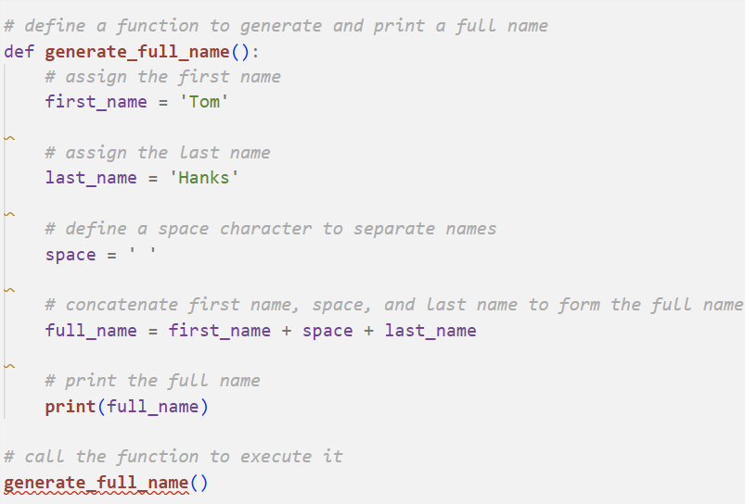
Void vs Return Functions
Void Function

Slide 6
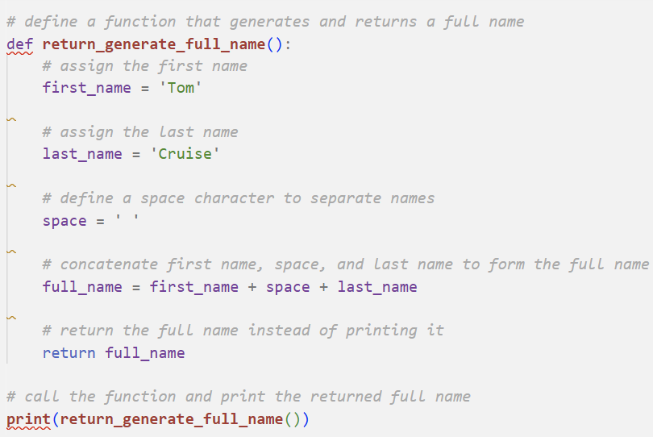
Void vs Return Functions
Return Function

Slide 7
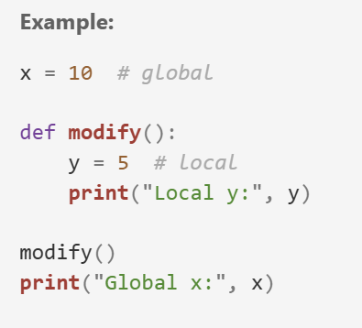

Variable Scope
Is only accessible within that function’s scope

Slide 8
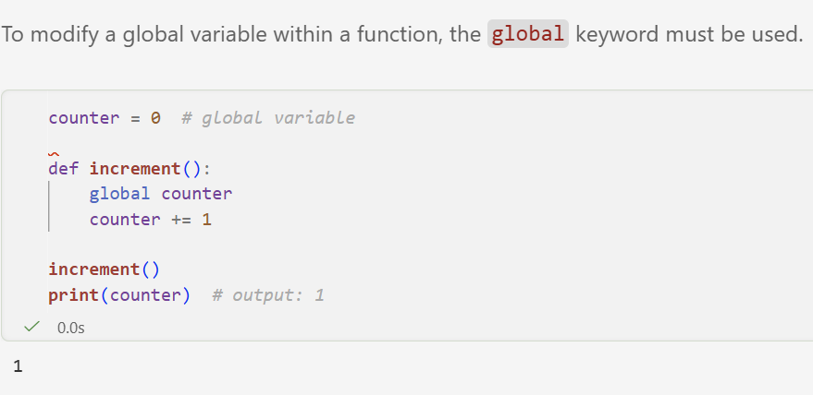
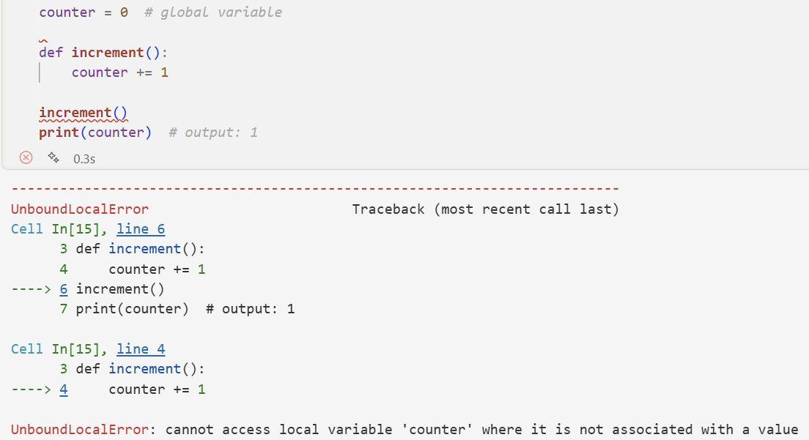
Modifying Global Variables inside a Function

Slide 9
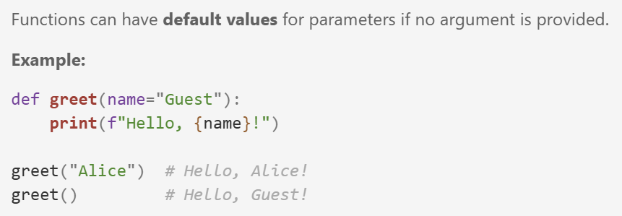
Default Parameters
Default Parameter

Slide 10
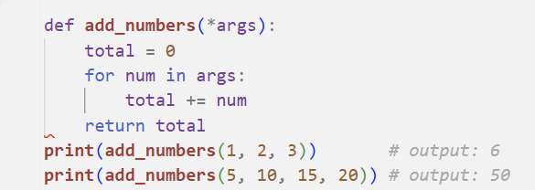
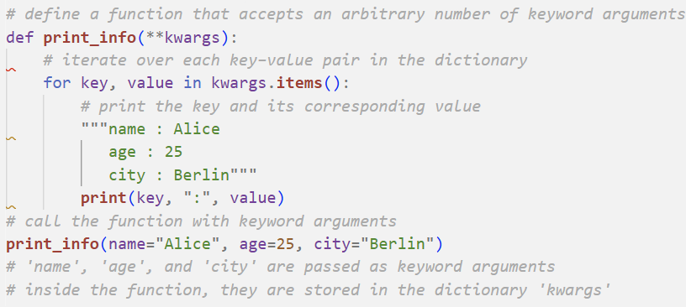
Arbitrary Number of Arguments
In Python, an arbitrary number of arguments allows a function to accept a variable number of inputs rather than a fixed number.
Arbitrary Positional Arguments: *args
The *args syntax allows a function to accept any number of positional arguments. These are stored as a tuple.
Arbitrary Keyword Arguments: **kwargs
The **kwargs syntax allows a function to accept any number of keyword arguments. These are stored as a dictionary.
Do you remeber the unpacking arguments? * operator to unpack list and ** opertator to unpack dictionary

Slide 11
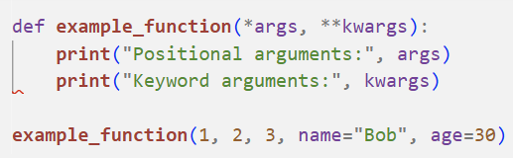

Combining Both Arguments
In Week4.ipynb, check all sections just before “Section 5. Lambda Expression“
In Week4_Exercise.ipynb, you have 40 minutes to solve “Problems 1 &2” .

Slide 12
Pause / Break
See you in 15 minutes ☺!
Please be on time.
Wednesday, 15 April 2026, 14:00–17:15

Slide 13
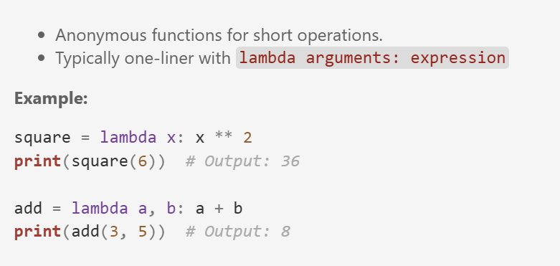
Lambda Expression

Slide 14
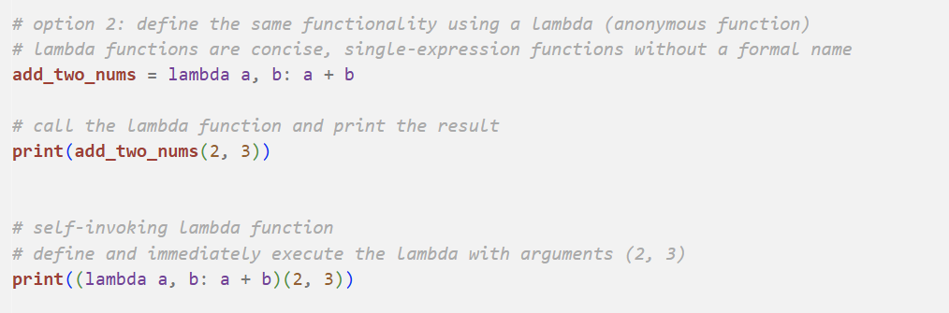
Self-invoking Lambda Function

Slide 15
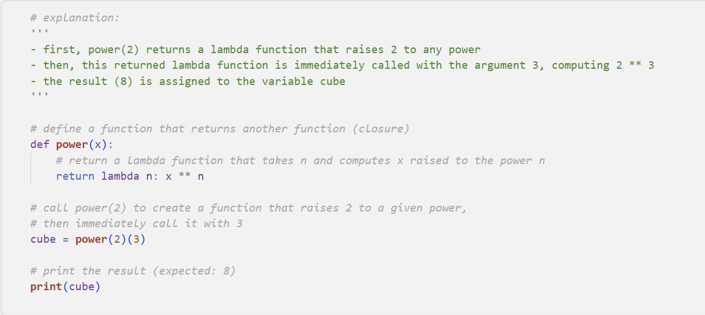
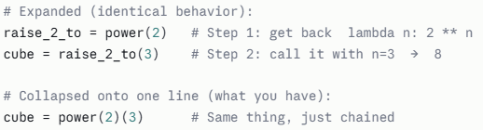
Power Lambda Function (call the first function, then immediately call whatever it returns)
Call 1
Call 2
In Week4.ipynb, check “Section 5. Lambda Expression“
In Week4_Exercise.ipynb, you have 40 minutes to solve “Problems 3 &4” .

Slide 16
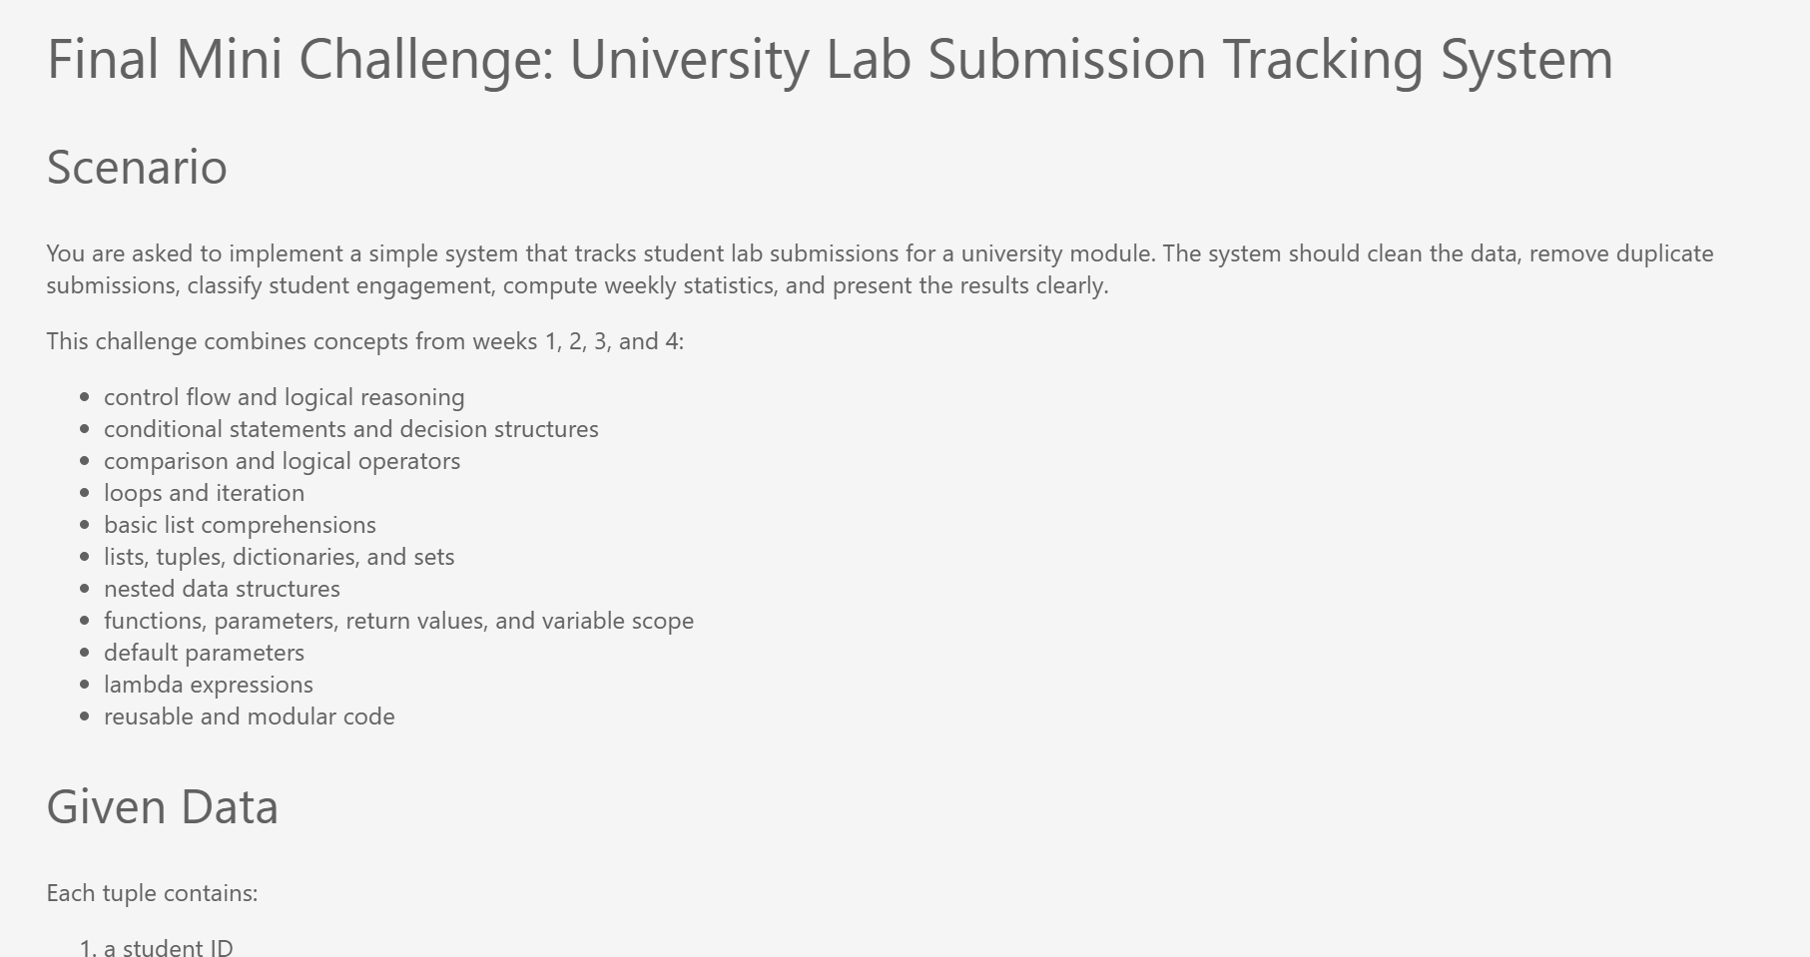
University Lab Submission Tracking System
In Week4_Exercise.ipynb, you have 60 minutes to solve “Mini Challenge”.

Slide 17
What did we learn today?
Purpose of Functions
Function Parameters & Return Values
Functions
Parameters & Return Functions
62.0
Variable Scope
Functions with Default Parameters
Global and Local Variables
Default Parameters
Functions passing an Arbitary Number of Arguments
Lambda Expression
Arbitary Number of Arguments
Anonymous functions for short operations

Slide 18
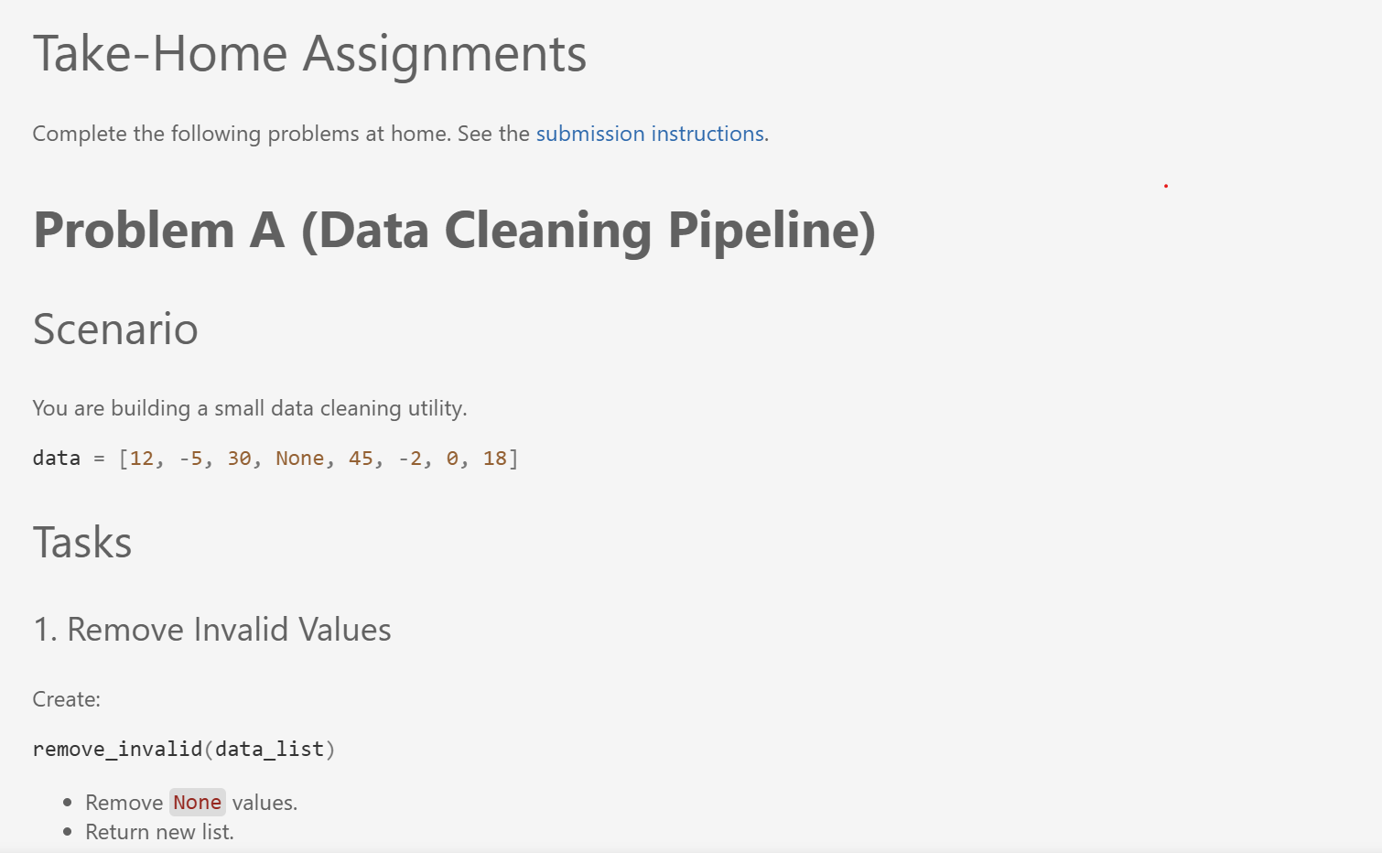
Take-Home Assignments
Solve Problems A-C in “Take-Home Assignments “ section and push them to your private individual repository in Week(4) directory. The deadline is Thursday, 14.05.2026, at 23:59. For more details, please have a look at our course’s GitHub Repository and submission instructions.

Slide 19
Coming Up : Week (5) So far, we have organised our code using functions and made it more modular. How can we now store our data in files, work with different file formats, and handle possible errors when reading and writing data? • File systems and directory structure • Reading and writing text and CSV files • Structured data formats • Error handling and exception concepts • Basic parsing principles

Slide 20

Your Voice Matters: Lab Session Feedback

Slide 21

Dr. Ghadeer Mobasher
ghadeer.mobasher@srh-hochschulen.de
https://www.linkedin.com/in/ghadeermobasher/
LGS 6, 2. OG, Arc 213

