Slide 1


Hush Hush Recruiter
Big Data Programming : Python
Presentation 2
Notes:
1.7.2013
‹#›

Slide 2



Factors from Data Sources
1
Public Contributions
4
Forks
GitHub are visible activities on public repos, like coding, bug fixed pull requests, reviews and documentation updates
Shows the initiative of candidate and others interests in candidate’s work.
Language Proficiency
5
Stars
2
Looking for specific coding language, in which you want the candidate to be proficient
Represents the popularity and approval of the candidate's projects by the community.
3
Commits
Frequent and regular commits recognizes the candidate’s habit of coding
Notes:
1.7.2013
‹#›

Slide 3

Why we use MongoDB database
MongoDB handles diverse data formats from GitHub: structured, semi-structured, and unstructured.
Stores data in native JSON, reducing preprocessing needs.
Supports fast querying and aggregation for easy feature extraction.
Highly scalable to accommodate system growth and evolution.
Ideal for flexible, efficient data ingestion and machine learning model training.
Notes:
1.7.2013
‹#›

Slide 4
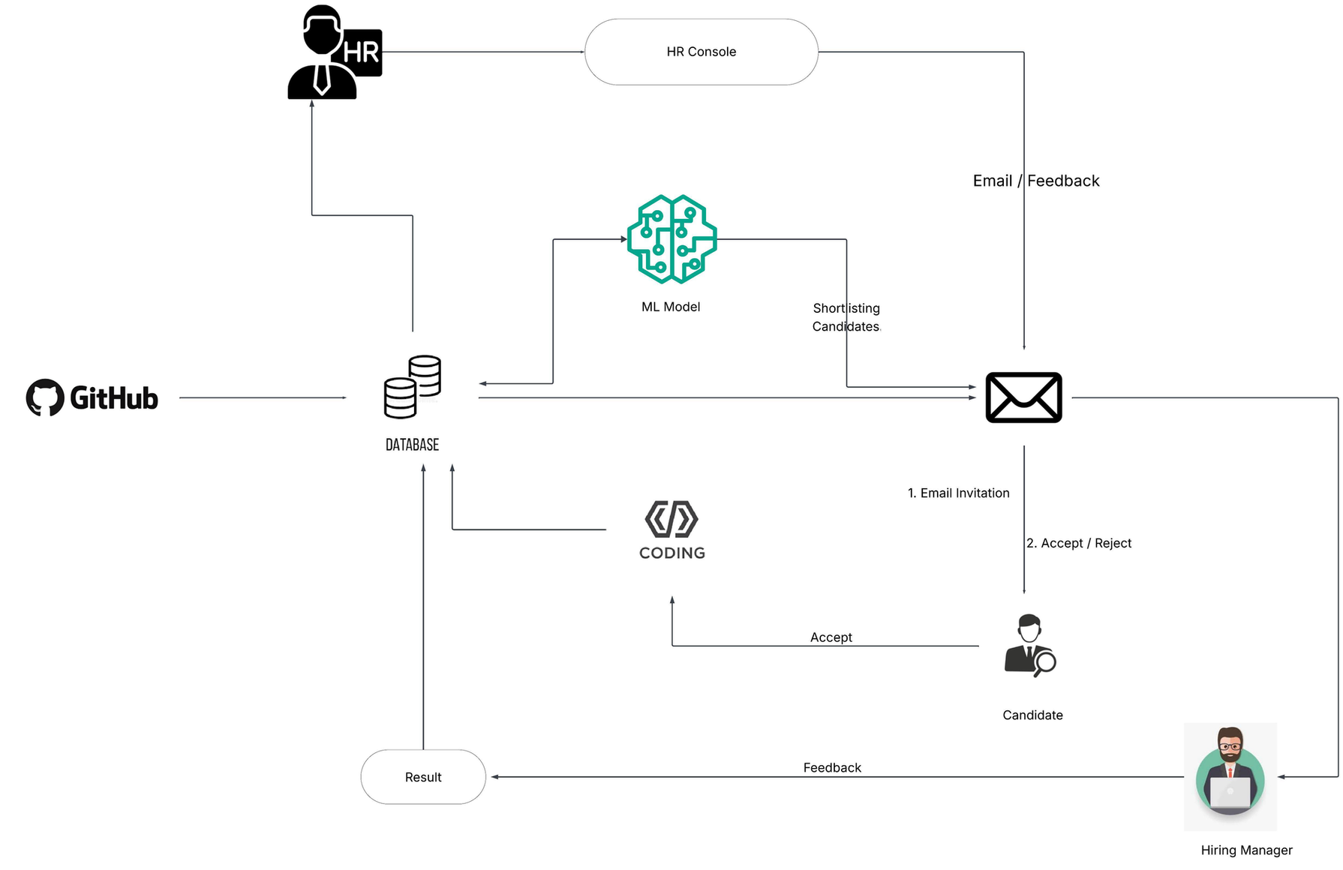
Architecture
Notes:
1.7.2013
‹#›

Slide 5


Thanks!
Team Members
Amith Gowda Eranna
Darshan Gowda Budanur Madappa
Gowrika Mahesh
Madhumitha Ramakrishnan
Prajwal Basavaraj
Notes:
1.7.2013
‹#›

