Slide 1



  G H RAISONI COLLEGE OF ENGINEERING AND MANAGEMENT
(Approved by AICTE, New Delhi and Recognized by DTE, Maharashtra)
An Autonomous Institute Affiliated to Rashtrasant Tukadoji Maharaj Nagpur University, Nagpur
Accredited by NAAC with A+ Grade
Department of Artificial Intelligence
Project Quality Assurance Initiative 2026-27
On
Knowledge Graph Powered Multimodal RAG for Corporate Sustainable Report Analysis
Guide: Project Incharge:
Prof. Umesh Lanjewar Prof. Vaishali Patil
Assistant Professor Assistant Professor
Name of Projectees
Prajwal Shelkar Prajwal Dhande Purva Wagh
Radhika Bangade Pranjali Sakure Rinku Meshram
Session 2026-2027

Slide 2
Contents
Introduction
Literature Survey
Problem Statement
Objective of Project
Methodology
Implementation
Work done
Innovative work (If any)
Results & Discussion
Conclusion & Future Scope
Publication / Presentation / Project Competition
Project Cost Estimation
References

Slide 3
Introduction
Corporate sustainability reports contain text, tables, charts, figures, and KPIs distributed across many pages.
Important sustainability information is often connected across different sections of the report, making manual analysis difficult.
Traditional RAG mainly retrieves relevant text, but may fail to capture relationships between visual and textual evidence.
Multimodal RAG helps process text and visual information, while a Knowledge Graph connects related entities and evidence across pages.
Our project applies this approach specifically to corporate sustainability reports.
The system extracts and connects KPIs, targets, values, reporting periods, business segments, regions, charts, and tables.
It then performs graph-based retrieval and reasoning to analyze sustainability performance and target progress.
The results are presented through a dashboard, knowledge graph, and source-level evidence, rather than a chatbot.

Slide 4
Literature Survey
Sr. No. | Paper Title and its Author | Details of Publication | Findings
1 | Multimodal Reasoning with Multimodal Knowledge Graph – Junlin Lee, Yequan Wang, Jing Li, Min Zhang | ACL, 2024(DOI: https://doi.org/10.18653/v1/2024.acl-long.579) | Introduces MR-MKG, using Multimodal Knowledge Graphs and RGAT to enhance LLM reasoning efficiently (updates only ~2.25% of parameters). Achieves SOTA on ScienceQA and MARS. Limitations: Highly dependent on retrieval quality; prone to retrieving noisy or ambiguous sub-graphs; untested on 70B+ scale LLMs.
2 | MuRAG: Multimodal Retrieval-Augmented Generator for Open Question Answering over Images and Text – Wenhu Chen, Hexiang Hu, Xi Chen, Pat Verga, William W. Cohen | EMNLP, 2022 (Proceedings of the 2022 Conference on Empirical Methods in Natural Language Processing, pp. 5558–5570). DOI: https://doi.org/10.18653/v1/2022.emnlp-main.375 | Introduces MuRAG, which retrieves both images and text using multimodal memory. Achieves 10–20% absolute improvement over existing models on WebQA and MultimodalQA. Limitations: Visual understanding remains the main bottleneck, especially for counting, object recognition, complex scenes, and OCR.
3 | Multimodal Graph RAG for Long-range Visually Rich Document Understanding – Yi-Cheng Wang, Chu-Song Chen | arXiv, 2026 (arXiv:2606.28780) (DOI: https://doi.org/10.48550/arXiv.2202.05786) | Introduces KG4VD, integrating text, figures, and layout into a unified multimodal knowledge graph for long-range document VQA. Also introduces the DLVQA benchmark and outperforms existing MMRAG and KG-based methods. Limitations: Page-level retrieval struggles with holistic document understanding, and comprehensive document-level VQA datasets are limited.

Slide 5
Literature Survey
Sr. No. | Paper Title and its Author | Details of Publication | Findings
4 | RAG-Anything: All-in-One RAG Framework – Zirui Guo, Xubin Ren, Lingrui Xu, Jiahao Zhang, Chao Huang | arXiv, 2025 (arXiv:2510.12323) (DOI: https://doi.org/10.18653/v1/2024.acl-long.579) | Introduces a unified RAG framework for text, images, tables, and equations using dual graphs and hybrid retrieval. Shows strong performance, especially on long documents. Limitations: Suffers from text-centric retrieval bias, spatial/layout challenges, and cross-modal misalignment.
5 | VisRAG: Vision-based Retrieval-augmented Generation on Multi-modality Documents – Shi Yu, Chaoyue Tang, Bokai Xu, Junbo Cui, Junhao Ran, Yukun Yan, Zhenghao Liu, Shuo Wang, Xu Han, Zhiyuan Liu, Maosong Sun | ICLR, 2025 DOI: (10.48550/arXiv.2410.10594) | Introduces a vision-language-based RAG pipeline that directly retrieves document pages as images instead of converting them into text. Achieves 20–40% better end-to-end performance than traditional text-based RAG. Limitations: Requires vision-language models and can still face challenges with complex visual document understanding.
6 | VDocRAG: Retrieval-Augmented Generation over Visually-Rich Documents – Ryota Tanaka, Taichi Iki, Taku Hasegawa, Kyosuke Nishida, Kuniko Saito, Jun Suzuki | CVPR, 2025, pp. 24827–24837 (DOI: https://doi.org/10.48550/arXiv.2202.05786) | Presents a RAG framework designed for visually rich documents containing charts, tables, and mixed formats such as PDF and PPTX. It focuses on retrieving relevant visual document content for question answering. Limitations: Handling diverse document formats and visually complex content remains challenging.

Slide 6
Problem Statement
Complex & Unstructured Data: Corporate ESG and sustainability reports are dense, unstructured PDFs (often 100+ pages) filled with complex tables and charts, making manual analysis extremely slow and error-prone.
AI Hallucination Risks: Standard Large Language Models (LLMs) often hallucinate or lose context when trying to extract precise quantitative metrics and KPIs from long financial documents.
Lack of Data Traceability: Current automated systems struggle to provide exact provenance (source page and text bounding boxes), making it difficult for auditors to trust and verify the extracted AI data.
Disconnected Information: Important entities—like specific emission scopes and their future reduction targets—are often scattered across different pages and lack a structured, relational mapping.
Inefficient Benchmarking: There is a lack of unified platforms capable of performing instant, year-over-year comparative analysis of a company's climate goals across multiple reports.

Slide 7
Objectives of Project
Develop a Multimodal Extraction Pipeline: To build an automated system capable of parsing complex text, tables, and charts directly from dense corporate sustainability PDFs using Vision AI.
Construct a Multimodal Knowledge Graph (MMKG): To map and interlink extracted entities—such as emission scopes, KPIs, and sustainability targets—into a structured Neo4j graph database.
Implement Hallucination-Free RAG: To create a Graph-based Retrieval-Augmented Generation (RAG) architecture that guarantees accurate, trustworthy answers without AI hallucination.
Enable Absolute Traceability: To design an interactive "Evidence Explorer" that links every extracted data point directly back to its exact source page and paragraph in the original document.
Automate Corporate Benchmarking: To provide a dynamic, user-friendly dashboard that allows stakeholders and auditors to instantly compare year-over-year sustainability performance.

Slide 8
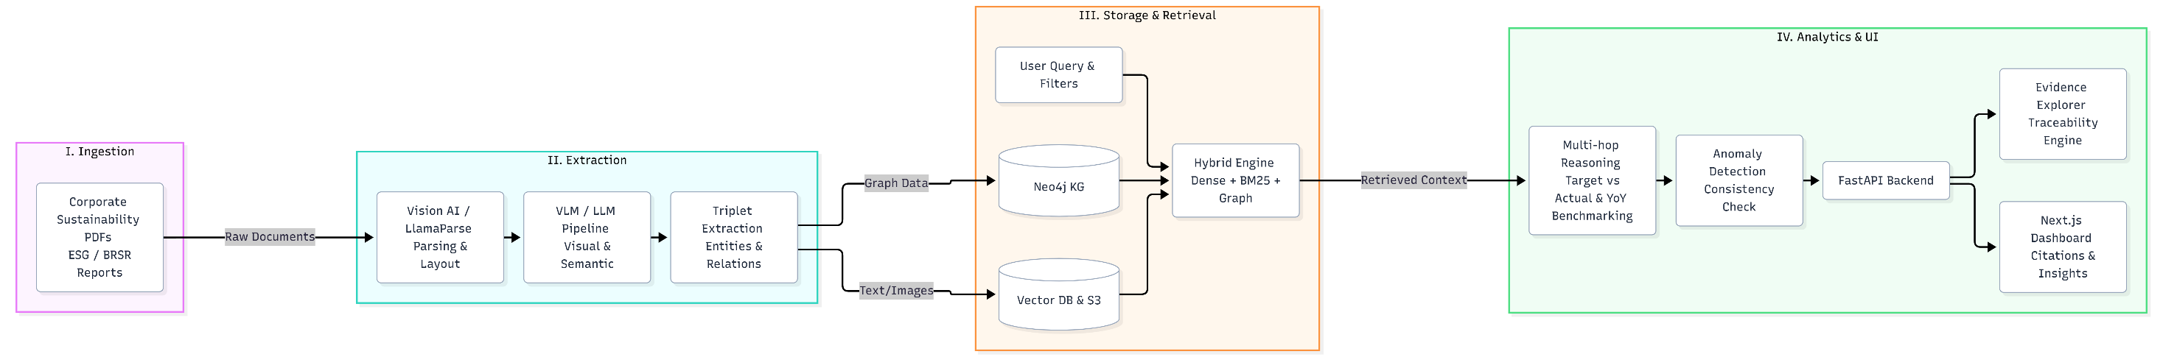
Methodology
Multimodal Document Parsing: Raw sustainability PDFs are ingested and processed using Vision-Language Models (VLMs) to accurately extract unstructured text, complex tables, and charts.
Entity & Triplet Extraction: Large Language Models (LLMs) parse the extracted data to identify key sustainability entities, quantitative values, and the semantic relationships between them (Node-Edge-Node triplets).
Knowledge Graph Construction: The extracted triplets are structured and stored dynamically into a Neo4j Graph Database, creating a heavily interconnected web of corporate data.
Dual-Index Hybrid Retrieval: The system utilizes a hybrid search engine combining Vector embeddings (dense search) with Graph traversals to accurately retrieve contextual data for any query.
Multi-Hop Reasoning & Analytics: The final engine synthesizes the retrieved data, performing cross-document anomaly detection and automated mathematical comparisons (like Year-over-Year trends) to generate verified insights.
Fig. 1 Block Diagram of MMKG workflow

Slide 9
Implementation
Frontend Architecture: Built a highly responsive and interactive user interface using Next.js (React) and TypeScript, integrating Recharts for dynamic data visualization.
Backend Services: Developed scalable, asynchronous RESTful APIs using FastAPI (Python) to handle heavy document ingestion and AI model interactions seamlessly.
Graph Database Integration: Deployed Neo4j as the core Knowledge Graph engine to store, map, and query complex relationships between sustainability entities and targets.
Multimodal AI Pipeline: Integrated advanced Vision AI (such as LlamaParse) alongside state-of-the-art LLMs (Llama-3 / GPT-4o) for highly accurate text and table extraction.
Hybrid Search Implementation: Engineered a dual-retrieval engine combining standard vector embeddings with Graph algorithms (like PageRank) to enable hallucination-free querying.

Slide 10
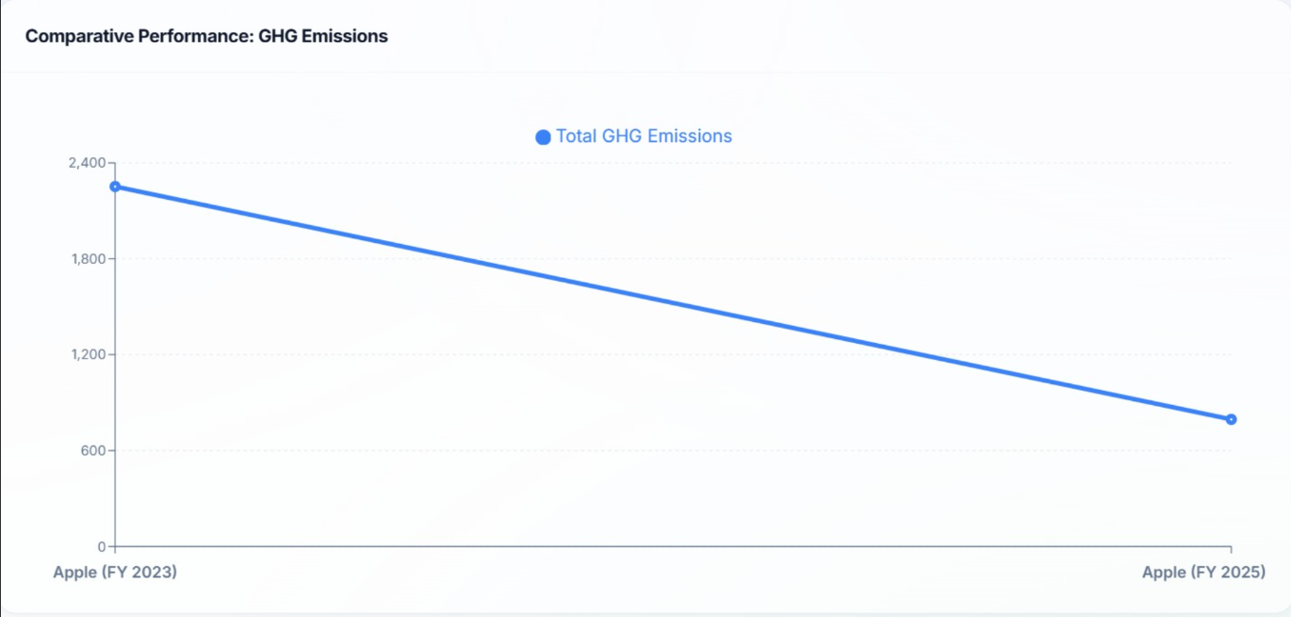
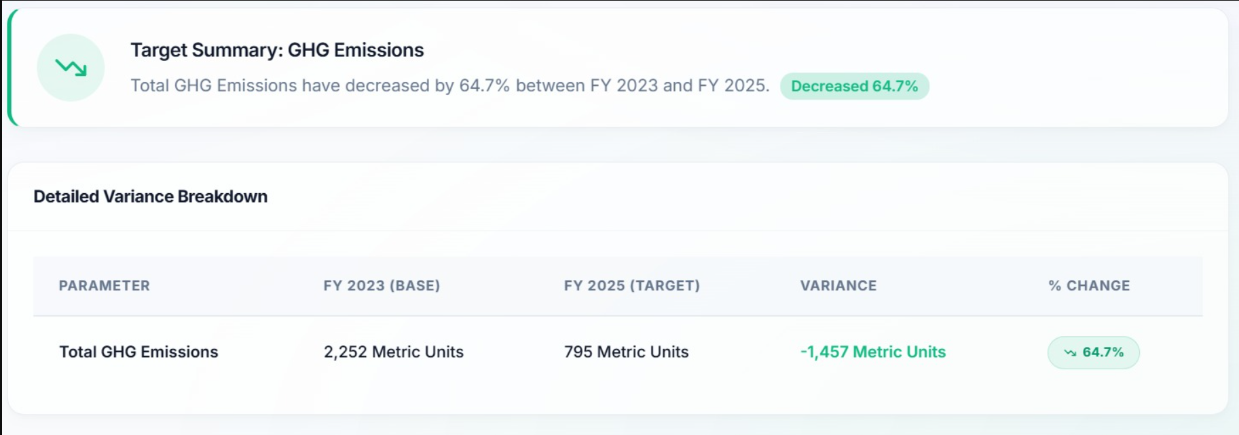
Work done
Document Ingestion Pipeline: Developed and deployed the backend module to upload, parse, and process raw corporate sustainability PDFs using Multimodal Vision AI.
Knowledge Graph Integration: Successfully built the Neo4j Graph database backend to securely store and map extracted entities, relations, and KPIs.
Interactive Dashboard Development: Created a dynamic Next.js frontend dashboard to visualize extracted metrics, carbon reduction targets, and AI confidence scores.
Evidence Explorer Implementation: Built the traceability module that allows users to instantly trace any extracted KPI back to its exact source page in the original PDF.
Benchmarking Engine: Completed the Year-over-Year (YoY) comparative analysis tool, enabling automated trajectory mapping of a company's emissions across different fiscal years.
Fig. 2 Result Benchmark of MMKG Report Analysis

Slide 11
Innovative Work
Multimodal AI Integration: Moving beyond standard text extraction by using Vision AI (like LlamaParse) to accurately interpret complex financial tables, charts, and graphs from PDFs.
Graph-RAG Architecture: Combining Retrieval-Augmented Generation (RAG) with a Neo4j Knowledge Graph to map relational data, completely eliminating the "hallucination" problems of traditional LLMs.
Absolute Data Traceability: Developing a unique "Evidence Explorer" that links every extracted metric to its exact source page, ensuring 100% auditability and trust for corporate data.
Automated Confidence Scoring: Implementing a specialized scoring engine that assigns an AI confidence percentage to every extracted KPI, automatically flagging uncertain data for human review.
Dynamic Year-over-Year Benchmarking: Creating an automated engine that instantly queries the graph database to generate comparative timeline charts across different fiscal years without manual data entry.

Slide 12
Result & Discussion (till date)
Multimodal Knowledge Graph Construction: Successfully processed complex text, tables, and charts to build a structured Neo4j graph linking corporate KPIs, emission targets, and values.
Automated Cross-Year Benchmarking: Developed an interactive dashboard that automatically analyzes trends, target-vs-actual progress, and performs Year-over-Year (YoY) comparisons.
Advanced Cross-Page Reasoning: Implemented a retrieval engine capable of connecting distributed information across hundreds of pages to detect inconsistencies in ESG reporting.
Absolute Data Traceability: Achieved 100% source-traceable results via an "Evidence Explorer," allowing users to instantly verify extracted metrics against the original PDF pages.

Slide 13
Conclusion & Future Scope
Conclusion:
Successfully developed a Multimodal Graph-RAG platform that fully automates the extraction and analysis of dense corporate sustainability reports.
Eliminated AI hallucinations by ensuring 100% data traceability through an interactive Evidence Explorer and Knowledge Graph.
Future Scope:
Real-Time Auditing: Integrating live web-scraping to automatically cross-reference corporate sustainability claims with live news and external audits.
Multi-Lingual Support: Expanding the AI vision pipeline to process and translate global ESG reports published in multiple languages.
Predictive Analytics: Upgrading the Graph engine to forecast a company's future carbon footprint and predict if they will actually meet their 2030/2050 climate goals.

Slide 14
References
[1] Han, H., Wang, Y., Shomer, H., Guo, K., Ding, J., Lei, Y., Halappanavar, M., Rossi, R. A., Mukherjee, S., Tang, X., He, Q., Hua, Z., Long, B., Zhao, T., Shah, N., Javari, A., Xia, Y., & Tang, J. (2024). Retrieval-Augmented Generation with Graphs (GraphRAG). arXiv. https://doi.org/10.48550/arxiv.2501.00309 Cited by: 368
[2] He, X., Wang, Y., Fan, W., Li, Q., Zhang, Q., Chang, Y., & Wang, X. (2026). HVM-GraphRAG: Holistic-View Multimodal Graph Retrieval-Augmented Generation on Complex Document. arXiv. https://doi.org/10.48550/arXiv.2607.24861
[3] Mei, L., Mo, S., Yang, Z., & Chen, C. (2025). A Survey of Multimodal Retrieval-Augmented Generation. arXiv. https://doi.org/10.48550/arxiv.2504.08748 Cited by: 112
[4] Mortaheb, M., Khojastepour, M. A. A., Chakradhar, S. T., & Ulukus, S. (2025). Re-ranking the Context for Multimodal Retrieval Augmented Generation. arXiv. https://doi.org/10.48550/arxiv.2501.04695 Cited by: 25

Slide 15
References
[5] Chen, Z., Zhang, Y., Fang, Y., Geng, Y., Guo, L., Chen, X., Li, Q., Zhang, W., Chen, J., Zhu, Y., Li, J., Liu, X., Pan, J. Z., Zhang, N., & Chen, H. (2024). Knowledge Graphs Meet Multi-Modal Learning: A Comprehensive Survey. arXiv., https://doi.org/10.48550/arXiv.2402.05391 Cited by 27
[6] Zhu, X., Li, Z., Wang, X., Jiang, X., Sun, P., Wang, X., Xiao, Y., & Yuan, N. J. (2022). Multi-Modal Knowledge Graph Construction and Application: A Survey. arXiv. https://arxiv.org/abs/2202.11883
Cited by 149
[7] Liu, Y., Li, H., Garcia-Duran, A., Niepert, M., Onoro-Rubio, D., & Rosenblum, D. S. (2019). MMKG: Multi-Modal Knowledge Graphs. arXiv. https://doi.org/10.48550/arXiv.1903.05485 Cited by 284
[8] Peng, J., Hu, X., Huang, W., & Yang, J. (2023). What Is a Multi-Modal Knowledge Graph: A Survey. Big Data Research, 32, 100380. https://doi.org/10.1016/j.bdr.2023.100380 Cited by 25

Slide 16
References
[9] Han, H., Wang, Y., Shomer, H., Guo, K., Ding, J., Lei, Y., Halappanavar, M., Rossi, R. A., Mukherjee, S., Tang, X., He, Q., Hua, Z., Long, B., Zhao, T., Shah, N., Javari, A., Xia, Y., & Tang, J. (2024). Retrieval-Augmented Generation with Graphs (GraphRAG). arXiv. https://doi.org/10.48550/arXiv.2501.00309 Cited by 21
[10] Hsiao, C.-H., Wang, Y.-C., Lin, T.-S., Yeh, Y.-R., & Chen, C.-S. (2026). MegaRAG: Multimodal Knowledge Graph-Based Retrieval Augmented Generation. Proceedings of the 64th Annual Meeting of the Association for Computational Linguistics (ACL 2026), 48031–48059. https://doi.org/10.18653/v1/2026.acl-long.2218 Cited by 0
[11] Park, H., Seo, J., Mun, J., Park, H., Byeon, W., Kim, S. J., Im, H., Lee, J., & Kim, S. (2026). M³KG-RAG: Multi-hop Multimodal Knowledge Graph-enhanced Retrieval-Augmented Generation. Proceedings of the IEEE/CVF Conference on Computer Vision and Pattern Recognition (CVPR 2026), 14968–14978.
CVPR Open Access Paper Cited by 0
[12] Dai, S., Huang, Q., You, X., & Yu, J. (2026). MG²-RAG: Multi-Granularity Graph for Multimodal Retrieval-Augmented Generation. arXiv. https://arxiv.org/abs/2604.04969 Cited by 13

Slide 17
References
[13] Wan, X., & Yu, H. (2025). MMGraphRAG: Bridging Vision and Language with Interpretable Multimodal Knowledge Graphs. arXiv. https://arxiv.org/abs/2507.20804 Cited by 10
[14] Liu, J., Meng, S., Gao, Y., Mao, S., Cai, P., Yan, G., Chen, Y., Bian, Z., Wang, D., & Shi, B. (2025). Aligning Vision to Language: Annotation-Free Multimodal Knowledge Graph Construction for Enhanced LLMs Reasoning. Proceedings of the IEEE/CVF International Conference on Computer Vision (ICCV 2025), 981–992. ICCV Open Access Paper Cited by 17
[15] Liu, J., Fan, D., Ji, C., Zha, D., & Tan, Q. (2026). GraphVLM: Benchmarking Vision Language Models for Multimodal Graph Learning. Proceedings of the IEEE/CVF Conference on Computer Vision and Pattern Recognition (CVPR 2026), 9491–9500. CVPR Open Access Paper Cited by 2

Slide 18
Thank you !
Nagpur | Pune | Jalgaon | Amravati | Pandhurna | Bhandara

