Slide 1
data analysis case study
Prajwal Narayanaswamy

Slide 2
AGENDA
Data Introduction
Questions
Visualizations
Hypothesis Testing
Co-relation and Regression Modelling
Analysis Summary
Optimization

Slide 3
Data Introduction
Survey of global state of happiness
Data taken from Gallup World Poll
Scores are based on answers to the main life evaluation question asked in the poll
Based on Cantril Ladder Scores and Gallup weights, data has been recorded
Dystopia Residual = Dystopia Happiness Score (1.85) + Unexplained Value of each country

Slide 4
Questions
Which is the happiest country over the years?
Does the Happiness Score vary across the years?
What factors influence the determination of Happiness Score?

Slide 5
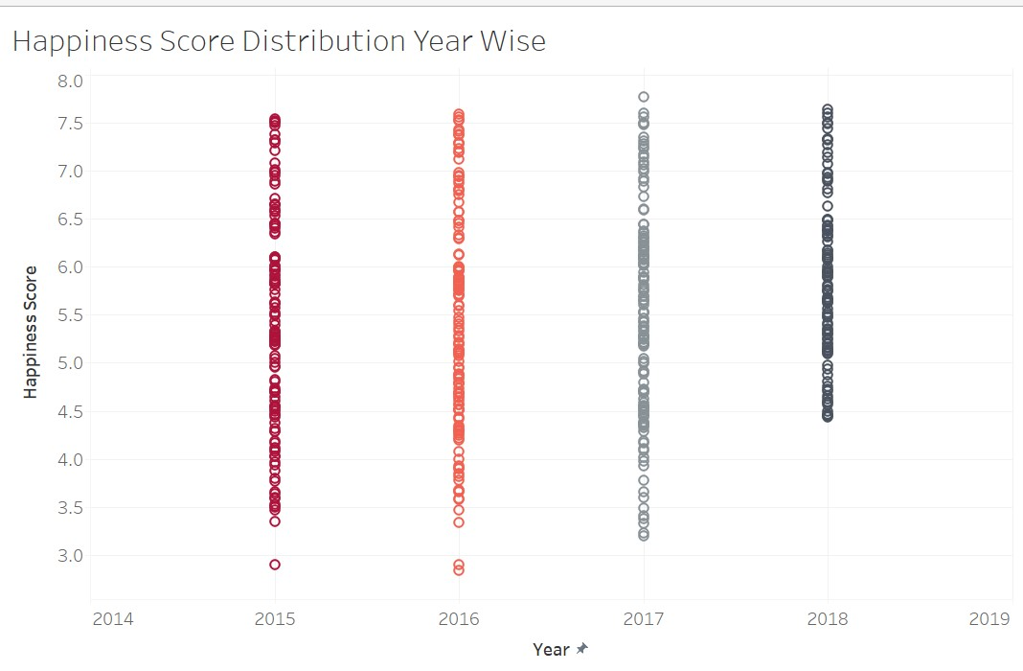
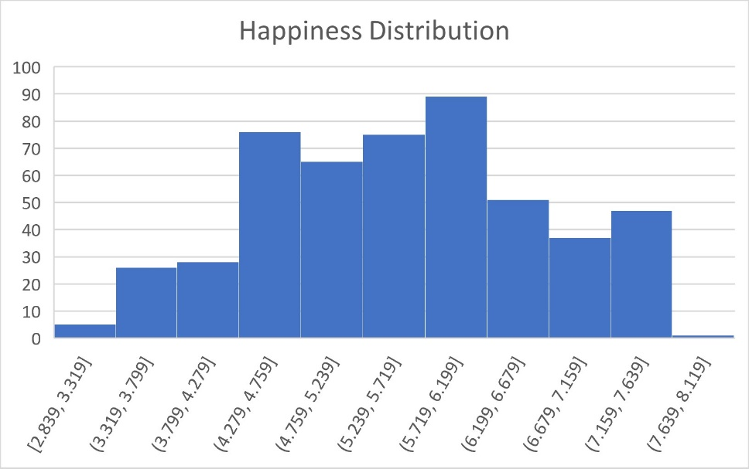
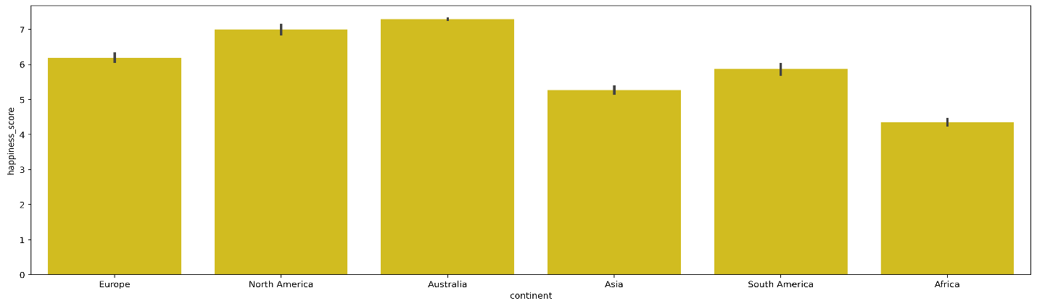
Visualizations

Slide 6
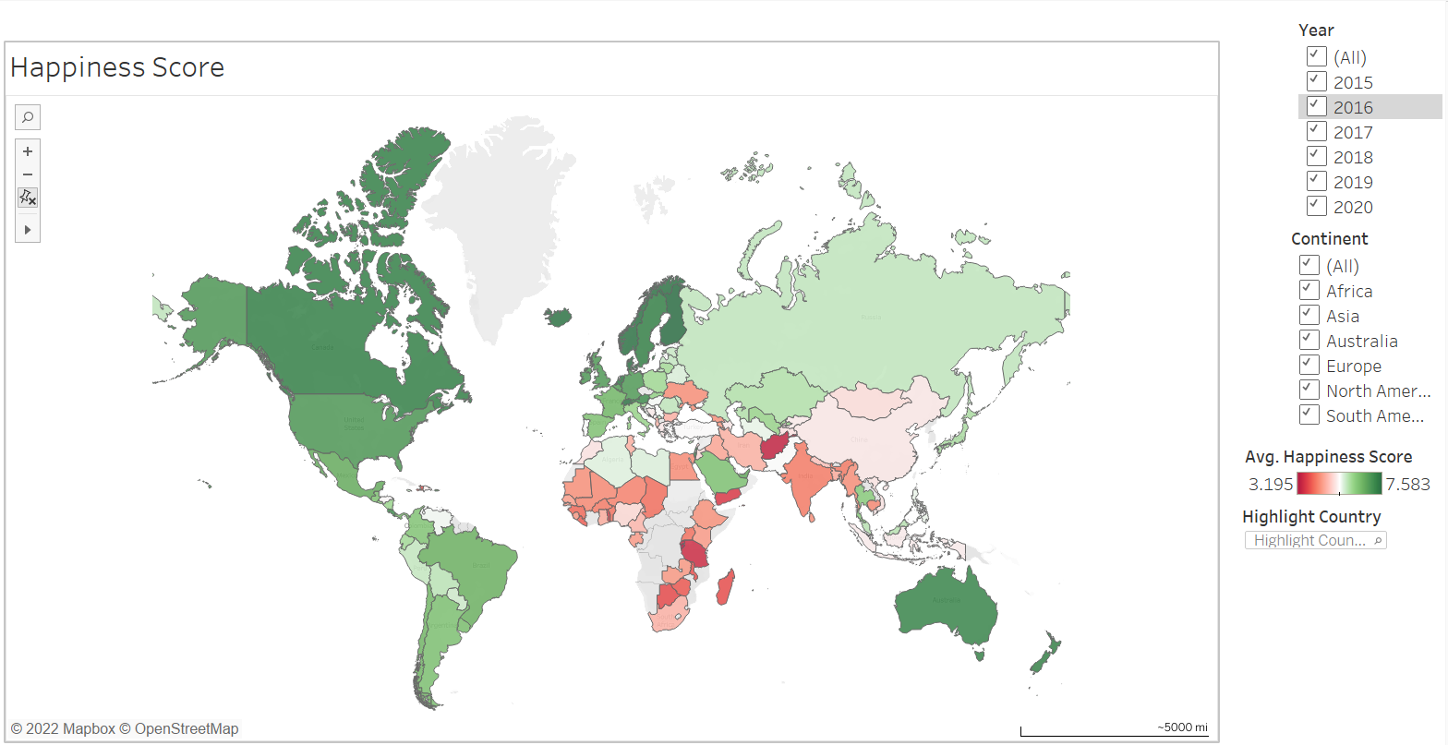
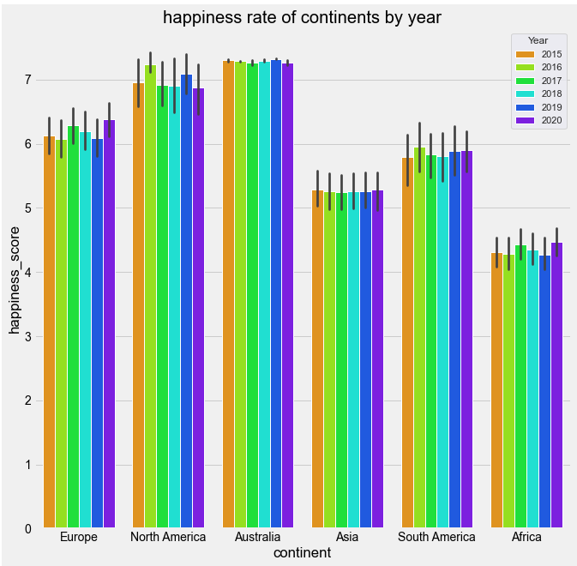
Visualizations (CONTD.)

Slide 7
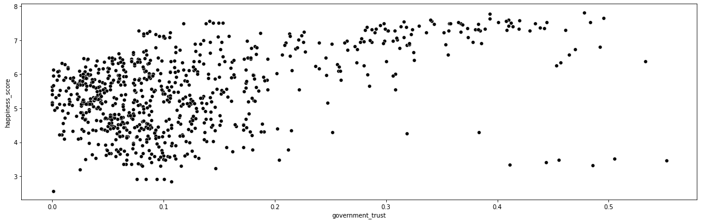
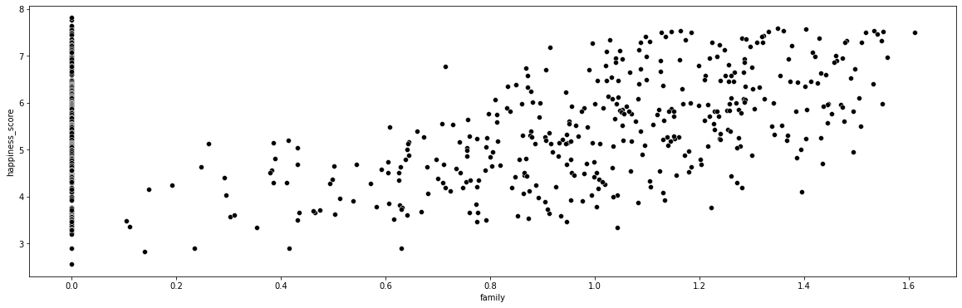
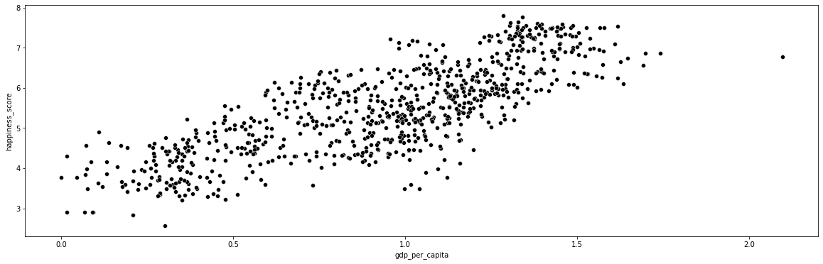
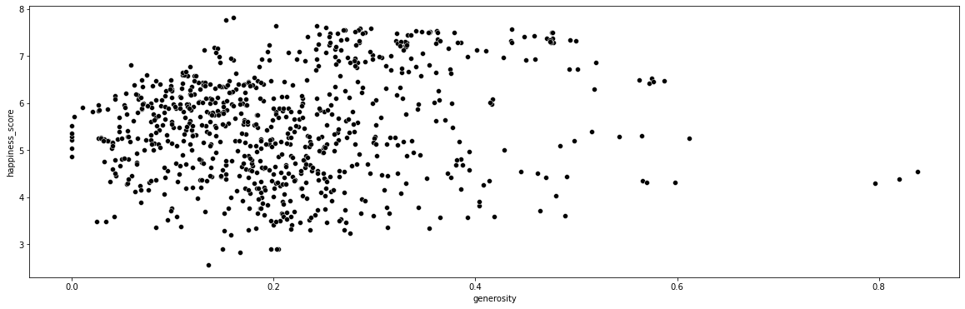
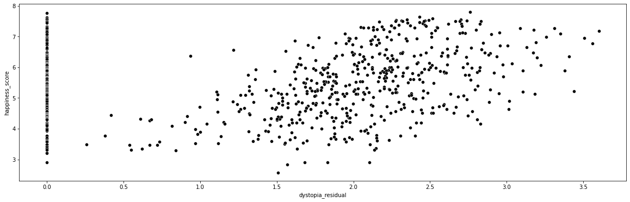
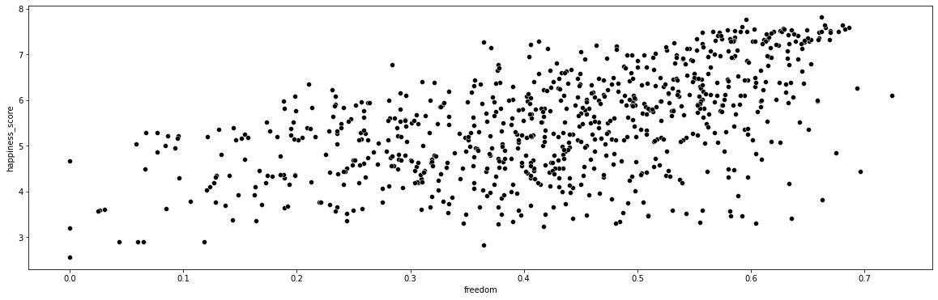
Visualizations (CONTD.)

Slide 8
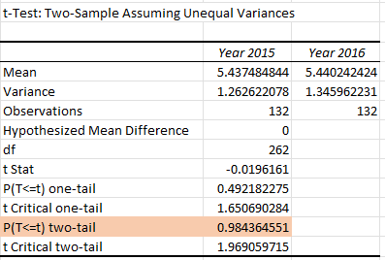
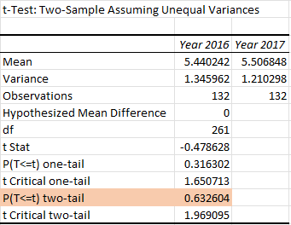
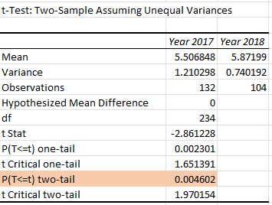
Hypothesis Testing
Null Hypothesis: There is similarity in happiness scores between 2015, 2016, 2017 and 2018
Alternate Hypothesis: There is difference in happiness scores between 2015, 2016, 2017 and 2018
Using T – Test : Two Sample Assuming Unequal Variance, Null Hypothesis is rejected.

Slide 9
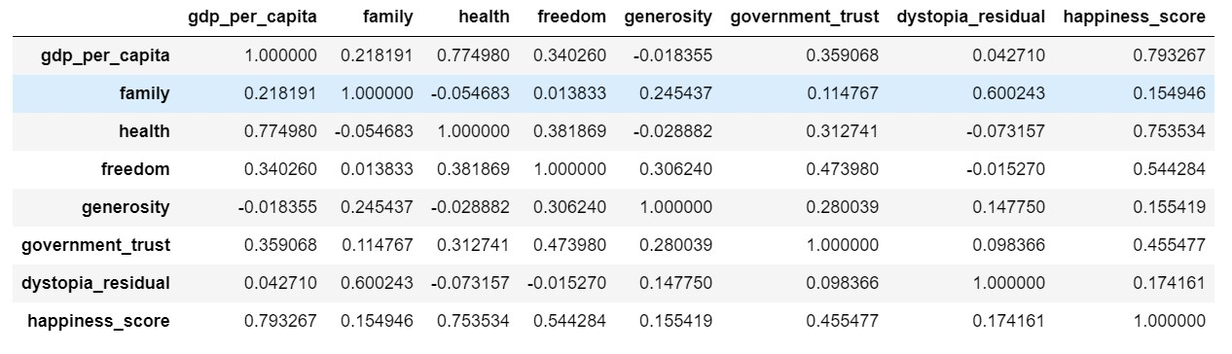
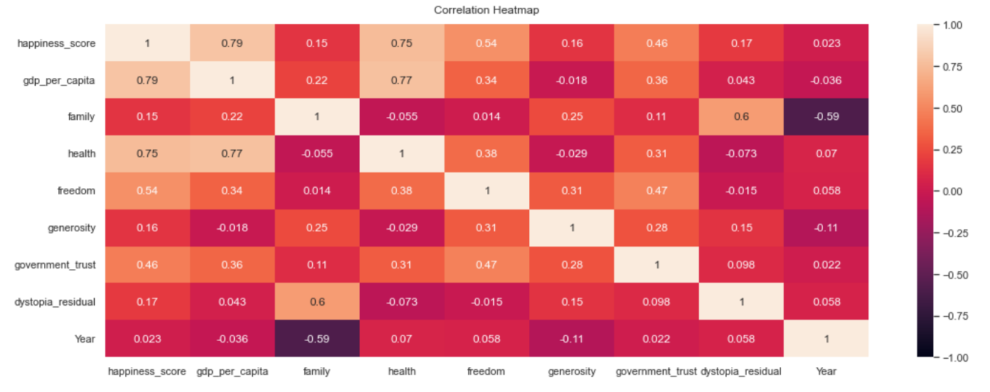
Correlation

Slide 10
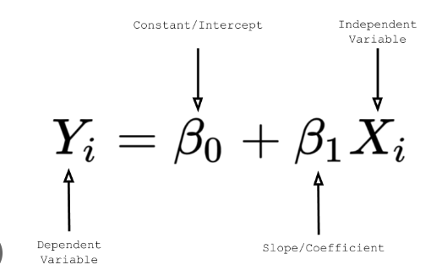
Regression Analysis
Considering both Categorical and Quantitative variables, we get final regression model of
Happiness_Score = -536.5274 + (1.5324 * gdp_per_capita) - (0.3102 * Family) + (1.0766 * Health) + (1.6950*Freedom) + (0.8595 * Generosity) + (0.5743 * Government_Trust) +(0.4651 * dystopia_residual) + (0.2671*Year)

Slide 11
Regression Validation
Data is divided into training set (80%) and testing set (20%)
Mean Absolute Error is 0.391

Slide 12
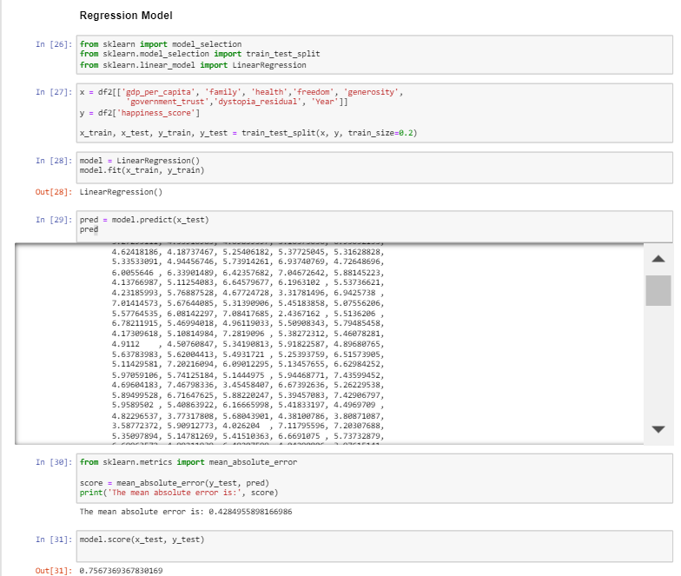
Regression Analysis Validation in Python

Slide 13
Analysis Summary
From Hypothesis Test, we can conclude that there is difference in Happiness Scores across the years.
From the Regression Model and Correlation Model, we can see that Happiness Score majorly depend on GDP Per Capita (aka Wealth), Health and Freedom which almost applies to life in real as well.

Slide 14
THANK YOU
Prajwal Narayanaswamy

