Slide 1
BANGALORE INSTITUTE OF TECHNOLOGY DEPARTMENT OF COMPUTER SCIENCE & ENGINEERING COMPUTER GRAPHICS & VISUALIZATION MINI PROJECT DEMO
“AIRPLANE”
USN NAME BATCH
1BI17CS111 PRAJWAL P B4
1BI17CS123 REVANTH P N B4
LAB INCHARGES: THEORY INCHARGE:
Prof. N Thanuja Prof. Shobha Y
Professor Assistant Professor Assistant
Prof. Shruthiba A
Professor Assistant

Slide 2
Problem Statement
The goal of this game is to fly as far as possible, this is one of those “easy to learn, difficult to master” situations. You’ll first select a plane and a scene. Click to start make your little guy take off from an airport, and it’s on!! As you fly, left click to begin ascending; the plane descends automatically. So it’s critical to master this bouncy method of flying. Missiles of varying sizes are shot at you. So, you’ll spend most of your time dodging these. Keep a close eye at the fuel gauge! You’ll steadily be running out of fuel as you try to gain height. Hit a missile, run out of fuel, or fly into the bottom edge of the screen, and you’ll crash and burn! As far as the game interface is concerned, you’ll be greeted with a loading screen followed by a splash screen with the name of the developers (that’s Prajwal and Revanth).
Menu options are given below:
• Play
• Settings
• Instructions
• Credits
• High Scores
• Exit
We used C++ along with OpenGL to develop this project.

Slide 3
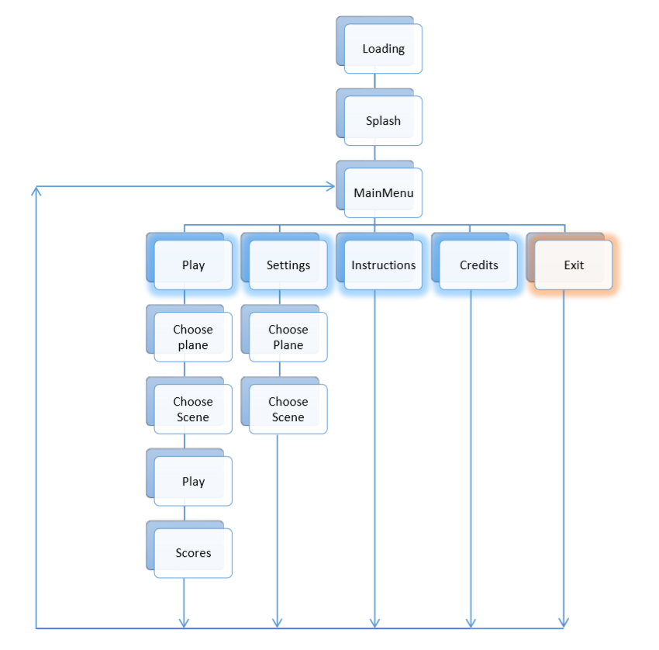
Flow Diagram

Slide 4
Some functions used
Keyboard function
Mouse function
Textures
Transformation functions
Translation
Rotation
Scaling

Slide 5
Lets see the Demo now

