Slide 1
Secure Data Hiding in Image Using Steganography
CAPSTONE PROJECT
Presented By:
Student Name : PRAJWAL PRATAP YADAV
College Name & Department : KIIT & CSE

Slide 2
OUTLINE
Problem Statement
Technology used
Wow factor
End users
Result
Conclusion
Git-hub Link
Future scope

Slide 3
Problem Statement
In today’s digital age, securing sensitive information during transmission is critical. Traditional encryption methods are often detectable, making data vulnerable to interception. Steganography offers a solution by hiding data within images, making it undetectable to unauthorized users. This project aims to develop a secure data hiding technique using steganography to ensure confidential information remains hidden during transmission. The goal is to create a system that can embed data into an image without altering its visual appearance and extract the data securely at the receiving end.

Slide 4
Technology used
Programming Language: Python
Libraries:
OpenCV (for image processing)
PIL (Python Imaging Library for image manipulation)
NumPy (for numerical operations)
Stegano (for steganography operations)
Platform:
Jupyter Notebook (for development and testing)
PyCharm (for code editing and debugging)
Other Tools:
Git (for version control)
GitHub (for hosting the repository)

Slide 5
Wow factors
Undetectable Data Hiding: The hidden data is completely invisible to the naked eye, ensuring that the image appears unchanged.
High Security: Combines steganography with encryption (e.g., AES) for an additional layer of security.
User-Friendly Interface: Simple and intuitive interface for encoding and decoding data, making it accessible to non-technical users.
Cross-Platform Compatibility: Works across multiple platforms (Windows, macOS, Linux) and devices.
Efficient Data Embedding: Supports embedding large amounts of data without significantly increasing the image file size.

Slide 6
End users
Individuals: For personal use to secure private messages, photos, or files.
Organizations: For secure communication of sensitive data within teams or departments.
Government Agencies: For transmitting confidential information securely.
Cybersecurity Professionals: For testing and developing secure communication methods.
Researchers: For academic purposes in the field of data security and steganography.

Slide 7
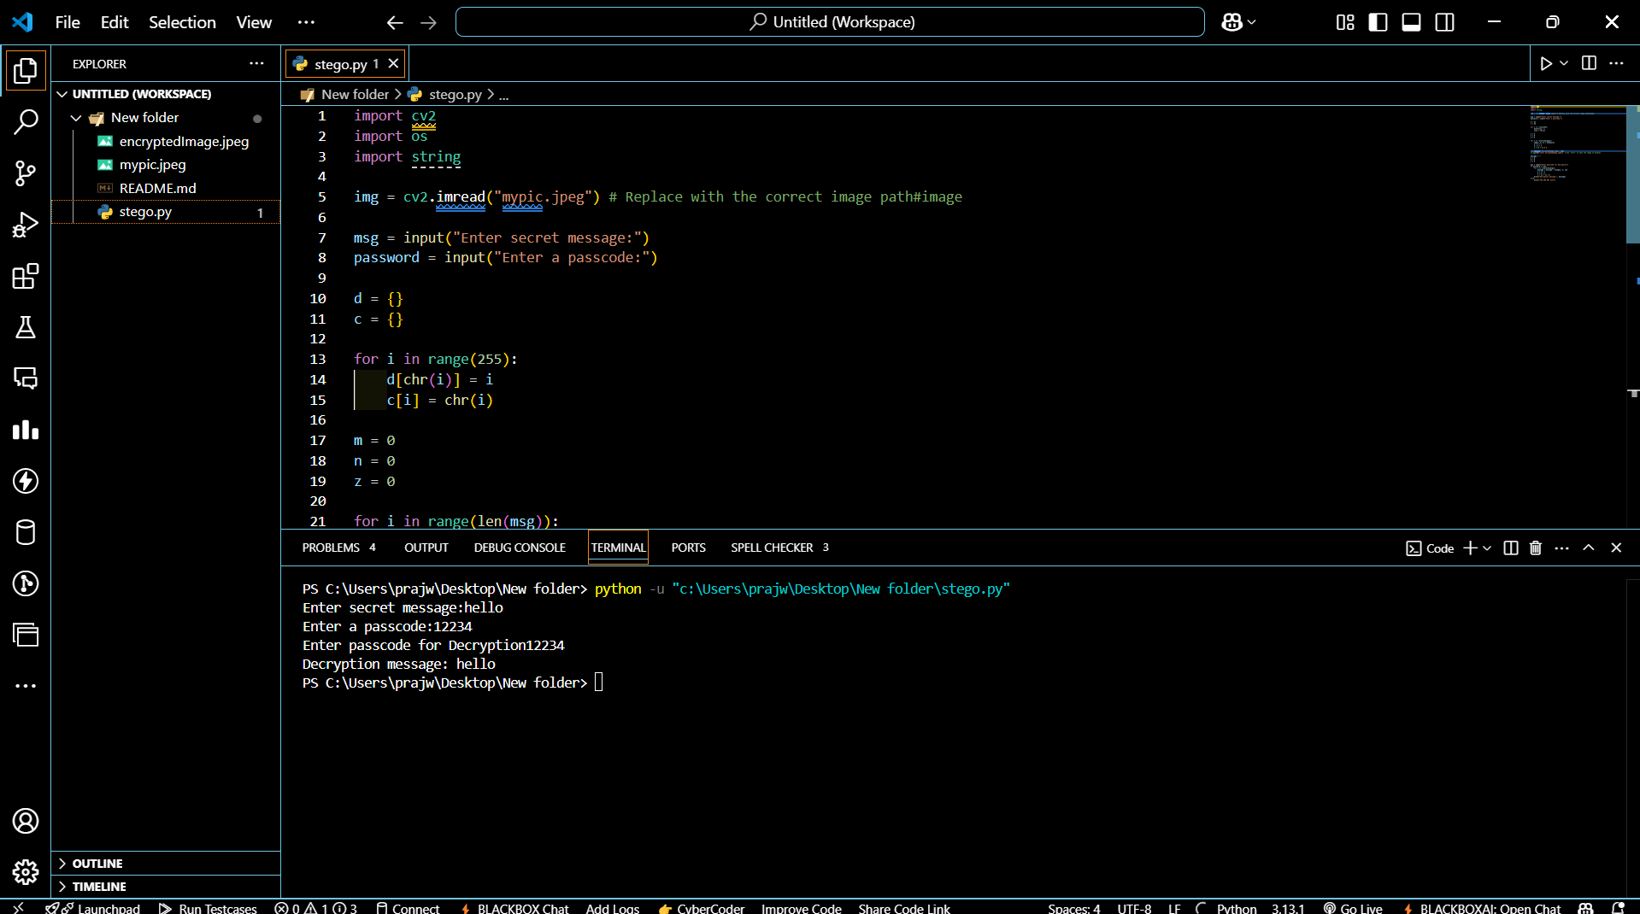
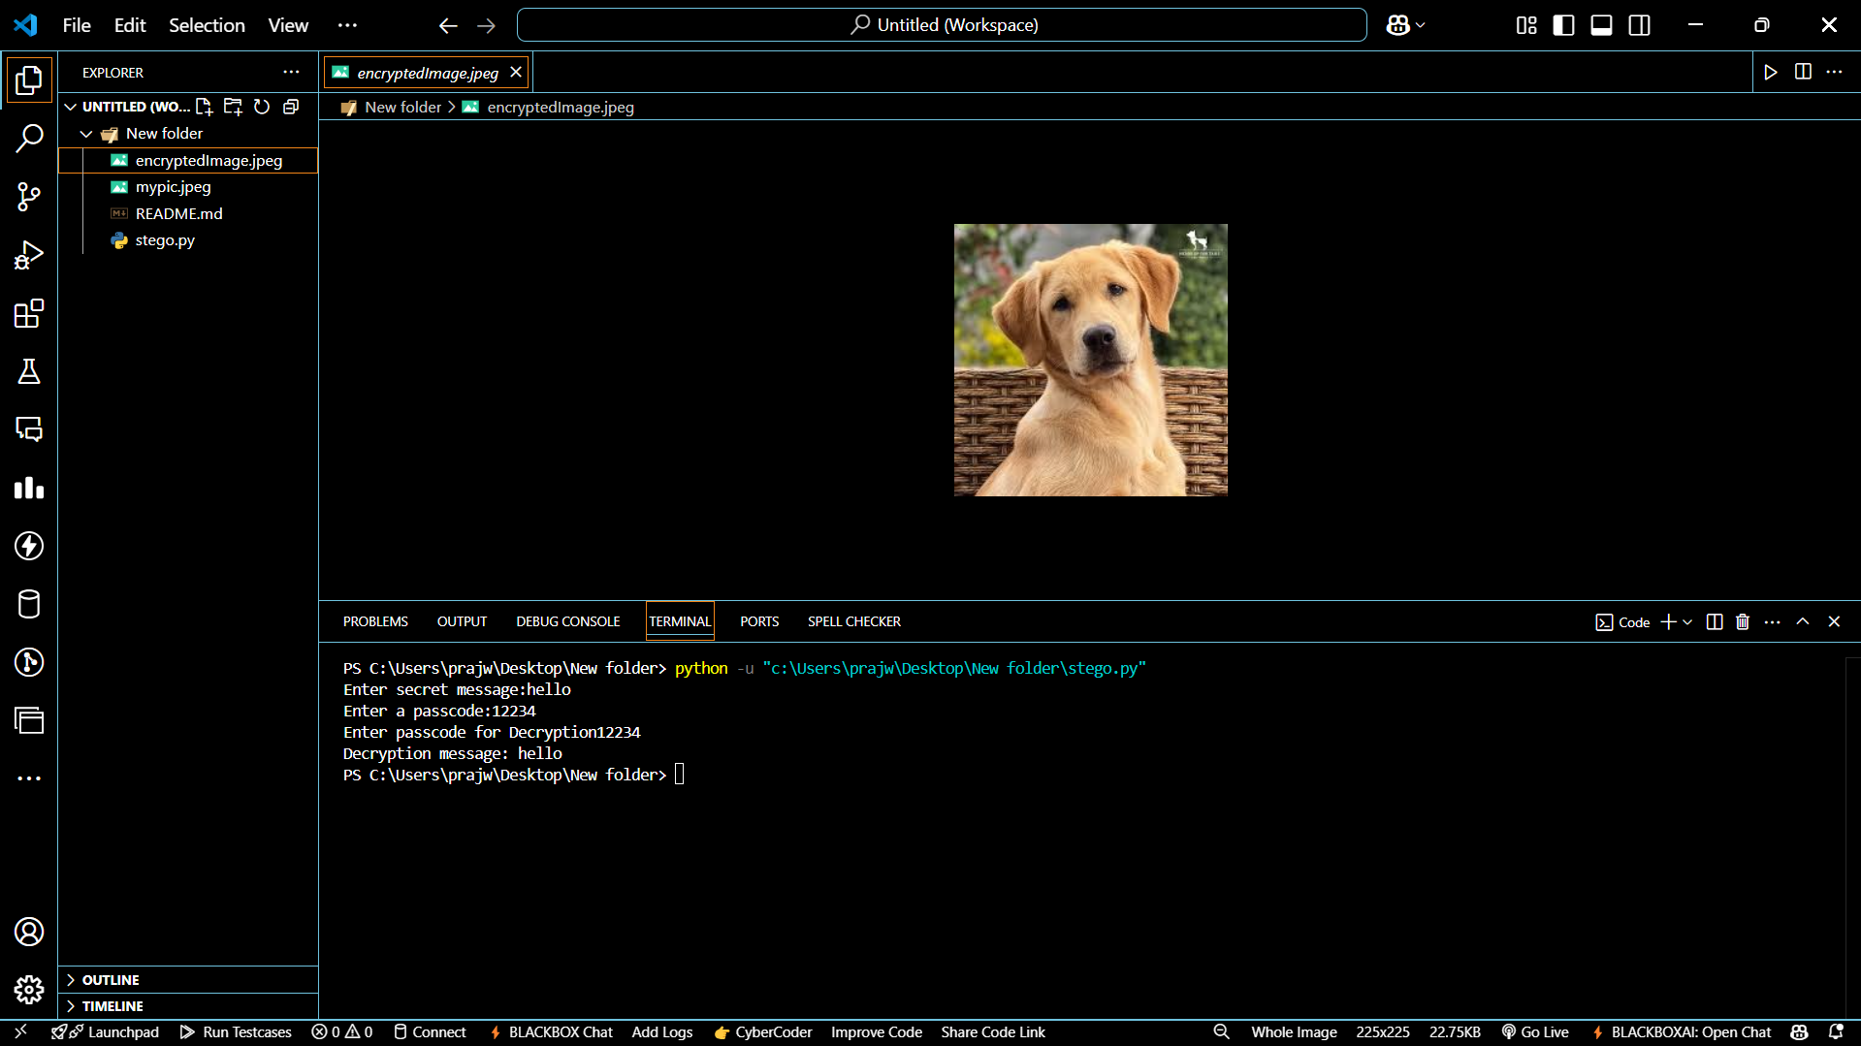
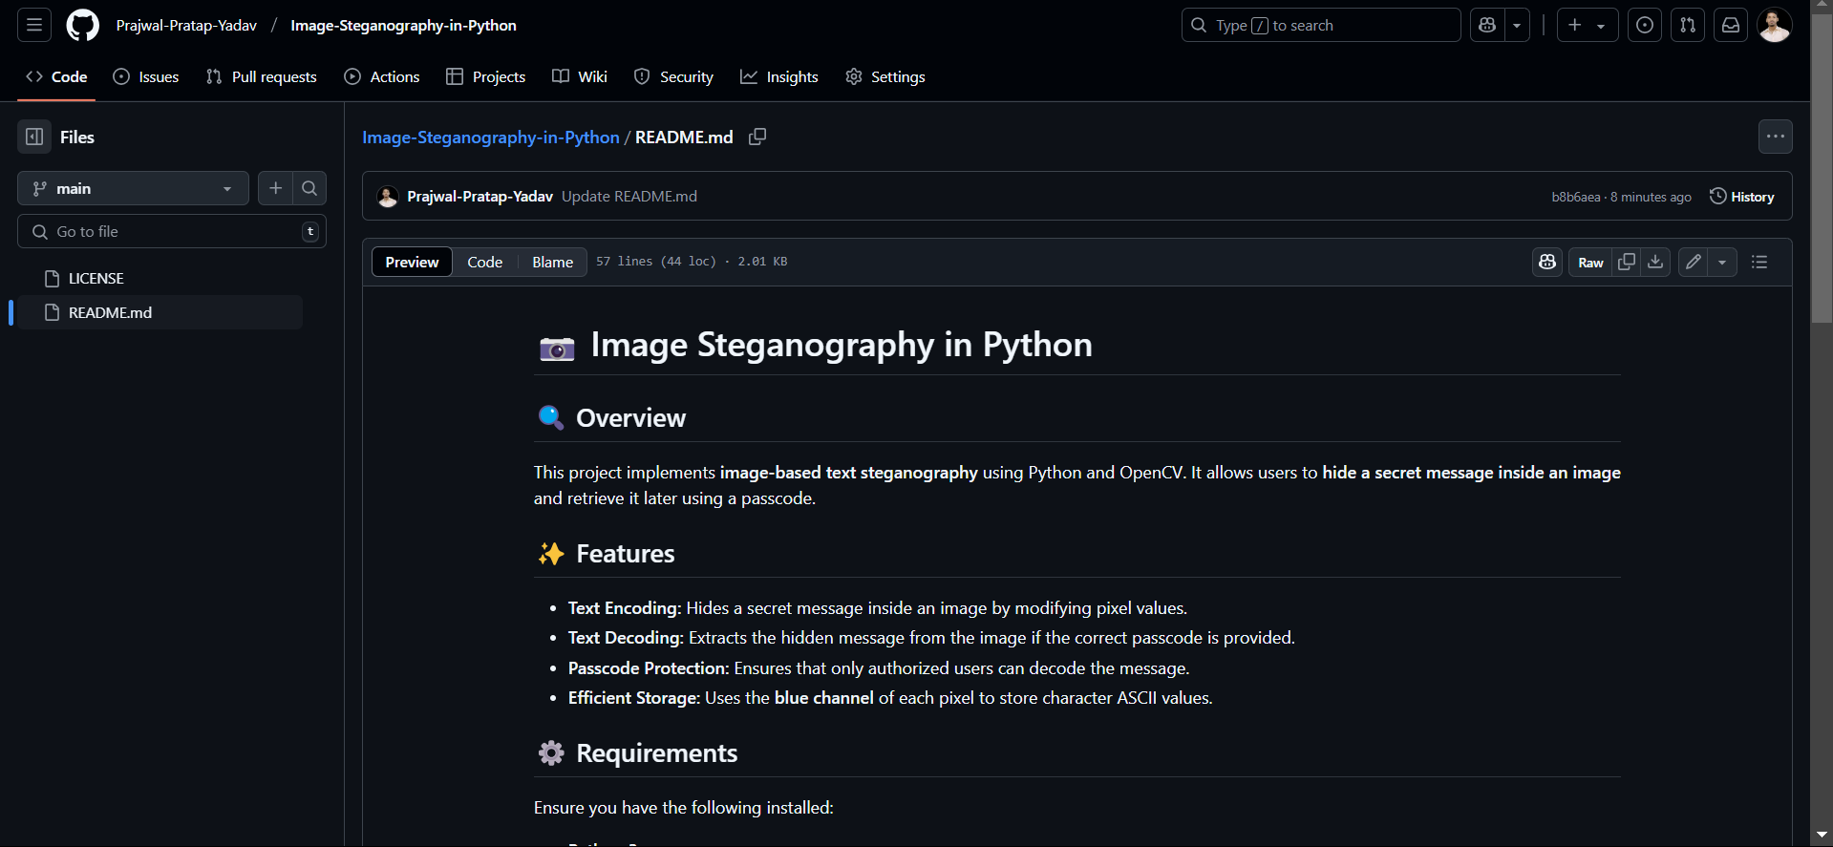
Results

Slide 8
Conclusion
The project successfully demonstrates a secure method of hiding data within images using steganography. By combining steganography with encryption, the solution ensures that sensitive information remains confidential and undetectable during transmission. The system is user-friendly, efficient, and works across multiple platforms. This project addresses the growing need for secure data communication in a digital world and provides a robust solution for individuals, organizations, and government agencies.

Slide 9
GitHub Link
https://github.com/Prajwal-Pratap-Yadav/Image-Steganography-in-Python.git

Slide 10
Future scope(optional)
Enhanced Security: Implement advanced encryption algorithms like AES or RSA for better security.
Support for Multiple File Types: Extend the project to hide data in audio, video, and other file formats.
Real-Time Application: Develop a real-time steganography tool for instant messaging platforms.
Machine Learning Integration: Use ML algorithms to detect and prevent steganalysis attacks.
Cloud Integration: Enable the system to work seamlessly with cloud storage services for secure data transmission.
Mobile Application: Develop a mobile app for easy encoding and decoding of data on smartphones.

Slide 11
THANK YOU

