Slide 1


ARIRAS
AI Regulatory Intelligence &
Reporting Assurance System
Concept By - Pragun & Harreet
ET Gen AI Hackathon 2026
Unstop

Slide 2
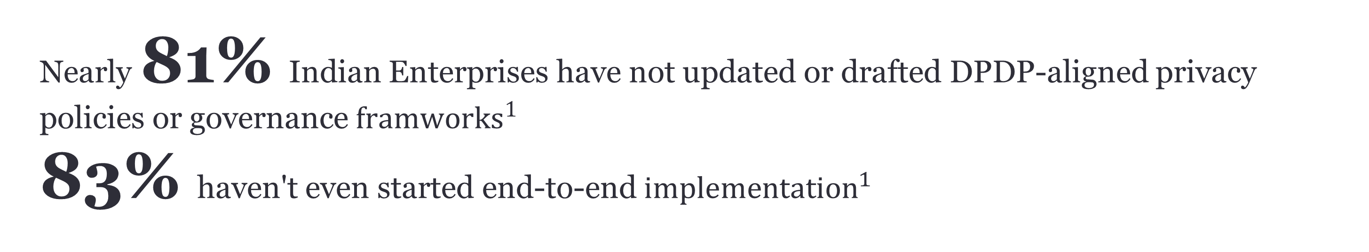
Nearly 81% Indian Enterprises have not updated or drafted DPDP‑aligned privacy policies or governance ${framworks}^{1}$
83% haven't even started end-to-end ${implementation}^{1}$
.
And the deadline?
May 2027.
That's 14 months away.
The fines?
Up to ₹250 crore per violation."
1,2 - EY (https://www.ey.com/en_in/insights/cybersecurity/india-s-data-privacy-shift-steering-the-dpdp-compliance-and-readiness)

Slide 3

SOURCE
1. Source EY https://www.ey.com/en_in/insights/cybersecurity/india-s-data-privacy-shift-steering-the-dpdp-compliance-and-readiness
https://www.ey.com/en_in/insights/cybersecurity/india-s-data-privacy-shift-steering-the-dpdp-compliance-and-readiness

Slide 4
Problem & Consequence
Company | Regulation | Reporting Failure Type | What They Failed To Report | Fine
Google | GDPR | Lack of transparency | Did not clearly disclose how user data was collected & used | €50M (The Times of India)
WhatsApp | GDPR | Incomplete disclosure | Failed to explain data sharing with parent company (Meta) | €225M (compliancehub.wiki)
Amazon | GDPR | Improper consent reporting | Did not properly inform users about ad-targeting data usage | €746M (CSO Online)
🚨 1. Scale of Regulatory Fines
Global regulatory fines reached $19.3 billion in 2024 Source: FinTech Global
Financial institutions have paid over $321 billion in fines since 2008 Source: Gitnux
A significant share of penalties stem from data, reporting, and governance failures Source: FinTech Global
Record-keeping and reporting failures alone caused $200M+ in fines annually in recent years Source: FinTech Global
👉 Use:
🧠 3. Regulatory Complexity
61% of organizations say keeping up with regulatory changes is their biggest challenge Source: Thomson Reuters
Large enterprises deal with hundreds of regulatory updates daily Source: Deloitte
💸 6. Cost of Non-Compliance
Cost of non-compliance is 2.7x higher than the cost of compliance Source: Ponemon Institute
Average cost of a data breach: $4.45 million Source: IBM

Slide 5

Solution
A system that understands regulations → maps them to company processes → detects reporting gaps → fixes them proactively
Policy & Process Mapping Layer
Takes:
company policies
workflows (financial close, reporting, etc.)
Maps:
“Which regulation applies where?”
👉 Output:
“Your current policy does NOT meet GDPR Article 13 requirements”
Regulation Intelligence Layer
Ingests:
GDPR, SEC, AML, SOX rules
Converts them into:
structured, machine-readable obligations
Detects:
missing disclosures
delayed reporting risks
incorrect data flows
Suggests:
corrections
automated reporting triggers

Slide 6
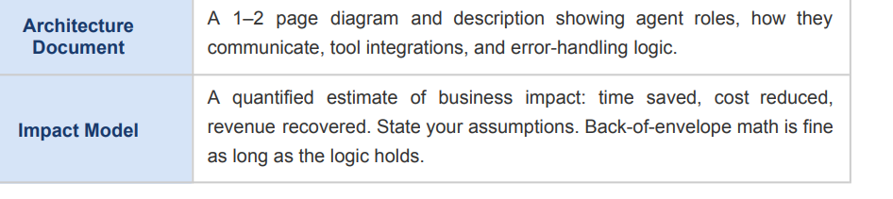
Impact Model

Slide 7
Project Demo Flow – User Perspective

Slide 8
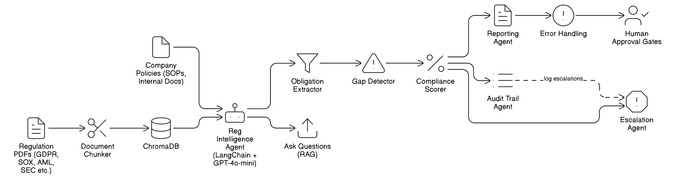
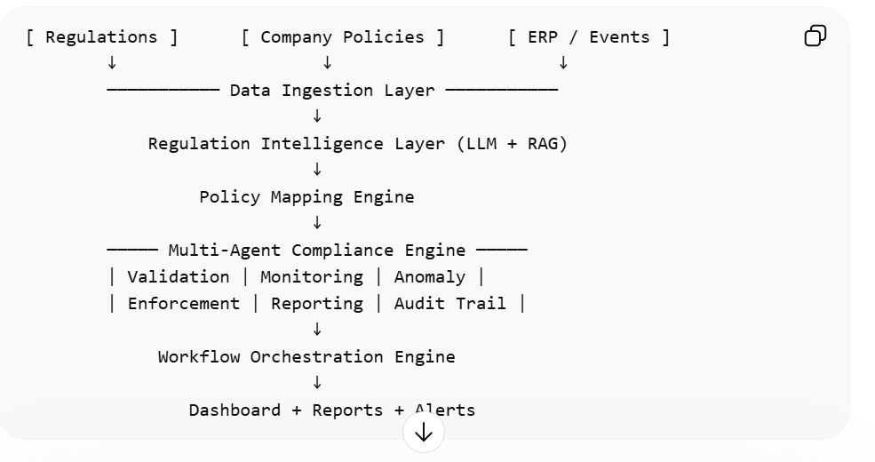
Model at a Glance – Tech Perspective
FLOW

Slide 9
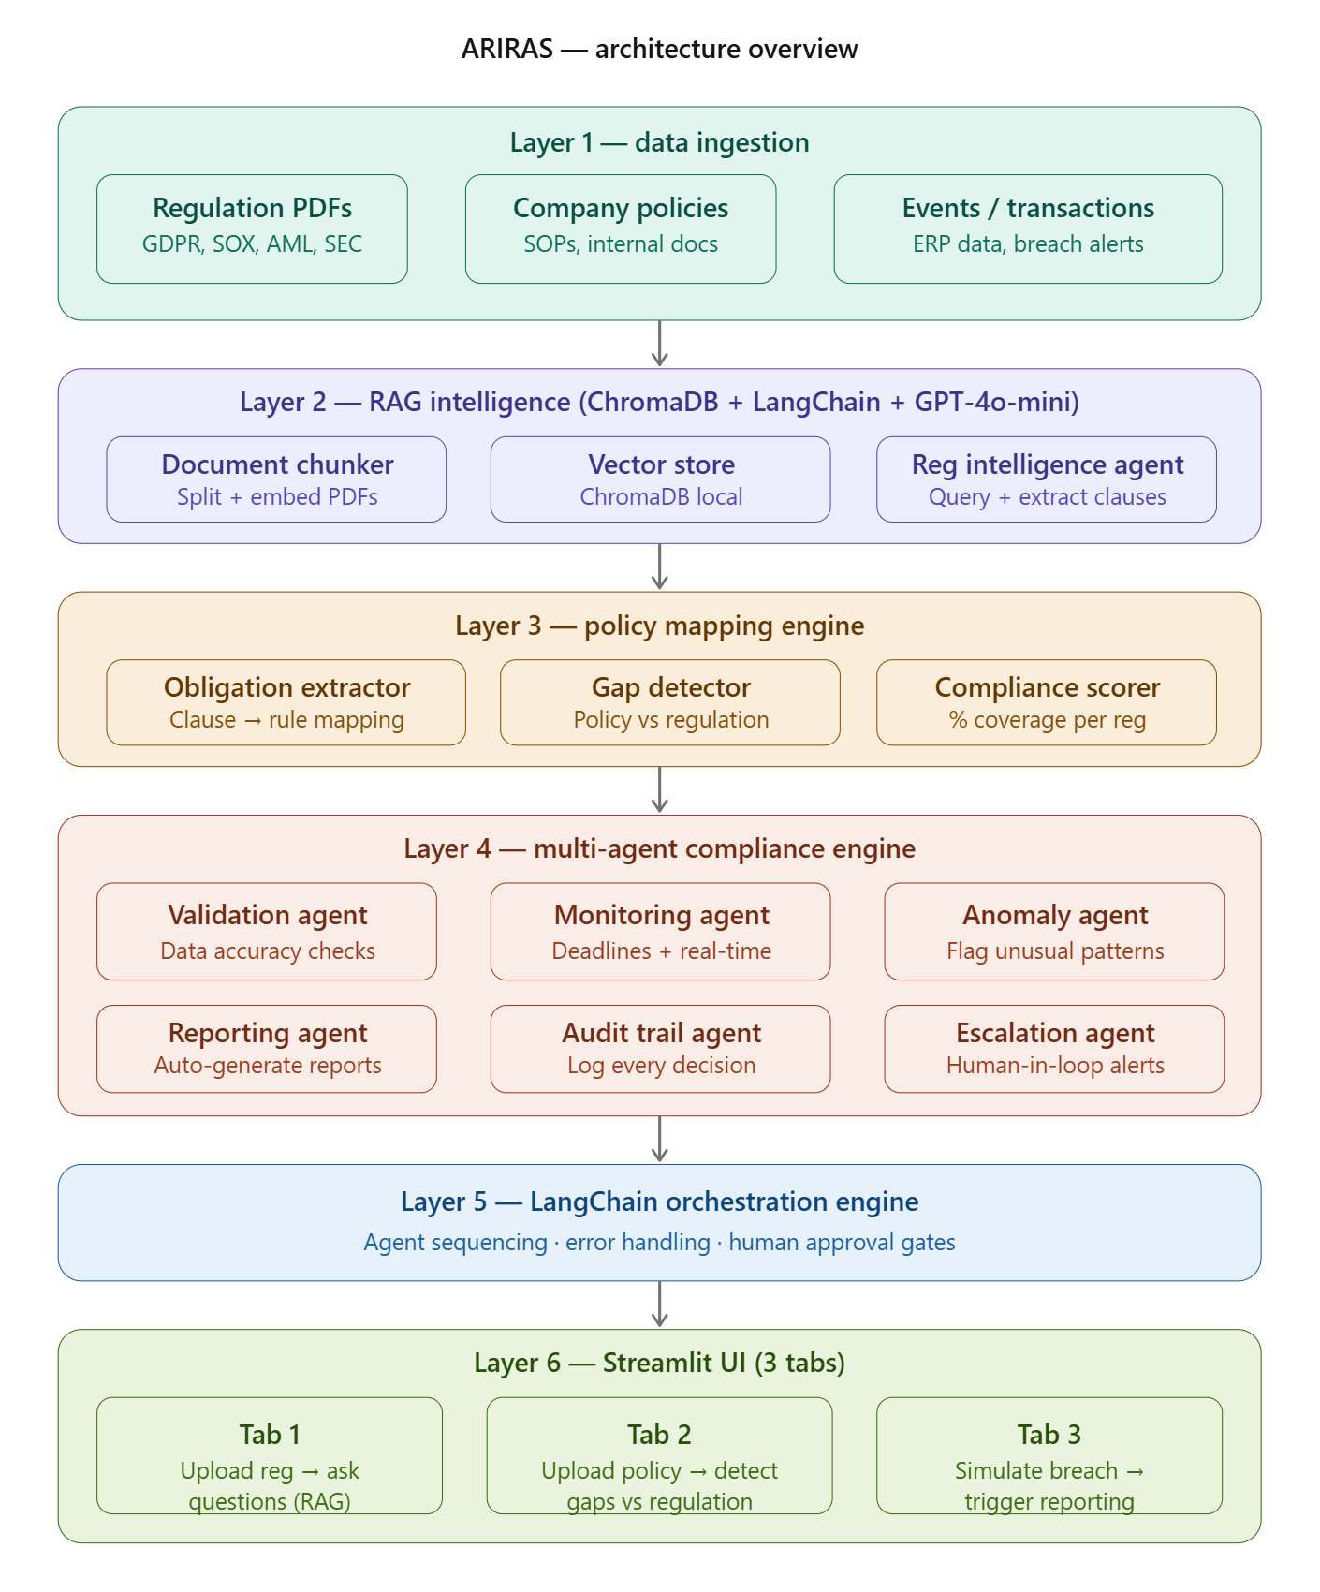
Architecture

