Slide 1





Problem
Compliance is broken. And getting worse.
Let’s take a real-life example
The Digital Personal Data Protection (DPDP) Act, 2023
Months of manual work
Legal teams spend 3 - 6 months reading, mapping, and cross-referencing regulation documents to produce gap reports. Every update restarts the clock.
Prohibitively expensive
Big-4 compliance consulting runs ₹15 - 50L per engagement. Mid-market and startup companies simply can't afford it - leaving them dangerously exposed.
Jurisdiction complexity
A company operating in India, the EU, and the US faces DPDP Act, GDPR, CCPA, SEBI, RBI, and sector-specific rules - each with overlapping and conflicting obligations.
Nearly 81% Indian Enterprises have not updated or drafted DPDP‑aligned privacy policies or governance ${framworks}^{1}$ because 71% simply cannot interpret what the Act ${requires}^{2}$
And the deadline?
May 2027
That's 14 months away.
The fines?
Up to ₹250 crore per violation.
EY (https://www.ey.com/en_in/insights/cybersecurity/india-s-data-privacy-shift-steering-the-dpdp-compliance-and-readiness)
Concept by Team Token Burners - Harreet & Pragun

Slide 2

PROBLEM BY USE CASE
Meet Syesha,
She's the compliance head at Paytm - an Indian fintech. She has a 21-page DPDP Act PDF, a 50-page company policy document, and a team of 3 people trying to figure out:
- Are we compliant?
- What are we missing?
- What happens if we're not?
She spends 3 weeks. Pays ₹2 lakh in consulting fees. And still isn't sure.
We created ARIRAS (AI Regulatory Intelligence & Reporting Assurance System)
- A system that understands regulations → maps them to company processes/ if policy document doesn’t exist, then helps give a guideline document → detects reporting gaps → fixes them proactively.
Concept by Team Token Burners - Harreet & Pragun

Slide 3

Solution
What takes consulting firms weeks, ARIRAS does in hours - not by replacing expertise, but by scaling it. Let’s see how!
Traditional Compliance Mapping Process
Mapping
🔗
Each regulation is understood and mapped to each control
📂
Regulatory Discovery
Regulatory Inventory
Policy Creation
Gap Assessment
Monitoring
Expert Dependency
🧾
📊
📝
🔄
🧠
Manual research / consultants identify applicable laws
Built manually in Excel & Consulting Frameworks
Policies in adherence by legal/compliance teams
Audit exercise – a lot of manual effort to manually find gaps.
Continuous monitoring and checks with policies.
High, as each process require manual interference & expertise.
Impact Analysis
🔍
Workshops + expert judgement
Post ARIRAS - AI Native Model
Mapping
🔗
H
A
AI auto-maps obligations to business context
Regulatory Discovery
Regulatory Inventory
Policy Guider
Gap Assessment
Monitoring
Expert Dependency
📂
A
🧾
H
A
📊
H
A
📝
H
A
🔄
🧠
Auto-ingested + searchable knowledge base
Auto-generated structured policy inventory
AI-generated clauses + guidance document
Automated gap detection in policies
Continuous monitoring and checks with policies.
High, as each process require manual interference & expertise.
Impact Analysis
🔍
Workshops + expert judgement
Fully Automated
H
Human Intervention + AI
A
Automated process

Slide 4
Enterprise Level Impact Model
conservative enterprise estimate
Pre - Considerations
Dedicated Team
Average Blended Cost Per Compliance FTE
- 25 Lakhs/Year
- ( ~ 1200 hours)
Team Diversification
Blend of
Coders and Tech folks
Analysts | 6
Seniors | 4
Managers | 2
Senior Managers | 1
PPMD | 1
Regulatory Compliance Officers
Prompt Engineers
Legal Team to verify the policy documents
- Time saved per regulation: → 100 – 30 = 70 hours
- Annual volume: → 100 regulations
👉 Total time saved: → 70 × 100 = 7,000 hours/year
Cost Impact
→ 1200 INR * 7000 Hours
Annual Savings
→ ₹84,00,000
PRE – ARIRAS - Baseline (Time Mapping) –
POST – ARIRAS - Baseline (Time Mapping) –
Activity | Time per Regulation ( per FTE) | Who
Regulatory interpretation | 12 - 16 hrs | Legal
Mapping to business processes | 25 - 30 hrs | Compliance
Policy drafting / updates | 30 - 40 hrs | Legal + Ops
Gap assessment + validation | 25 - 30 hrs | Internal audit
Total | 100 – 120 hours/regulation | —
Activity | Time per Regulation
AI-assisted interpretation | 2 - 3 hrs
Auto-mapping + validation | 10 - 15 hrs
Guided policy generation | 1 -2 hrs
Policy Drafting | 15 -20 hrs
Automated gap detection | 2 - 3 hrs
Total | 30 – 50 hours/regulation
3.5x efficiency gain
For a team of 14 members
At enterprise scale, compliance inefficiency is not a cost problem - it is a multi-crore risk exposure
Concept by Team Token Burners - Harreet & Pragun

Slide 5
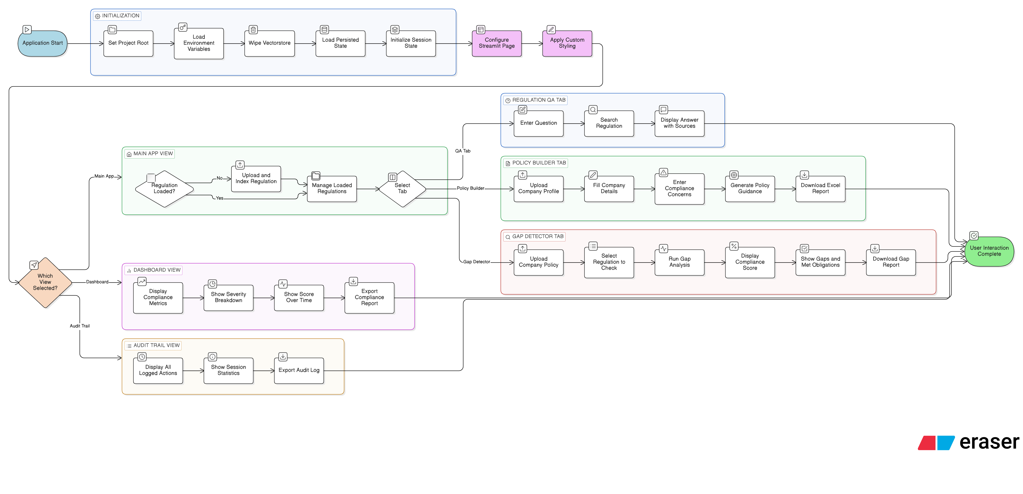
Entire Model – USER FLOW
Concept by Team Token Burners - Harreet & Pragun

Slide 6
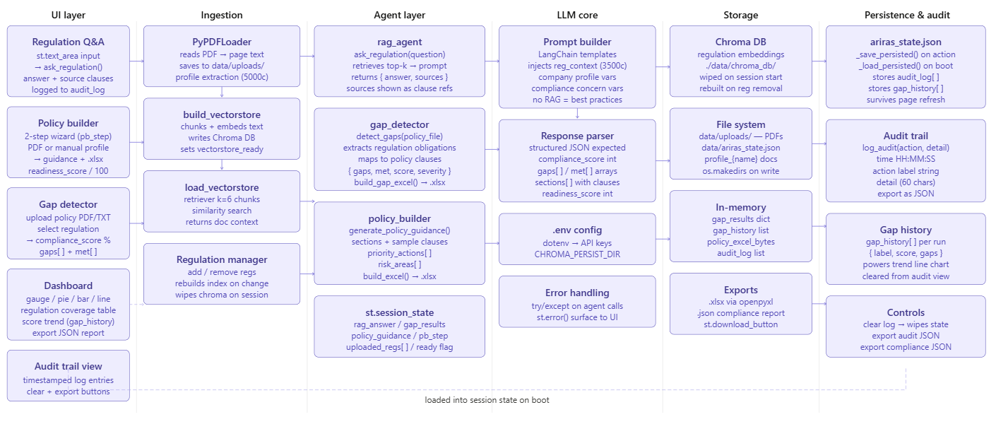
Architecture ( For detailed architecture please refer to word doc attached)
Concept by Team Token Burners - Harreet & Pragun

