Slide 1
PROJECT-34
GROUP-03

Slide 2
Market Sales Prediction
Business Objective -
Each Salesperson will be assigned with a target(No.of products to be sold) for each month which is given to them based on their last month’s achievement (No.of products sold) i.e. 10% increased from the last achievement.

Slide 3
Exploratory Data Analysis

Slide 4
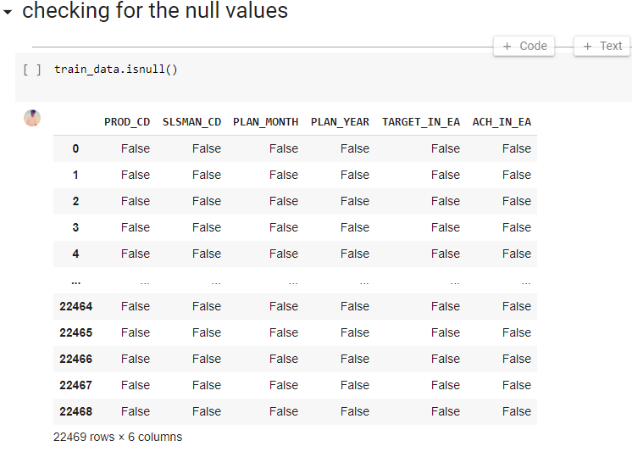
CHECKING NULL VALUES

Slide 5
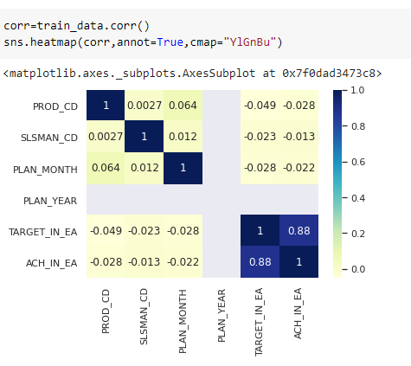
CO-RELATION OF DATA

Slide 6
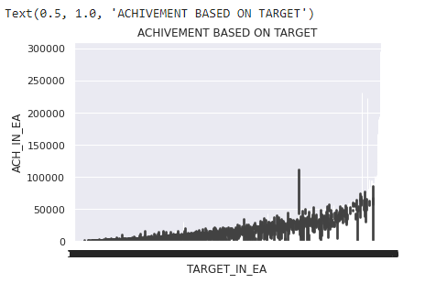
MANIPULATION USING BASIC OF STATISTIC (ACHIVEMENT BASED ON TARGET)

Slide 7
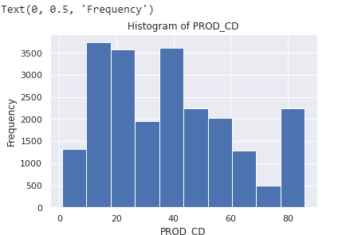
HISTOGRAM OF PRODUCT CODE

Slide 8
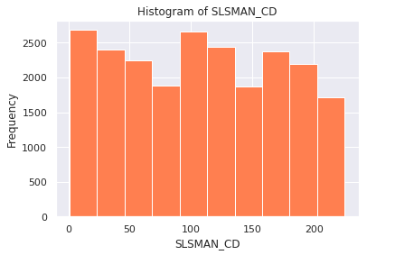
HISTOGRAM OF SALESMAN CODE

Slide 9
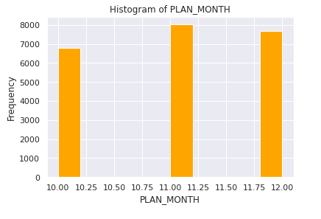
HISTOGRAM OF MONTH

Slide 10
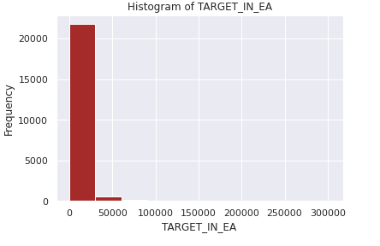
HOSTOGRAM OF TARGET

Slide 11
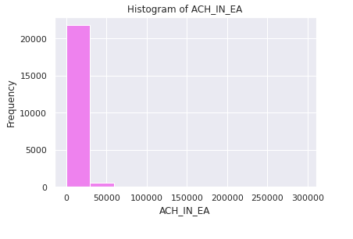
HISTOGRAM OF TARGET ACHIEVE

Slide 12
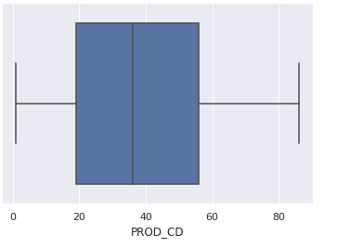
BOX PLOT USING PRODUCT CODE

Slide 13
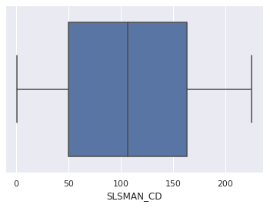
BOX PLOT USING SALESMAN CODE

Slide 14
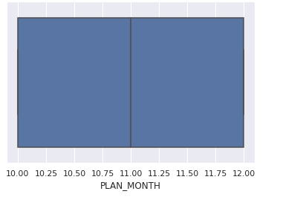
BOX PLOT USING AVERAGE MONTH PLAN

Slide 15
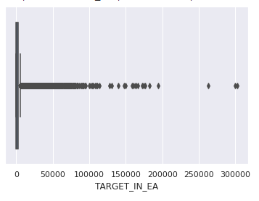
BOX PLOT USING TARGET

Slide 16
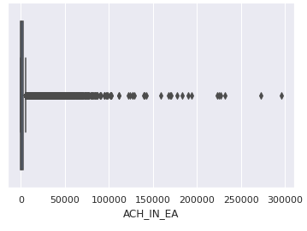
BOX PLOT USING TARGET ACHIVED

Slide 17
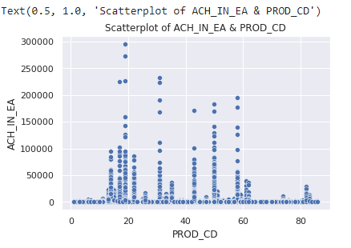
SCATTERED PLOT OF PRODUCT CODE

Slide 18
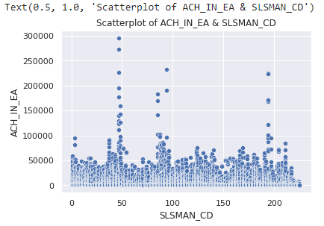
SCATTERED PLOT OF SALESMAN CODE

Slide 19
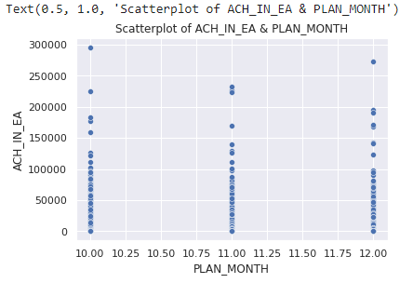
SCATTERED PLOT USING TARGET ACHIEVED

Slide 20
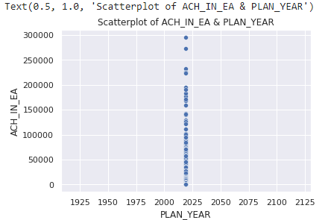
SCATTERED PLOT OF TARGET ACHIEVED IN YEAR

Slide 21
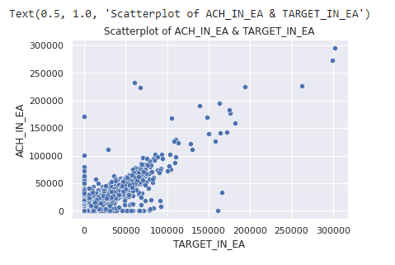
SCATTERED PLOT OF TARGET

Slide 22
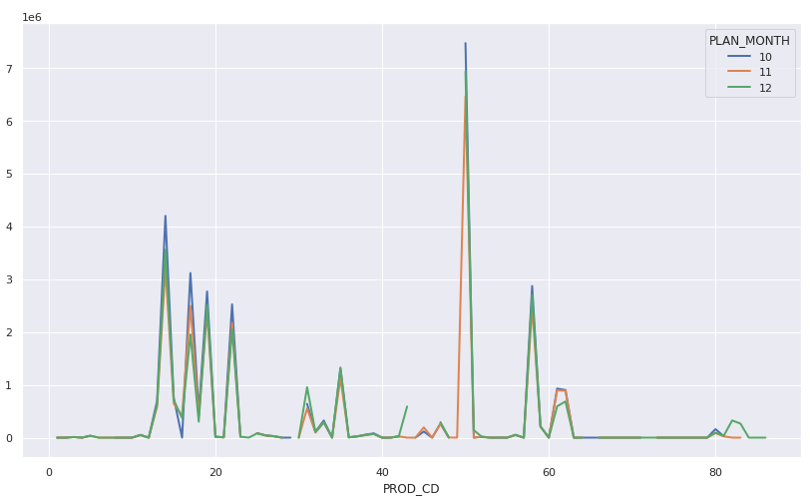
Stack overflow of product code

Slide 23
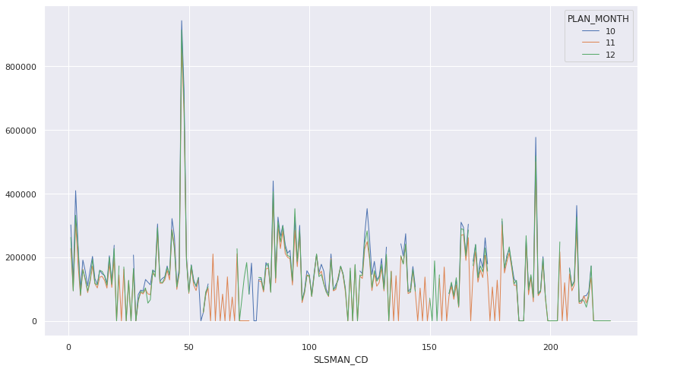
Stack overflow of salesman code

Slide 24
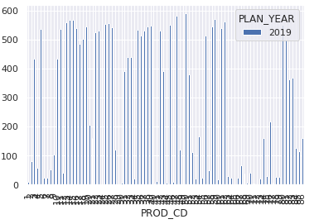
Manipulation of product code

Slide 25
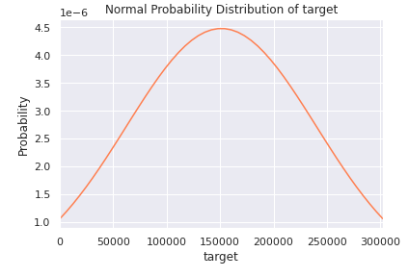
Probability of target

Slide 26
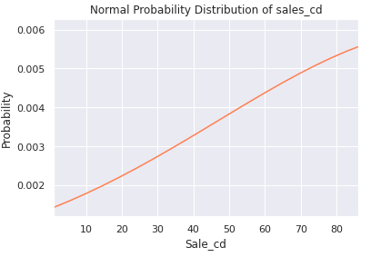
Probability of sales

Slide 27
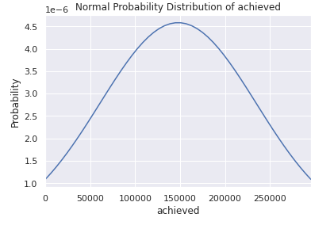
Probability of sales achived

Slide 28
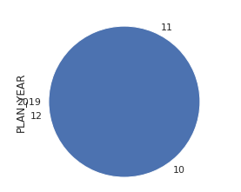
Pie chat (showing the ratio)

Slide 29
MODEL BUILDING

Slide 30

Data Split

Slide 31
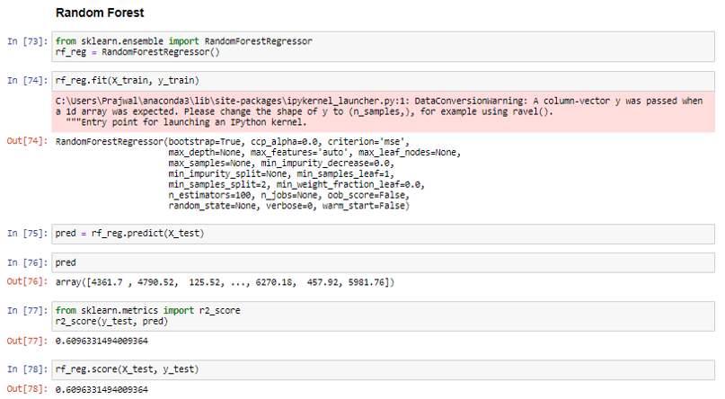
Random Forest

Slide 32
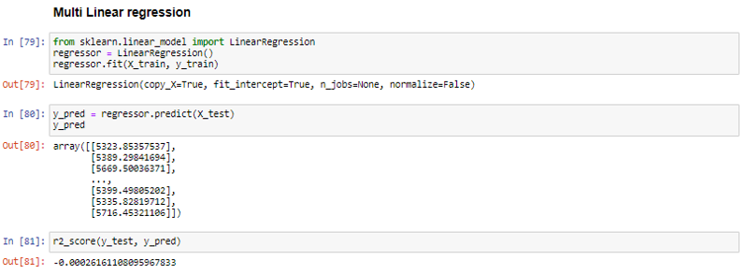
Multi Linear Regression

Slide 33
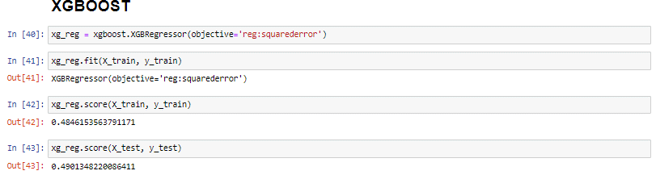
XGBOOST

Slide 34
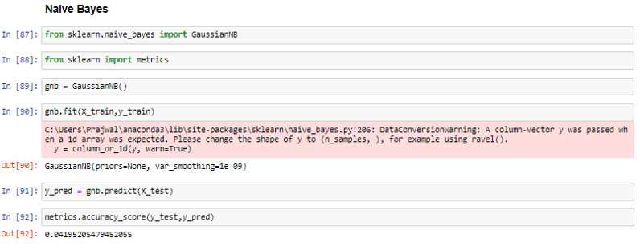
Naïve Bayes

Slide 35
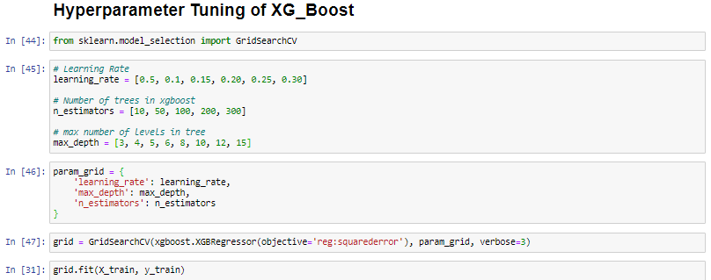
Hyperparameter Tuning of XGBOOST

Slide 36
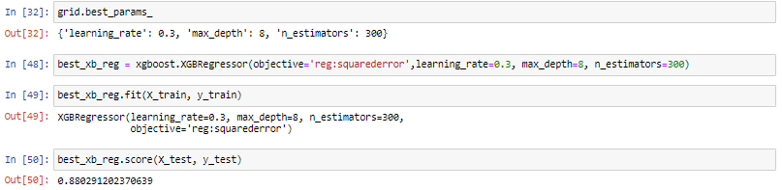

Slide 37
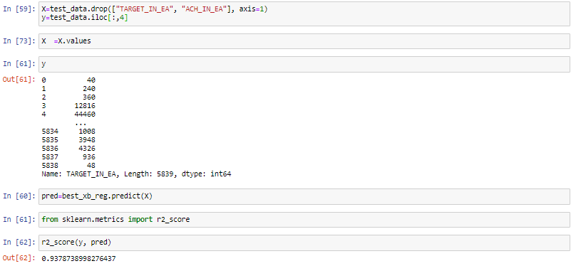

Slide 38
Deployment

Slide 39
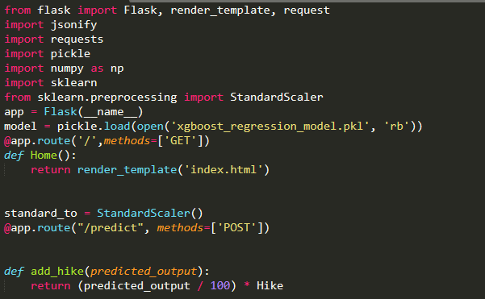

Slide 40
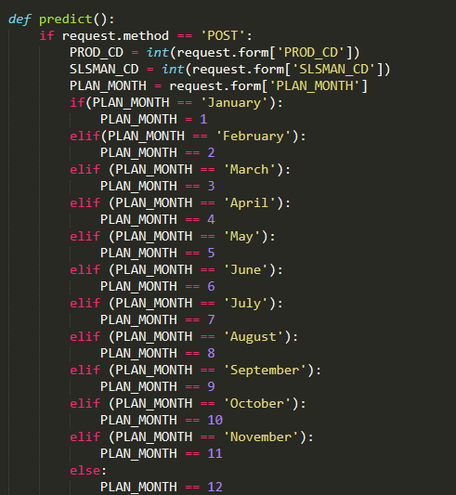

Slide 41
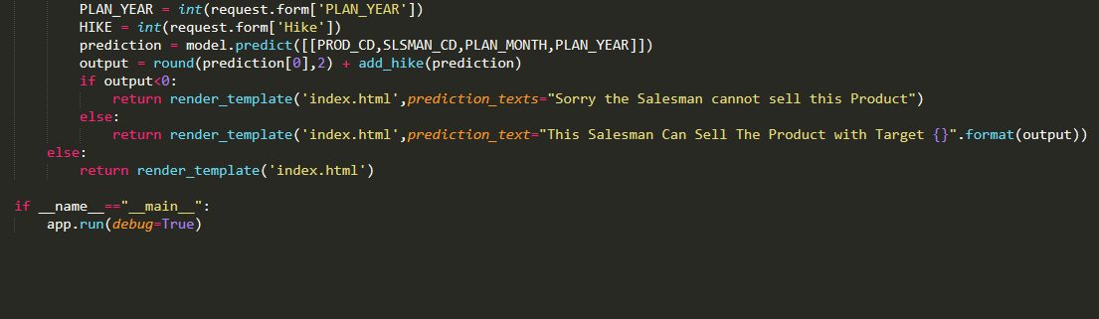

Slide 42
THANK YOU 1) Chandan N. 2) Sarfaraz Ansari 3) Harish Soni 4) Sainath Dahibhate 5) Mohammed Umar Farooq 6) Prajwal Dhumal

