Slide 1
G. H. Raisoni College of Engineering and Management, Pune
Submitted By : Group ABM24
Prajwal Bhoyar BCOA07
Aditya Butley BCOA08
Sumedh Dhole BCOA14
Nishad Joshi BCOA16
Subject : Mini Project

Slide 2
INDIAN SCHOOL EDUCATION ANALYSIS

Slide 3
What is Education
Education in its broadest, general sense is the means through which the aims and habits of a group of people lives on from one generation to the next Generally, it occurs through any experience that has a formative effect on the way one thinks, feels, or acts. In its narrow, technical sense, education is the formal process by which society deliberately transmits its accumulated knowledge skills, customs and values from one generation to another.
e.g., instruction in schools.

Slide 4
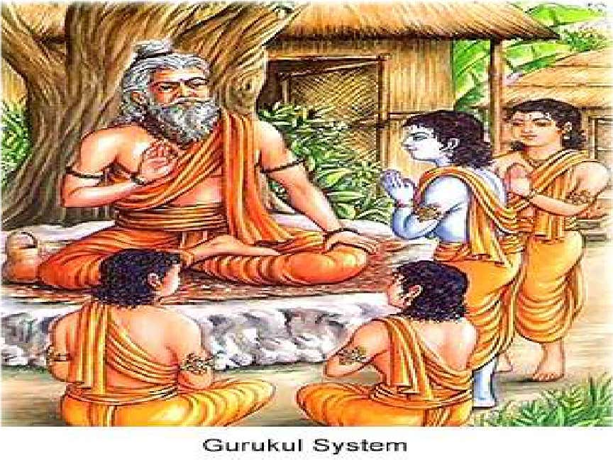
Education in Ancient India
The history of education in ancient India is fascinating and is recorded and can be tracked to the ancient era. Education in ancient India began around the 3rd century BC with elements of religious training and impart of traditional knowledge. Sages and scholars imparted education orally. Palm leaves and barks of trees were used for writing.

Slide 5
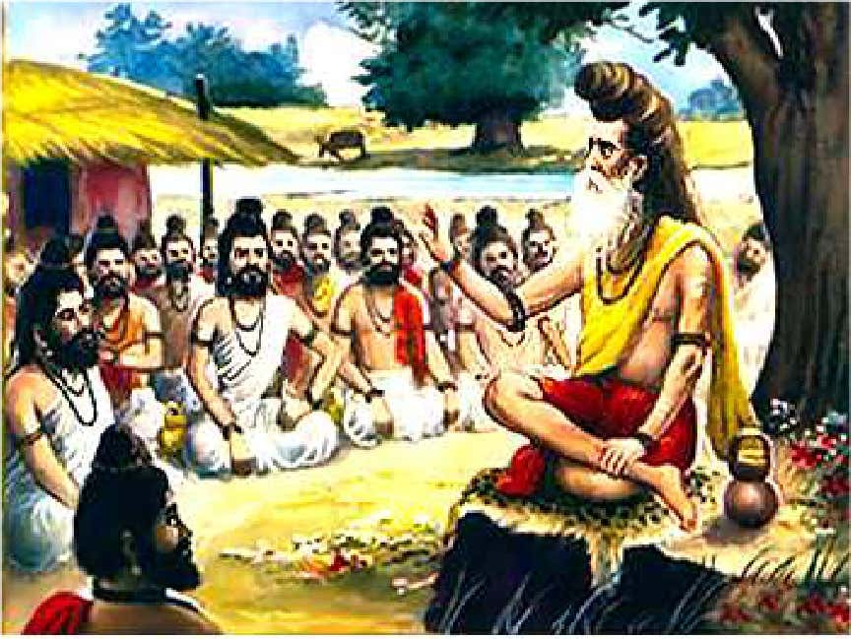
Gurukul a System
Education in ancient India was more identified with the Gurukul a system
These ancient Hindu schools in India were residential in nature with the sishyas or students living in the same house with the Guru or the teacher.
The students lived together irrespective of their social standing .

Slide 6
Education in the Medieval Period
The first millennium and the few centuries preceding it saw the flourishing of higher education at Nalanda, Takshila, Ujjain & Vikramshila Universities. Art, Architecture, Painting, Logic, Grammar, Philosophy, Astronomy, Literature, Buddhism, Hinduism, Arthashastra (Economics& Politics), Law, and Medicine.
Takshila specialized in the study of medicine, while Ujjain laid emphasis on astronomy. Nalanda, being the biggest centre, handled all branches of knowledge, and housed up to 10,000 students at its peak.

Slide 7
Education in Modern India
The educational system which the British introduced teaching of English language was given greater emphasis and the study of languages like Arabic ,Persian and Sanskrit were left to individual efforts.

Slide 8
Objectives
The English introduced modern education
To reduce the expenditure on administration
To encourage the study of English language
To expand market for English goods
To spread Christianity
According to Lord Macaulay after receiving modern education Indians would remain Indians only in their colour while their interests, ideas, morals and Intelligence.

Slide 9
Education in the post Independence era
After independence, education became the responsibility of the states.
The Central Government's only obligation was to co-ordinate in technical and higher education and specify standards.
This continued till 1976, when the education became a joint responsibility of the state and the Centre.
Education in India falls under the control of both the Union Government and the states, with some responsibilities lying with the Union and the states having autonomy for others.

Slide 10
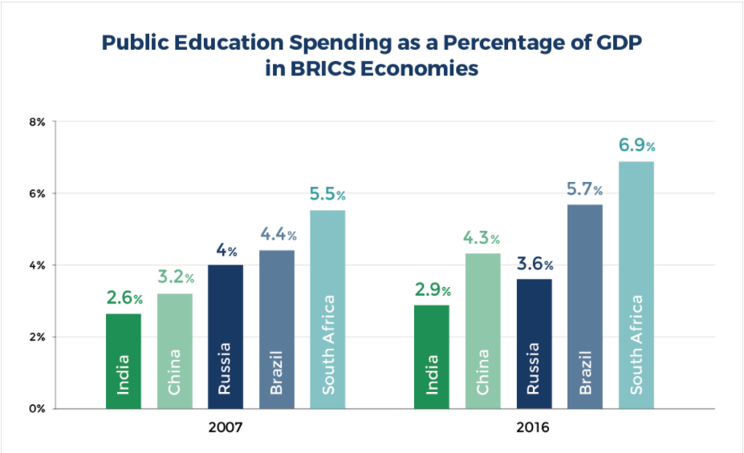

Slide 11
The various articles of the Indian Constitution provide for education as a fundamental right. Most universities in India are controlled by the Union or the State Government.
India has made progress in terms of increasing primary education attendance rate and expanding literacy to approximately two thirds of the population
India's improved education system is often cited as one of the main contributors to the economic rise of India.
Much of the progress especially in Higher education, Scientific research has been credited to various public institutions.
Value based education is a three fold development of any individual of any gender and age, but most importantly of a child. Education tries to develop three aspects: physique, mentality and character.

Slide 12
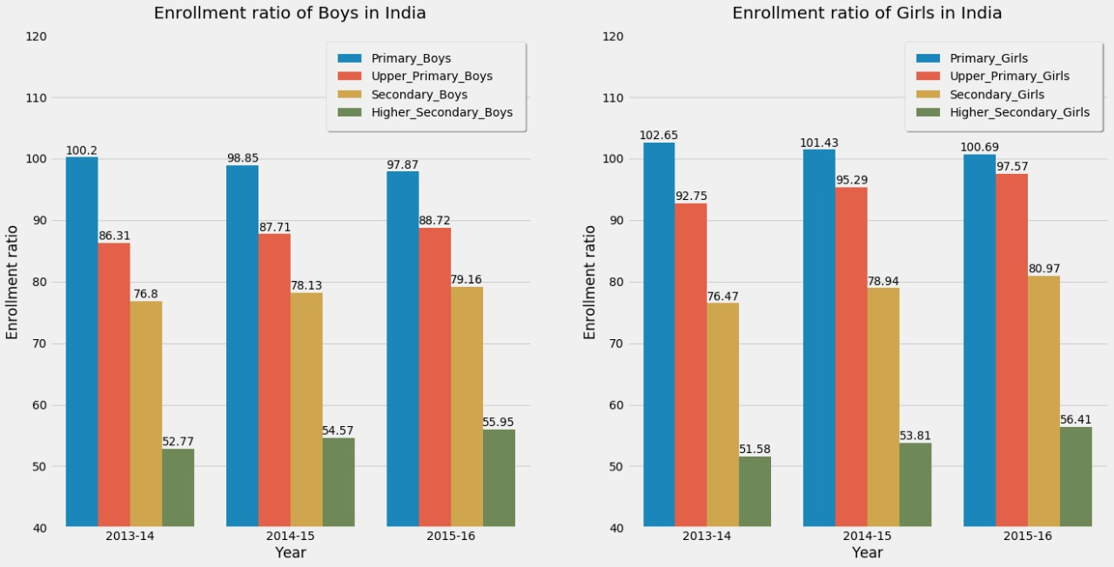
Gross Enrolment Ratio: Number of students enrolled in a given level of education, regardless of age, expressed as a percentage of the official school-age population corresponding to the same level of education.

Slide 13
An education system refers to the economic and social factors that typically make up public schools at the federal, state or community levels. Such factors include public funding, school facilities, staffing, compensation, employee benefits, teaching resources and more.
1) Primary: The Primary Education in India consists of students studying in Class I-IV.
2) Upper Primary: The Upper Primary Education in India consists of students studying in Class V-VIII. The Indian government lays emphasis on primary education (Class I-VIII) also referred to as elementary education, to children aged 6 to 14 years old.
3) Secondary: Secondary education in India begins after eight years of elementary education and is divided into two years of secondary education (classes IX and X) and two years of Higher secondary education (classes XI and XII)
4) Higher Secondary: Higher Secondary Education consists of students studying in Class XI & XII.

Slide 14
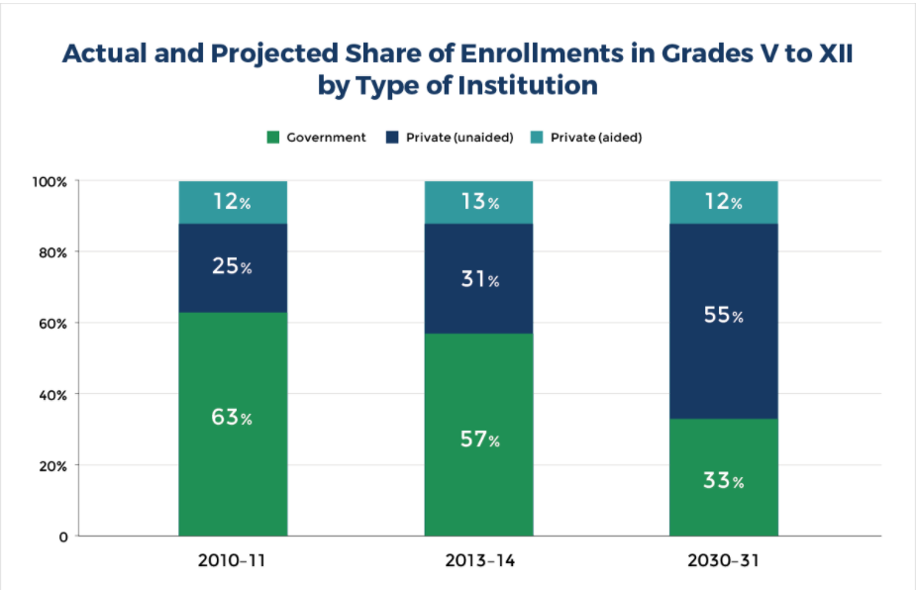
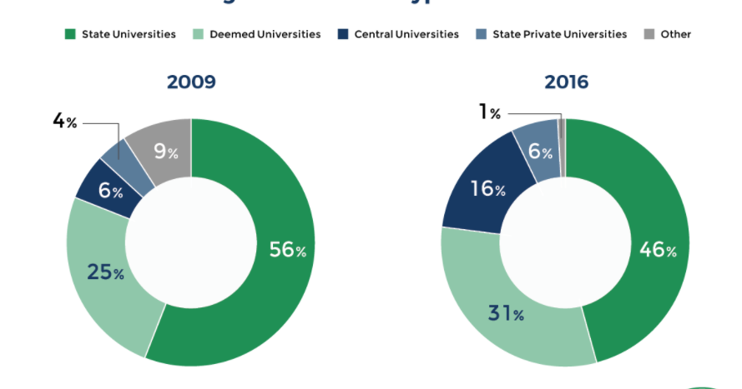

Slide 15
THANK YOU !

