Slide 1
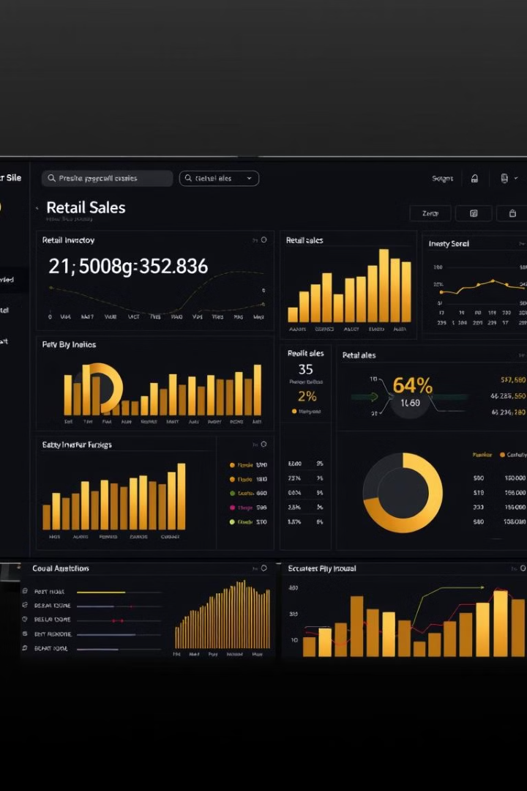

Power BI Dashboard for Inventory & Sales Analysis

Slide 2

Problem Statement
1
Background
2
Objective
Overstocking, stockouts, and inefficient forecasting lead to losses.
Build a dashboard to monitor inventory and forecast demand.
3
Scope
Analyze turnover, demand, pricing impact, and regional performance.

Slide 3
Data Sources & DAX Measures
Data Sources
DAX Measures
Sales_Inventory.csv
Competitor Price Impact
Product_Brand_Details.xlsx
Inventory Turnover
Store_Location.csv
Price Impact
Total Inventory
Total Revenue

Slide 4

Data Editing & Modifications
Minimal Cleaning
Outliers Retained
Data was already well-structured.
Crucial for demand forecasting accuracy.
New Columns (Python)
Postal Code, State, City, Brand Name added.

Slide 5
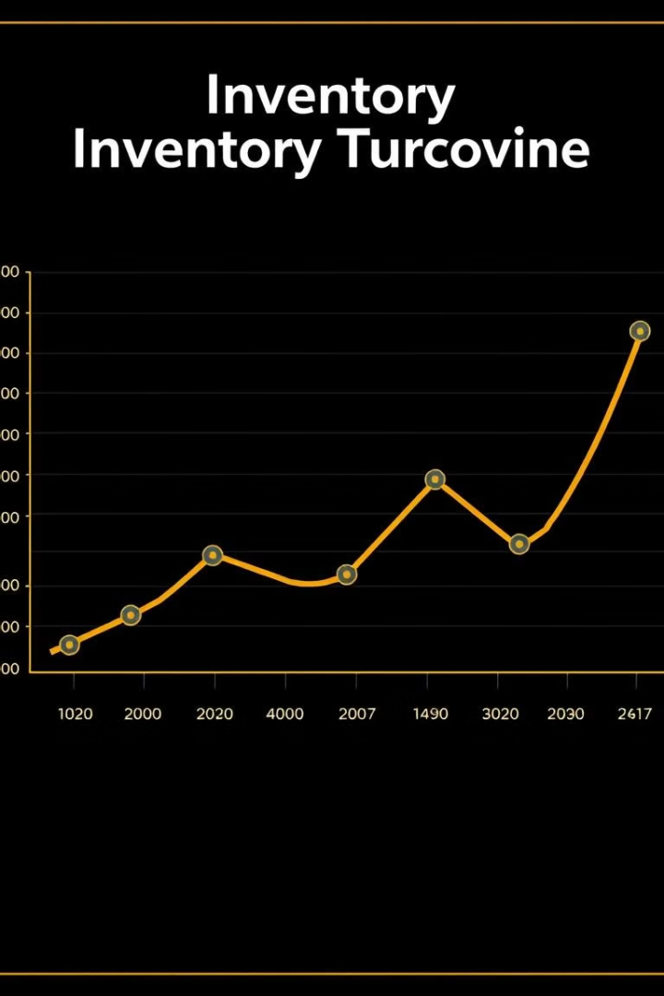
Inventory Turnover Trends
1
Fluctuations
Low points in February, April, and September.
2
Peak
July shows a peak (3126), indicating seasonal demand.
3
Action
Optimize replenishment strategies.

Slide 6
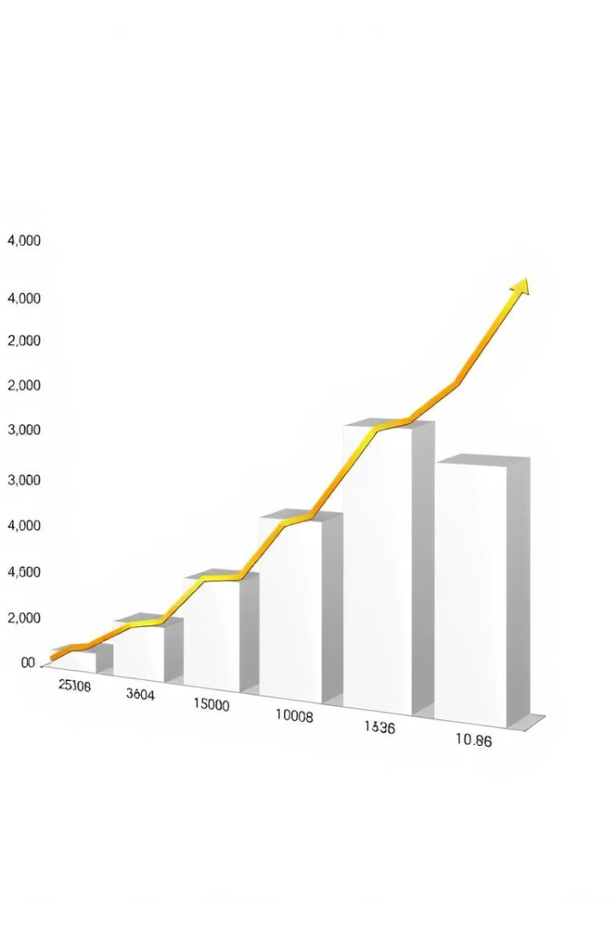



Demand Forecasting & Seasonality
Stock Levels
Furniture & Electronics have the highest stock.
Lowest Stock
Toys have the lowest stock, possibly faster sales.
Action
Reallocate stock based on seasonal data.

Slide 7



Competitor Pricing Impact
Decline
2
Sales decline (2025) aligns with price drop.
Stable Sales
1
Sales stable (2023-2024) despite pricing.
Price-Sensitive
Electronics & Clothing are price-sensitive.
3

Slide 8



Region-Wise Performance
East
1
Leads in revenue across categories.
West & North
2
Underperform, need sales improvement.
Furniture & Electronics
3
Drive the highest revenue overall.

Slide 9




Key Takeaways
Seasonal Planning
Competitor Pricing
Regional Gaps
Clear gaps in West & North regions.
Inventory needs better seasonal planning.
Directly affects sales in key categories.

Slide 10

Conclusion & Next Steps
Key Takeaways:
Inventory management needs better seasonal planning.
Competitor pricing directly affects sales in key categories.
Regional performance analysis shows clear gaps in West & North.
Next Steps to be taken:
Implement dynamic pricing strategies for price-sensitive categories.
Optimize inventory allocation based on demand trends.
Run regional marketing campaigns to boost underperforming areas.

