Slide 1

NOTE-NODES
Group No. 12
Presented By:-
Prajwal Negi 204200146
Lalit Rathore
Pradeep Sharma 204200145
Ravi Sharma
Om Singh Raghav
Nitesh Deshwal
Manish Tiwary
Under the Supervision of :
Mr. Puneet Sharma
Department of CEA
GLA University, Mathura

Slide 2
Contents
Introduction
Objective
Tools and technologies
Hardware and Software Requirements
DFD
References

Slide 3
Introduction
This program will help students to make handy notes
Will help them organize their both physical and e-notes into the form of folders and pdfs
The notes that will be made can later be converted into PDF and DOCX format for using it on other devices like PC, Laptops or other file reading apps

Slide 4
Objectives
Make notes making easier
Provide the better way to organize your documents
Keeps tracks of all your documents and makes them portable by storing them in once place
Editing and adding comments on the notes themselves
Can be later converted into other documents if required
Sharing is also easy

Slide 5
Technologies and Tools
TOOLS
Android Studio – This application will help in designing the whole interface of the app
Java/React – Will be used to make the backend of the application
SQL – Will be used in querying the data in the
FIGMA – For designing the whole interface UI and UX of the application

Slide 6
Hardware and Software Requirements
Hardware
Quad Core Snapdragon/Mediatek Processor
1 GB RAM
1GB Storage
Software
Android version 8 or above

Slide 7
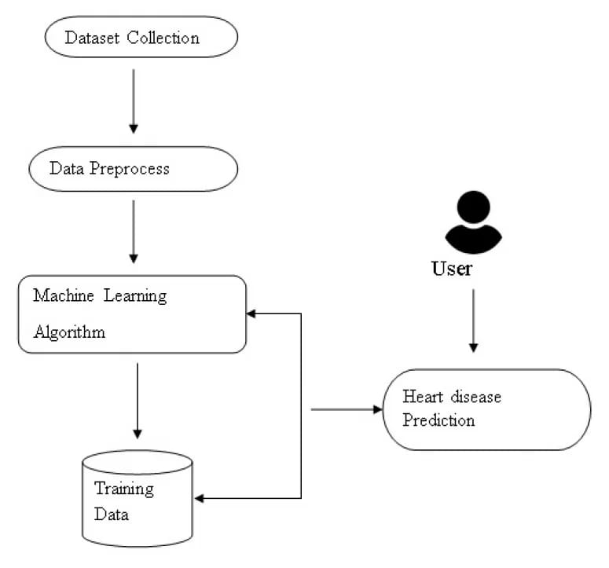
Flow Of Data Diagram
The following diagram gives a visual representation for how will data go from one component for another when we use the ML model for prediction

Slide 8
Code
The Code is divided into following components
Importing Libraries
Importing the ML models
Importing the dataset
Pre-Processing the Dataset
Applying the Datasets on ML models
Printing the Accuracy graph for each model
Conclusion

Slide 9
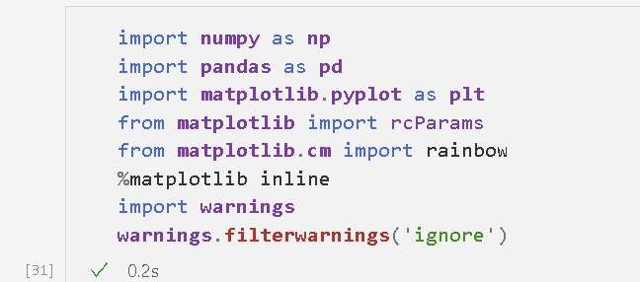
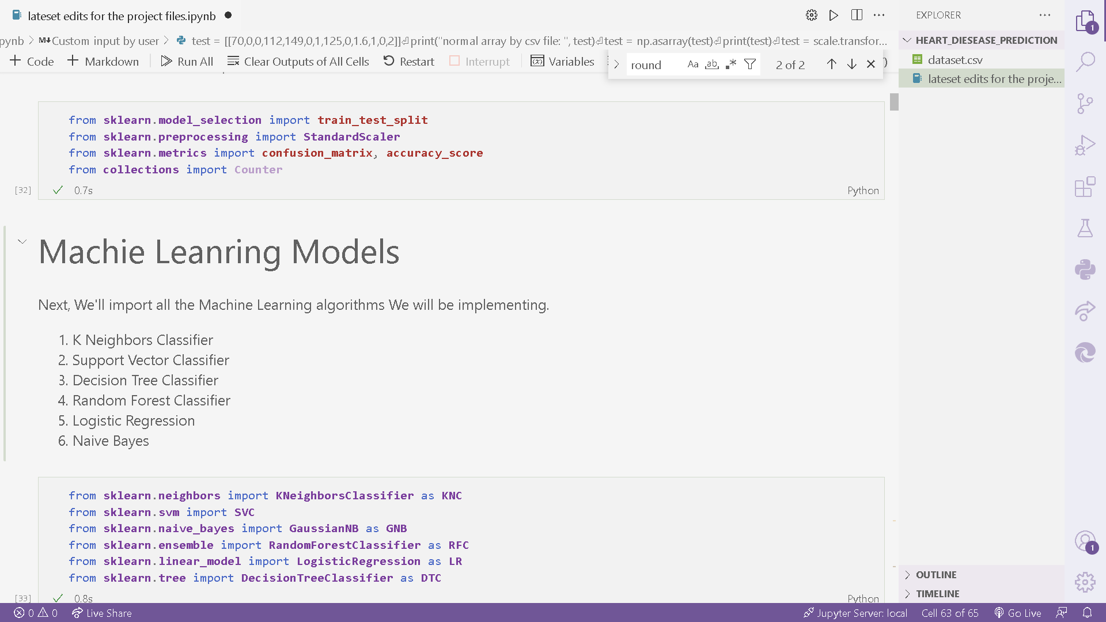
Importing Libraries
Here we imported all the necessary libraries and tools for our progject
On the right we imported libraries like pandas, Matplotlib, and numpy
One the other hand we imported data manipulation tools and some other tools

Slide 10
Importing ML Models
Now Let’s import all the 6 Machine Models that we will be using in our Project to predict

Slide 11
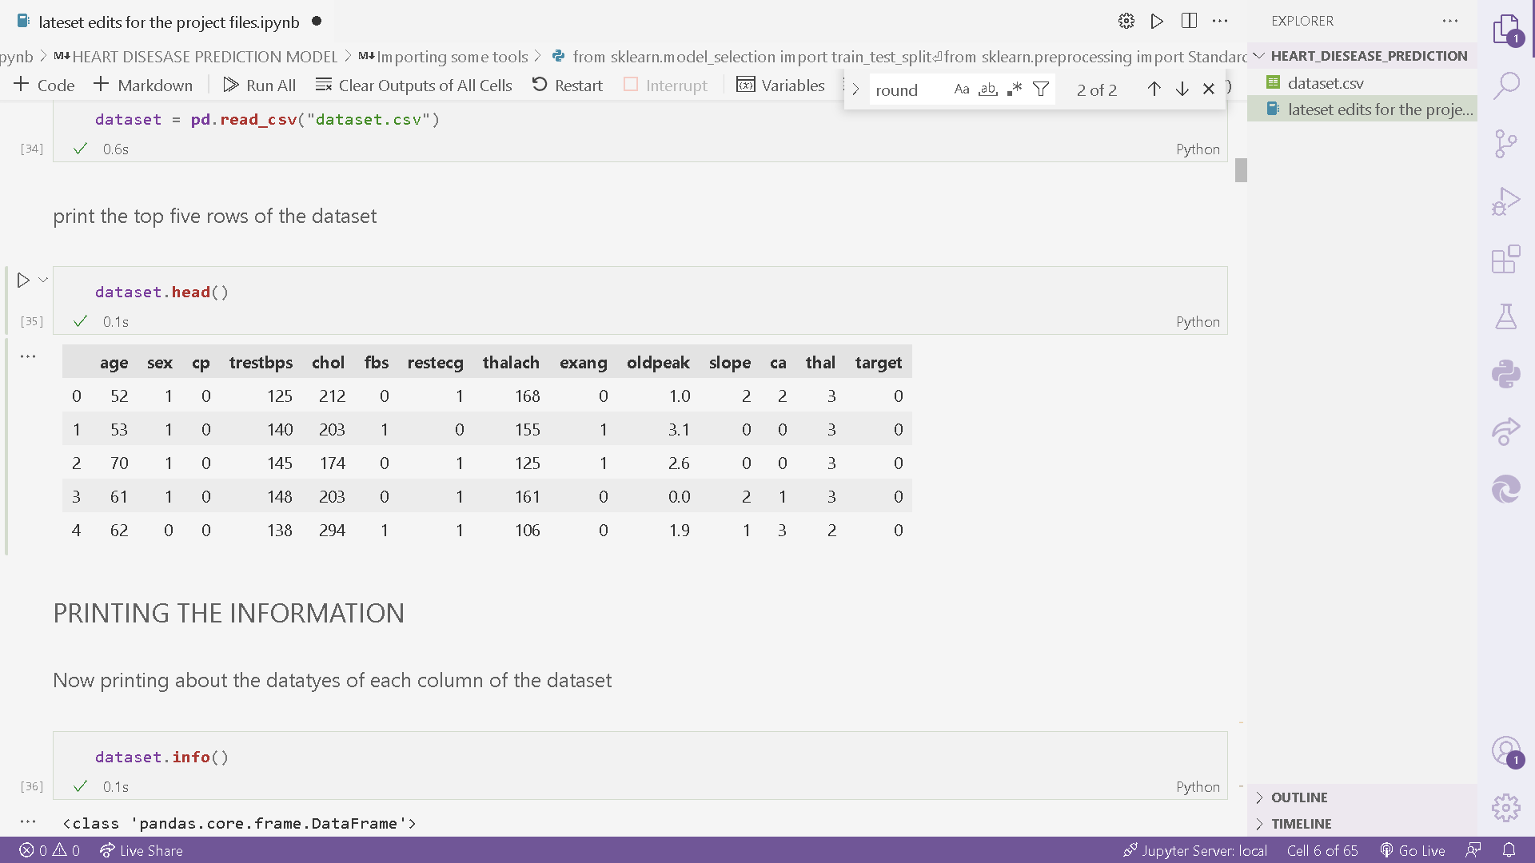
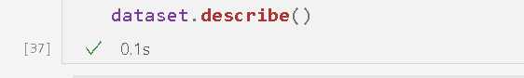
Importing Dataset
Now we will use the following tools to import the dataset
Print the top 5 records of the dataset
Print the Information about the entities and their data types in dataset
Describe the Dataset, like mean median, top 50% top 25% values in the dataset records

Slide 12
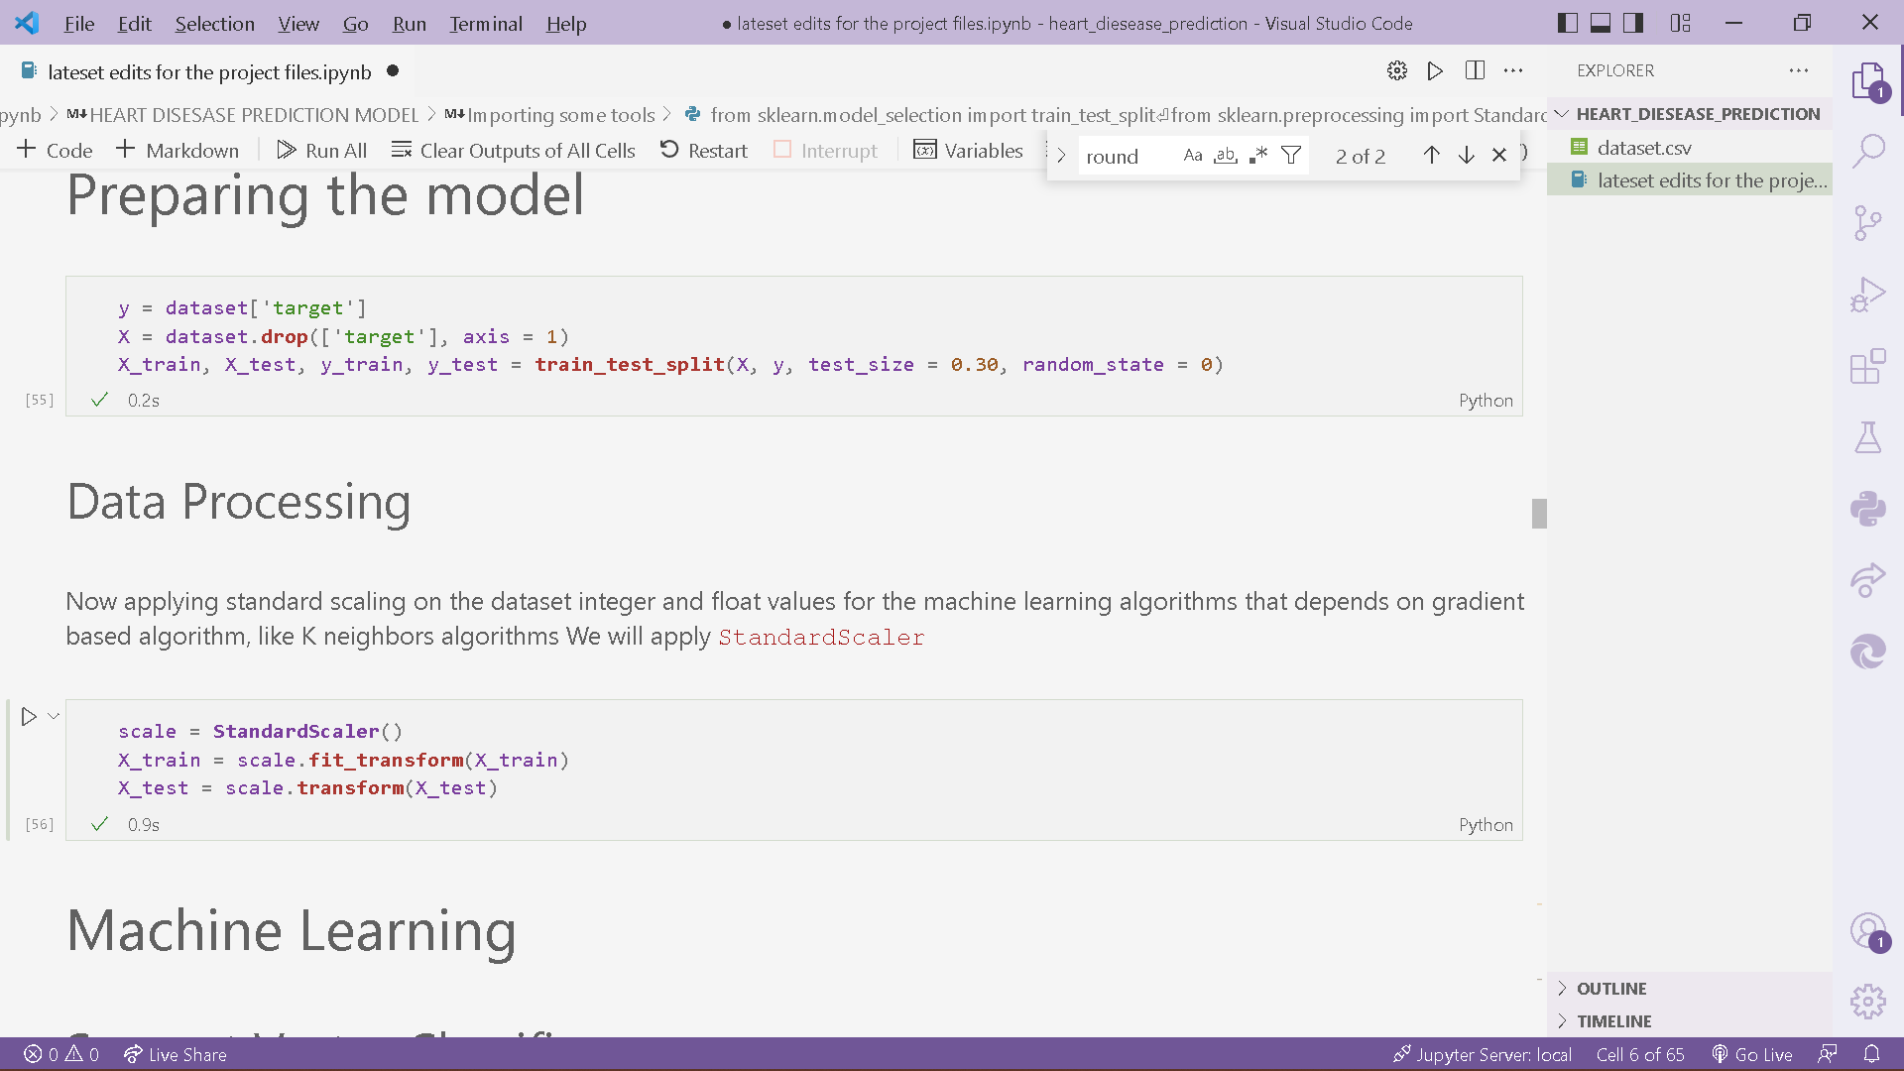
Preprocessing the dataset
The following functiona and tools are required to preprocess the dataset
So that it becomes compatible for our machine learning Models to be played around with
First we divied the dataset into Train and test parts
Secondly we applied some Standard Scaling around the model

Slide 13
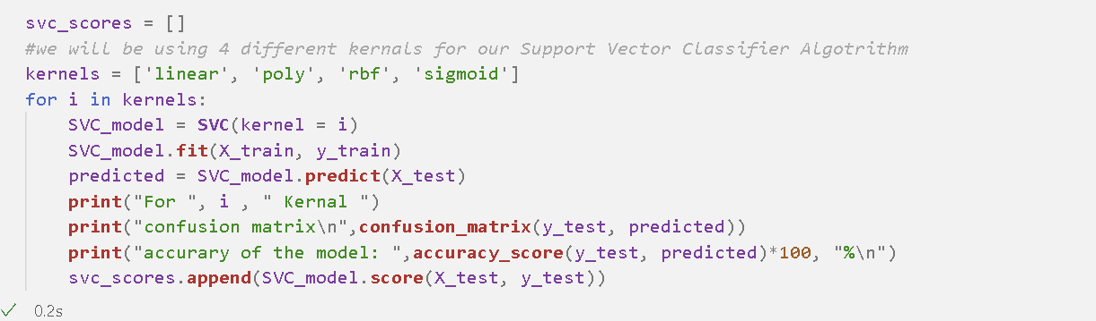
Applying the Algorithms
Screen shot of the code for one of the ML model and printing it’s accuracy

Slide 14
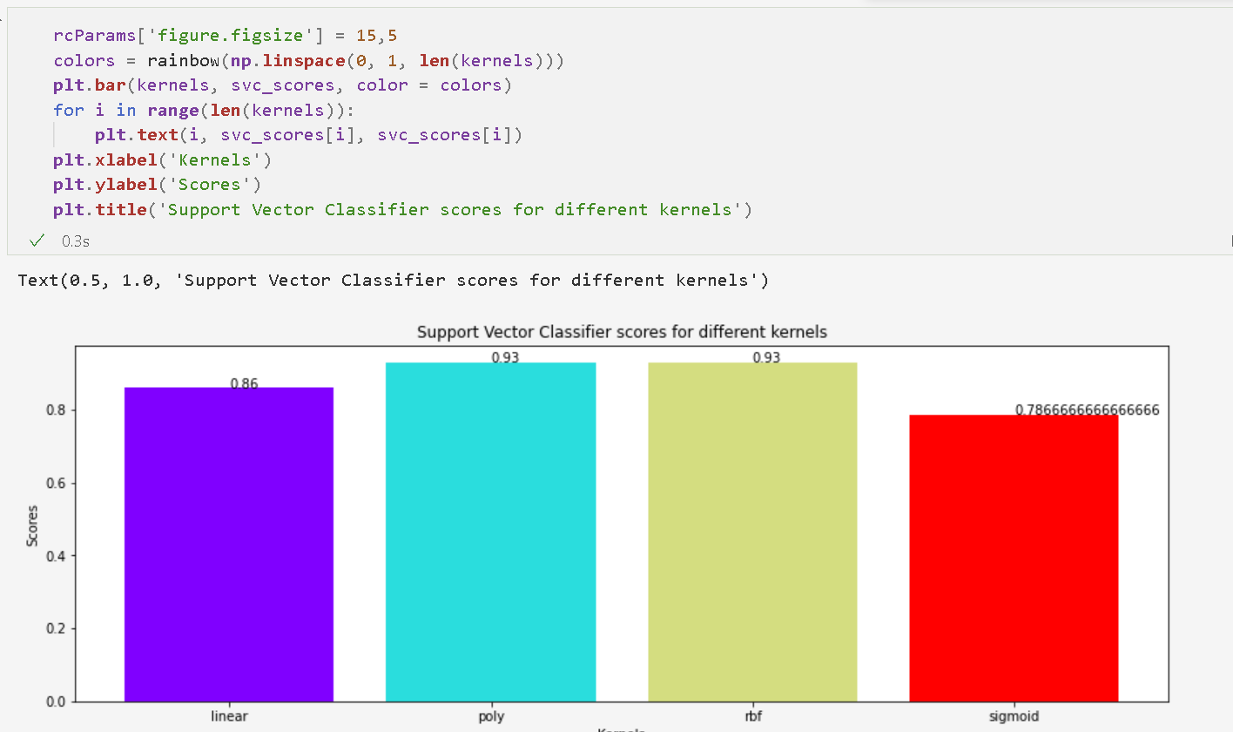
Plotting the graph
Using Matplotlib for printing the graph representation for each ML model accuracy (SVC in this example)

Slide 15
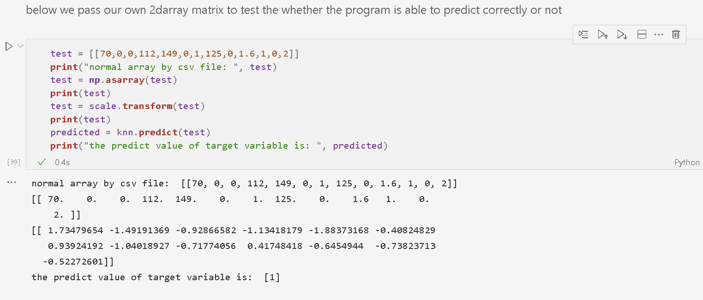
Applying the model to predict
Below we made our own 2d array that is stored in variable test and then we passed the test variable into the predict function of the program to predict the value
Predicted value is stored in another variable which is later printed

Slide 16
References
Analytics Vidhya
Stack Overflow
Kaggle

Slide 17
Thank You !

