Slide 1

Heart Health Checker
Group No. 17
Presented By:-
Prajwal Negi 204200146
Priyanshu Agrawal 204200156
Rihans Jain 204200170
Sarthak Agarwal 204200185
Saksham Gupta 204200180
Prerak 204200148
Under the Supervision of :
Mr. Atul Kumar Uttam
Department of CEA
GLA University, Mathura

Slide 2
Contents
Introduction
Objective
Tools and technologies
Hardware and Software Requirements
DFD
References

Slide 3
Introduction
This program will help in detecting the Heart disease in a human.
Will consider different factors from patient to predict the health of the patient’s heart.
Through this one can easily provide the program with the information required and can get their heart easily health checked up
Can be used both by patients and doctors for getting results.

Slide 4
Objectives
It reduces the extra labor for doctors by implementing the the algorithms by itself.
Quite a cost effective solution for the patients as well, lesser the work, lesser the cost.
The results can be further analyzed to classify the factors, that are mainly responsible and further helping in developing the cure for the disease.
We can as well classify the age groups and can help in early prediction of the disease before it actually affects the patients.

Slide 5
Technologies and Tools
TOOLS
Python – Programming language that will be used for the whole backend development for this project
Pandas – A python library analyzing and editing the data
NumPy – A python library for complex mathematical functions
Matplotlib - A python library for data visualization
Sklearn – sklearn stands for SciKitLearn, A python library that will store most of the ML models that we will work with

Slide 6
Technologies and Tools
TECHNOLOGIES
Machine Learning – a popular field in IT sector, that with the help of computer can do certain types of tasks and can also improve themselves automatically through the analysis of data. It is a subset of Artificial Intelligence.

Slide 7
Hardware and Software Requirements
Hardware
Intel core i5 7th gen
4gb RAM
10GB of available disk space
Software
Windows 7 or later
Python and it’s libraries installed on the system

Slide 8
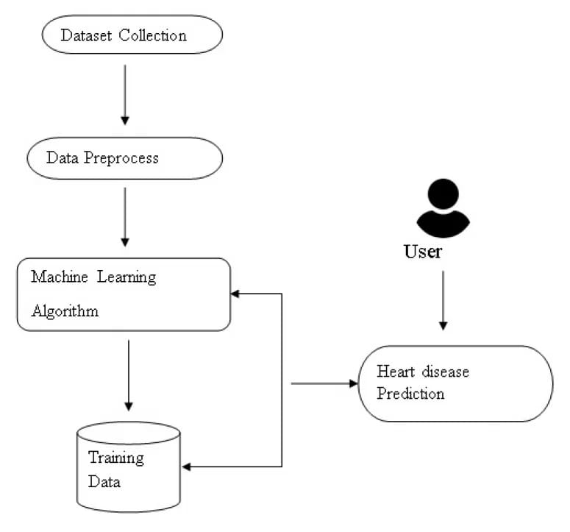
Flow Of Data Diagram
The following diagram gives a visual representation for how will data go from one component for another when we use the ML model for prediction

Slide 9
Code
The Code is divided into following components
Importing Libraries
Importing the ML models
Importing the dataset
Pre-Processing the Dataset
Applying the Datasets on ML models
Printing the Accuracy graph for each model
Conclusion

Slide 10
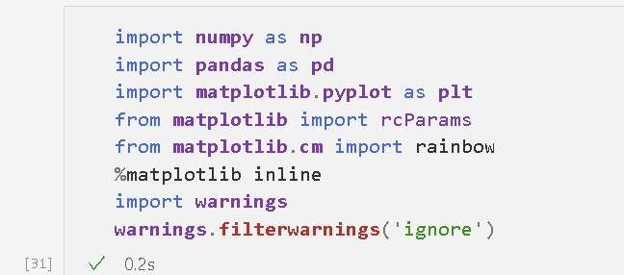
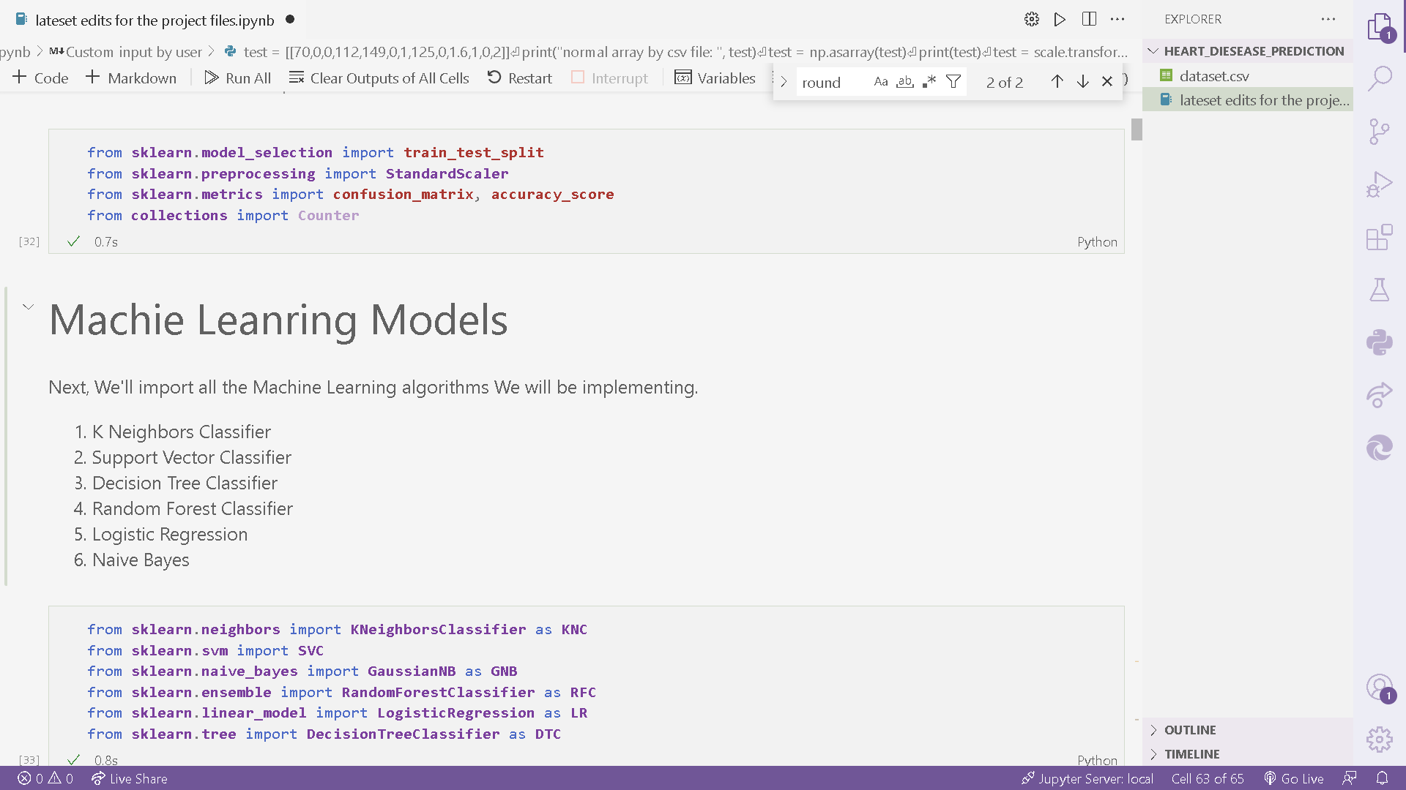
Importing Libraries
Here we imported all the necessary libraries and tools for our progject
On the right we imported libraries like pandas, Matplotlib, and numpy
One the other hand we imported data manipulation tools and some other tools

Slide 11
Importing ML Models
Now Let’s import all the 6 Machine Models that we will be using in our Project to predict

Slide 12
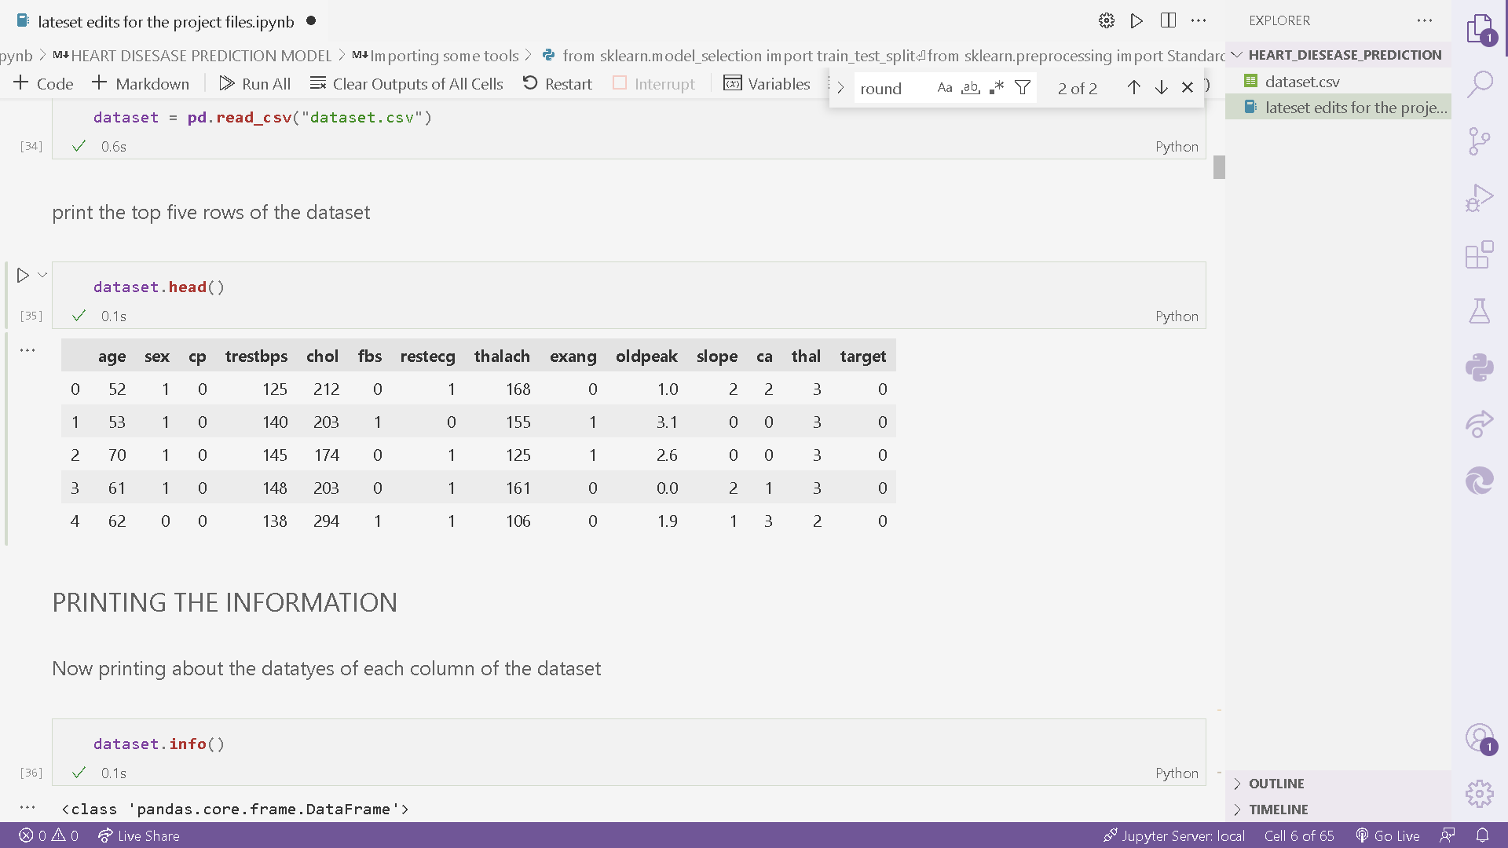
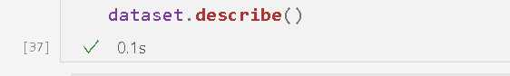
Importing Dataset
Now we will use the following tools to import the dataset
Print the top 5 records of the dataset
Print the Information about the entities and their data types in dataset
Describe the Dataset, like mean median, top 50% top 25% values in the dataset records

Slide 13
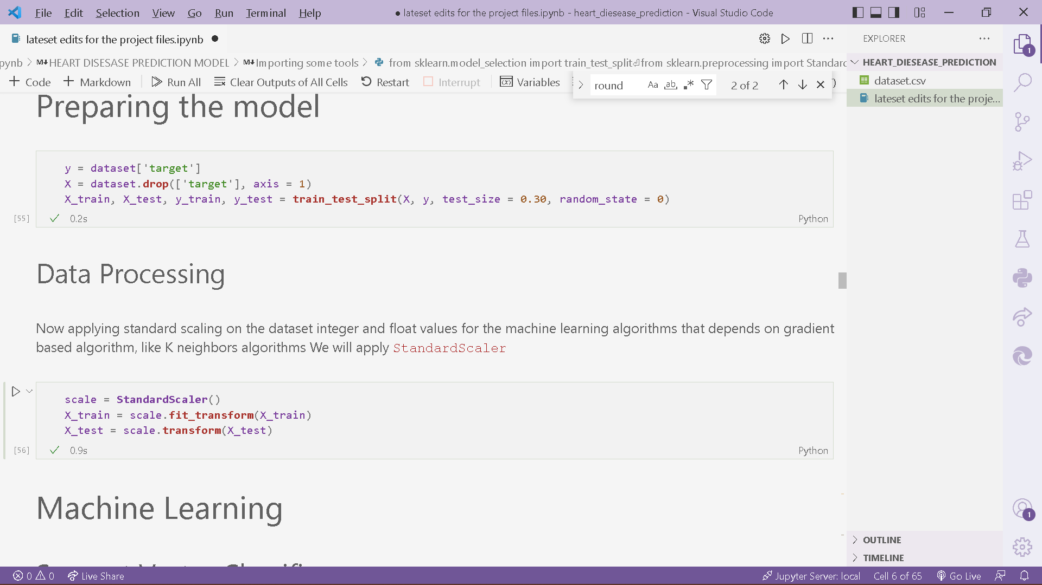
Preprocessing the dataset
The following functiona and tools are required to preprocess the dataset
So that it becomes compatible for our machine learning Models to be played around with
First we divied the dataset into Train and test parts
Secondly we applied some Standard Scaling around the model

Slide 14
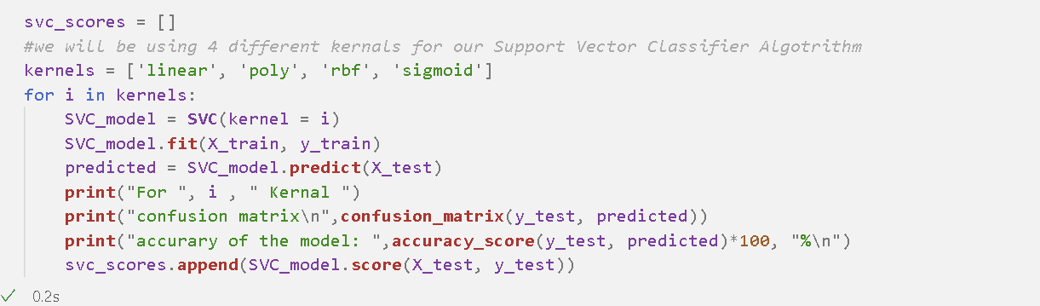
Applying the Algorithms
Screen shot of the code for one of the ML model and printing it’s accuracy

Slide 15
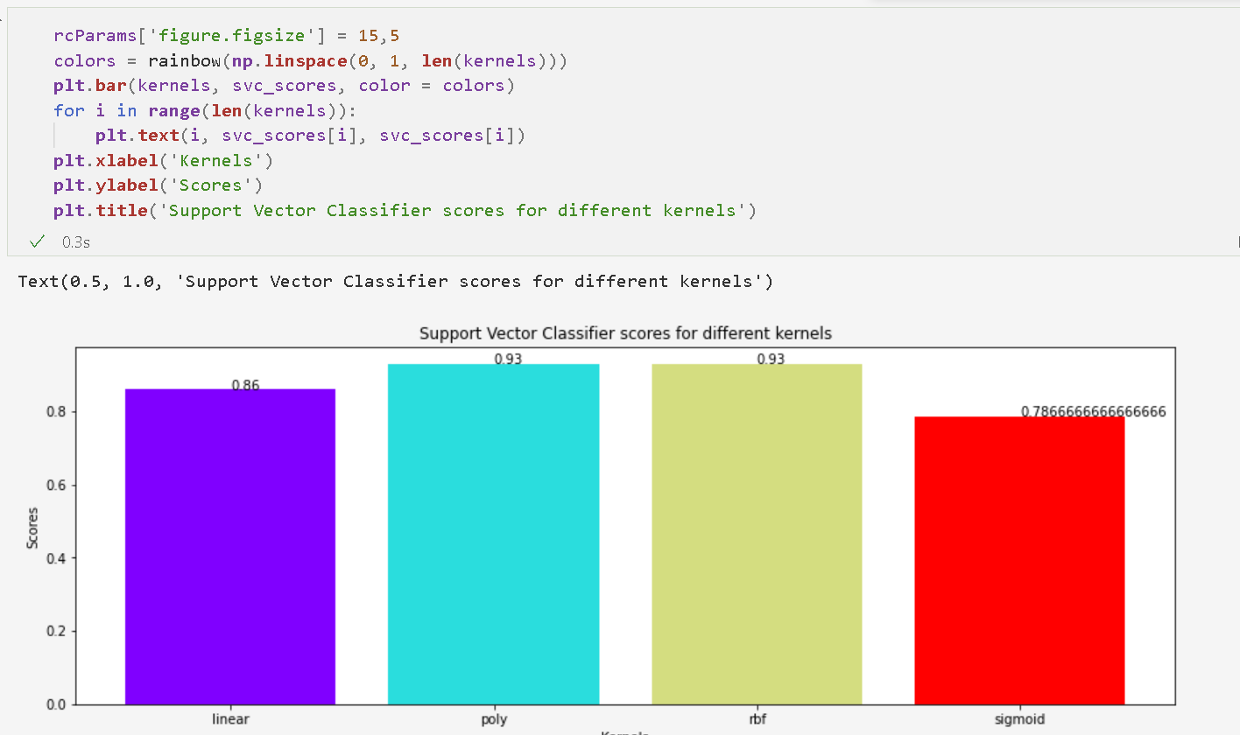
Plotting the graph
Using Matplotlib for printing the graph representation for each ML model accuracy (SVC in this example)

Slide 16
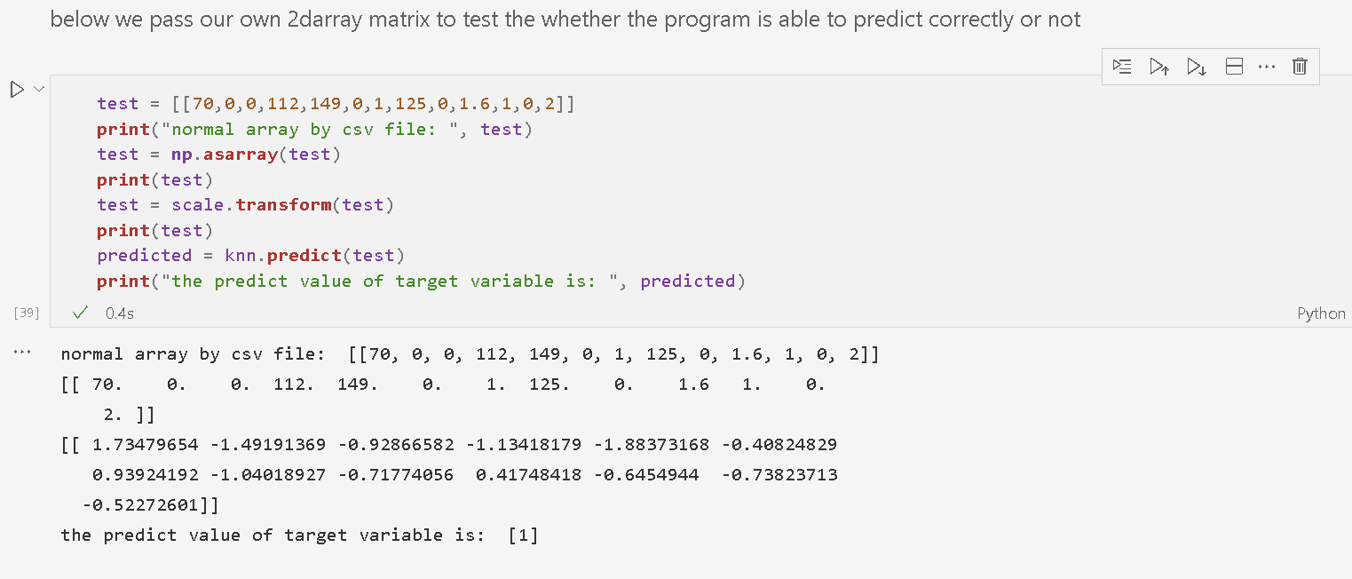
Applying the model to predict
Below we made our own 2d array that is stored in variable test and then we passed the test variable into the predict function of the program to predict the value
Predicted value is stored in another variable which is later printed

Slide 17
References
Analytics Vidhya
Stack Overflow
Kaggle

Slide 18
Thank You !

