Slide 1

Mini Project Presentation CSEMP22-12
Members:
Harshit Ranjan (BT22CSA029)
Harsh Suhan (BT22CSA034)
Sharit Vaishnav (BT22CSA042)
Prajwal Prasad (BT22CSA043)
Under the mentorship of: Dr. Prerna Mishra
Project Coordinator :
Dr. Khushboo Thakkar Jain

Slide 2
Problem Statement
Advanced Object Detection For Military using Aerial Surveillance
The objective of this machine learning model is to detect and classify various
military vehicles, including planes, ships, and cars, in drone images of military
bases. The model must accurately identify these vehicles under varying
conditions such as different angles, lighting, terrains, and potential occlusions.
It should classify the vehicles into their respective categories while
minimizing false detections and ensuring high precision. The model should
also be optimized for efficient, near real-time processing to support timely
analysis in surveillance and defense operations.

Slide 3
Table of Contents
01
02
04
Introduction
Literature Review
03
Methodology
Novelty

Slide 4
INTRODUCTION
This project aims to develop a machine learning model that can detect and classify vehicles like planes, ships, and cars from drone images of military bases. By automating this process, the model will enhance surveillance capabilities and reduce the need for manual analysis of aerial imagery.
AIMS
Accurately detect and classify military vehicles in drone images under various conditions.
Minimize false positives and false negatives for more reliable vehicle identification.
Ensure the model processes images efficiently for near real-time surveillance and decision-making.

Slide 5
Literature Review

Slide 6
1. Object detection in unmanned aerial vehicle (UAV)
•Geospatial Object Detection in High Resolution Satellite Images Based on Multi-Scale Convolutional Neural Network
Haijian Zhang, Guang Hua, Wei Guo and Wen Yang (18 January 2018 )
•Object Detection in Aerial Images: A Large-Scale Benchmark and Challenges
Jian Ding, Nan Xue, Gui-Song Xia (4 Dec 2021)
Approach The project introduces a unified multi-scale CNN designed to detect objects of various sizes, especially small ones, in high-resolution satellite images. It integrates a multi-scale object proposal network with a detection network, both sharing a base network that generates feature maps for different object sizes. This approach ensures effective handling of varying object scales.
Challenges The primary challenges include enhancing small object detection and ensuring consistent performance across scales. Despite these obstacles, the model achieves an mAP of 89.6% and operates at 10 FPS on a GTX 1080Ti GPU, surpassing state-of-the-art methods.
Approach
The project introduces DOTA, a large-scale dataset for object detection in aerial images with over 1.8 million instances across 18 categories. It includes oriented-bounding-box annotations and evaluates 10 state-of-the-art algorithms with over 70 configurations to improve detection in challenging aerial scenarios.
Challenges
The main challenges include detecting objects with varying orientations, scales, and densities in aerial images. Adapting models trained on natural images to handle large-scale aerial images, rotation-invariance, and high aspect ratios also poses significant difficulties.

Slide 7
2. ⁠ YOLO V7 Implementation In Image Detection
•Small object detection model for UAV aerial image based on YOLOv7
Jinguang Chen, Ronghui Wen and Lili Ma (29 Dec 2023)
Object detection using YOLO
Tausif Diwan, G. Anirudh, Jitendra V. Tembhurne (2 Aug 2022)
Approach SOD-YOLOv7 enhances small object detection in UAV images by combining Swin Transformer, convolution, and Bi-Level Routing Attention (BRA) to improve focus on small objects. It also adds detection branches and deformable convolution for better multi-scale and occlusion handling.
Challenges Key challenges are small and occluded object detection. SOD-YOLOv7 improves mAP@0.5 to 53.2% on VisDrone and 98.5% on CARPK, outperforming YOLOv7 by 4.3% and 0.3%.
Approach
The paper uses a single-stage object detection method based on the YOLO (You Only Look Once) architecture, which reframes object detection as a regression problem. The approach focuses on real-time detection with high inference speed by predicting bounding boxes and class probabilities directly in one step, making YOLO faster compared to two-stage detectors.
Challenges
The main challenges include handling variations in object size and resolution, class imbalance between foreground and background, difficulties in detecting smaller objects, and the requirement of large, well-labeled datasets for training. These issues often result in inaccurate localization and poor performance for smaller objects.

Slide 8
⁠3. Use of Horizontal Bounding Boxes (HBB)
Gliding Vertex on the Horizontal Bounding Box for Multi-Oriented Object Detection
Yongchao Xu, Mingtao Fu, Qimeng Wang, Yukang
Wang, Kai Chen, Gui-Song Xia, Xiang Bai (2020)
The Border Restriction of Horizontal Bounding Box for Arbitrary-Oriented Ship Detection in SAR Images
Pengfei Guo, Turgay Celik, Nanqing Liu, Heng-Chao Li (Jan 2023)
Approach: The proposed framework detects multi-oriented objects by gliding the vertex of the horizontal bounding box and regressing four length ratios to describe the object's orientation. An obliquity factor is introduced to decide between horizontal or oriented detection based on the area ratio, integrated into the regression head of Faster R-CNN.
Challenges: Key challenges include accurately learning the offsets for multi-oriented objects and handling the confusion caused by nearly horizontal objects. Additionally, ensuring minimal computational overhead while incorporating these enhancements remains crucial.
Approach: The paper introduces a method to detect arbitrary-oriented ships in SAR images using a novel bounding box representation. The approach relies on left-top point offsets (LTPO) to infer the four vertices of oriented bounding boxes (OBBs), and employs a Feature Adaptive Module (FAM) to enhance feature alignment for object orientation and shape.
Challenges: Challenges include handling the misalignment between ordinary convolution kernels and rotated objects, and accurately modeling geometric transformations for ships in SAR images. The method also aims to improve localization accuracy while maintaining computational efficiency​.

Slide 9
Work Done (Methodology)

Slide 10
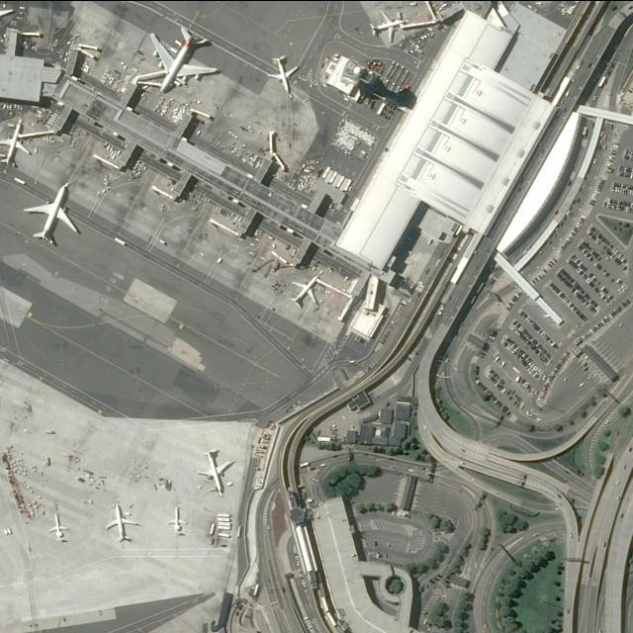
DATA DESCRIPTION
This projects leverages 28,000 images featuring 700,000 objects across 3 classes, annotated with Horizontal Bounding Boxes(HBB). This dataset is designed for detecting tiny objects, which are challenging due to their small size and low resolution in large-scale images.
SOURCE : AI-TOD v2
CLASSES: Vehicles , Ships, Aircraft
Annotation Format : MS-COCO json
Annotation Type : Horizontal Bounding Boxes (HBB)

Slide 11
Model Development
Data Preprocessing:
Image resizing, normalization, and bounding box adjustments will be performed to ensure consistency across varying image sizes and annotations.
Model Architecture:
A convolutional neural network (CNN)-based architecture, such as YOLO or Faster R-CNN, will be employed to detect and classify vehicles in real-time from drone images.
Training and Evaluation:
The model will be trained on annotated images, using metrics mAP (mean Average Precision) to evaluate its accuracy in detecting and classifying vehicles under different conditions.

Slide 12
Data Pre-Processing
Load JSON Annotations: Read the JSON file containing image metadata and bounding box coordinates
Convert Bounding Boxes: For each annotation, convert bounding box coordinates from absolute pixel values to YOLO format (normalized center coordinates, width, and height relative to image dimensions)
Save YOLO Annotation Files: Create .txt files for each image with YOLO-formatted annotations
Sanity Check on Images: Check the existence of file in the path and catch an error/exception if any.

Slide 13
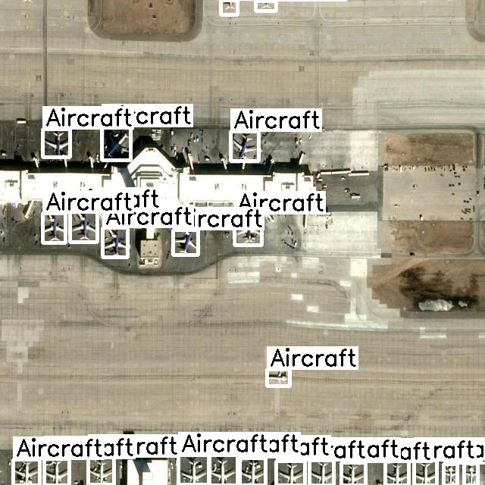
Visualize the Annotations
This image shows an airport with multiple aircraft annotated using the YOLO object detection algorithm. Each aircraft is labeled with a bounding box and the tag "Aircraft," demonstrating how YOLO efficiently detects objects in real-time within aerial or satellite images. The annotations highlight aircraft positions along the terminal gates and the tarmac, providing a clear visualization of object recognition in a complex environment.

Slide 14
Training Preparation and Execution
Data Preparation:
Adjust annotation labels to ensure proper YOLOv7 format, apply data augmentation techniques (e.g., rotation, scaling), and normalize images to the required dimensions.
Configure YOLOv7:
Load pre-trained YOLOv7 weights to utilize transfer learning, set hyperparameters such as learning rate, batch size, and epochs based on validation data, and ensure all settings align with the dataset and task.
Training:
Train the YOLOv7 model using the prepared dataset, monitor performance metrics (e.g., loss, precision, recall), and make necessary adjustments to hyperparameters to optimize accuracy and reduce errors.

Slide 15
Novelty

Slide 16
1. SkyFusion Dataset Focus
The model leverages the SkyFusion dataset, which focuses on detecting tiny objects in aerial imagery. This domain is challenging due to the small object size and diverse backgrounds. Applying YOLOv7 in this context makes the model's application unique, especially in domains where detecting small objects is critical, like surveillance or environmental monitoring.
2. Custom COCO-to-YOLO Conversion
A custom utility is designed to convert COCO annotations into YOLO format using pylabel. This streamlines dataset preparation, reducing the complexity for other researchers working with aerial imagery datasets. By automating the conversion, the model can more easily handle complex datasets, improving workflow efficiency and supporting reproducibility in detection tasks involving non-standard data formats.
3. Pre-trained YOLOv7 Fine-Tuning
The model fine-tunes pre-trained YOLOv7 weights on a highly specialized dataset (SkyFusion). This demonstrates effective transfer learning by adapting the YOLOv7 architecture for specific aerial tiny object detection tasks. Fine-tuning in this domain enhances the applicability of YOLOv7 beyond generic datasets and improves its adaptability for specialized detection needs.

Slide 17
4. Enhanced Post-Training Analysis
A unique approach to post-training analysis is implemented by automatically converting YOLOv7’s result logs into a clean, structured DataFrame. This allows for easier visualization and interpretation of performance metrics like precision, recall, and mAP, providing faster insights into model improvements and ensuring that critical metrics are readily available for evaluation.
5. Bounding Box Debugging Utility
A bounding box visualization tool is included, making it easier to verify the accuracy of predictions and annotations during training. This is especially valuable for tiny object detection in aerial imagery, where misaligned or incorrect bounding boxes can easily go unnoticed. The visualization aids in identifying errors in data labelling or model predictions efficiently.
6. Optimized Data Pipeline for Tiny Object Detection
By employing caching mechanisms and tailored augmentation techniques specific to the aerial domain, the model’s data pipeline is optimized for handling high-resolution imagery and small objects. This optimization enhances training efficiency and accuracy for tiny object detection, making it suitable for use cases where large datasets with challenging object scales are present.

Slide 18
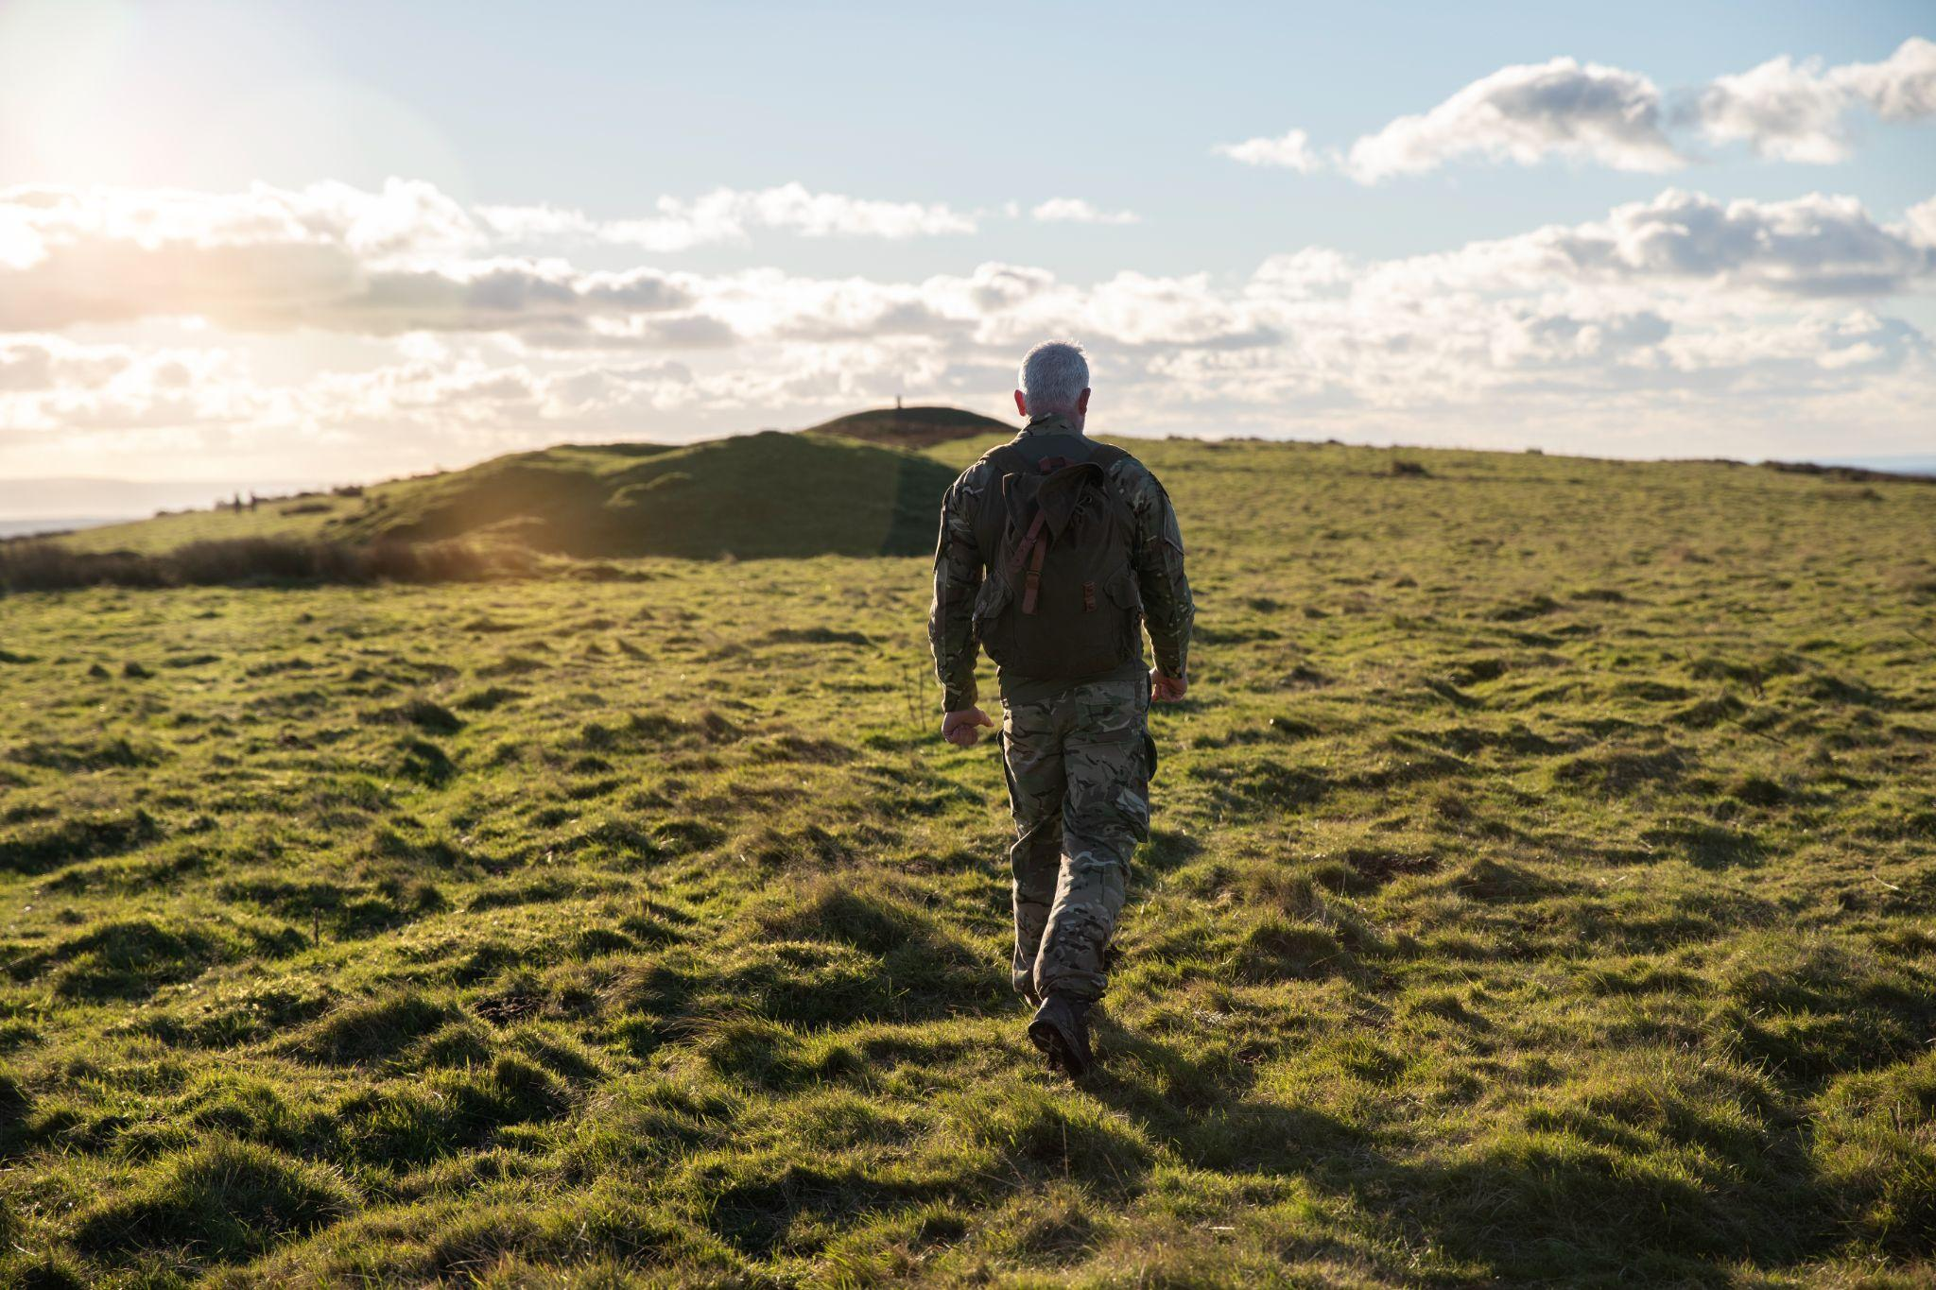
Thank You
CONCLUSION
Accurate Detection:
The YOLOv7 model successfully detects and classifies vehicles from drone images, including planes, ships, and cars.
High mAP Performance:
Evaluation using mAP demonstrates the model's effectiveness and precision in identifying and categorizing objects.
Robust and Efficient:
The model performs well under various conditions, ensuring reliable and timely object detection.
Future Improvements:
Implementing YOLOv8 introduced in 2023 for better speed and accuracy.
Using Semantic segmentation instead of HBB for visualisation.

