Slide 1
Resource Demand Forecasting
Prajwal Bhosale

Slide 2
Agenda
Problem Statement
Tech Stack
Applications
System Workflow
Demonstration

Slide 3
Problem Statement
Organizations find it difficult to turn changing project requirements and market trends into clear, accurate resource plans. Data about skills, availability, and costs is scattered, leading to wrong staffing levels, higher expenses, and delayed delivery. This project provides a simple, standardized way to capture inputs, forecast quarterly headcount by role and skill, and generate a budget-aware plan that smartly uses available internal resources before suggesting new hires.
Objective:
The system standardizes JDs into roles, levels, and skills, forecasts quarterly headcount using market and salary data, optimizes staffing within budget (internal first, then external), supports scenario planning, and outputs clear hiring and allocation plans for decision-makers.

Slide 4
Tech Stack
Frontend - Streamlit UI
Backend - Python
Databases Supported - .CSV
AI/LLM - spaCy for NLP enrichment
Environment & Config - dotenv (.env file for credentials)
Libraries Used – streamlit(app,UI),
pandas (data handling),
plotly(charts plotting),
puLP (LP optimizer, optional)
spaCy (NLP enrichment)

Slide 5
Applications
Headcount and budget forecasting: derive quarterly demand from JD + market trends to plan spend and staffing needs.
Allocation planning: prioritize internal reassignments, then external hires, to meet demand under budget constraints.
Skills normalization and matching: parse tech stacks, standardize requirements, and score candidate/JD fit (LLM or rule-based).
Scenario planning: vary budget, team size, region, and timeline to compare hiring/assignment strategies and trade-offs.
Reporting and handoffs: generate tables/charts and export CSV/JSON (forecast, hiring plan, reassignments, releases) for stakeholders.

Slide 6
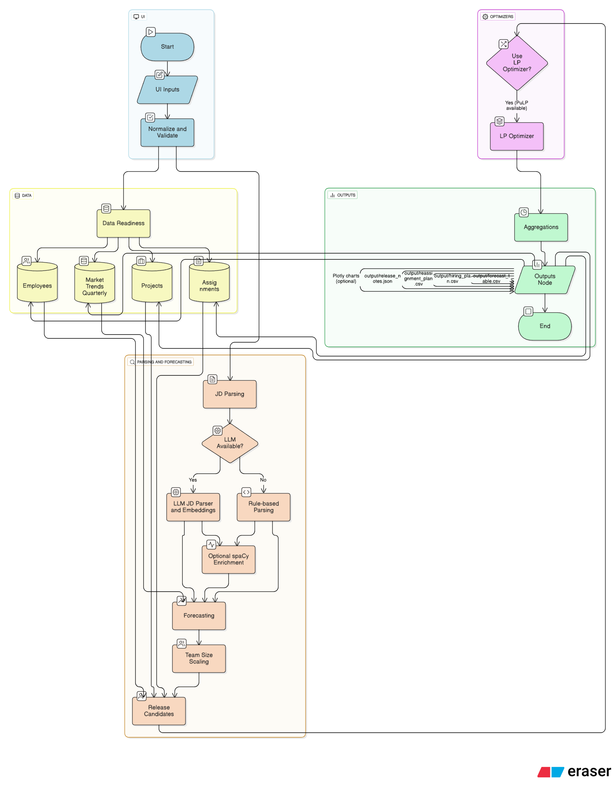
System Workflow

Slide 7
Demo
Resource Demand Forecasting.

Slide 8
Thank You !

