Slide 1



Simple Map Navigator Using C Programming Using Graph Data Structure
Discover the power of C programming and graph data structures to create a simple, yet efficient map navigator. Uncover the secrets of navigation algorithms and unleash their potential.

Slide 2
Team Members
Ansh T Shetty
PES2UG22CS080
Avula Vamshi Maheedhar Reddy
PES2UG22CS116
Ankith Gowda B S
PES2UG22CS077

Slide 3

Introduction
Navigation plays a crucial role in our daily lives. From finding the shortest route, we rely on smart navigation systems. Explore the impact and possibilities of map navigation using C programming.

Slide 4

Code :
#include <stdio.h>
#include <stdlib.h>
#include <stdbool.h>
#include <string.h>
#define MAX_PLACES 100
typedef struct
{
char name[50];
} Place;
typedef struct
{
Place places[MAX_PLACES];
bool adjacencyMatrix[MAX_PLACES][MAX_PLACES];
int numPlaces;
}Graph;
Graph g;

Slide 5
void addPlace(char name[])
{
if (g.numPlaces >= MAX_PLACES)
{
printf("Maximum limit exceeded, cannot add more places.\n");
return;
}
Place newPlace;
strcpy(newPlace.name, name);
g.places[g.numPlaces++] = newPlace;
FILE *file = fopen("PlaceInfo.txt", "a");
if (file == NULL)
{
printf("Error opening file.\n");
return;
}
fprintf(file, "%s\n", name);
fclose(file);
}
void addRoad(int from, int to)
{
if (from < 0 || from >= g.numPlaces || to < 0 || to >= g.numPlaces)
{
printf("Invalid place index. Please try again.\n");
return;
}
g.adjacencyMatrix[from][to] = true;
g.adjacencyMatrix[to][from] = true;
}

Slide 6
void deleteRoad(int from, int to)
{
if (from < 0 || from >= g.numPlaces || to < 0 || to >= g.numPlaces)
{
printf("Invalid place index. Please try again.\n");
return;
}
if (!g.adjacencyMatrix[from][to] || !g.adjacencyMatrix[to][from])
{
printf("No road exists between the given places. Please try again.\n");
return;
}
g.adjacencyMatrix[from][to] = false;
g.adjacencyMatrix[to][from] = false;
}

Slide 7
void deletePlace(int index)
{
if (index < 0 || index >= g.numPlaces)
{
printf("Invalid place index. Please try again.\n");
return;
}
// Remove the place
for (int i = index; i < g.numPlaces - 1; i++)
{
g.places[i] = g.places[i+1];
for (int j = 0; j < g.numPlaces; j++) {
g.adjacencyMatrix[i][j] = g.adjacencyMatrix[i+1][j];
g.adjacencyMatrix[j][i] = g.adjacencyMatrix[j][i+1];
}
}
g.numPlaces--;
// Update file
FILE *file = fopen("PlaceInfo.txt", "w");
if (file == NULL)
{
printf("Error opening file.\n");
return;
}
for (int i = 0; i < g.numPlaces; i++)
{
fprintf(file, "%s\n", g.places[i].name);
}
fclose(file);
}

Slide 8
void displayPlaces()
{
printf("\nPlaces in the map:\n");
for (int i = 0; i < g.numPlaces; i++)
{
printf("[%d] - %s\n", i, g.places[i].name);
}
}
void displayConnections(int index)
{
printf("Connected places for %s:\n", g.places[index].name);
for (int i = 0; i < g.numPlaces; i++)
{
if (g.adjacencyMatrix[index][i])
{
printf("- %s\n", g.places[i].name);
}
}
}

Slide 9
void findRoutes(int from, int to, bool visited[], int path[], int pathIndex)
{
visited[from] = true;
path[pathIndex] = from;
pathIndex++;
if (from == to)
{
printf("Route: ");
for (int i = 0; i < pathIndex; i++)
{
printf("%s -> ", g.places[path[i]].name);
}
printf("\n");
}
else
{
for (int i = 0; i < g.numPlaces; i++)
{
if (g.adjacencyMatrix[from][i] && !visited[i])
{
findRoutes(i, to, visited, path, pathIndex);
}
}
}
visited[from] = false;
pathIndex--;
}

Slide 10
void shortestPath(int from, int to, int distance[])
{
bool visited[g.numPlaces];
int previous[g.numPlaces];
for (int i = 0; i < g.numPlaces; i++)
{
visited[i] = false;
distance[i] = INT_MAX;
}
distance[from] = 0;
for (int i = 0; i < g.numPlaces; i++)
{
int minDistance = INT_MAX;
int current = -1;
for (int j = 0; j < g.numPlaces; j++)
{
if (!visited[j] && distance[j] < minDistance)
{
minDistance = distance[j];
current = j;
}
}
if (current == -1 || current == to)
{
break;
}
visited[current] = true;

Slide 11
for (int j = 0; j < g.numPlaces; j++)
{
if (g.adjacencyMatrix[current][j] && !visited[j])
{
int newDistance = distance[current] + 1; // assuming equal distance between all places
if (newDistance < distance[j]) {
distance[j] = newDistance;
previous[j] = current;
}
}
}
}
if (distance[to] != INT_MAX)
{
printf("Shortest path: ");
printf("%s", g.places[to].name);
int vertex = to;
while (vertex != from)
{
vertex = previous[vertex];
printf(" <- %s", g.places[vertex].name);
}
printf("\n");
}
else
{
printf("No path found.\n");
}
}

Slide 12
int main()
{
int choice;
char newPlace[50];
int from, to, index;
do
{
printf("\nMenu:\n");
printf("1. Add a new place\n");
printf("2. Add a new road\n");
printf("3. Delete a road\n");
printf("4. Delete a place\n");
printf("5. Display all places\n");
printf("6. Exit\n");
printf("7. Display all Connections\n");
printf("8. Display all Routes\n");
printf("9. Display Shortest Route\n");
printf("Enter your choice: ");
scanf("%d", &choice);
bool visited[g.numPlaces];
int distance[g.numPlaces];

Slide 13
switch(choice)
{
case 1:
printf("Enter the name of the new place: ");
scanf(" %[^\n]s", newPlace);
addPlace(newPlace);
printf("Place added successfully!\n");
break;
case 2:
displayPlaces();
printf("Enter the indices of the places to connect (separated by a space): ");
scanf("%d %d", &from, &to);
addRoad(from, to);
printf("Road added successfully!\n");
break;
case 3:
displayPlaces();
printf("Enter the indices of the places to disconnect (separated by a space): ");
scanf("%d %d", &from, &to);
deleteRoad(from, to);
printf("Road deleted successfully!\n");
break;
case 4:
displayPlaces();
printf("Enter the index of the place to delete: ");
scanf("%d", &index);
deletePlace(index);
printf("Place deleted successfully!\n");
break;
case 5:
displayPlaces();
break;

Slide 14
case 6:
printf("Exiting...\n");
break;
case 7:
displayPlaces();
printf("Enter the index of the place to see the connections: ");
scanf("%d", &index);
displayConnections(index);
break;
case 8:
displayPlaces();
printf("Enter the indices of the places to find the route (separated by a space): ");
scanf("%d %d", &from, &to);
int path[MAX_PLACES];
memset(visited, false, sizeof(visited));
findRoutes(from, to, visited, path, 0);
break;
case 9:
displayPlaces();
printf("Enter the indices of the places to find the shortest path (separated by a space): ");
scanf("%d %d", &from, &to);
shortestPath(from, to, distance);
break;
default:
printf("Invalid choice. Please try again.\n");
break;
}
}while (choice != 6);
return 0;
}

Slide 15
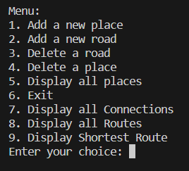
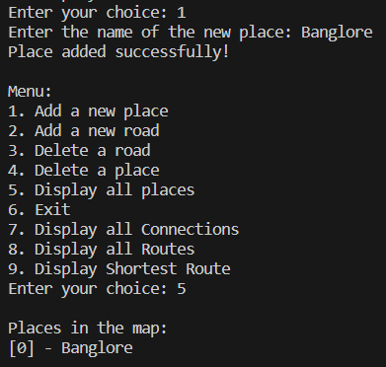
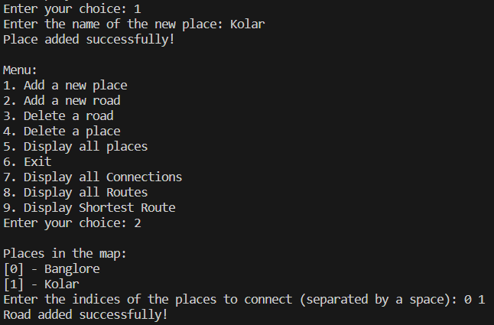
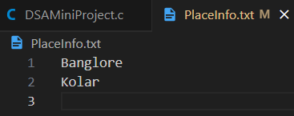
Output

Slide 16
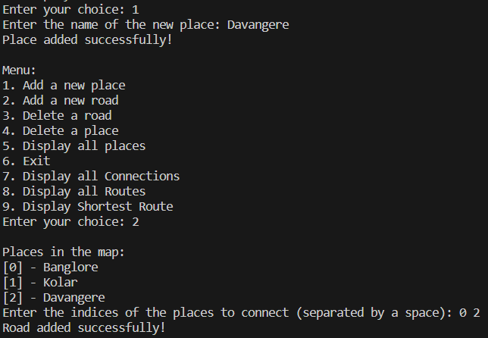
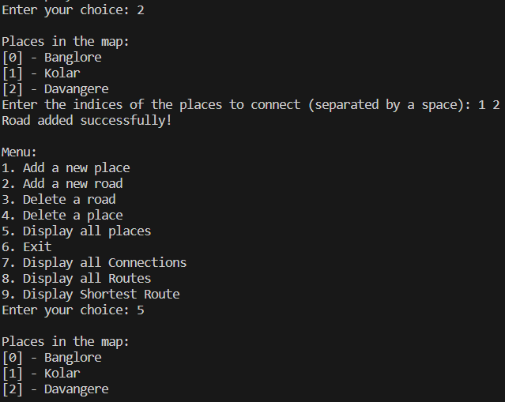
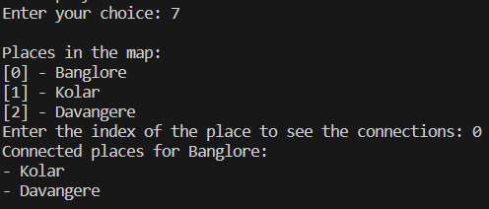
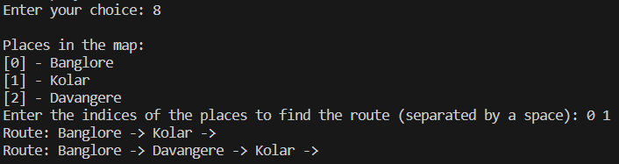
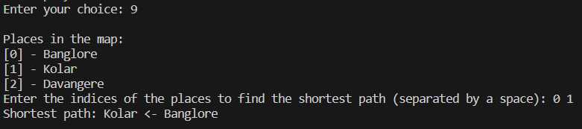
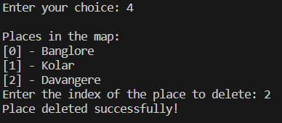
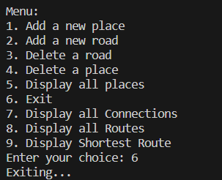
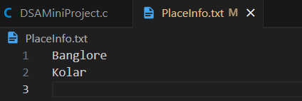

Slide 17

Conclusion
Reflect on the journey of creating a simple map navigator using C programming and graph data structures. Gain insights into the challenges faced, lessons learned, and the limitless possibilities of navigation.

Slide 18
Team Members Contribution
1
ANSH T SHETTY
2
AVULA VAMSHI MAHEEDHAR REDDY
findRoutes() - Function To Display all possible routes Between Two Places.
shortestPath() - Function To Display Shortest Path Between Two Places.
deleteRoad() - Function To Delete Existing Road Between Two Places.
deletePlace() - Function To Delete Existing Place.
displayPlaces() - Function To Display All The Places.
displayConnections() - Function To Display All The Places Which The Particular Place Connects.
3
ANKITH GOWDA B S
addPlace() - Adding New Place To The Map.
addRoad() - Adding New Road Between Existing Places.
main() - Integrating All The Functionalities.

