Slide 1

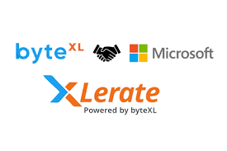
“Free Fire: Code Royale – A Battle Simulation in C"
Team Members :
24kb1A05AL - Irfan
24kb1a05AA - Manoj
24kb1a05A8 - Tejas
24KB1A05KM - Prajwal

Slide 2
Introduction:
This project simulates a basic version of a Free Fire-style battle royale game using the C programming language. It involves two teams, each with four players, competing over four rounds. Each player starts with fixed Health Points (HP) and Energy Points (EP). The game focuses on basic game mechanics such as team setup, round victories, and win conditions, using structured programming and data structures.

Slide 3
Objective :
Demonstrate the use of structures and arrays in C.
Simulate a team-based battle game scenario.
Allow user interaction to determine the round winners.
Determine the overall winner based on game conditions like remaining HP and round victories.

Slide 4
Working Flow of the Program:
Input Phase:The program prompts the user to enter HP and EP for all 8 players (4 in each team).
Game Phase:The game runs for up to 4 rounds.Before each round, the program checks if any team has all players' HP = 0 (in which case they lose the game immediately).The user is asked to input the round winner (Team 1 or Team 2).Round wins are recorded for each team.
Decision Phase:After 4 rounds or an early knockout, the team with the most round victories is declared the winner.If both teams win an equal number of rounds, it's considered a draw.

Slide 5
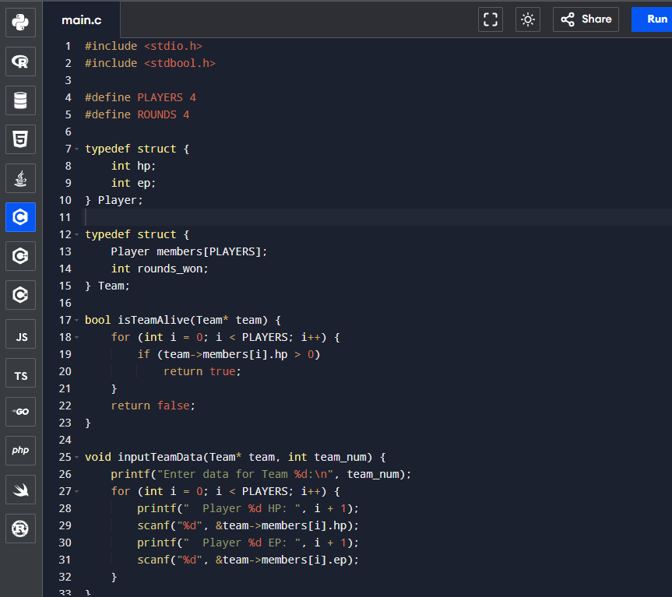
System Overview :

Slide 6
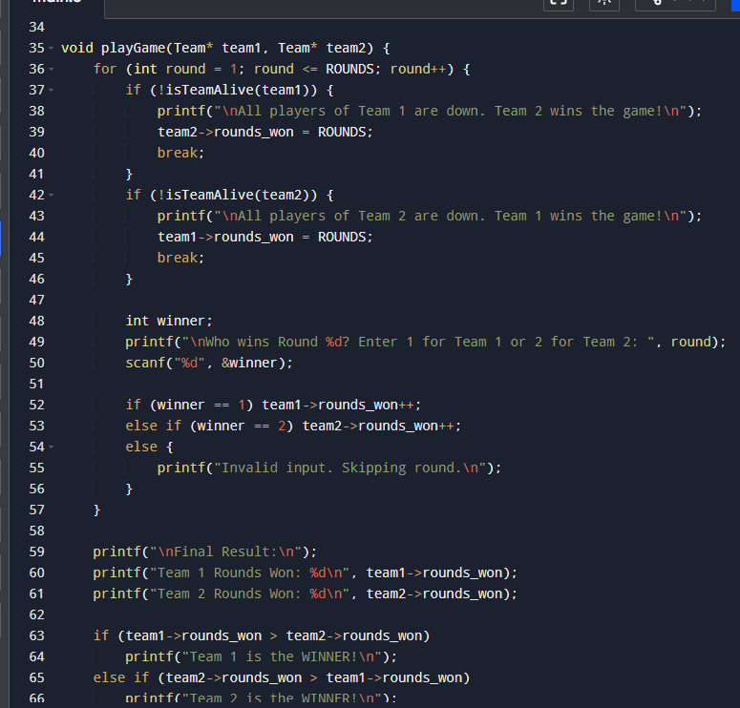

Slide 7
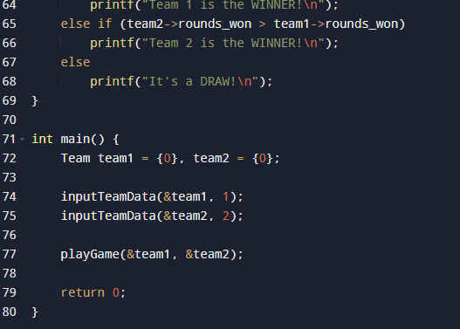

Slide 8
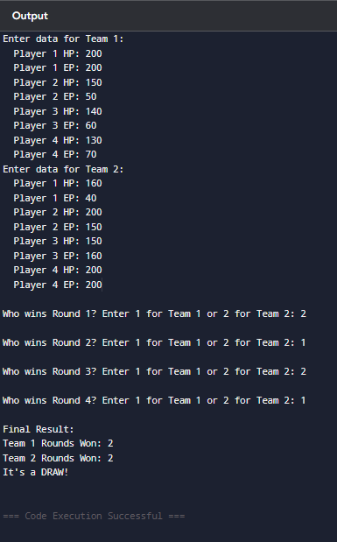
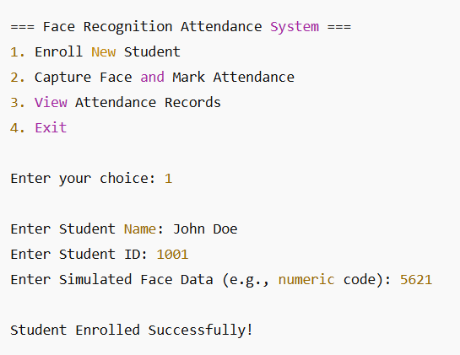
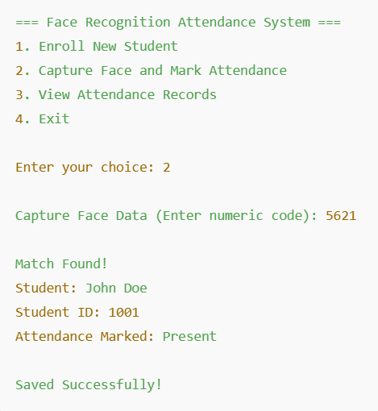
Output Image :

Slide 9
Modules:
1. Player Setup Module Initializes players with default or user-input HP (Health Points) and EP (Energy Points).Stores player stats in structures.
2. Team Management Module Groups players into two teams using arrays of structures.Checks overall team status (active/inactive based on HP).
3. Game Engine Module Manages rounds (up to 4).Records which team wins each round based on user input or logic.Ends game early if a team's all players are defeated.

Slide 10
Advantages of the Project
Understanding Game Logic: Helps simulate and structure a turn-based game.
Practice with Structures: Real-world use of struct and arrays to manage complex data.
Hands-on with Conditions: Demonstrates use of conditions and loops to simulate rounds and outcomes.
Customizable: Easily extendable with weapons, maps, or AI logic.
Team Collaboration: Promotes modular programming and teamwork.

Slide 11
CONCLUSION :
This project helps in understanding the fundamentals of structured programming in C. By simulating a real-world gaming concept, it integrates logical thinking, decision-making, and user interaction. It also highlights the use of custom data types, control structures, and game logic. The project was a collaborative effort by the team and provided hands-on experience in building a text-based simulation game

Slide 12


