Slide 1


Simulation of Link-State Routing Protocol
This presentation explores the implementation of a Link-State Routing Protocol simulation using Dijkstra's Algorithm. We'll dive into the intricacies of optimal routing in computer networks, demonstrating how routers calculate the most efficient paths for data transmission.
Prajwal Thakare

Slide 2

Introduction to Link-State Routing
1
Complete Network Map
Routers maintain a comprehensive view of the network topology for informed routing decisions.
2
Independent Calculation
Each router autonomously computes the shortest path to all destinations in the network.
3
Rapid Convergence
Link-State protocols adapt quickly to network changes, outperforming distance-vector alternatives.

Slide 3

Project Overview and Objectives
1
Input Processing
Parse network topology from a cost matrix file, validating the NxN format.
2
Algorithm Implementation
Apply Dijkstra's Algorithm to compute optimal routes between network nodes.
3
Output Generation
Produce a connection table and shortest path information for practical routing use.

Slide 4

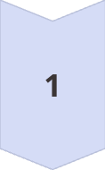
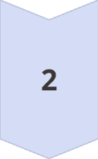
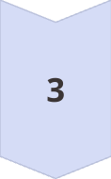
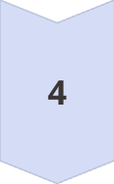
Dijkstra's Algorithm Deep Dive
Initialization
Set source node distance to zero, all others to infinity. Create a priority queue.
Node Selection
Choose the unvisited node with the smallest tentative distance from the source.
Distance Update
Calculate tentative distances to unvisited neighbors, update if a shorter path is found.
Iteration
Repeat node selection and distance update until all nodes are visited.

Slide 5
Key Functions in Implementation
process_file()
set_distances()
dijkstra()
Reads and validates the network topology file, converting it to a matrix format.
Creates a dictionary of router distances, mapping neighbors to their respective link costs.
Implements the core algorithm, calculating shortest paths and updating routing tables.

Slide 6

Project Implementation Details
Language
Python
Input Format
NxN Cost Matrix
No Link Representation
-1
Self-Loop Representation
0
Output
Connection Table, Shortest Paths

Slide 7

Results and Demonstration
Connection Table
Displays next-hop interfaces for efficient packet forwarding between routers in the network.
Shortest Path
Provides optimal routes between any two routers, including the total path cost.
Scalability
Demonstrates effectiveness on various network sizes, from small to large topologies.

